Slide 1
Starry Lights
A graphics project that makes a wonderful Christmas star lantern

Slide 2
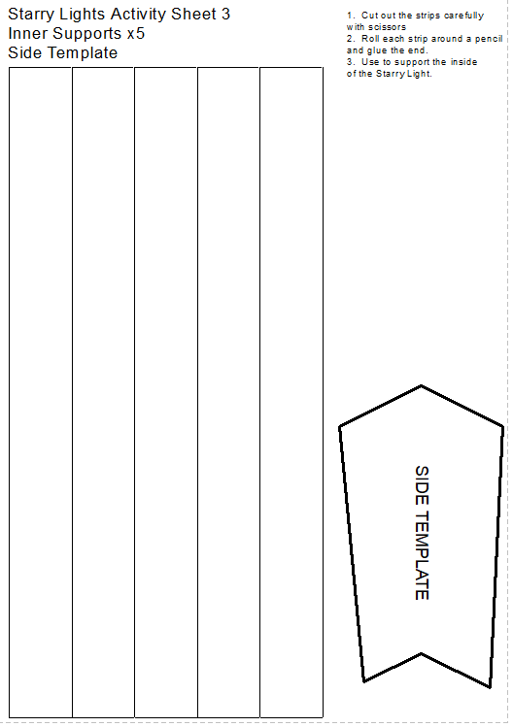
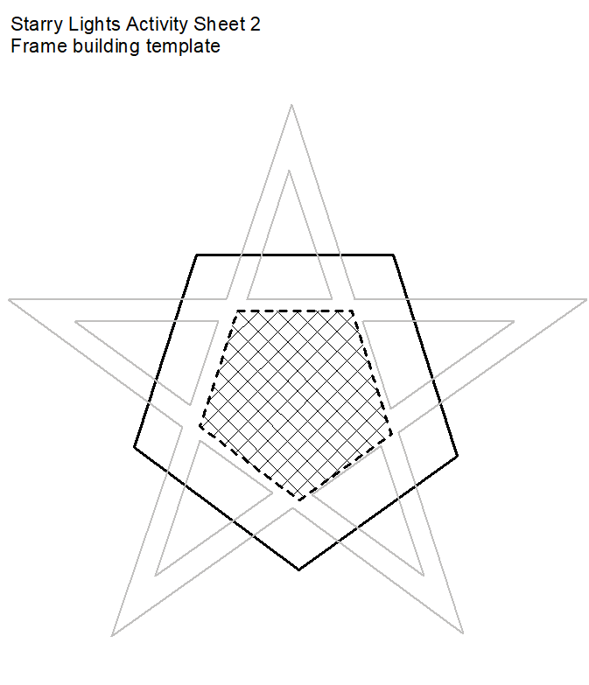
Templates

Slide 3
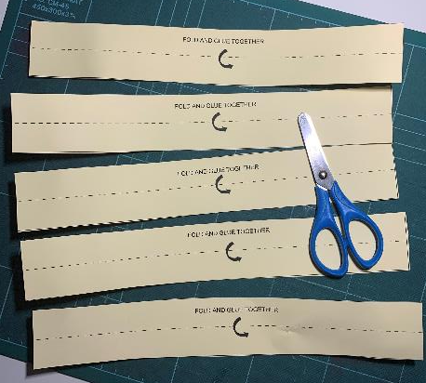
Step 1a – Star Lantern Frame
You need two templates for the star lantern sides
Cut out the ten frame strips on the solid lines

Slide 4
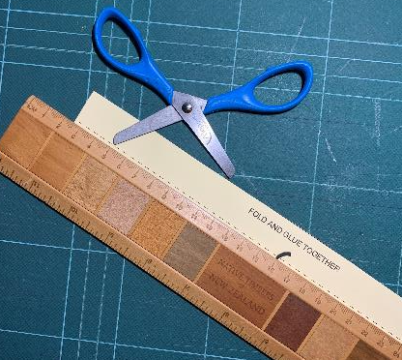
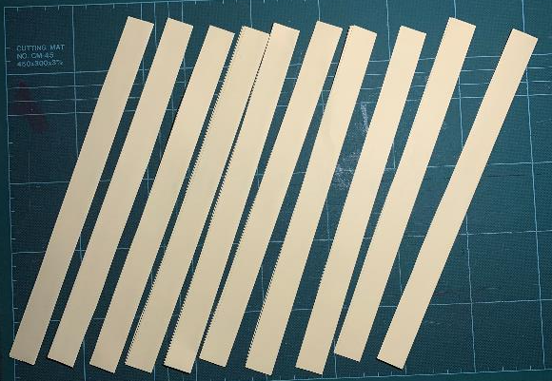
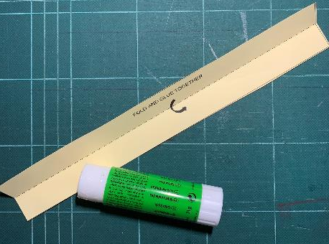
Step 1b – Star Lantern Frame
Score each strip on the dotted line
Fold in half and glue the two halves of each strip together.
You should have ten double-thickness strips

Slide 5
Cut
Step 2a – Build the Frames
Use the Frame building template
Place the strips onto the template following the guide

Slide 6
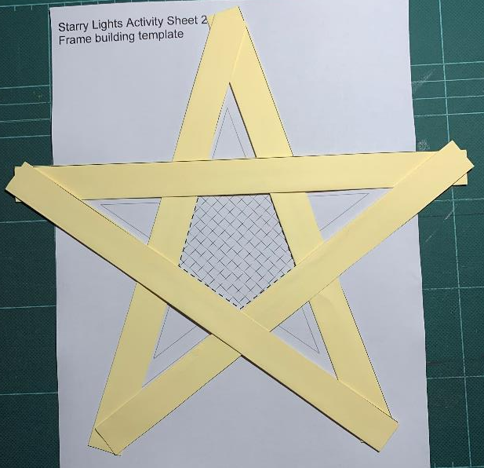
Step 2b – Build the Frames
When complete, glue each strip together at the red s
Repeat steps 1-2 to make a second frame

Slide 7
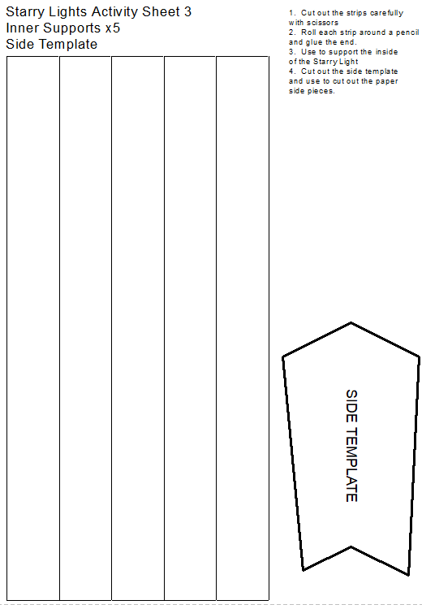
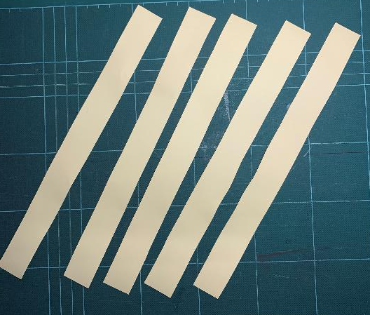
Step 3a – Inner Supports
Carefully cut the solid line for the five supports

Slide 8
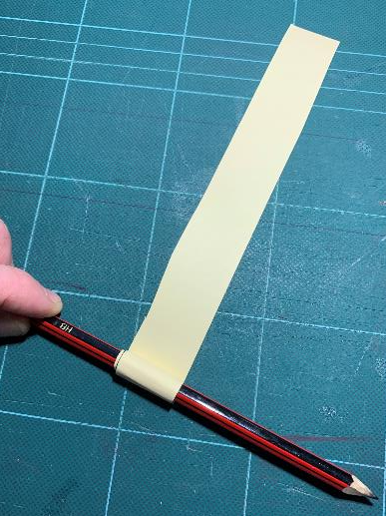
Step 3b – Inner Supports
Roll each strip tightly around a pencil and glue to the end.

Slide 9
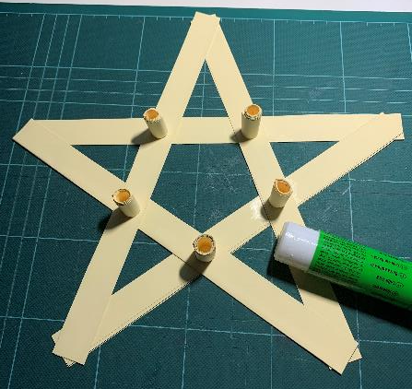
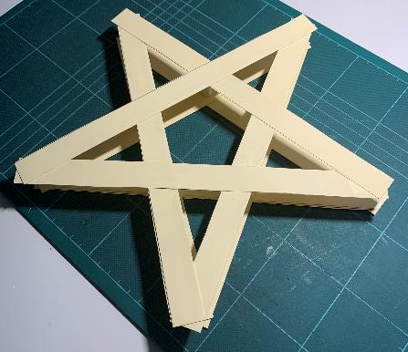
Step 4 – Join Lantern Frames Together
Glue the five supports into position
Glue the second frame on top of the supports

Slide 10
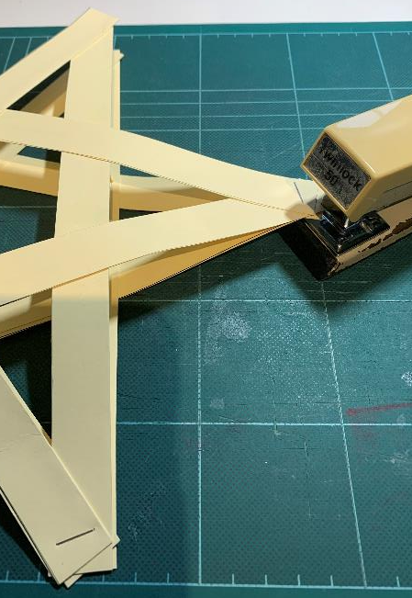
Step 5 – Attach the Points of the Star Together
Staple four of the points together
Leave one point open
You can also use paperclips, sticky tape or glue the tips

Slide 11
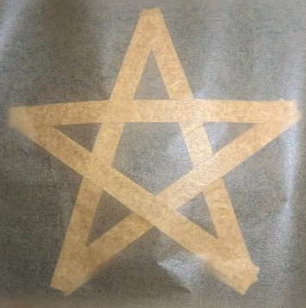
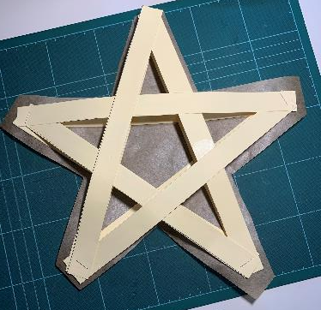
Step 6 – Cover Lantern with Paper
Cover one side of the frame with paper
Glue the paper to the frame
Use either: baking, greaseproof or tracing paper
Let the glue dry
Trim the paper leaving a small overlap about the star
Save the off-cuts for later

Slide 12
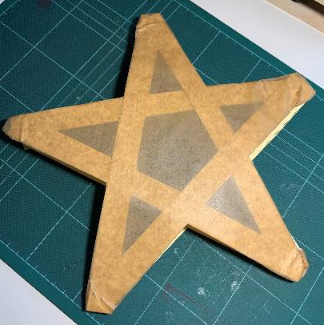
Step 7 – Covering
Glue the paper overlap onto the inside of the frame
The first side is now covered
Repeat steps 6 to 7 to cover the second side
The second side is now covered

Slide 13
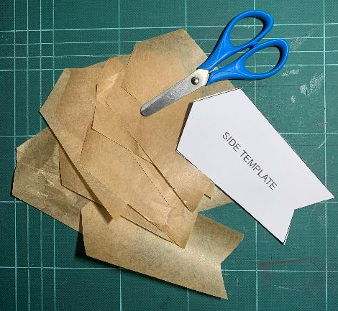
Step 8 – Cut out sides
Cut out the side template from activity sheet 3
Use this to cut out ten side pieces

Slide 14
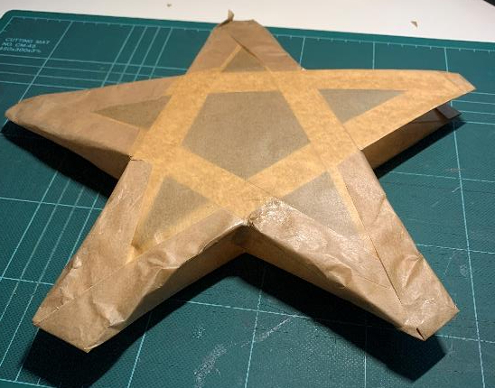
Step 9 – Cover the sides
Glue eight side strips onto the lantern
Leave the top gap open

Slide 15
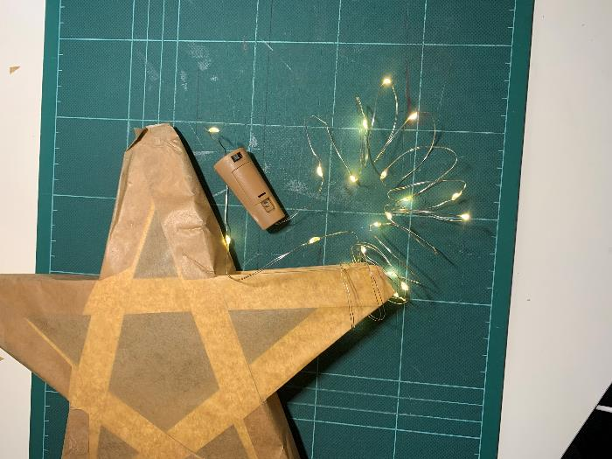
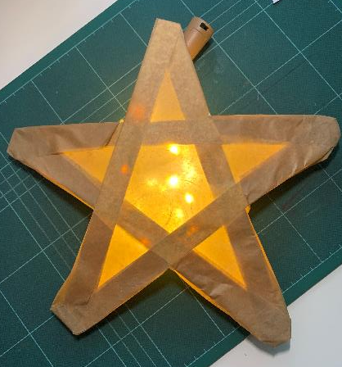
Step 10 – Insert Lights
Insert LED lights into the body of the lantern
Instead of this you could use a small torch or a PP3 9V battery with an LED attached to the terminals - these could be stuck to a piece of string with sticky tape
Bottle fairy string lights

Slide 16
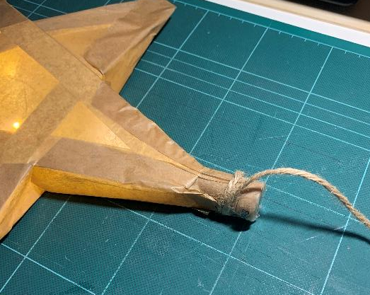
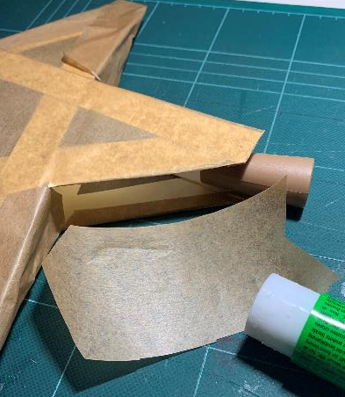
Step 11
Glue on the top side pieces
Use sticky tape to attach string to the top point
Hang up the Star Lantern

