Slide 1
EVolution of Vehicle Sales in Great Britain
Key Stage 3 Maths
Notes:
EV=electric vehicles

Slide 2
In 2019, the UK recorded 454.8 million tonnes of CO₂ equivalent emissions
Passenger cars produced 67.7 million tonnes of emissions in 2019
67.7
down
from
2018
Road traffic in the UK covered 573.8 billion road-kilometres in 2019.
19.5
2.8%
3.1 million
CARS and
EMISSIONS
tonnes
1%
Aviation
Rail
Other
Shipping
Road
27%
Types of Transport
1%
Transport produced 27% of the 2019 emissions
2%
5%
91%

Slide 5
Definitions of Vehicle Types
Petrol
Diesel
Powered by an internal combustion engine which is fuelled by petrol which is produced from crude oil.
Powered by an internal combustion engine which is fuelled by diesel which is produced from crude oil.
Hybrid
Electric
Powered by an internal combustion engine (petrol or diesel) and an electric motor which is either charged by the vehicle as it moves or by plugging in to the mains electricity supply.
Powered by a battery which can be charged by plugging in to the mains electricity supply.
Notes:
In case needed.

Slide 6
Use the information in the table to calculate the number of each type of new vehicle registered in each year
 | Total New Registrations | Petrol | Diesel | Hybrid | Electric
2005 | 2,400,000 | 63% | 37% | 0% | 0%
2010 | 2,000,000 | 53% | 46% | 1% | 0%
2015 | 2,600,000 | 49% | 48% | 2% | 1%
2020 | 1,600,000 | 61% | 18% | 14% | 7%

Slide 7
ANSWERS
 | Total New Registrations | Petrol | Diesel | Hybrid | Electric
2005 | 2,400,000 | 1,512,000 | 888,000 | 0 | 0
2010 | 2,000,000 | 1,060,000 | 920,000 | 20,000 | 0
2015 | 2,600,000 | 1,274,000 | 1,248,000 | 52,000 | 26,000
2020 | 1,600,000 | 976,000 | 288,000 | 224,000 | 112,000

Slide 8
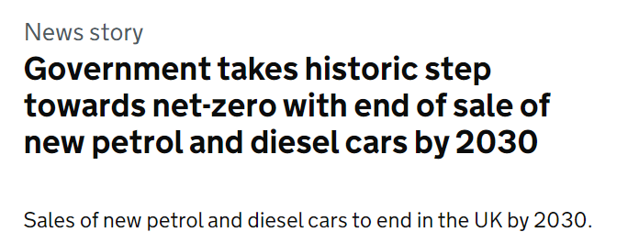
Ban on sale of new petrol and diesel cars
In November 2020, the UK government announced that the sale of all new petrol and diesel cars and vans would end by 2030
Why do you think this decision was made?
Notes:
Headline taken from here: https://www.gov.uk/government/news/government-takes-historic-step-towards-net-zero-with-end-of-sale-of-new-petrol-and-diesel-cars-by-2030

Slide 12
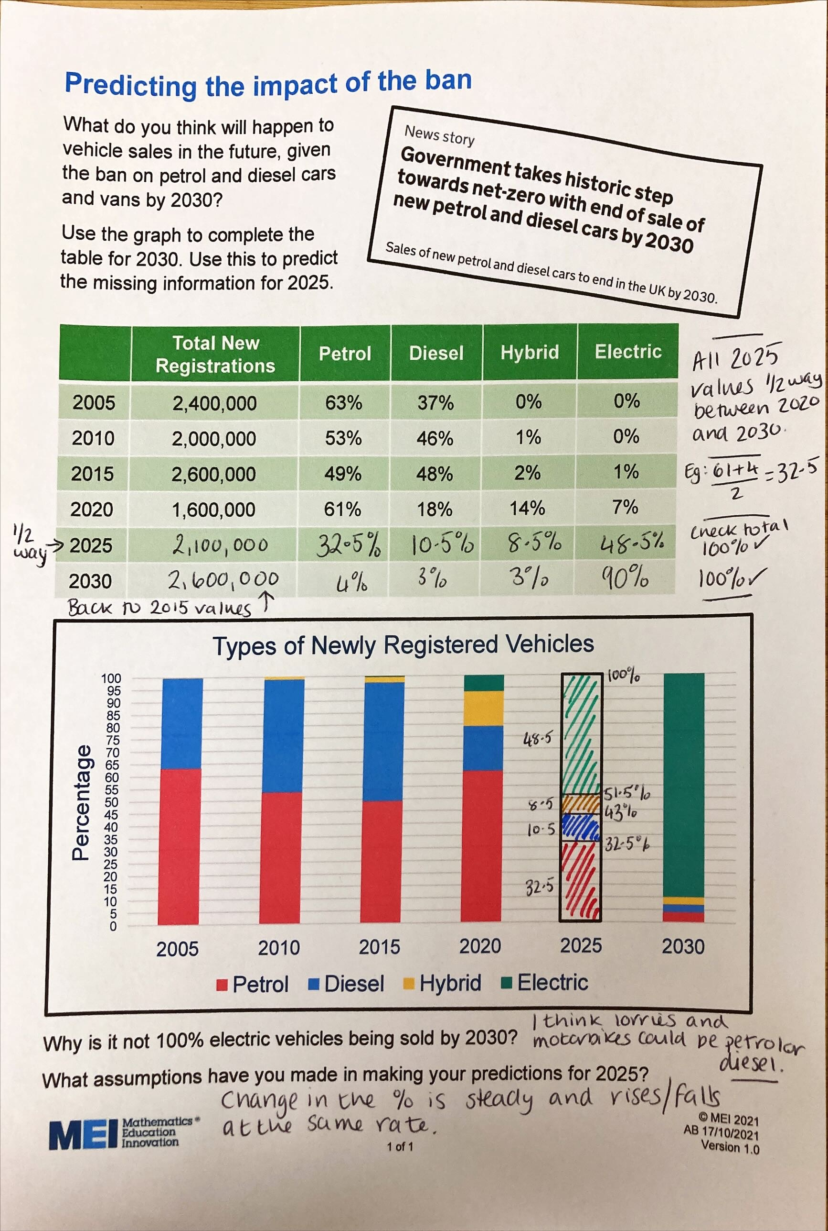
Student Work Example

Slide 13
In 2019, the UK recorded 454.8 million tonnes of CO₂ equivalent emissions
Passenger cars produced 67.7 million tonnes of emissions in 2019
67.7
down
from
2018
Road traffic in the UK covered 573.8 billion road-kilometres in 2019.
19.5
2.8%
3.1 million
CARS and
EMISSIONS
tonnes
1%
Aviation
Rail
Other
Shipping
Road
27%
Types of Transport
1%
Transport produced 27% of the 2019 emissions
2%
5%
91%

Slide 14
More statistics…
The average age of a car on the road in 2020 was 8.4 years
In 2021, there were 9 rapid car charging points for every 100km of road
In 2020, there were 40,350,714 vehicles on the road in the UK
By 2050, an increase of 20% to 30% in electricity production of will be needed to power electric vehicles

