Slide 1
Snow Place Like Home
Making a snow globe

Slide 2
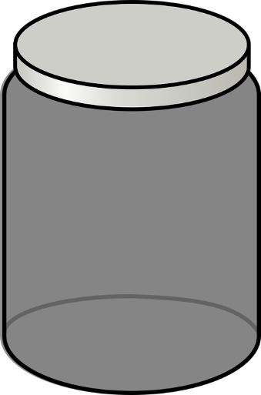
Step 1
Gather your equipment and resources.
You will need:
A jam jar and lid
Plastic glitter
A Christmas decoration or ornament
Access to water
Glue gun and glue stick (or waterproof glue)
Glycerine (if available)
A spoon
Notes:
If a glue gun is not available other household glue can be used, as long as it is waterproof and can stick the ornament to the jam jar lid. The Christmas decoration or ornament should be small enough to fit into the jam jar and be made from waterproof material, such as plastic.

Slide 3
Step 2
Decoration
Glue the bottom of your decoration or ornament to inside of the jam jar lid
Glue here
Inside of jam jar lid
Notes:
If a glue gun is not available other household glue can be used, as long as it is waterproof and can stick the ornament to the jam jar lid. The Christmas decoration or ornament should be small enough to fit into the jam jar and be made from waterproof material, such as plastic.

Slide 4
Step 3
Fill the jam jar almost to the top with water
Remember to leave some space as your ornament will add to the volume of the water.
Add a small amount of glycerine
Add glitter and stir
Add water,
glycerine and glitter
Jam jar
Notes:
Glycerine helps the glitter to suspend in the water, resulting in a better snow globe effect. If this is not available the snow globe can still be produced without it, but the effect will not be as pronounced or impressive!

Slide 5
Step 4
Add glue around the rim of the jam jar and attach the lid
Make sure that the lid is securely fitted and watertight
Add glue and secure the lid
Notes:
The glue helps to create a watertight seal so that the liquid does not escape. A cheap, tube based clear silicone sealant could also be used. Ensure the seal is watertight before testing.

Slide 6
Step 5
Turn the jam jar upside down
Shake your new snow globe, enjoy the effect and share with your friends!
Notes:
Shaking the snow globe should result in the glitter spreading around inside and then slowly falling like snow!

