Slide 1

Build your own football team
Select your own football team based on data and strategy

Slide 2
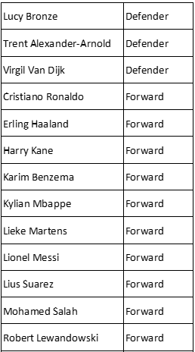
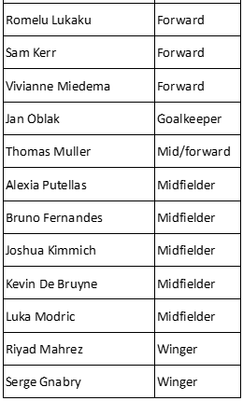
Who do you want on your team?

Slide 3
How would you use this information?

Slide 4
How would you use this information?

Slide 5
When you pick your team you must
Have players for all the team positions
Add up the overall scores for your players (the last column)
  The total must be under 800 if you are using the 2-digit scores
  The total must be under 80 if you are using the 1-digit scores

Slide 6
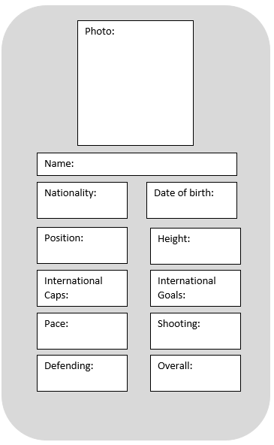
Top Trumps
What information should be on the cards?
Who wins?
Date of birth:
24 Jun 1987
Date of birth:
5 Feb 1985
Who wins?
Position:
Midfield
Position:
Defender

Slide 7
Please do share your learning highlights and final creations with us so we can display it for other students to see.
Share them with us on social media @IETeducation or send them via email to IETEducation@theiet.org

