Slide 1
Introduction
A video introduction on what to expect during an 8-12 week booking appointment.
Notes:
Activity 1, Phase 1
Watch video and write down questions to ask or issues raised by the scan.
Share the questions in the class and in small groups develop these into a series of key research questions.
Answering these questions should lead to an understanding of how a prenatal ultrasound scan works, the scientific facts about the 8-12 week scan and an exploration of the ethical, social (perhaps religious) and philosophical issues surrounding the choices that may be prompted by the scan.
Each group now feeds back their refined research questions back to the class, in order to reach a consensus on a ‘final’ set of research questions.
Video: thanks to NHS Fife for allowing us to use their information video as part of this project.

Slide 2
Sources of information
Searchable, up to date medical information.
A national charity helping parents and healthcare professionals through antenatal screening and its consequences
Support and information for parents, for people with Down’s syndrome, for family and carers, and for professionals.
Notes:
Activity 2, introduced in phase 1 and continuing through phase 2
Divide the class into small research groups to follow up on the research questions.
Links to some different sources of information are given in this slide.
A pro-former sheet for collating research information is available to accompany this task. As well as collecting information, students need also to consider the accuracy and reliability of their source, as well as separating opinion and bias from objective fact.
Questions might include, amongst others:
What can an ultrasound scan detect and is it safe?
What is the normal medical ultrasound screening process during pregnancy?
False-negative and false-positive tests (data analysis)
What is Down’s syndrome?
Who ought to decide whether another person has a quality of life worth living?
Can diagnosis at a foetal stage improve quality of life for someone with Down’s syndrome?
Are there circumstances under which the termination of pregnancy is desirable?

Slide 3
Consolidating research findings
To do:
Collect a copy of the flow chart of the Danish parental screening programme.
Stick this to the centre of a large sheet of paper.
Use your research to make changes so that the flow diagram represents the process in the National Health Service.
How can this flow chart be adapted to show the information available during each decision making processes, and the factors that can affect those decisions?
Use the area around the flow chart to organise useful information that you found during your research.
Notes:
Activity 3, phase 3

Slide 4
Flow chart of the Danish prenatal screening programme
Antenatal visit at GP
8-10 Weeks
Information and choice of screening tests
Ultrasound scan and screening tests
(if chosen)
11-13 Weeks
High risk (≥ 1:300)
Information by sonographer or foetal medicine specialist
Low risk (< 1:300)
Diagnostic test
No diagnostic test
Positive result delivered by foetal medicine specialist
Negative result delivered by sonographer
Standard prenatal care:
20 week ultrasound scan
GP consultations
Midwife consultations
Continue pregnancy
Offer of additional consultations
Termination of pregnancy
(≤ 22 weeks)
Back to task
Adapted from: Stina Lou et al. BMJ Open 2019;9:e026825
©2019 by British Medical Journal Publishing Group
Notes:
Activity 3, phase 3
Instructions for this task are on the previous slide.
It can help to give a time limit to this activity.

Slide 5
Difficult decisions
A three person mountaineering team are climbing K2 high in the Himalayas. All three are good friends. Two of the team are seriously hurt in a fall and bad weather is closing in. Both injured climbers will die from their injuries if they are not treated quickly. They both have young families.
The third person, Nirmal, can make it back to safety in two days, but he is only able to rescue one of the climber, but if he stays (or tries to rescue both) both will die. Nirmal injured climbers. Nirmal can prevent the death of either has a morally compelling reason to choose to leave one of his friends to their fate. But for each climber, Nirmal has an equally strong reason to save him or her.
The moral precept that confronts Nirmal gives rise to conflicting obligations.
(This is a hypothetical scenario)
Notes:
Activity 4 (1/2), Phase 3
A discussion activity to develop students awareness of moral dilemmas.
Often there is a least bad solution, but sometimes there is not.
Here Nirmal has conflicting obligations – which are equally strong.
What choices can Nirmal make? (Choosing one climber or neither.)
What responsibility will Nirmal have for each possible outcome?
What will Nirmal feel about each possible outcome?
How will Nirmal’s choice affect the rest of his life?
How would Nirmal’s choice affect the life of his surviving friend?
Reference: https://plato.stanford.edu/entries/moral-dilemmas/

Slide 6
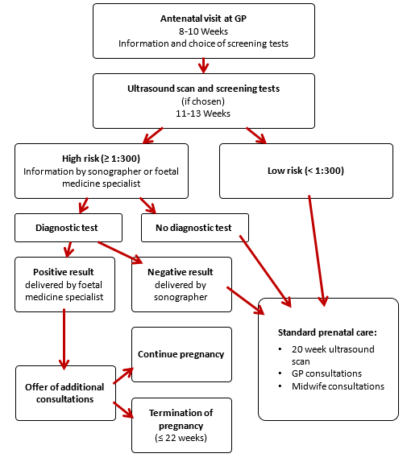
Difficult decisions
What dilemmas may be encountered through the prenatal screening process?
Notes:
Activity 4 (2/2), Phase 3
Prompt students to identify dilemmas that may be raised during the different stages of the screening process.
Through a structured class discussion, students should explore how choices are made, the factors that affect individuals’ choices, and whether these influences are justified.
Are there any factual uncertainties?
Are there any uncertainties about the consequences of a choice or action?
Are there instances when two or more conflicting obligations exist? And if so, how should we choose between them?
What impact will choices have on those making them? Will they feel remorse or guilt – and can these feelings be avoided (perhaps by making another choice)?
What impact will choices have on those affected by them?
What factors should/do influence the choices that are made? How would these influences be justified or rebutted?
Why do different people facing the same situation make different choices and is this acceptable?
How can those involved be supported?
Reference: https://plato.stanford.edu/entries/moral-dilemmas/
Image adapted from: Stina Lou et al. BMJ Open 2019;9:e026825

Slide 7
Life stories
Find out about a person with Down’s syndrome.
Represent their life in a way that you think is appropriate.
Life stories of people with Down’s syndrome
Notes:
Activity 5, phase 4
Emotions, awareness and understanding all play a part in the decisions we make. The purpose of this activity is to raise awareness of lives of people living with Down’s syndrome.
Students may choose to produce an artwork, a blog, a curriculum vitae, or something else – it is up to them.
There may be a student in your class with Down’s syndrome, or some students who have a friend or relative who has Down’s syndrome. If the life of someone known to students in the class is depicted, it would be appropriate to obtain that person’s permission (or their parents, if they are still a child). The link on the slide connects to a section on the Down’s Syndrome Association website which celebrates the lives of people with Down’s syndrome.

Slide 8
Screen time
To do:
One person picks up a card and reads out the scenario to the group.
The rest of the group make a list of what can be scientifically known about the scenario, that can inform a decision.
The first person then describes the choice that they would make and explains the reasons for their choice.
Others in the group are each allowed to ask one question about the decision.
That same person then argues against their own choice and explains why they might otherwise have made a different decision.
The next person then takes a turn and so on.
Notes:
Activity 6, phase 5
Each group of 3-5 students will need a pack of scenario cards.
Students make decisions based on their understanding of how the person in each scenario should respond.
There are no right or wrong answers.
During this activity, students can be prompted to consider the different influences on their decision making.
Decisions that are ethically based lean towards decisions based upon individual character and a subjective understanding of right and wrong held by individuals.
Decisions that are morally based emphasise the widely-shared communal or societal norms about right or wrong.
Both ethical and moral decisions are informed by evidence, experience, understanding and emotion.
A follow up class discussion could be used to unpick these factors that influence decision making and to give students an opportunity to reflect on their own decision making process. This could perhaps lead to insights into what extra evidence, experience or understanding could/should be actively sought when making important decisions.

