Slide 1
Introduction
We are Youth Verdict, an organisation of young people from across Queensland, Australia, using legal avenues to fight for our human rights and climate justice.
Notes:
Activity 1 (slide 1/2), Phase 1
This activity sets the scene for the unit.
Watch the video that describes the group Youth Verdict and what they hope to achieve.
Ask students to share any of their experiences of taking part in, or observing, a campaign of any sort. Give time to these stories.
What do they remember? What action did they take, or see others take? How did it make them feel? What was the outcome?
Discuss the questions on the next slide.
Images: Credit: Youth Verdict, CC BY 2.0

Slide 2
We are Youth Verdict, an organisation of young people from across Queensland, Australia, using legal avenues to fight for our human rights and climate justice.
What other methods of political participation could the young people have used?
Who benefits from fossil fuel extraction?
Who experiences the risks and harms of fossil fuel extraction?
The young people in this video used human rights law to fight against fossil fuel extraction - which rights are affected, and who do they belong to?
Is it fair to make ‘trade-offs’?
(e.g. between environmental quality and money)
Notes:
Activity 1 (slide 2/2), Phase 1
Reflecting the specific case on which Youth Verdict are campaigning, students discuss answers to these questions in small groups and then feedback their thoughts into a whole class discussion.
Each question is revealed on a mouse click.

Slide 3
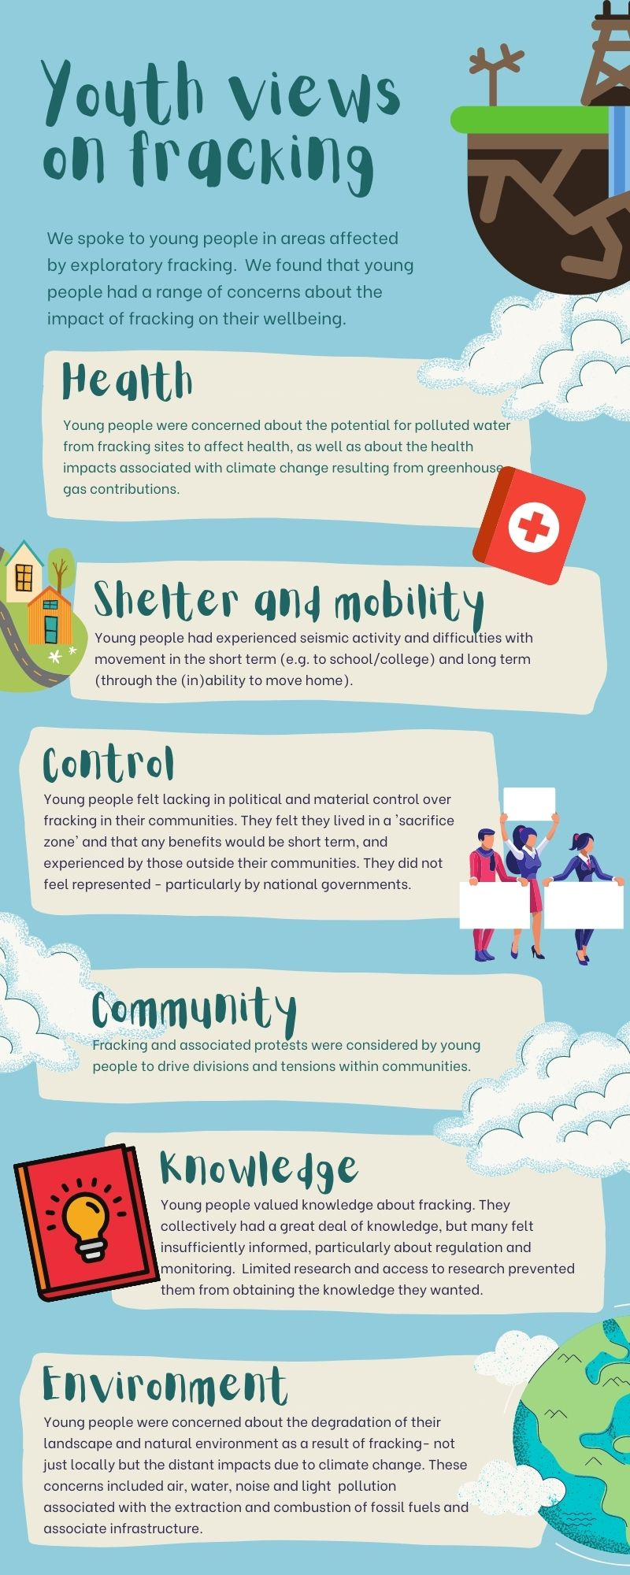
Project task
As a class:
Run a ‘Government Select Committee’, which has been set up to investigate the viability of hydraulic fracturing (fracking) in the UK.
As an individual:
Create a summary position statement of the select committee findings, which could be communicated to the media.
Notes:
Activity 2 (slide 1/4), Phase 1
Introduce the project task, which is split into two sections.

Slide 4
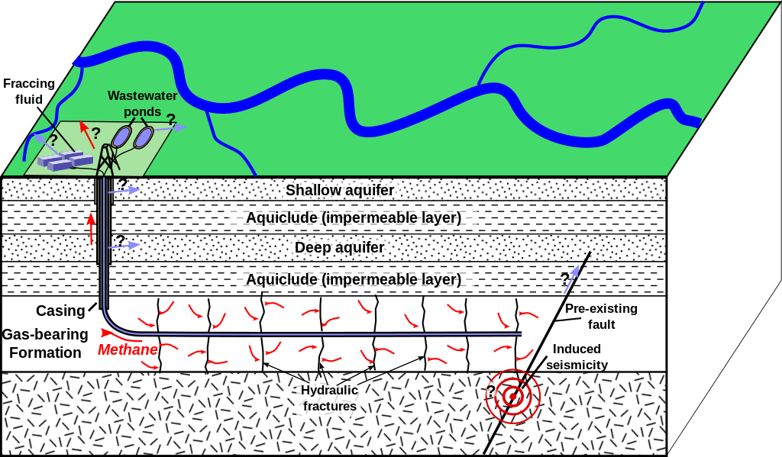
What is fracking?
Fracking: the process in which pressurised liquid is used to fracture underground rock in order to release natural gas (methane).
Notes:
Activity 2 (slide 2/4), Phase 1
Briefly describe what fracking is.
Image by Mikenorton from Wikimedia, under the Creative Commons Attribution-Share Alike 3.0 Unported license.

Slide 5
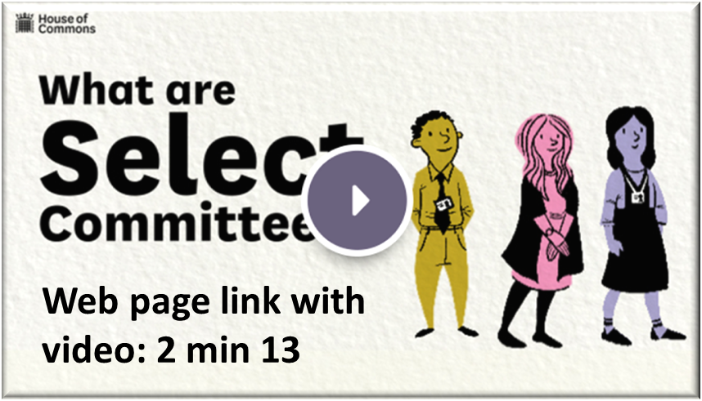
Project task
As a class:
Run a ‘Government select committee’, which has been set up to investigate the viability of hydraulic fracturing (fracking) in the UK.
Notes:
Activity 2 (slide 3/4), Phase 1
The initial focus is on running a Government select committee, with students taking part both as expert witnesses and as members of the committee interrogating (questioning for clarity and understanding) other expert witnesses.
Explore with the students what a select committee is, using the link on the image. This connects to a UK Parliament webpage, which includes as (2 min 15 s) video that explains how House of Commons select committees work.
Select committees normally have between 11 and 15 members.

Slide 6
Project task
As a class:
Run a ‘Government select committee’, which has been set up to investigate the viability of hydraulic fracturing (fracking) in the UK.
Agenda items for the next meeting of the ‘Fracking Select Committee’.
Hearing from a range of experts, with time for questions, on:
Impact of fracking on air and water quality
Implications of fracking on climate change
Impact of fracking on energy supplies
Economic impacts of fracking
Seismicity (Earth tremors)
Social and community impacts and the legal rights of local people
Notes:
Activity 2 (slide4/4), Phase 1
Introduce the six areas of expertise that will be heard at the next committee meeting.
Together: decide how to split the class into groups that will each research one of these areas in order to become expert witnesses reporting back to the committee. (Friendship groups, focused areas of expertise in each group, range of skill sets in each group, random groups …)
Together: divide the class into teams that will each research a specified area of expertise.
The focus should be on creating a set of teams that would all be expected to produce good evidence for the committee.
Each team will collaborate to produce one expert witness statement that will be read to the committee.

Slide 7
Research task
Individually:
Search for information and evidence for the impact of fracking within your ‘area of expertise’.
Complete a research document to summarise your findings and your thoughts about them.
Importantly, identify likely questions that others are likely to ask about your findings, and plan answers to those questions.
Who benefits?
What are the risks?
What is certain to happen?
How can negative impact be minimised?
How can risks be reduced?
How is impact measured?
Who loses out?
Notes:
Activity 3, Phases 1 and 2
Students each use a research summary sheet to record their findings, ready for phase 3.

Slide 8
Expert witness preparation for a
‘select committee hearing’
Environmental Audit Select Committee: hearing on Hydraulic Fracturing (fracking)
Committee remit: to consider the extent to which the policies and programmes of government departments and non-departmental public bodies contribute to environmental protection and sustainable development, and to audit their performance against sustainable development and environmental protection targets.
Notes:
Activity 4 (slide 1/3), Phase 3
Introduction to remit of the committee to which expert witnesses are reporting.

Slide 9
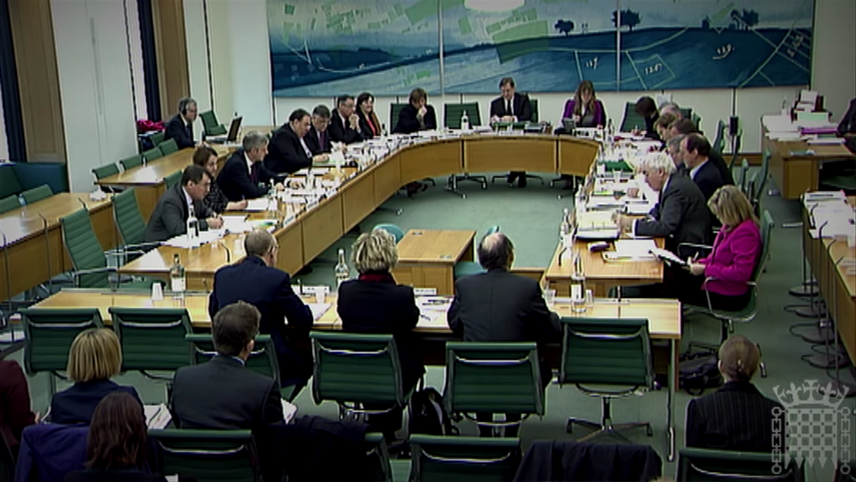
Expert witness preparation for a
‘select committee hearing’ ^{①}
Identify three or four main points, from your research, to include in your formal presentation to the select committee in order to give a balanced summary of your research.
Script a three minute (~360 word) presentation.
A select committee of the House of Commons hearing evidence from three witnesses, circa 2010-2012.
Notes:
Activity 4 (slide 2/3), Phase 3
In research groups, students review their individual findings in order to identify the main points of a three minute formal presentation to the select committee (this time limit is solely to enable all groups to present their evidence during the course of a single one-hour lesson and may be adjusted to fit the time available).
Each group prepares a written script of their report. Additional information – pictures, graphs or diagrams – could be prepared as PowerPoint slides.
Image: A select Committee of the House of Commons in session at Portcullis House, circa 2010-12 from https://www.youtube.com/watch?v=ENIW7i48xHA licensed under the Creative Commons Attribution 3.0 Unported license.

Slide 10
Expert witness preparation for a
‘select committee hearing’ ^{②}
Make a list of the possible questions that members of the select committee may ask about your group’s evidence.
For each question agree on and rehearse an answer.
(It is likely that some members of the committee are strongly in favour of fracking and others are strongly against it.)
Three witnesses being questioned about their evidence by a select committee of the House of Commons, circa 2010-2012.
Notes:
Activity 4 (slide 3/3), Phase 3
Continuing in research groups, students review their individual findings and their scripted presentation in order to identify possible questions, especially awkward questions, that members of the select committee might ask.
All members of each group rehearses answering these questions clearly and concisely, citing relevant evidence to support their answers.
Image: A select Committee of the House of Commons in session at Portcullis House, circa 2010-12 from https://www.youtube.com/watch?v=ENIW7i48xHA licensed under the Creative Commons Attribution 3.0 Unported license.

Slide 11
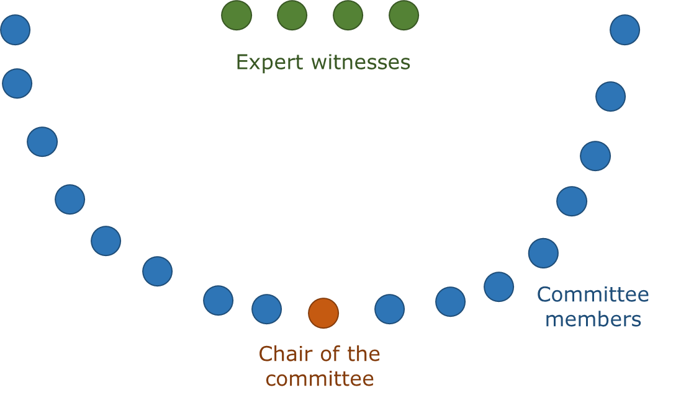
Select committee hearing
In turn, each group of expert witnesses:
present their evidence (3 min)
answer questions from the committee (5 min).
Timer
Time up
Timer
03 mins
02 mins
01 mins
Timer
Time up
Timer
05 mins
04 mins
03 mins
02 mins
01 mins
Start 3 minute timer
Start
5 minute
timer
Notes:
Activity 5, Phase 3
The class model a select committee hearing.
Arrange the classroom into a horseshoe shaped arrangement of chairs for the select committee, with three or four chairs in the centre for each group of witnesses to sit on in turn.
Chair of the committee.
A different chair of the committee should be appointed to take charge for each presentation. The job of the chair is to invite the witnesses to give their presentation, to ask a few questions to clarify points made in the presentation, and to provide opportunity for members of the committee to ask their own questions – including quieter members of the committee, in order to achieve a balanced hearing with views heard from each side of the argument.
Committee members reflect on each presentation and ask questions in response to the invitation of the chair. Their questions may be biased, and some students may wish to take a stance in their questioning which is contrary to their own opinion.
Witnesses each research group sits on the witness chairs in turn. One member of the team reads out the prepared statement. All members of the group respond to questions asked by the committee following the presentation.
Clicking the ‘Start 3 minute timer’ or ‘Start 5 minute timer’ will start (or stop) a timer that displays the time remaining for each activity.

Slide 12
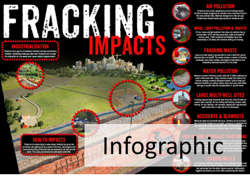
Influencing policy
What do you want to say?
Prepare your piece for
next time!
… other ideas are also allowed…
Notes:
Activity 6, Phase 4
This slide summarises what students need to prepare for next time.
Individuals review what they learnt from the select committee and prepare some form of public reporting of their opinions about fracking, based on evidence from the select committee hearing, which they hope will influence other people.
Next session, each individual’s opinion piece will be peer reviewed.
Image for infographic from https://frack-off.org.uk/campaign-materials/

Slide 13
Changing the world
What determines the effectiveness of an opinion piece?
Collect a set of ‘effectiveness cards’ and add any additional factors that are relevant.
Organise the cards into rank order (in any way that works).
Review the opinion pieces produced by the group and award each one two stars and a wish based on its likely effectiveness.
Next time you could …
… worked well, because …
Notes:
Activity 7, Phase 5
Each instruction appears on a mouse click.
Students reflect on the factors needed for an opinion piece to be effective in influencing policy.
Using the cards for this activity: ‘Effectiveness cards’, any additional factors can be added to the blank cards.
Students then work in teams to rank the importance of each factor that can be effective in influencing policy.
Feedback should be taken, with each group given the opportunity to explain why they feel certain factors are more important.
Does this order depend on:
the nature of the issue?
the complexity of the issue?
the personality of those involved?
What else could affect the relative importance of each of these factors?
At the end of the process, students should review each other’s opinion pieces and reward two stars and a wish to each one.
This could be run as a ‘gallery’ with the pieces laid out around the room, and students moving from one piece to the next and providing feedback to several in turn (not necessarily all, so long as a few students review each one).
Feedback could be given on separate feedback sheets.
It may be appropriate to nominate and vote on the most effective one or two opinion pieces.

Slide 14
Political activism
What works?
How effective is it?
Is it worth it?
What is my place in politics?
What would happen if no one involved themselves in political activism?
Notes:
Activity 8, Phase 5
The example of fracking has been used to explore the purposes and effectiveness of political action on influencing public opinion and policy.
Class discussion: Discuss answers to the questions on the slide in relation to fracking and in relation to other issues.
What issues should/could we get involved with and how worthwhile is it to be politically active?
What other questions about political action do students have?

