Slide 1
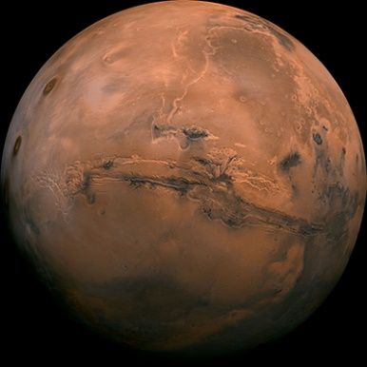
Introduction: commercial exploration of space
Benefits
Mining and minerals
Scientific advances
Technological advances
Economic opportunities
Risks
Space piracy or conflict
Extreme conditions and isolation
Loss of life
Financial loss
Notes:
Activity 1, phase 1 (15 minutes) (slide 1 of 3)
This unit is about the risks, costs and potential benefits for different parties involved in a commercial exploration of space; and why decisions about scientific and engineering solutions need to take account of expert opinions from a range of other disciplines.
This slide illustrates a few of the benefits and risks involved.
Students might be encouraged to suggest further benefits and risks and to consider who might gain or lose.
One current funding model is for a government to post innovation challenges online in open competitions and to enter into a fixed price contract with the winning entry. The commercial business winning the contract can increase their profit by minimising the costs in delivering on the specification.
The design competition is based on this model.
Image: NASA

Slide 2
Commercial exploration of space
Design competition
Land base on Mars
Design competition
Purpose: habitable base on the surface of Mars to support human exploration of the planet.
Time scale: a fully functioning research base operating with sixteen full time scientists within fifteen years.
Specifications: self-sufficient in oxygen, water, food and power,
fail-safe back-up provision for all of the essential support systems,
all support systems can be fully maintained and repaired in situ,
comfortable environment for work and relaxation appropriate for twelve month postings on Mars,
Notes:
Activity 1 continued (slide 2 of 3) There is a student sheet for this activity (it includes information about Mars given on the next slide)
This slide introduces students to a design competition, for which they will create their own individual designs for a land-base on Mars. Their design will need to address the competition criteria, the conditions on Mars listed on the next slide, and the needs identified in activity 2.
Individual designs may be completed in lesson time or for homework. These will be peer reviewed in phase 3 and used to inform work in later parts of the unit.
Designs might be submitted as: a written description; a labelled picture or diagram; a computer-generated model; or any other appropriate format.
Designs need to include both the physical infrastructure and organisational systems of the base.

Slide 3
Conditions on Mars
Mars spins on an axis in a similar way to the Earth.
A day is 24 hours 37 minutes and a year is 687 Earth days.
Gravity is 2.7 times less strong than it is on Earth.
Very thin atmosphere: mostly CO₂; a tiny proportion of water vapour.
Average temperature is –63ºC. (–140ºC to +30ºC).
Intensity of solar radiation is 2.25 times weaker than it is on Earth.
Surface is mostly volcanic rock covered in a fine powder.
Soil holds nutrients such as sodium, potassium, chloride and magnesium. It contains no organic matter.
Perchlorates in the soil are poisonous. They can be washed out with water. Other processes can separate them from the water.
Distance from Earth varies between 55 Gm and 400 Gm.
A one-way message takes between 3 and 22 minutes.
Mars does not have a magnetic field to protect its surface from forms of solar radiation harmful to humans.
1 Gigametre (1 Gm) = 1 million km
Notes:
Activity 1 continued (slide 3 of 3) There is a student sheet for this activity (it includes the information about Mars given on this slide)
This information about Mars describes the conditions that need to be taken into account in the design of a land base on Mars.
The minimum temperature -140ºC is the temperature at the poles in winter; the maximum temperature is the summer temperature closer to the equator.
The solar intensity is the average energy (most obviously heat and light) falling on each square metre of the surface.
The distance between Mars and Earth is greatest when their orbits move them to opposite sides of the Sun.
The time for the time it takes for a one-way message to vary between the two extremes is about one year.
On Earth, the magnetic field and thick atmosphere minimise the amount of the most harmful solar radiation that reaches the surface.
Images: NASA

Slide 4
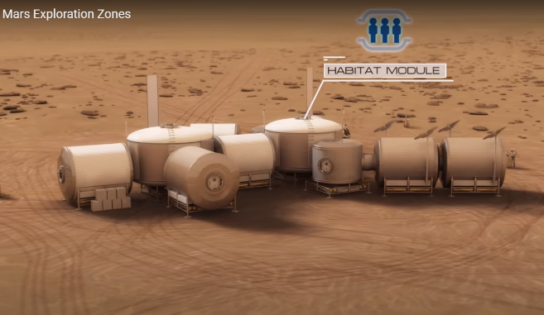
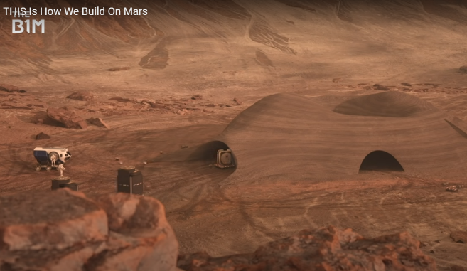
Commercial exploration of space
Land base on Mars
A NASA video describing the necessary requirements for a land base on Mars.
A B1M video describing one possible solution to building a land base on Mars.
7 Minutes
10 Minutes
Notes:
Activity 2, Phase 1 (20 minutes)
Students watch each video and write down a list of requirements in developing a base on Mars.
The lists can be used as reference in activity 3.
(You may consider showing just one of the videos to provide more time for the activity 3).

Slide 5
Priorities for a land base on Mars
To do:
Sort the ‘needs cards’ into an order of priority.
Use an ordering system that makes the most sense to your group.
To answer:
Are there any essential needs that are missing from this list? (What are they?)
What challenges will face those living in a land base on Mars?
How can these challenges be mitigated (reduced) by careful design?
What factors could make compromises to the best design necessary?
Who should decide what compromises are acceptable?
Notes:
Activity 3, phase 1 (20 minutes) There is a student sheet for this activity
This is a ranking exercise designed to encourage students to think about the requirements of a land base on Mars, that is isolated from Earth.
The activity should be carried out in pairs or in small groups.
It is not expected that students rank all twenty needs in order from 1 to 20. Instead, they are free to group needs and to rank groups, or to organise the cards in the way they think is best.
The questions are designed to prompt discussion.
Image: NASA

Slide 6
Land base on Mars: judging
To do:
Organise into groups of about five.
Each person has five minutes to present their proposal to the rest of their group.
Each group agrees on the best proposal to put forward to the final round of judging.
Each group prepares a presentation for their best design.
Each group has five minutes to present their best design to the class.
A class vote decides the winning design.
Notes:
Activity 4, phase 3 (40 minutes)
Students present their completed competition entries to a small group and the best one from each group is presented to the class.
A winner is voted on.
Students should be encouraged throughout, to judge entries in terms of both physical infrastructure and organisational systems.
Image: NASA

Slide 7
Expert development groups
Several aspects of the winning design now need to be developed further.
You will now work in an expert group to develop a more detailed proposal for one of these essential parts of the design:
Food production
Power generation
Oxygen generation
Lay out of the base and social organisation
Governance and jurisdiction
Your design should build on the winning design.
Notes:
Activity 5, phase 3 (15 minutes to introduce the activity that is completed in phase 4) (There is a student sheet for each expert group)
Organise students into five expert groups, depending on the subjects they are studying.
This list identifies which subjects could be used to identify members for each expert group: food production (biology); power generation (physics); oxygen generation (chemistry); lay out of the base and social organisation (sociology, psychology); governance and jurisdiction (politics, history, sociology).
A best fit is required to achieve groups of roughly equal size (the number in each group is otherwise not important).
This may be most easily organised in advance.
This work should be completed during phase 4 using the relevant student sheet as a guide.
Image: NASA

Slide 8
Developing final proposals
Work in development teams that include one person from each expert group.
Incorporate additional research and ideas gained from working in expert groups.
Identify potential issues and determine solutions.
Time up
20 mins
19 mins
18 mins
17 mins
16 mins
15 mins
14 mins
13 mins
12 mins
11 mins
10 mins
09 mins
08 mins
07 mins
06 mins
05 mins
04 mins
03 mins
02 mins
01 mins
Start
20 minute
timer
Notes:
Activity 6, phase 5 (25 minutes)
Put students into groups of five that include one person from each of the five expert groups. Any ‘spare’ experts may be distributed around the class to form some groups of six.
In these cross-expert groups, students work up the winning design from phase 3 to incorporate the additional research and thinking that was completed during phase 4, activity 5. Each group has 20 minutes to prepare a five minute presentation that two students will show to another group.
Clicking the ‘Start 20 minute timer’ will start a timer that displays the time remaining in the centre of the screen.
Images: NASA

Slide 9
Presenting final proposals
Two students from each group present their group’s final proposal to another group.
That group feeds back: two positives and a suggested improvement.
Time up
05 mins
04 mins
03 mins
02 mins
01 mins
Start
5 minute
timer
Notes:
Activity 7, phase 5 (30 minutes) (slide 1 of 2)
Two students from each group are given five minutes to present their group’s final proposal to another group.
That group agree on feedback – two positives and a suggested improvement.
Clicking the ‘Start 5minute timer’ will start a timer that displays the time remaining in the centre of the screen.
This process is repeated with each presentation being given to a different group (perhaps with a second pair from each group presenting).
If time permits, further presentations can be made.

Slide 10
Reviewing final proposals
Notes:
Activity 7, phase 5 (slide 2 of 2)
One group describes the better of the two proposals that they were shown and explains why it is the best proposal.
Other groups are challenged to describe a better proposal that they were shown, again with reasons that justify their choice, and so on.
In this way the best design is selected by the class.
No group is allowed to defend their own proposal.
Images: sign by Gerd Altmann from Pixabay; other images by NASA.

