Slide 1
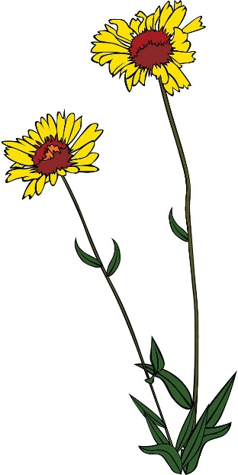
Standing up
The long, thin stems of a flower can stand up off the ground. They can support the weight of a flower at the top.
But if a flower doesn’t get enough water it will wilt and droop.
Your teacher will demonstrate a model of this using water and long, thin balloons.
To talk about in your group
What is inside the stem of a flower that provides support to help it stand up?
What is inside a human that provides support to help them stand up?
Can you explain why a plant is stuck in one place, while a human can move around?

