Slide 1
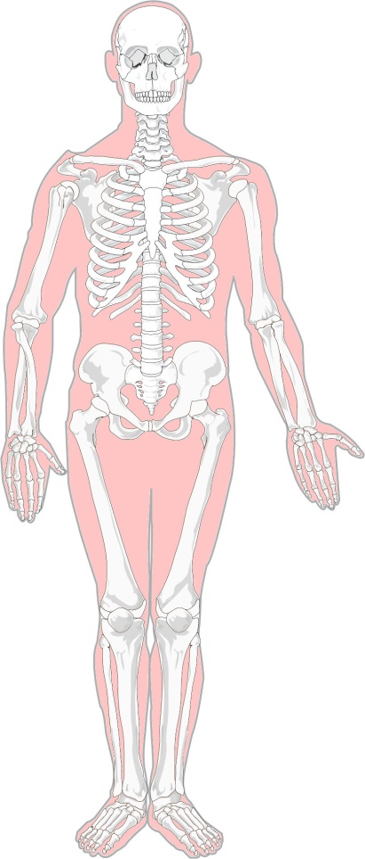
Without bones
There are many bones in the human body.
But imagine if there weren’t any…

Slide 2
Without bones
Part 1
The statements below suggest what might happen if there were no bones in the human body.
What is your decision for each statement?
I am sure this is right
I think this is right
I think this is wrong
I am sure this is wrong
1
We would be like a floppy jellyfish on the floor.
2
The heart and lungs could get damaged easily.
3
We would not be able to walk around.
4
We would not be able to breathe.
5
We would not be able to make blood.

Slide 3
Without bones
Part 2
The boxes below describe what would happen if there were no bones in the human body.
What is the correct explanation for each description?
Explanation
for why it would happen
To dissolve food and absorb nutrients.
A
To digest food and absorb nutrients.
B
Description
of what would happen
To store and churn food.
C
We would be like a floppy jellyfish on the floor.
1
To transport food from the mouth.
D
The heart lungs could get damaged easily.
2
To release energy from food.
E
We would not be able to walk around.
3
To absorb oxygen.
We would not be able to breathe.
F
4
To absorb oxygen.
We would not be able to make blood.
G
5

