Slide 1
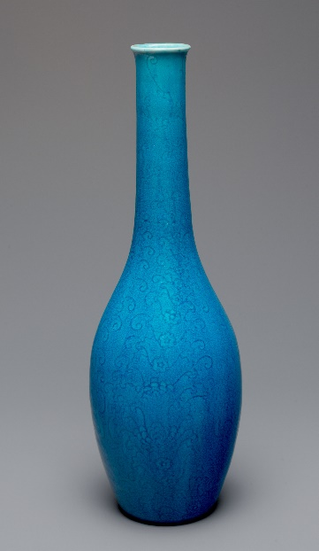
Vase
A vase can be made of glass or materials known as ceramics.
Look at the vase in the photograph.
It is used as an ornament.
Notes:
Read through the slide with children and ask them to look carefully at the image of the vase and think about its different properties.

Slide 2
Vase
Think about the properties of the vase.
How could you tell that it is made of a ceramic material?
What do you think about each of these statements?
I am sure this is right
I think this is right
I think this is wrong
I am sure this is wrong
A
The vase is ceramic because it is blue.
B
The vase is ceramic because it is smooth.
C
The vase is ceramic because it is brittle.
D
The vase is ceramic because it is tall.
Notes:
Encourage the children to decide whether each of these statements is right or wrong; and whether they are sure or unsure of each of their answers.
Expected answers: Statement C is right; statements A, B and D are wrong.
A breakdown of what the other choices tell you about students’ misunderstandings can be found in the teacher notes for this activity.

