Slide 1
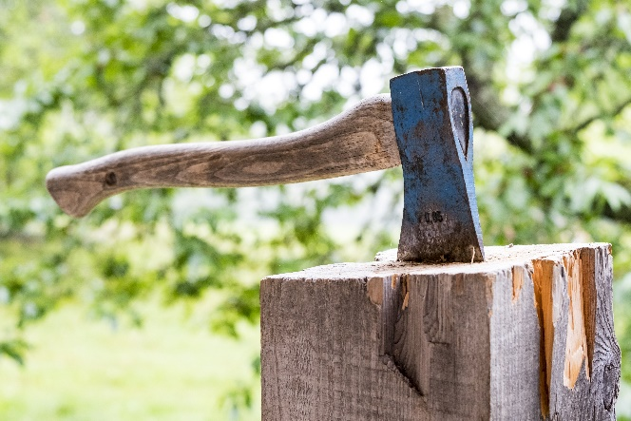
Axe
An axe can be used for chopping down trees. It has a handle and a head.
axe handle
axe head
Notes:
Read through the slide with children and ask them to look carefully at the image of the axe and think about the different properties of the handle and the head.

Slide 2
Axe
Some children are discussing whether the axe head is made of metal.
They use properties of materials to explain their answers.
Who do you agree with, and why?
Freddie: The axe head is a metal because it is hard.
Elsie: The axe head is not a metal because it is not shiny.
Isla: The axe head is a metal because it is heavy.
Logan: The axe head is a metal because it is sharp.
Notes:
Expected answer: Freddie gives the most scientifically correct answer: The axe head is a metal because it is hard.
A breakdown of what the other choices tell you about students’ misunderstandings can be found in the teacher notes for this activity.

