Slide 1
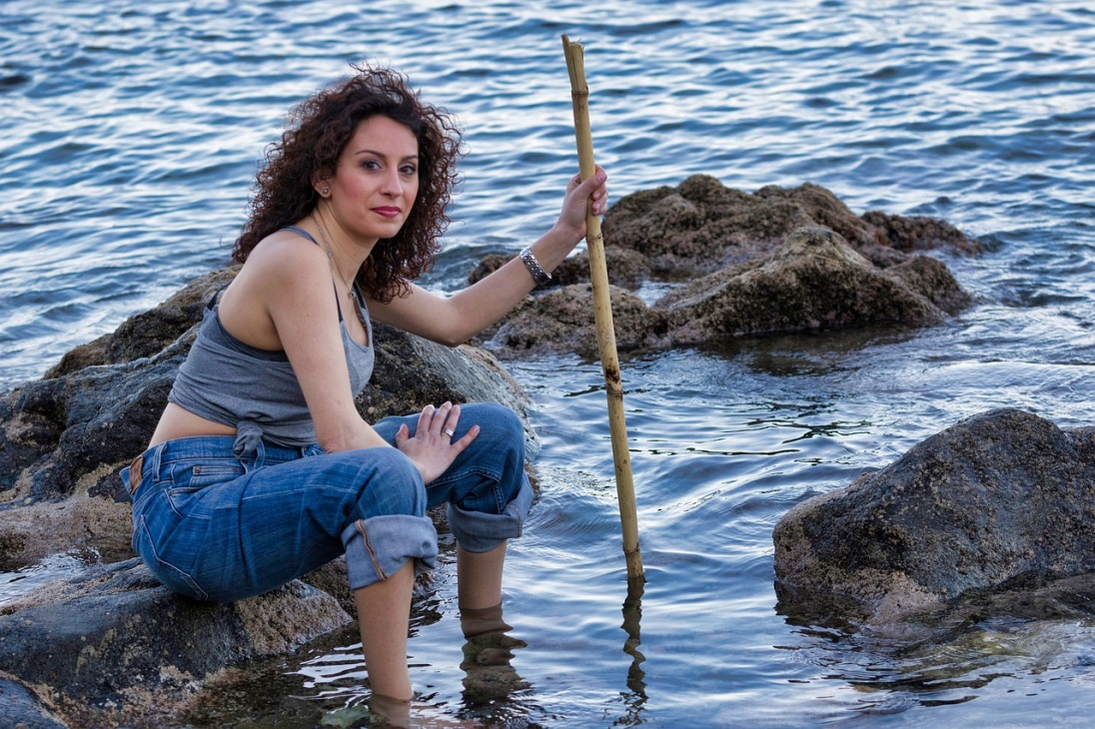
Seaside sorting
Katie is a scientist.
She studies organisms (living things) that live in and around the sea.
Notes:
This slide could be omitted, but it is useful to take opportunities to present positive role models and challenge preconceptions that children may have about what “a scientist” looks like.
Image: woman – pixabay.com/nicolagiordano (3368678)

Slide 2
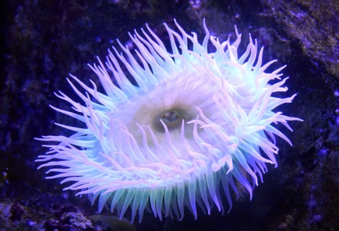
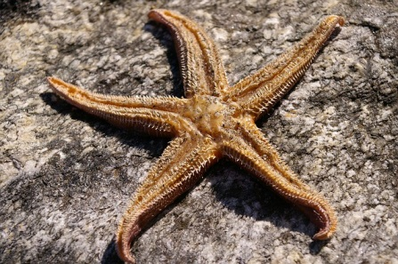
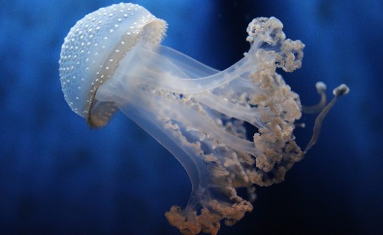
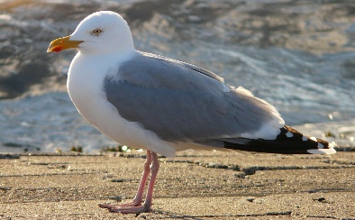
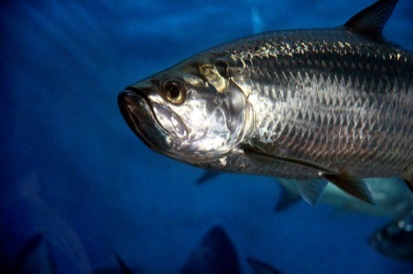
Seaside sorting
Katie took photographs of these organisms at the seaside:
Sea anemone
Starfish
Jellyfish
Seagull
Fish
Notes:
Read through the slide with children, and allow sufficient time for them to look at the images.
Images: fish – pixabay.com/zoosnow (3686185); seagull – pixabay.com/Hans (57752); starfish – pixabay.com/KRiemer (773758); jellyfish – pixabay.com/Andrea294 (4064588); sea anemone – pixabay.com/Dieter_G (3417960)

Slide 3
Seaside sorting
Katie wants to sort the organisms into groups.
Why would a scientist sort organisms into the same group?
Sea anemone
Starfish
Jellyfish
Seagull
Fish
A
The organisms have similar names.
B
The organisms have similar habitats.
C
The organisms have similar features.
D
I don’t know.
Notes:
Read through the slide with children and ask them to look carefully at statements A, B, C and D.
They should think about what they know and understand about how scientists classify and sort organisms.
Expected answer: Answer C gives the most scientifically correct response, indicating an understanding that scientific classification is based on similarities and differences in organisms’ observable/physical features.
A breakdown of what the other choices tell you about students’ misunderstandings can be found in the teacher notes for this activity.

