Slide 1
EAL Nexus Resource
Specialised cells
Flashcards
Subject(s): | Science
Key Stage: | KS3 KS4
Topic: | Cells, organs and life processes
© Bell Educational Trust 2020
This resource was originally developed by Z. Davies and has been adapted by EAL Nexus.

Slide 2
red blood cells
nerve cells
Notes:
Print slides 2 - 4 as 2 per page handouts, cut in half and laminate for repeated use. Give a set to each EAL learner or to each group.

Slide 3
egg cells
sperm cells

Slide 4
leaf cells
root hair cells

Slide 5
to carry oxygen around the body
Notes:
Print slides 5 - 12 as 6 per page handouts, cut out to make flashcards and laminate for repeated use. Give a set to each EAL learner or to each group.

Slide 6
to transmit messages from one part of the body to another

Slide 7
to join with a sperm cell and to provide food for the newly formed cell

Slide 8
to reach the egg cell and fertilise it

Slide 9
to absorb sunlight for photosynthesis

Slide 10
to absorb water and minerals from the soil

Slide 11
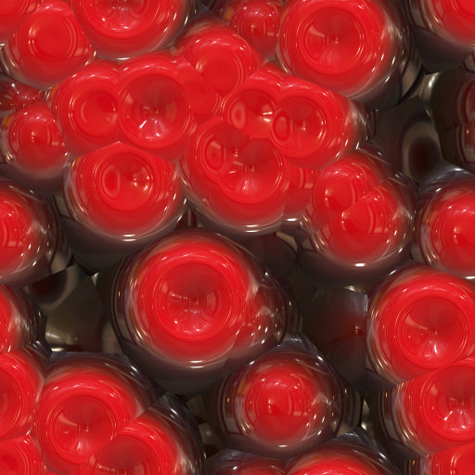

Slide 12
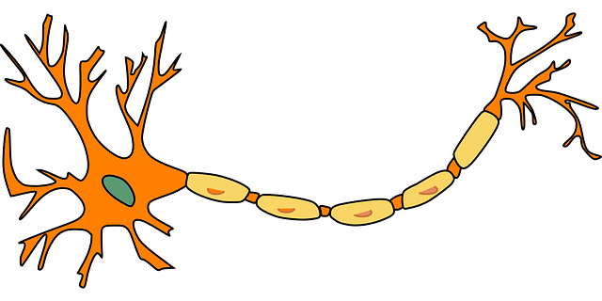

Slide 13
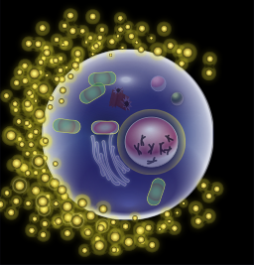

Slide 14
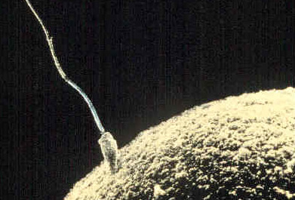

Slide 15
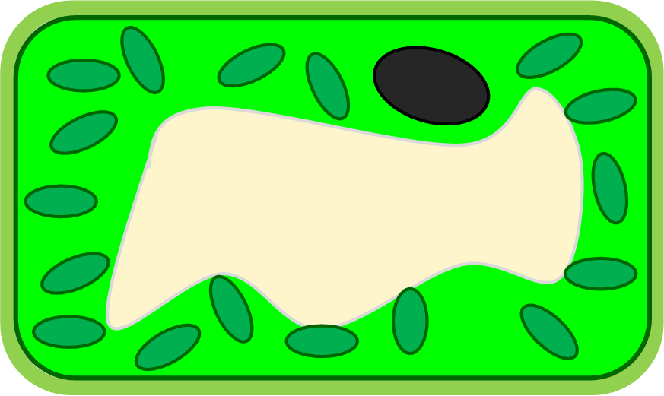

Slide 16
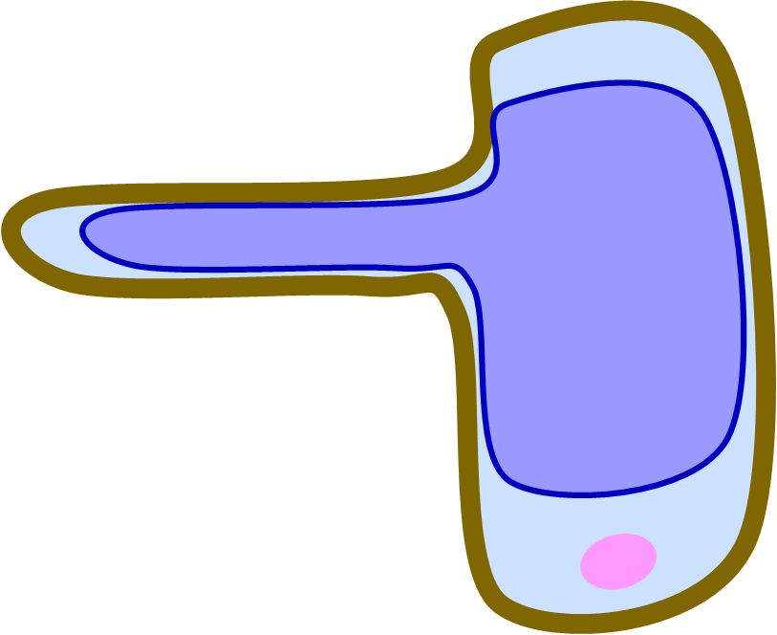

Slide 17
has a large surface area | has connections at all ends | has no nucleus
carries oxygen around the body | has long shape | has haemoglobin which joins with the oxygen
Notes:
Print slides 17-19, cut into six, laminate for multiple use, punch the bottom left corner of every card and join with a treasure tag. Make as many copies as needed for the EAL learners you are teaching.

Slide 18
can carry electric signals | carries messages from one part of the body to another | contains a lot of cytoplasm
joins with a sperm cell and provides food for the new formed cell | has a pointed head for getting into the egg cell | has a long tail

Slide 19
can swim | reaches the egg cell, joins with it and fertilises it | has a specific shape
has lots of chloroplasts | absorbs sunlight for photo-synthesis | absorbs water and minerals from the soil

Slide 20
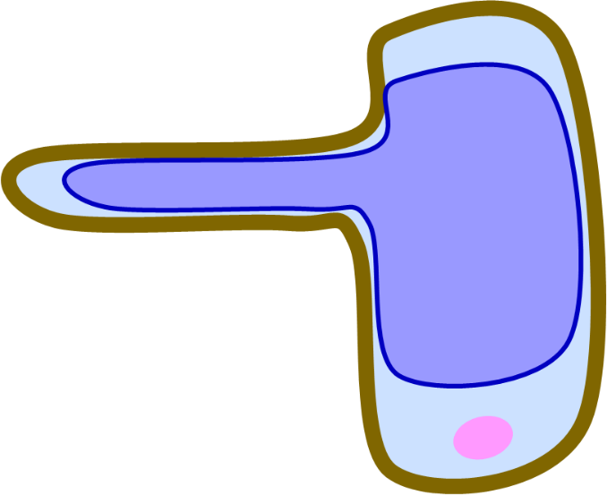
Notes:
Display this slide and as the different specialised cells appear ask the pupils to find and show any particular characteristics and functions of the cells. Use the cards with cells’ parts and functions.

Slide 21
Image attributions
Red blood cells: https://www.flickr.com/photos/filterforge/16701439376 Creative commons public domain via Flickr
Nerve cell: https://pixabay.com/en/neuron-nerve-cell-axon-dendrite-296581/ Public domain via Pixabay
Egg cell: https://en.wikipedia.org/wiki/Egg_cell By KDS444 (Own work) [CC BY-SA 3.0 (http://creativecommons.org/licenses/by-sa/3.0)], via Wikimedia Commons.
Sperm cell: https://commons.wikimedia.org/wiki/File:Sperm-egg.jpg Author unknown [Public domain], via Wikimedia Commons
Leaf cell: Drawn by R Wilson on behalf of The Bell Foundation
Root hair cell: Drawn by R Wilson on behalf of The Bell Foundation

