Slide 1
EAL Nexus Resource
Answers
Adaptation to different habitats
Subject(s): | Science and Geography
Key Stage: | KS3, KS4
Topic: | Adaptation to different habitats
© Bell Educational Trust 2020
This resource was originally developed by Alison Fisher and has been adapted for EAL Nexus.

Slide 2
Adaptations to different habitats

Slide 3
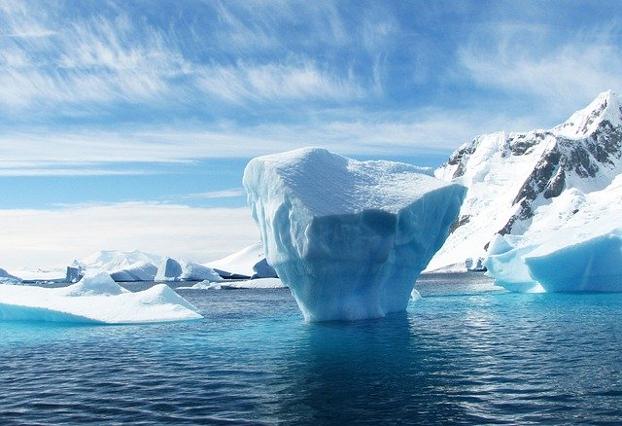
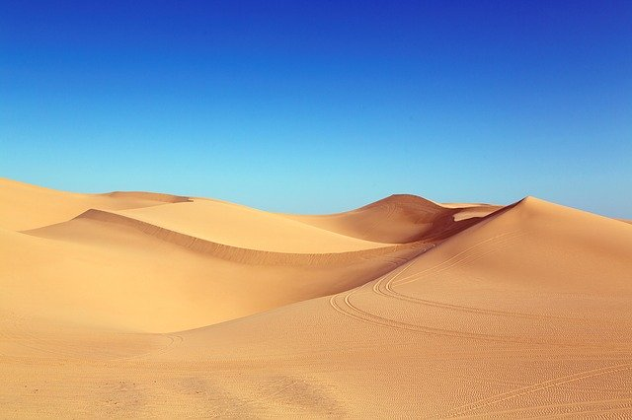
Write down as many words as you can to describe each habitat. Then try to find some similarities between the two habitats.
Arctic
Desert

Slide 4
Differences between the Arctic and the desert Put the words into the correct box.
Arctic
Desert
Temperature
cold
hot
scorching
Temperature
sunny
sandy
dry
arid
snowy
dusty
Other
freezing
parched
icy
Other
bitterly cold
frosty
searing heat

Slide 5
Similarities between the 2 habitats Put the words in the correct boxes
Arctic
Desert
Climate
glaring sunlight
monotonous
Landscape
severe climatic conditions
sparse vegetation
no trees
extreme temperatures
bleak
desolate
harsh weather

Slide 6
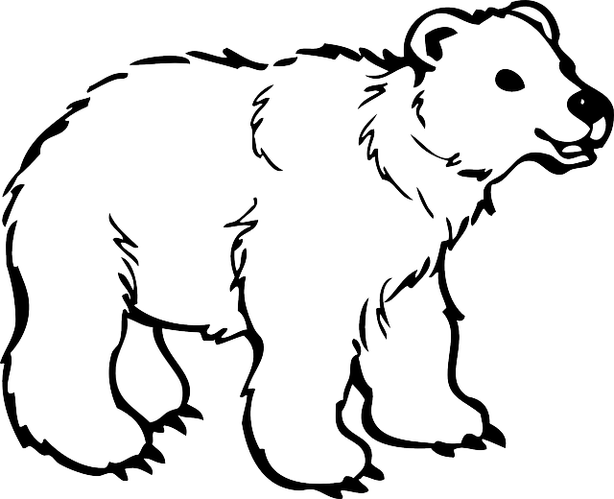
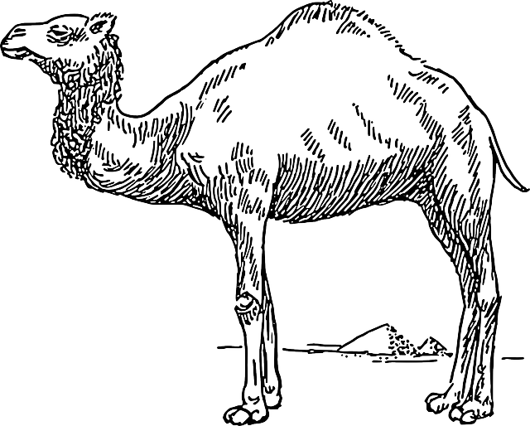
Match the adaptation to the correct animal
Polar bear
Camel
long eyelashes
nostrils can close
long legs
brown fur
fur covered soles of feet
hair lined nostrils
transparent fur
black skin
stores fat in hump
covered in blubber (fat)
thick fur
does not sweat
large feet
small ears and tail

Slide 7
What are the reasons for the adaptations?
Discuss with a partner the reasons for the polar bear’s adaptations
Think about what it needs to do:
protect itself from the cold
stay hidden (when there are no trees or rocks)
walk on soft snow
swim in cold water.
Phrases to help you:
It needs … so that it can …
Its … help it …
It can … so that …
Polar bear

Slide 8
Match the adaptation to the reason.
black skin
large feet
transparent fur
thick fur
small ears and tail
nostrils can close
fur covered soles of feet
covered in blubber
to reflect the snow so the bear appears white
have a small surface area so less heat escapes
to provide insulation from the cold
to stop the bear sinking into the snow
to stop cold water going into the bear’s nose
to absorb heat to keep the bear warm
to give a good grip on ice

Slide 9
Match the adaptation to the reason - answers.
black skin – to absorb heat to keep the bear warm
large feet - to stop the bear sinking into the snow
transparent fur – to reflect the snow so the bear appears white
thick fur – to provide insulation from the cold
small ears and tail - have a small surface area so less heat escapes
nostrils can close – to stop cold water going into the bear’s nose
fur covered soles of feet – to provide insulation from the cold and to give a good grip on ice
covered in blubber – to provide insulation from the cold

Slide 10
What are the reasons for the adaptations?
Discuss with a partner the reasons for the camel’s adaptations.
Think about what it needs to do:
protect itself from the heat
stay hidden (when there are no trees or rocks)
walk on soft sand
survive without water.
Phrases to help you:
it needs … so that it can …
its … help it …
it can … so that …
Camel

Slide 11
Match the adaptation to the reason.
long eyelashes
long legs
brown fur
thick fur on its hump
nostrils that can close
stores fat in hump
does not sweat
large feet
to keep its body away from the hot sand.
to provide energy if it has had no food or water for a while.
to stop sand irritating it.
to prevent water loss.
to protect its back from the sun.
to stop it sinking into the soft sand.
so it cannot be seen easily.

Slide 12
Match the adaptation to the reason – answers.
long eyelashes - to stop sand irritating it.
long legs - to keep its body away from the hot sand.
brown fur - so it cannot be seen easily.
thick fur on its hump - to protect its back from the sun.
nostrils that can close - to stop sand irritating it.
stores fat in hump - to provide energy if it has had no food or water for a while.
does not sweat - to prevent water loss.
large feet - to stop it sinking into the soft sand.

Slide 13
Writing task
Write a paragraph about what you have learnt. You will need to:
describe the Arctic and desert environments
explain how the polar bear and camel have adapted to their environment
compare and contrast the two animals.

Slide 14
You could start like this:
Both the camel and the polar bear are well suited to their environment. A polar bear has white fur which ...................................... On the other hand, a camel has.....................
Try to use all the words in the table below.
Words to show similarity | Words to show difference | Words to explain
as well as similarly this is the same as also | unlike this is different from however although | this is because so that which because it needs to

Slide 15
Check your work.
Polar bear and camel adaptations - Checklist.
I have: | ✓ or ✗
described the desert and the Arctic using at least four of the words from my list
written about at least three adaptations for the polar bear and the camel
explained the reasons for the adaptations
used at least six different words to compare, contrast and explain.
described at least one similarity and two differences between the camel and the polar bear.

Slide 16
Appendix – Images in this resource
1. Iceberg - Antarctica
No description (https://pixabay.com/photos/iceberg-antarctica-polar-blue-ice-404966/)
By 358611 (https://pixabay.com/users/358611-358611/)
Available under Pixabay License. For more information see https://pixabay.com/service/license/.
2. Camel - Pyramid
No description (https://pixabay.com/vectors/camel-pyramid-travel-hump-desert-48307/)
By Clker-Free-Vector-Images (https://pixabay.com/users/clker-free-vector-images-3736/)
Available under Pixabay License. For more information see https://pixabay.com/service/license/.
3. Desert - Dunes
No description (https://pixabay.com/photos/desert-dunes-algodones-dunes-1654439/)
By Falkenpost (https://pixabay.com/users/falkenpost-1987955/)
Available under Pixabay License. For more information see https://pixabay.com/service/license/.
4. Bear - Cub
No description (https://pixabay.com/vectors/bear-cub-animal-fur-polar-baby-30787/)
By Clker-Free-Vector-Images (https://pixabay.com/users/clker-free-vector-images-3736/)
Available under Pixabay License. For more information see https://pixabay.com/service/license/.
5. Snowflake - Christmas
No description (https://pixabay.com/vectors/snowflake-christmas-winter-flake-29366/)
By Clker-Free-Vector-Images (https://pixabay.com/users/clker-free-vector-images-3736/)
Available under Pixabay License. For more information see https://pixabay.com/service/license/.
© Bell Educational Trust 2020
This resource was originally developed by Alison Fisher and has been adapted for EAL Nexus.

Slide 17
6. Sun - Astro
No description (https://pixabay.com/illustrations/sun-astro-vector-ray-lights-1789653/)
By DavidRockDesign (https://pixabay.com/users/davidrockdesign-2595351/)
Available under Pixabay License. For more information see https://pixabay.com/service/license/.
© Bell Educational Trust 2020
This resource was originally developed by Alison Fisher and has been adapted for EAL Nexus.

