Slide 1
EAL Nexus Resource
A balanced diet
Introduction
Subject(s): | Science
Key Stage: | KS3
Topic: | Food and nutrition

Slide 2
A balanced diet

Slide 3
Key language
English
My language
Balanced diet
Well nourished
Malnourished
Energy
nutrients
Carbohydrates
Proteins
Fats
Vitamins and minerals
Fibre
Water
Vegetables contain vitamins
We need water to keep our cells hydrated

Slide 4
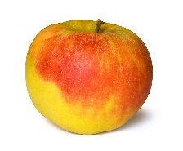
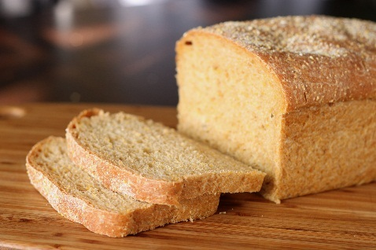
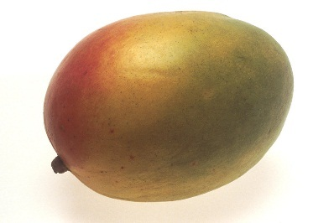
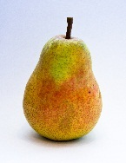
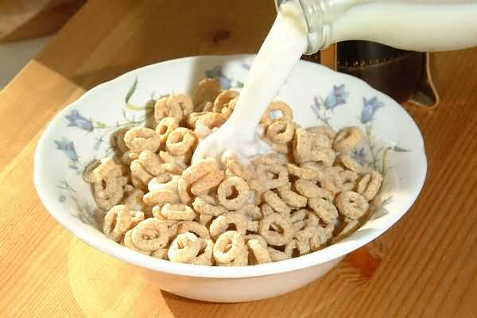
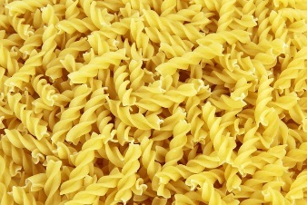
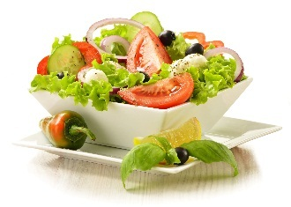
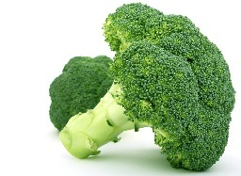
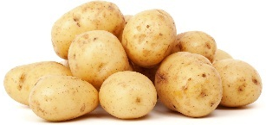
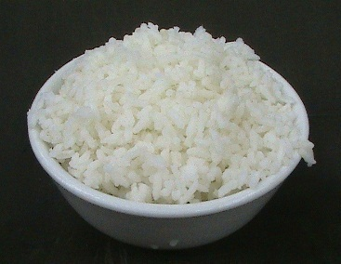
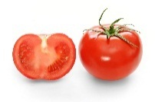
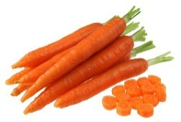
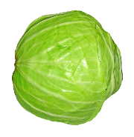
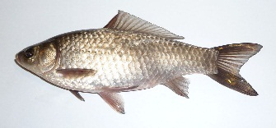
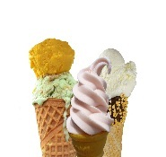
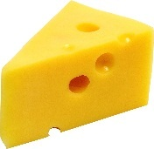
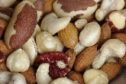
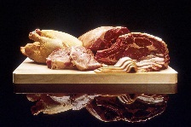
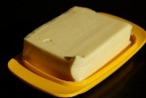
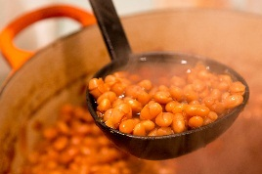
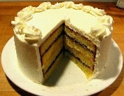
The Eatwell Plate
Use the Eatwell Plate to make sure you have a balanced diet.

Slide 5
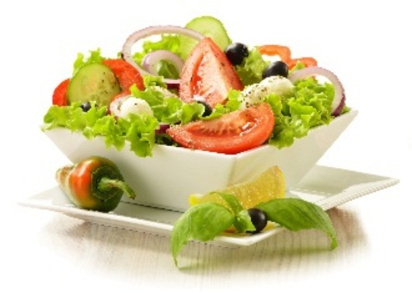
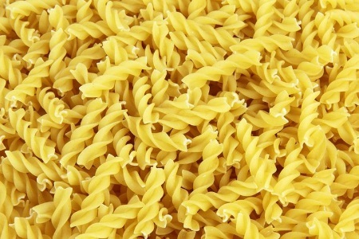
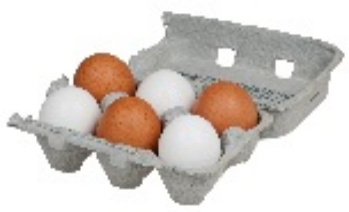
A balanced diet contains all the energy and nutrients that the body needs

Slide 6
What nutrients does the body need?
Carbohydrates
Proteins
Fats
Vitamins
Minerals
Fibre
Water

Slide 7
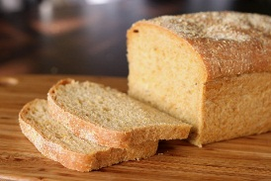
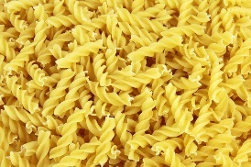
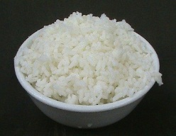
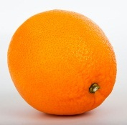
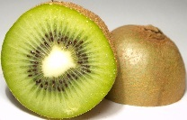
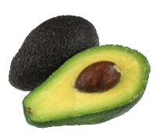
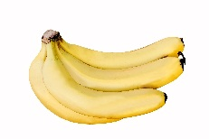
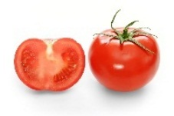
Which foods contain…?
Carbohydrates
Proteins
Fats
Vitamins
Minerals
Fibre
Water

Slide 8
Image attributions
Aubergine: http://www.publicdomainpictures.net/pictures/10000/velka/1-1210580242pikC.jpg Petr Kratochvil, licence – public domain.
Cake: https://upload.wikimedia.org/wikipedia/commons/0/04/Pound_layer_cake.jpg public domain
Cereal: http://s3.freefoto.com/images/09/04/09_04_3_web.jpg Ian Britton, licence – non-commercial no derivative works.
Bananas: https://upload.wikimedia.org/wikipedia/commons/9/9b/Cavendish_Banana_DS.jpg Augustus Binu [CC BY-SA 4.0 (http://creativecommons.org/licenses/by-sa/4.0)], via Wikimedia Commons
Tomato: https://en.wikipedia.org/wiki/Tomato Fir0002/Flagstaffotos
Pear: https://commons.wikimedia.org/wiki/File:Alexander_Lucas_10.10.10.jpg#/media/File:Alexander_Lucas_10.10.10.jpg
Meat: https://en.wikipedia.org/wiki/Meat#/media/File:FoodMeat.jpg Unknown photographer - https://visualsonline.cancer.gov/details.cfm?imageid=2402 Pubic domain.
Fish: By George Chernilevsky - Own work, CC BY-SA 3.0, https://commons.wikimedia.org/w/index.php?curid=5101375
Eggs: https://upload.wikimedia.org/wikipedia/commons/1/12/6-Pack-Chicken-Eggs.jpg
Nuts: https://commons.wikimedia.org/wiki/File:Fancy_raw_mixed_nuts_macro.jpg By Sage Ross (Own work) [CC BY-SA 3.0 (http://creativecommons.org/licenses/by-sa/3.0)], via Wikimedia Commons
Beans: https://en.wikipedia.org/wiki/Boston_baked_beans#/media/File:Boston_Baked_Beans_in_Concord,_Mass_2012-0193.jpg By Victorgrigas - Own work, CC BY-SA 3.0, https://commons.wikimedia.org/w/index.php?curid=23943506
Bread: https://commons.wikimedia.org/wiki/File:Anadama_bread_(1).jpg#/media/File:Anadama_bread_(1).jpg by Stacey Spensley
Pasta: http://res.freestockphotos.biz/pictures/9/9515-uncooked-dry-yellow-fusilli-pasta-pv.jpg
Rice: https://en.wikipedia.org/wiki/Steamed_rice#/media/File:Steamed_rice_in_bowl_01.jpg Anna Frodesiak - Own work
Carrots: http://www.picserver.org/pictures/carrots01-lg.jpg
Cheese: https://i.ytimg.com/vi/6Gbhfy-XXxE/maxresdefault.jpg
Milk: https://upload.wikimedia.org/wikipedia/commons/4/42/Milk_-_olly_claxton.jpg
Ice cream: https://pixabay.com/en/photos/ice%20cream%20cone/ public domain
An orange: http://www.publicdomainpictures.net/view-image.php?image=8790 by Vera Kratochvil
Butter: https://pixabay.com/static/uploads/photo/2013/09/27/09/53/butter-186909_960_720.jpg
Potatoes: http://www.publicdomainpictures.net/pictures/30000/velka/isolated-potatoes.jpg
Kiwifruit: https://upload.wikimedia.org/wikipedia/commons/f/f2/Kiwifruit_halved.jpg Tiia Monto [CC BY-SA 3.0 (http://creativecommons.org/licenses/by-sa/3.0)], via Wikimedia Commons
Salad; https://upload.wikimedia.org/wikipedia/commons/4/42/Saladlt95.jpg By LouiseTynan95 (Own work) [CC BY-SA 4.0 (http://creativecommons.org/licenses/by-sa/4.0)], via Wikimedia Commons
A mango: http://www.freestockphotos.biz/stockphoto/17438 public domain
Broccoli: https://pixabay.com/en/appetite-broccoli-brocoli-broccolli-1238251/ public domain
Cabbage: https://pixabay.com/en/appetite-broccoli-brocoli-broccolli-1238251/ public domain
An apple: http://www.freestockphotos.biz/stockphoto/11380 public domain
Avocados: http://www.picserver.org/a/avocados.html by NY - http://nyphotographic.com/
Plate: https://pixabay.com/en/porcelain-plate-knife-fork-spoon-30612/ public domain.

