Slide 1
Lesson 1 – Viruses and the spread of pathogens

Slide 2
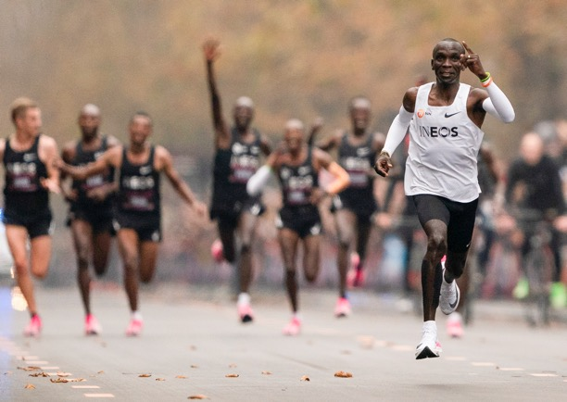
IMAGINE STANDING ON THE PODIUM, COLLECTING A MEDAL AFTER WINNING A MAJOR SPORTING EVENT
Notes:
Teacher Notes
Encourage students to think about the pride, emotion and sense of achievement after years of hard work and training that must have gone into that moment in time.
Encourage students to think about the pride of that athlete’s team - all those involved in getting that individual to that point; coaches, physios, parents etc.

Slide 3
NOW IMAGINE THE DISAPPOINTMENT OF MISSING OUT DUE TO AN ILLNESS
Notes:
Teacher Notes
Encourage students to think about the devastation of missing out due to illness or injury. If time allows you might want to show some examples

Slide 4
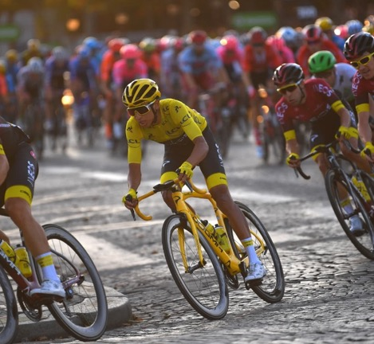
INEOS Grenadiers identified illness as a threat to the performance of their world beating cycling team several years ago, so they started the Zero Days project to reduce illness in the team.
Notes:
Teacher Notes
Injury and illness prevention is a top priority for the INEOS Sports family to eliminate training time or competition days lost to sickness. They do this by focusing on three key behaviours which they apply everyday: Prepare, protect and control.
•Prepare – for example, by boosting individual health, identifying and eliminating threats at home and when training and competing.
•Protect – for example, by understanding how to maintain the highest hygiene standards to stop transmission.
•Control – for example, by monitoring their own health and reporting illness immediately.
The aim of Zero Days is to bring together expertise and insight to deliver enhanced performance across the collective sports, but this knowledge can also be shared and applied to young people in a school contexts.

Slide 5
LEARNING OBJECTIVES
Describe what is meant by a pathogen.
Describe different ways pathogens can be spread.
Describe how viruses and bacteria cause illness.
Explain how the spread of pathogens can be reduced or prevented.
Describe how viruses live and reproduce inside cells, causing cell damage.
Keywords:
Communicable Diseases
Disease
Pathogen
Infectious
Virus

Slide 6
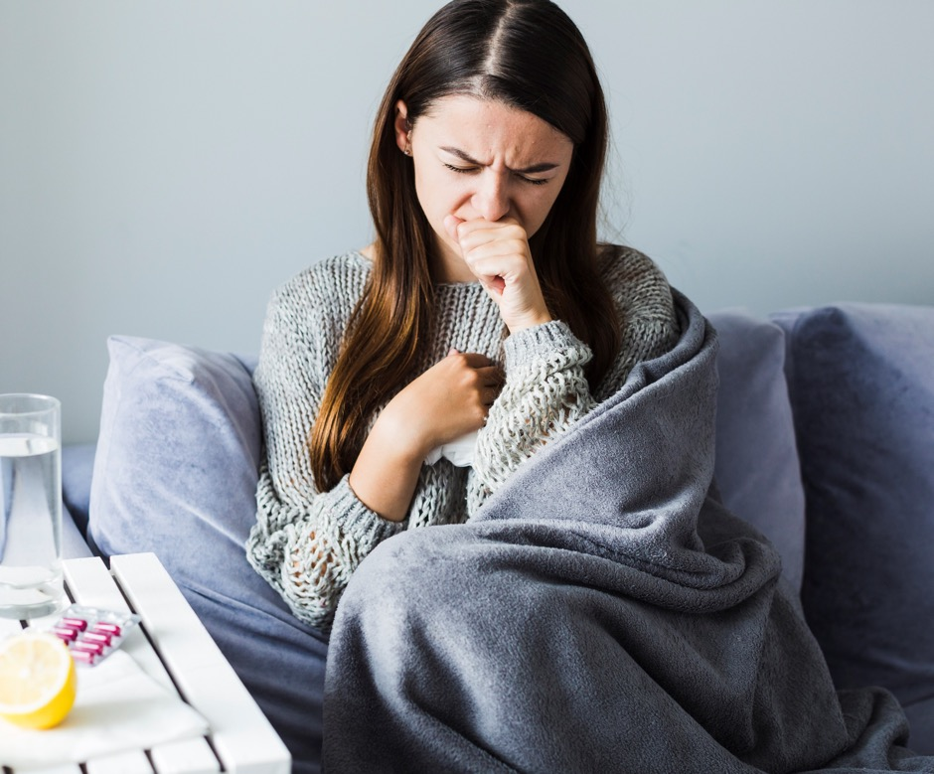
WHAT MAKES US ILL?
STARTER:
List as many diseases or illnesses that you can think of.
THINK:
Are the diseases you have identified infectious (communicable) or not?
Notes:
Teacher notes
This activity could be done with talking partners or individually

Slide 7
WHAT MAKES US ILL?
Communicable and non-communicable diseases
Communicable Diseases
Non-Communicable Diseases
Measles
Cancer
Mumps
Heart attack
COVID-19
Diabetes
Malaria
Asthma
Notes:
Teacher Notes
Examples of communicable and non-communicable diseases, encourage students to classify the diseases they have identified as either communicable or not. Encourage discussion leading to them producing their own definition see next slide.

Slide 8
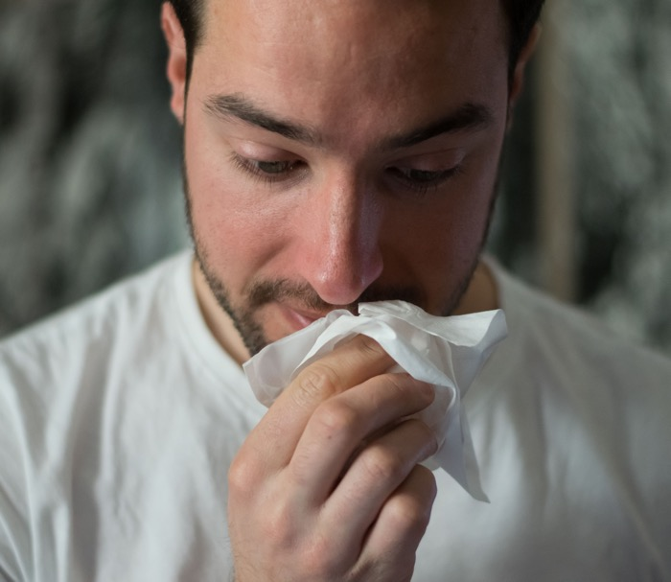
COMMUNICABLE AND NON-COMMUNICABLE DISEASES
Can you write a definition for the words communicable and non-communicable, in terms of diseases?
Communicable diseases can be spread from person to person. They are infectious.
Non communicable diseases cannot be spread from person to person.
Communicable diseases are spread by microorganisms known as pathogens
Notes:
Teacher Notes
Sensitivity will be required when discussing diseases including cancer and COVID-19 with students.
Give students a limited time to come up with a definition and share with the class. This could be done with talking partners or individually.
Then show the definitions on this slide and compare.

Slide 9
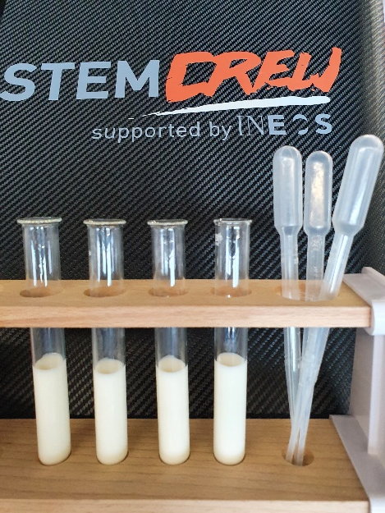
ZERO DAYS CLASS ACTIVITY Modelling the spread of an infection
You are going to carry out a practical investigation to look at the spread of a communicable disease.
Communicable diseases are spread by microorganisms known as pathogens.
Share a small amount of the fluid in your test tube with five other people in your class using the pipette provided.
One person in the group was infected at the start, now it is time to get tested to see who is infected. Place a couple of drops of iodine in each test tube - if it turns black that person has become infected.
Notes:
Teacher notes
See lab sheet available on STEM Crew resources for this investigation
Note- you may wish to organise this activity with social distancing in mind. If so, set up on a desk and individuals come up one at a time to add their solution to the (5) different test tubes.
In this activity, students are given test tubes containing milk and then exchange ‘fluids’ with each other. One student is infected at the start as their test tube contains starch. After five exchanges the class is stopped and it’s time to get ‘tested’ with iodine. The results can then lead to a discussion about:
Transmission – how?
Transmission – what?
Speed of transmission
How can we stop infection?
Can we work out who the source of the infection was i.e. work like an epidemiologist?

Slide 10
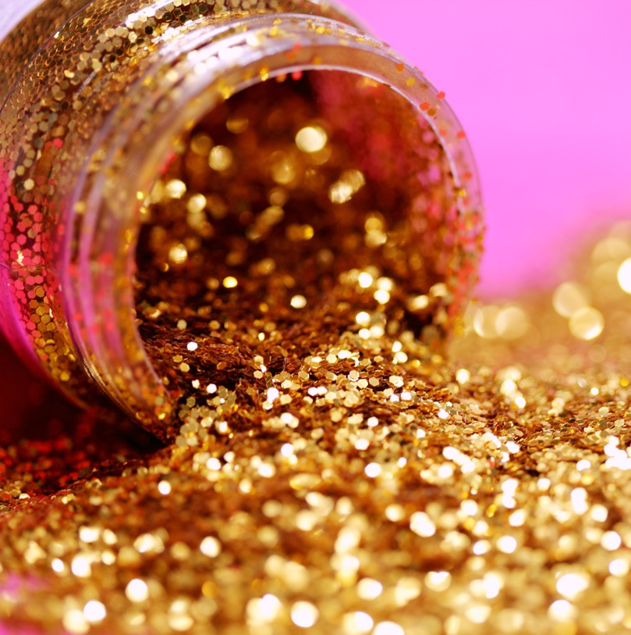
SPREAD OF AN INFECTION
Have you ever had a glitter card and found glitter all around the place for weeks after
COMMUNICABLE DISEASES ARE SPREAD BY MICROORGANISMSKNOWN AS PATHOGENS.
THINK
How does the glitter get from the card to other places?
Notes:
Teacher notes – Alternative to practical activity
If it is not appropriate to carry out the class practical on the previous slide or students are working from home, you could use the example above of glitter on a card or Christmas decoration, getting students to think about how the glitter gets from the card onto hands and into different rooms.

Slide 11
SPREAD OF PATHOGENS
We have just seen how pathogens can be spread by direct contact; pathogens have evolved many different ways of passing from one organism to another, can you identify the four other ways pathogens can be spread?
AIRBORNE
DIRECT CONTACT
WATER
INDIRECT CONTACT
CONTAMINATED FOOD
Note each of these methods down, we will need to know these if we are going to stop transmission.
Notes:
Teacher Notes
Ask students to identify examples of each form of transmission.

Slide 12
WHAT IS A PATHOGEN? A MICROORGANISM THAT CAUSES INFECTIOUS DISEASE

Slide 13
WHAT IS A MICROORGANISM?
MICRO = VERY SMALL
ORGANISM = LIVING THING

Slide 14
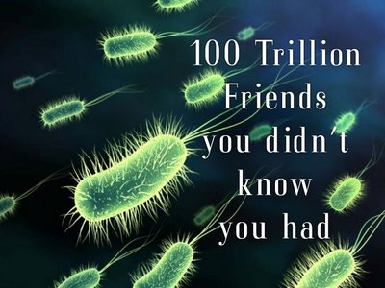
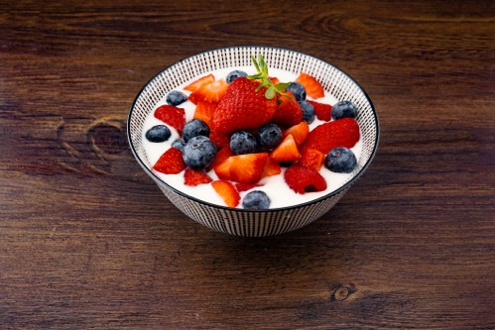
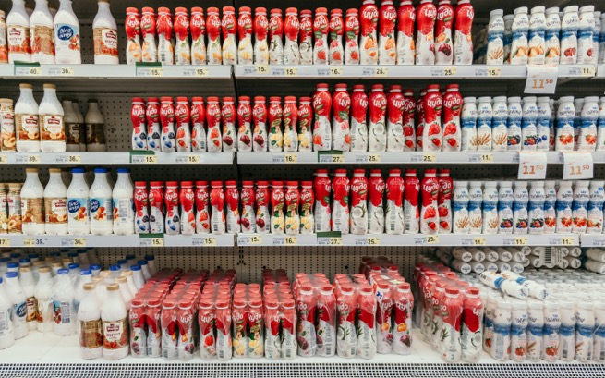
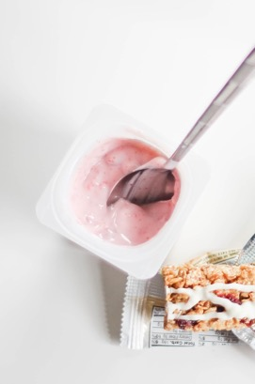
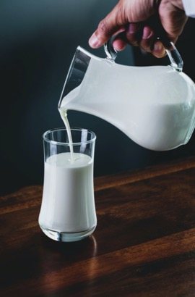
KEY POINT!
Pathogens are a type of microorganism, and they cause disease.
But NOT ALL microorganisms are pathogens!
Many microorganisms are beneficial to us, for example they are essential for digestion in our gut.

Slide 15
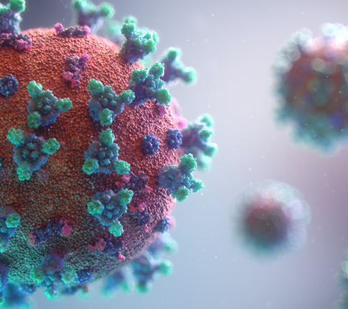
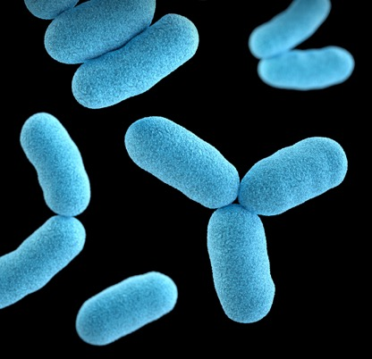
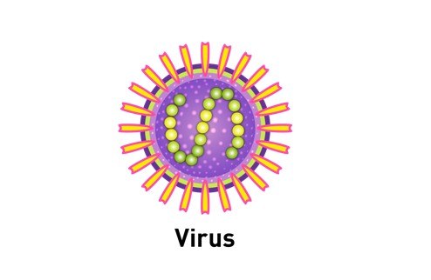
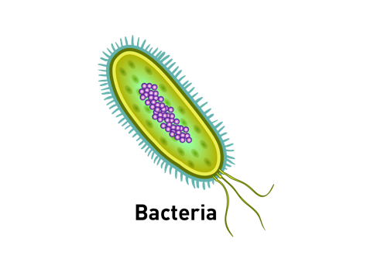
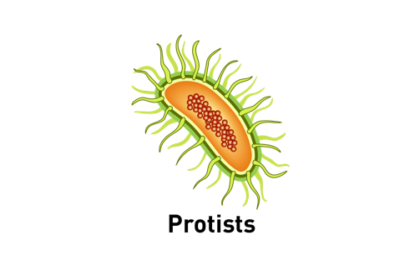
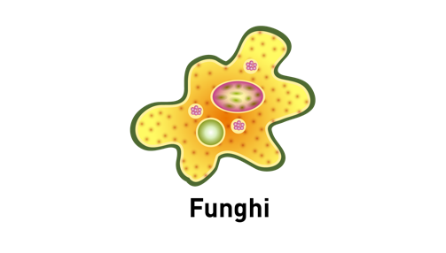
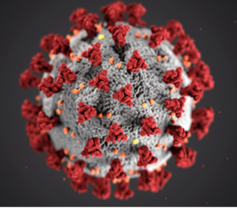
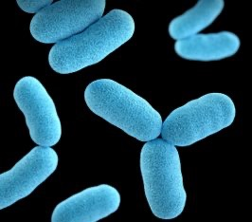
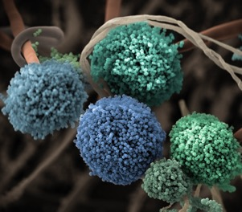
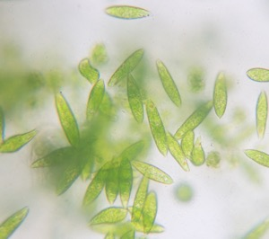
THERE ARE FOUR MAIN TYPES OF PATHOGENS: THE BADDIES OF BIOLOGY!
Notes:
Teacher notes
Each pathogen type is illustrated with a coloured electron microscope image and illustration and will appear on a mouse click

Slide 16
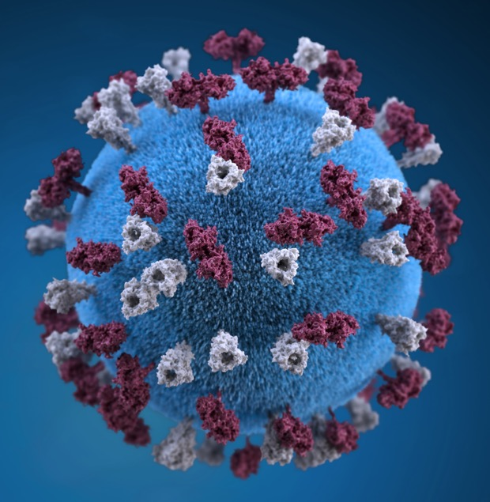
VIRAL DISEASES
Viruses are the smallest pathogens and the simplest, made from a strand of genetic material surrounded by a protein coat. Coronavirus, Measles and Flu are all examples of a viral disease.
WHAT IS CORONAVIRUS?
Coronavirus is the name of a family of viruses that are associated with the common cold. Most people will be infected with these viruses at some point in their lives.
Viruses live inside cells. They reproduce rapidly inside the cell, then burst out, causing damage to the cell. The new viruses then go on to infect further cells.
120–140 nm

Slide 17
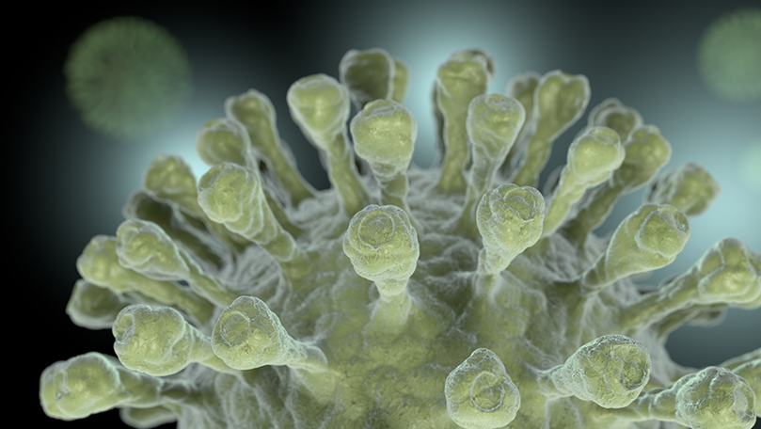
WHY IS IT CALLED CORONAVIRUS?
Coronaviruses get their name from the crown-like halo or corona that are visible when the virus is viewed under an electron microscope.
120–140 nm

Slide 18
WHAT IS COVID-19? COVID-19 IS THE NAME THAT HAS BEEN GIVEN TO THE DISEASE CAUSED BY A NOVEL STRAIN OF CORONAVIRUS.

Slide 19
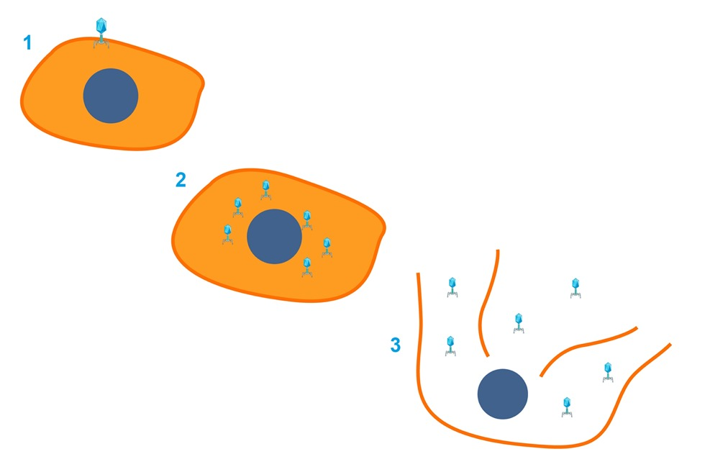
VIRUS
VIRUSES LIVE INSIDE CELLS.
They invade a cell
Reproduce rapidly inside the cell,
then burst out, causing damage to the cell.
The new viruses then go on to infect further cells to and repeat the process, rapidly increasing the number of infected cells.

Slide 20
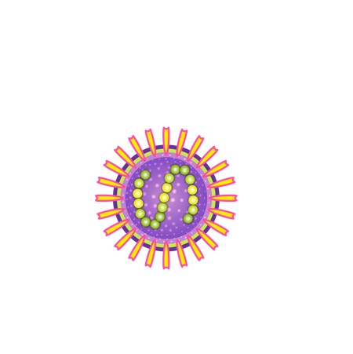
WHAT IS COVID-19?
COVID-19 is the name that has been given to the disease caused by a novel strain of Coronavirus.
COVID-19
Coronavirus – the family of viruses
Disease
19 the year the virus was identified
Viruses, and the diseases they cause, often have different names. For example, the HIV virus causes AIDS and the Rubeola virus causes Measles.

Slide 21
FEATURES OF VIRUSES:
THEY ARE NOT CELLS – THEY HAVE NO NUCLEUS AND NO CYTOPLASM (DNA INSIDE PROTEIN COAT).

Slide 22
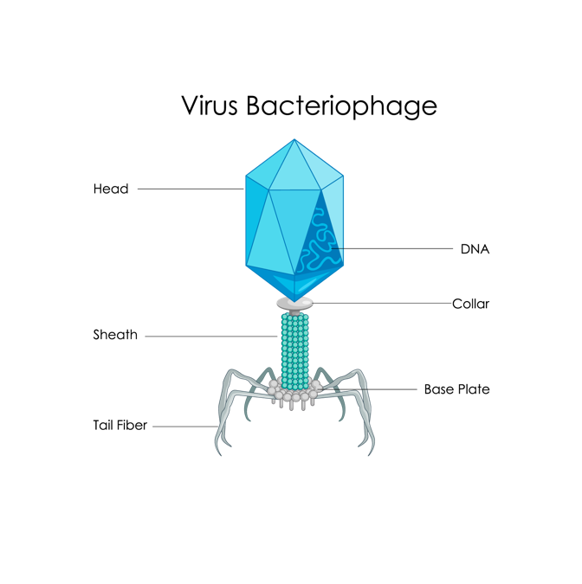
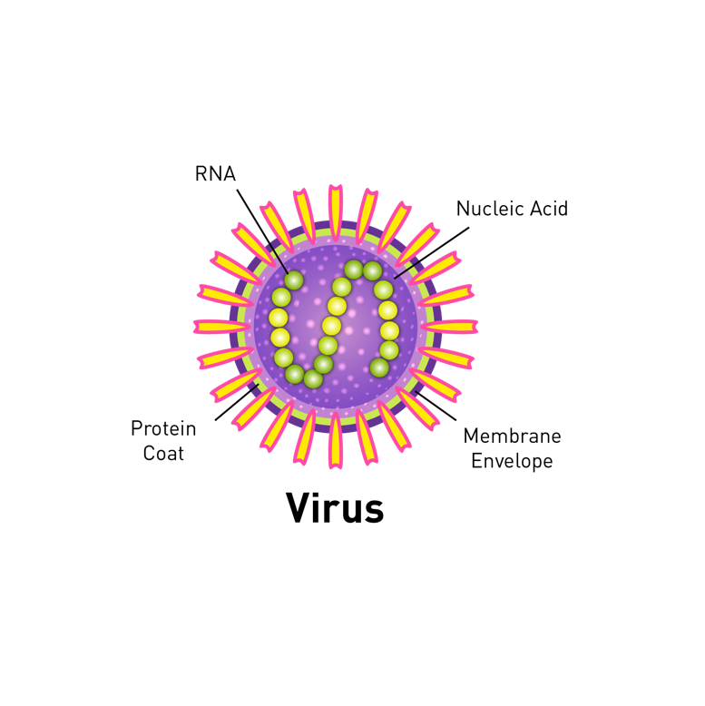
FEATURES OF VIRUSES:
They are the smallest pathogens (120-140 nm) smaller than bacteria.
They consist of genetic material and a protein coat.
They invade a single cell in a host and use it to replicate their genetic material and protein coat.
They cannot reproduce by themselves; they can only reproduce inside a host cell.
They reproduce rapidly inside host cells and make thousands of copies of itself.
The host cell then bursts and releases the new infected particles to repeat the cycle.
It is the damage to the host cells that makes humans feel unwell.
Notes:
Teacher notes
Size of viruses - The link in the slide goes to an interactive animation that illustrates the relative size of a virus in comparison to other things.
https://htwins.net/scale2/ [CURRENT DIAGRAM]

Slide 23
VIRUSES – THE KEY POINTS VIRUSES ARE EVEN SMALLER THAN BACTERIA. VIRUSES CAN ONLY REPRODUCE INSIDE HOST CELLS.

Slide 24
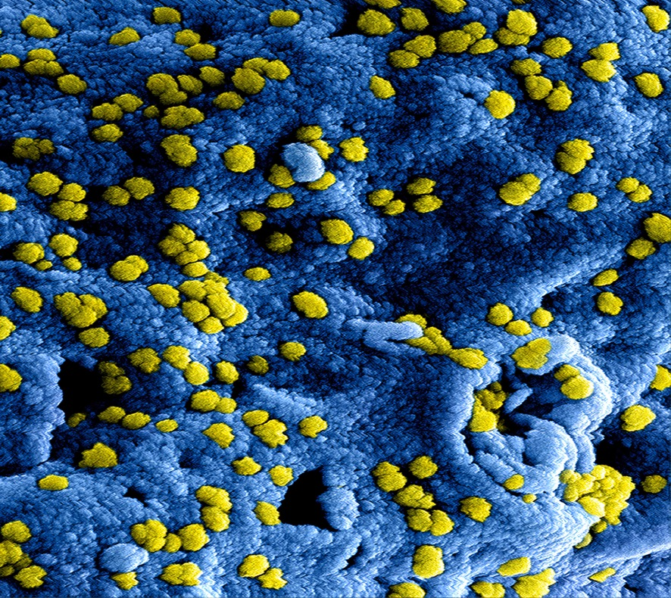
VIRUSES – THE KEY POINTS
The virus enters individual cells.
They reproduce rapidly inside the cell, then burst out, causing damage to the cell.
The new viruses then go on to infect further cells.
EXAMPLES INCLUDE:
COVID-19, Flu (Influenza), Colds, AIDs, Chicken Pox

Slide 25
WERE YOU SUCCESSFUL?
I can describe what is meant by a pathogen.
I can describe different ways pathogens can be spread.
I can describe how viruses and bacteria cause illness.
I can explain how the spread of pathogens can be reduced or prevented.
I can describe how viruses live and reproduce inside cells, causing cell damage.

Slide 26
WERE YOU SUCCESSFUL?
Key words check
Communicable Diseases - Diseases that can be passed (transmitted) between living things. They can also be known as an infectious diseases.
Disease - Something that negatively affects a living thing.
Pathogen - A microorganism (virus, bacteria, protist or fungus) that can cause diseases in animals and plants.

