Slide 1
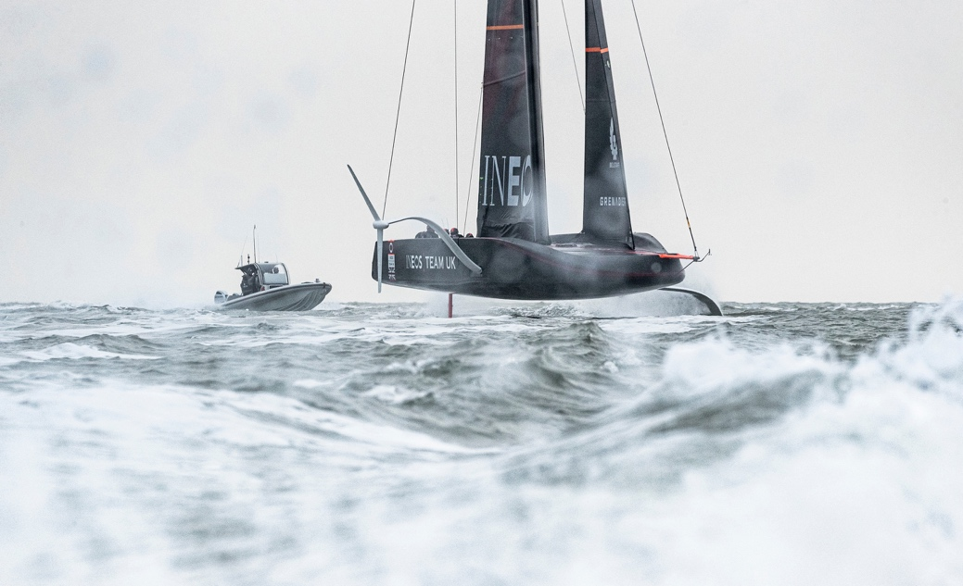
LESSON 2
Renewable Energy Resources
Notes:
Teacher notes:

Slide 2
Renewable Energy Resources
Talking Partners
What are the advantages and disadvantages of using wind to power a boat?
Wind powers the America’s Cup boat allowing it to sail at speeds of up to 60mph. Whereas petrol powers the safety boat that follows it.
Notes:
Teacher notes:
Begin the session by discussing the question on the slide.

Slide 3
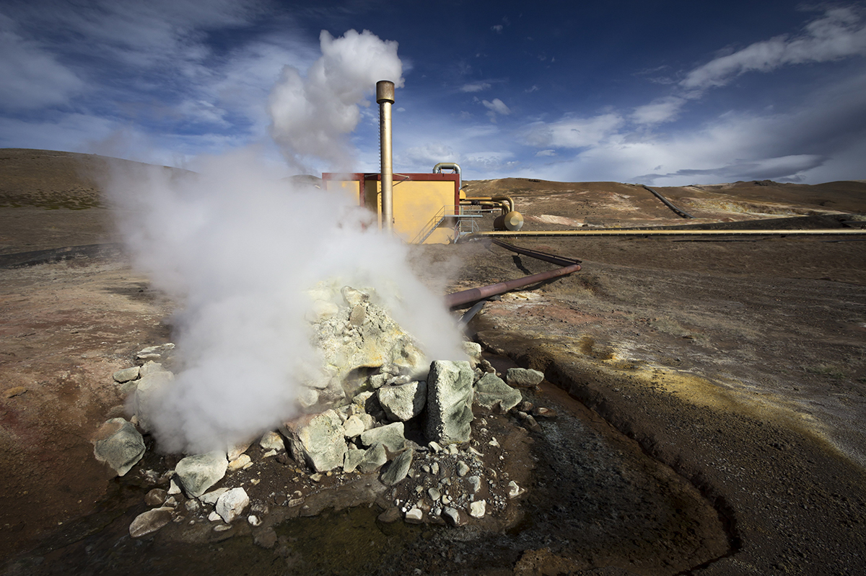
Energy Resources - Learning Objective
Keywords:
Renewable Biomass Hydroelectric Geothermal Gigawatt (GW)
Identify renewable energy sources
Describe the difference between renewable and non-renewable energy sources
Evaluate different renewable energy resource
Be aware of the arguments for and against the selection of fossil fuels, renewable energy and nuclear power

Slide 4
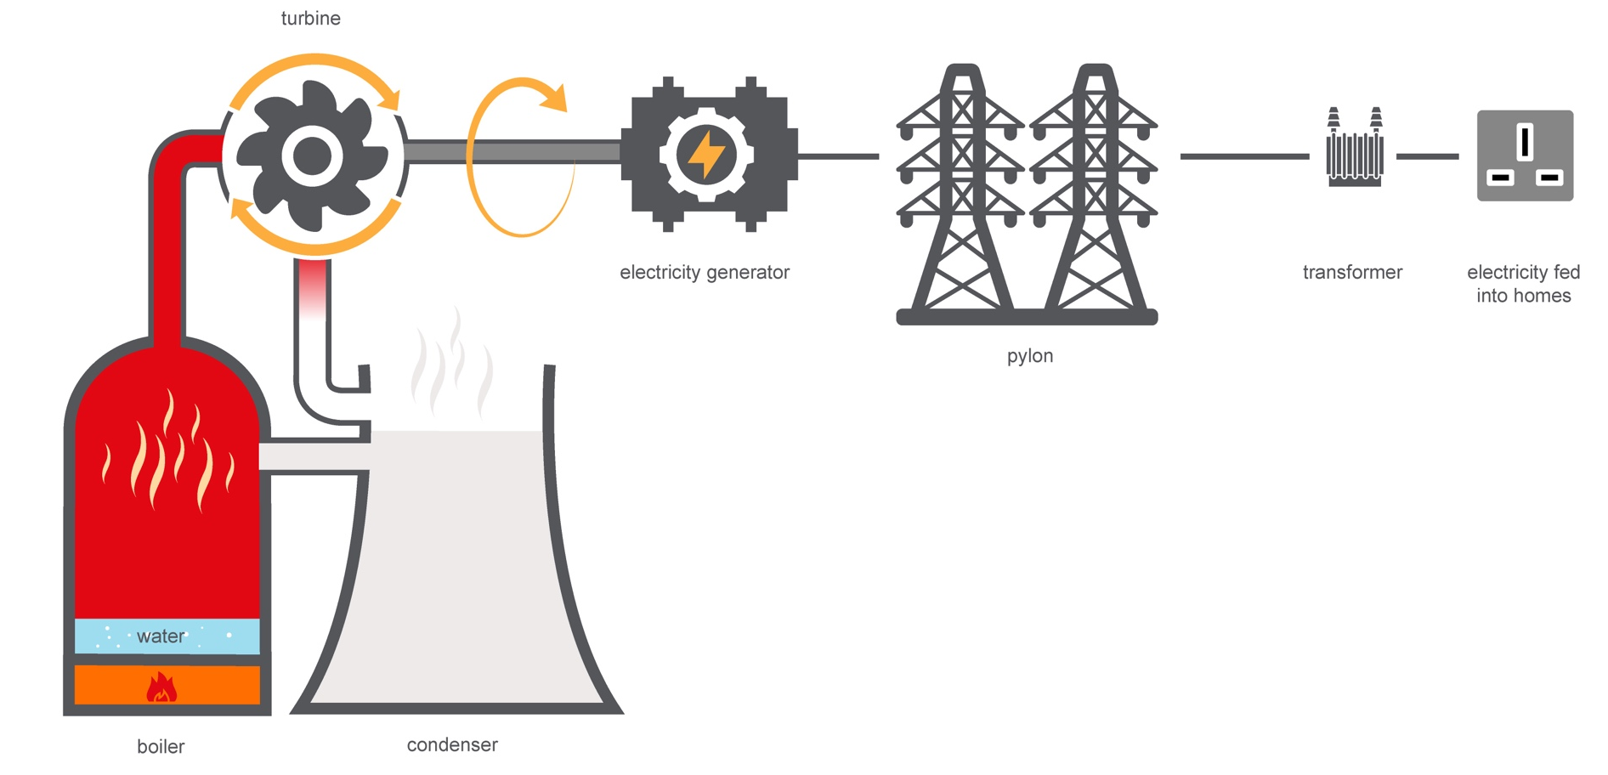
Generating Electricity using Sustainable Resources
We know that the chemical energy stored in fossil fuels is converted to heat (internal energy) by burning to produce kinetic energy to turn the generator to create electricity.
Talking Partners What are the alternatives to using fossil fuels to generate electricity?
Notes:
Teacher notes
Having experimented with generating electricity last lesson remind students of the generating process, encourage them to start to think about how else the turbine could be turned to generate electricity or any other ways of generating electricity they may know about.

Slide 5
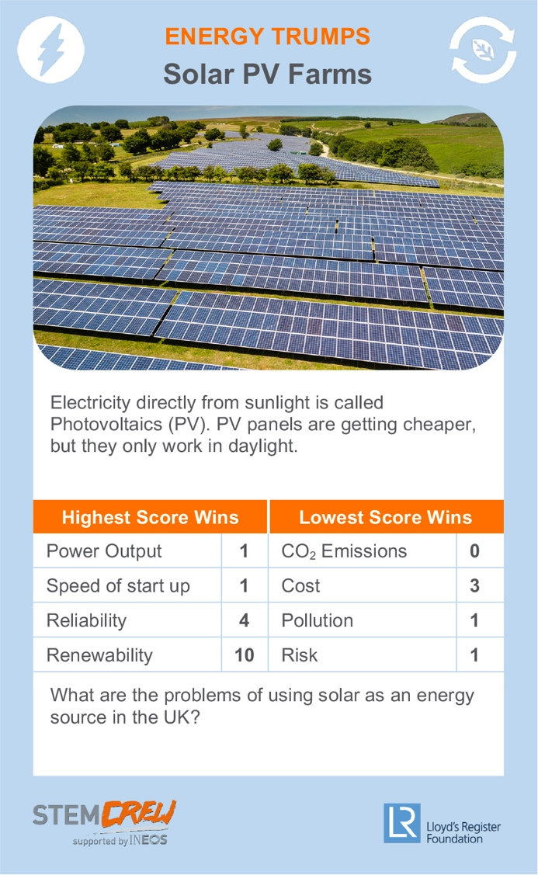
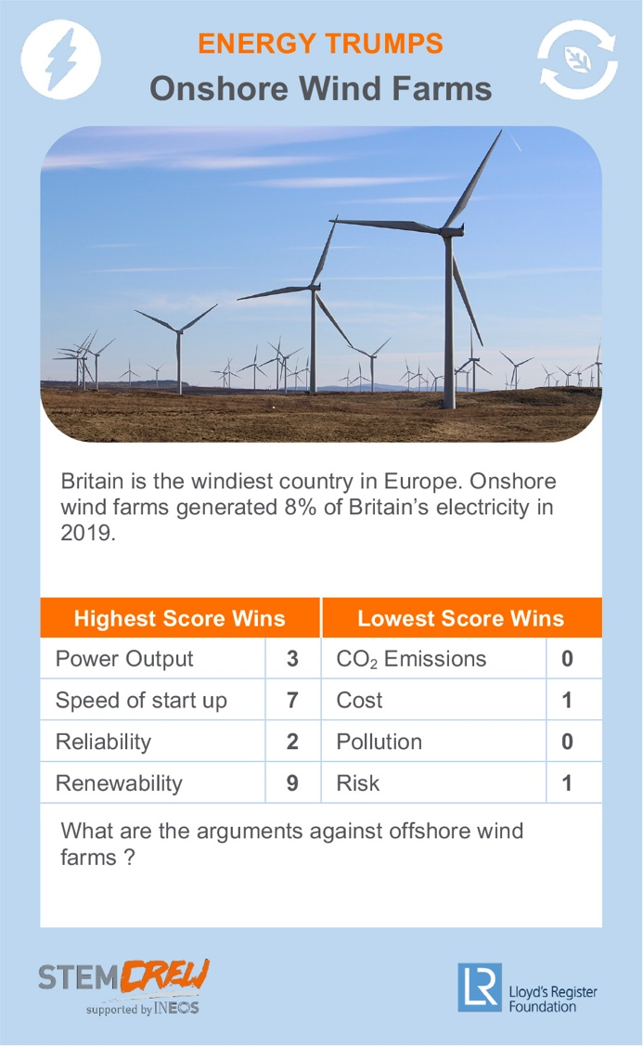
Renewable Energy Sources - Activity
Task 1- Renewable or non-renewable? What is the difference?
Using the energy resource top trump cards
Work in groups of three. Take it in turns to read the card out loud, and place into two piles: renewable or non-renewables
Put the non-renewable fuels to one side.
Which of the renewable resources do you think is best and why?
Notes:
Teacher notes:
A set of ‘Top Trump’ cards is available to support this resource. Print and cut out a set for each group to get students thinking about what makes an energy source renewable.

Slide 6
Renewable Energy Sources - Activity
Information Hunt and Share Task
There are 8 posters around the room
Members of your team should visit each poster to learn about alternative energy sources and report back to the rest of the group.
For each poster, a member of the team should report back with the following information:
• Where the energy comes from and how it works • The advantages • The disadvantages
Notes:
Teacher notes:
Print each of the 8 renewable energy resource slides and place around the room.
Split the class into smaller groups
Each student researches one or two different energy resources before reporting back to the rest of the group teaching them the key points from their notes
All students complete their notes on all resources using the summary sheet available from the STEM Crew resource page.

Slide 7
Energy Sources - Posters
Print out these 8 posters from the associated file
Notes:
Print each of the following 8 renewable energy resource slides 6-13 and place around the room.

Slide 8
Renewable Energy Sources
The team base in Portsmouth has a large area of its roof covered in photovoltaic solar cells to provide electricity for the base.
From the knowledge you have gained what solutions would you suggest for a power plant to supply your local area?
Challenge Task
Design your own energy plant based on one or more of the alternative energy resources.
Justify your choice of energy resource within your explanation.

Slide 9
Energy Resources Plenary Review
Review questions:
1
Explain how fossil fuels are used to produce electricity.
The National Grid is the network of power cables that connect power sources to supply electricity to homes and businesses across the UK. Discuss how the National Grid ensures a consistent supply of power on a cold and still winter’s evening and justify why demand might be high at this point?
2

Slide 10
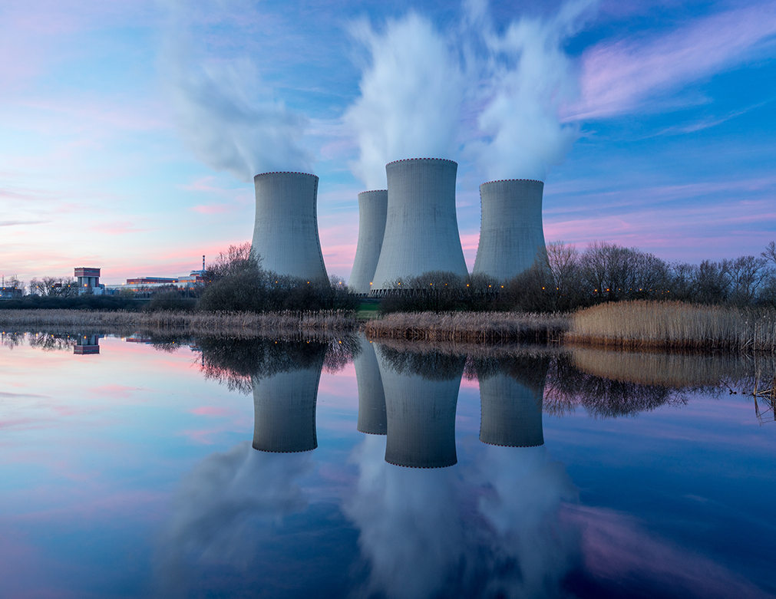
Energy Resources Plenary Review
Keywords:
Renewable Biomass Hydroelectric Geothermal Gigawatt (GW)
Learning Objective
Identify renewable energy sources
Describe the difference between renewable and non-renewable energy sources
Evaluate different renewable energy resource
Be aware of the arguments for and against the selection of fossil fuels, renewable energy and nuclear power
Notes:
Teacher notes
The lesson is designed to support Science, Design Technology, Product Design and Geography curriculum learning.

Slide 11
Taking it further - Sustainability & Energy Generation
Case studies on Lloyd's Register's involvement
Renewables
Hydro-electric power
Offshore windfarm technology
Nuclear power
Shipping
Future fuels
Alternative forms of propulsion
The Lloyd's Register has not only played a key role in making shipping safer over the last 250 years but has also used the expertise and long experience of testing to help develop sustainable energy resources across the world.
Notes:
Teacher notes:
The Lloyd's Register has not only played a key role in making shipping safer over the last 250 years but has also used the expertise and long experience of testing to help develop sustainable energy resources across the world.

Slide 12
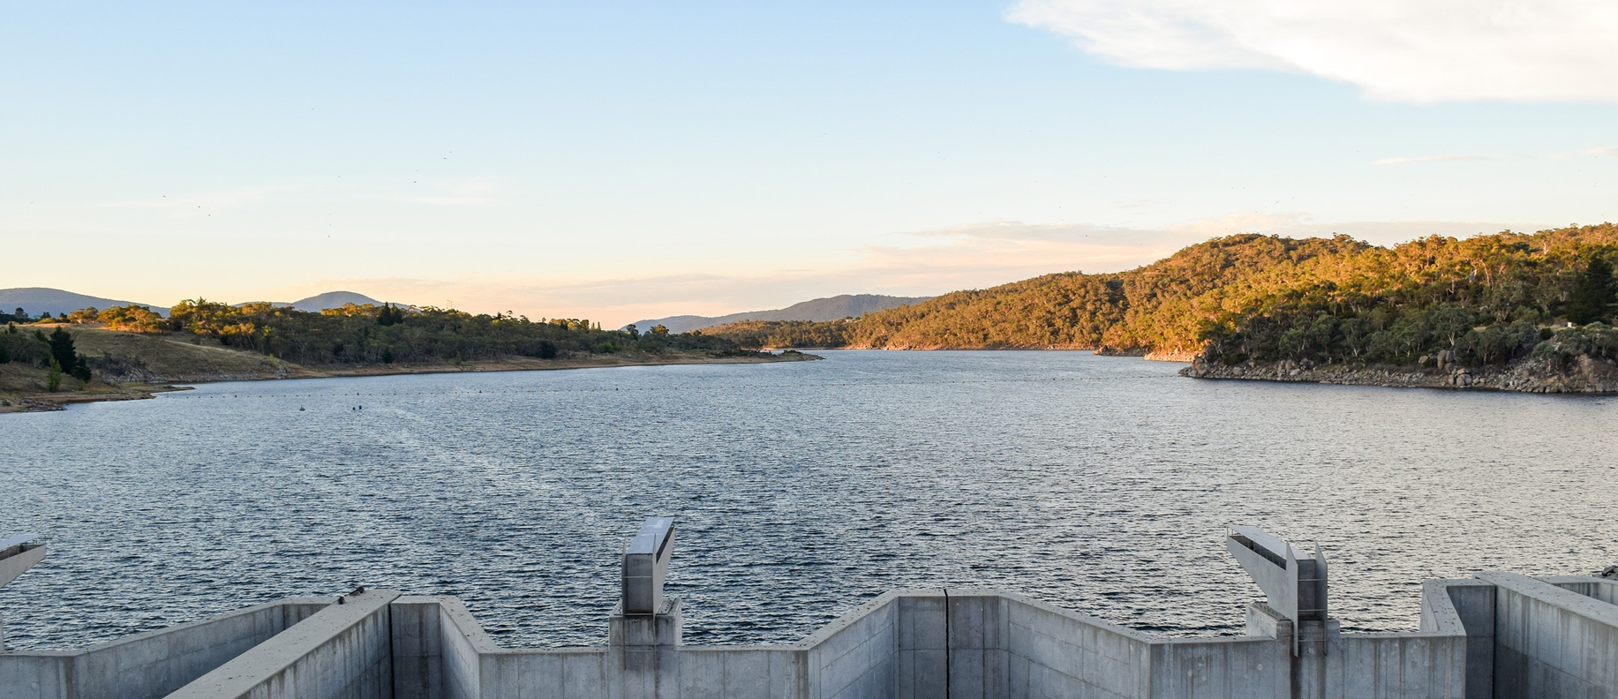
Case Study - Hydroelectric Power
Snowy Mountains hydro-electric project
World's largest hydro-electric scheme. Work began in 1949. It took 25 years to build and took over 100,000 people to construct.
The system works by collecting water from the Snowy Mountains and diverting it through 145 km of tunnels and 80 km of aqueducts and storing it in 16 major dams with a capacity of 7,000 gigalitres (almost 12x the volume of Sydney Harbour).
The water is converted to hydro-electricity by 9 power stations and 33 turbines with a 4,100 megawatt capacity.
Lloyd's Register's surveyors in Australia inspected many different aspects of the project. Work included involvement with transformers and circuit breakers, power stations, electrical power plant and equipment, dams, pipelines, tunnelling projects, aqueducts and electricity transmission towers.
In 1959 the Snowy-Mountains hydro-electric scheme celebrated its 10th anniversary with the coming into operation of the Tumut I power station and the completion of a 14-mile long mountain tunnel diverting the Eucumbene River in the Murrumbidgee Valley.
The Snowy scheme currently supplies more than 30% of all renewable energy to the eastern mainland grid of Australia.
A planned extension to the scheme, Snowy 2.0, anticipated for completion in 2025, will upgrade the system's power stations and tunnels to add 2,000 megawatts of energy to the current output. Enough to power 500,000 more homes. 200 million LED lightbulbs at the same time.
Renewable energy can be used to pump water back up to the Tantangara Dam to be used again.
Providing a storage capacity equivalent to 35 million domestic batteries.
Notes:
Teacher notes:
The Lloyd's Register has not only played a key role in making shipping safer over the last 250 years but has also used the expertise and long experience of testing to help develop sustainable energy resources across the world.
Resource ideas
Visit the Lloyd’s Heritage education website for an online exhibition information about their involvement in sustainable energy projects including types of hydro-electricity generation – conventional dams, pumped storage, run-of-the river, and tidal.
YouTube Hydro Scheme: by the numbers ; Snowy Mountains Hydro-electric Scheme - Behind the News ; Power From The Snow
Institute of Civil Engineers (1962)

Slide 13
Case Study - Offshore Windfarm Technology
Resource
More about the construction ;
Windcarrier fleet Fred Olsen ; YouTube Timelapse installation
Turbine blades are 75m long and weigh 28 tons. See installation in Hull City of Culture for some great images to highlight the scale.
WindEurope – "In 2019 Europe connected 502 new offshore wind turbines to the grid across 10 projects. This brought 3,627 MW of new (gross) additional capacity. Europe now has a total installed offshore wind capacity of 22,072 MW from 5,047 grid-connected wind turbines across 12 countries."
Key Trends & Statistics 2019.
World's largest offshore wind farm
In October 2019 the final Siemens Gamesa 7MW wind turbine was installed at the Hornsea One offshore wind farm located 120km off Yorkshire, UK.
174 turbines spread over 407 km2 of North Sea can generate 1,218MW
Project officially inaugurated in 2020 as the world’s largest offshore wind farm.
Hornsea One will be the world’s first offshore wind farm to be able to generate over 1GW of electricity – enough to power well over one million UK homes.
The power generated by the wind turbines is converted from medium voltage to high voltage via three 400MW offshore substations. The electricity is then transmitted via the world’s first offshore Reactive Compensation Station, which is around half way between the site and the shore.
Lloyd’s Register Quality Assurance certified different aspects of the companies involved to ISO 9001 Quality, ISO18001 Health & Safety and ISO 14001 Environmental Management Systems.

Slide 14
Where does our energy come from?
Notes:
Teacher Notes:
Conclusion:
Refer to the big question at the beginning: Where does energy come from?
Extension:
Students could extend their learning by researching other energy sources used at INEOS TEAM UK’s.
Alternatively they could apply their findings to other areas of everyday life and make suggestions for renewable energy swaps.

