Slide 1
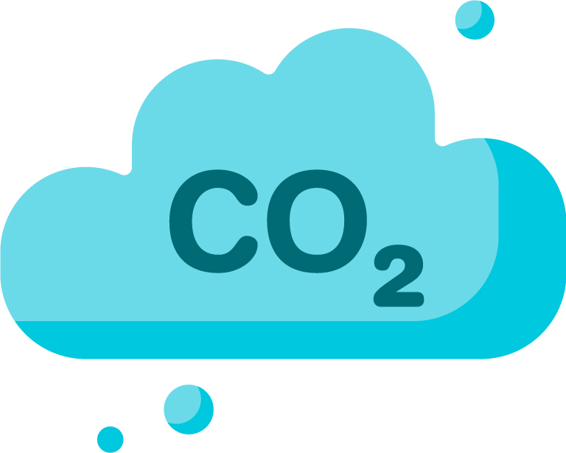
Wave Energy
Picture source: http://www.emec.org.uk/about-us/wave-clients/pelamis-wave-power/
Renewable Energy
Energy from the sea:
Sea waves have kinetic energy. Many different ways are being developed to harness this energy to generate electricity. Some systems use machines that bob up and down in the waves, others use the waves to compress air to turn the turbine and generate electricity.
Advantages
Clean and renewable
No air pollution or CO₂ produced
Waves occur across the world
Disadvantages
Requires suitable location
Expensive, technology still being developed
Equipment can be damaged in storms
Large number of generators needed
Energy generated varies dependent on sea conditions
Could be a hazard to shipping
Current situation: Sea wave energy generation has great potential as a renewable energy source, but it is still at an early stage of development compared with other renewables. There are many different prototype solutions currently being developed.
Notes:
Teacher notes
Print each of the following 8 renewable energy resource slides and place around the room
Split the class into smaller groups
Each student researches one or two different energy resource before reporting back to the rest of the group teaching them the key points from their notes
All students complete their notes on all resources using the summary sheet available from the STEM Crew resource page.

Slide 2
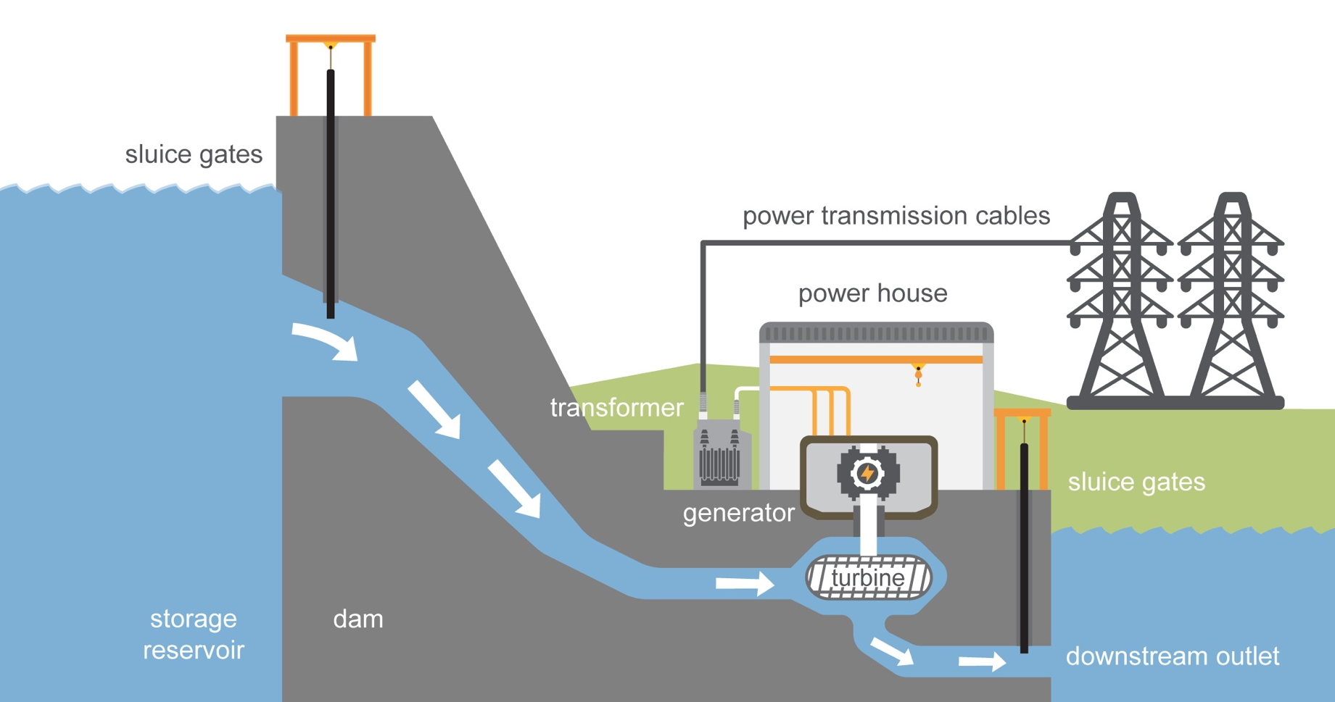
Hydroelectric Energy
Renewable Energy
Energy from rivers
The water flowing in a river has kinetic energy. The energy is used to turn a turbine and generate electricity known as hydroelectric power (HEP). Often a dam is built to increase the energy stored and control the flow through the turbine.
Advantages
Renewable energy source that can generate huge amounts of power
No pollution, caused by electricity production
Energy can be stored in the dam releasing it on demand when electricity is needed
Quick start up time for electricity generation
Disadvantages
Requires suitable location
Very expensive to build a dam
Dam building and flooding of valleys can cause large scale loss of habitats
Farmland and homes may have to be lost
Effects river flow and ecosystems
Case study - Snowy Mountains HEP project Australia - The world's largest hydro-electric scheme took 25 years to build and over 100,000 people to construct!
The system works by collecting water from the Snowy Mountains in Australia and diverting it through 145 km of tunnels and 80 km of aqueducts and storing it in 16 major dams with a capacity of 7,000 gigalitres (almost 12x the volume of Sydney Harbour).

Slide 3
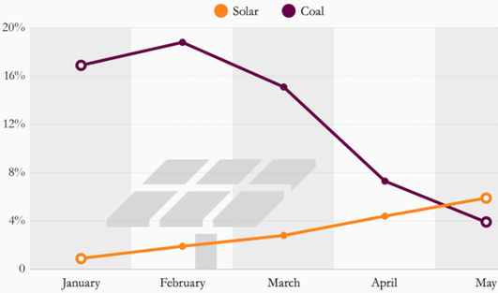
Solar Energy
Renewable Energy
Energy from the sun
The Earth gets heat and light energy from the sun. Solar cell technology converts solar energy into usable electricity through a process known as the photovoltaic effect. Incoming sunlight strikes a semiconductor material and knocks electrons loose, setting them in motion and generating an electric current. The Sun’s heat can also be used to heat water for homes, using solar panels. Solar panels only work during daylight hours, production is less during the winter when days are shorter, and the angle of the sun's rays are reduced.
Advantages
Renewable source of energy,
No pollution, caused by electricity production
Very low maintenance and production cost once set up
Large potential energy
Solar power eclipses coal in the UK
% share of total UK electricity generation met by solar and coal (Jan – May 2016)
Disadvantages
Solar cells and thermal panels are expensive and require space.
They only work in day light; less direct sun means less energy available.
Difficult to predict energy availability due to changing weather
Interesting facts: Photovoltaic effect was discovered by French physicist in 1839, but it was not until recently that cost of producing photovoltaic cells has fallen enough to become a viable method for large scale energy production with large scale solar farms becoming increasingly common.
In just one hour the sun provides enough energy to power the world for one year!

Slide 4
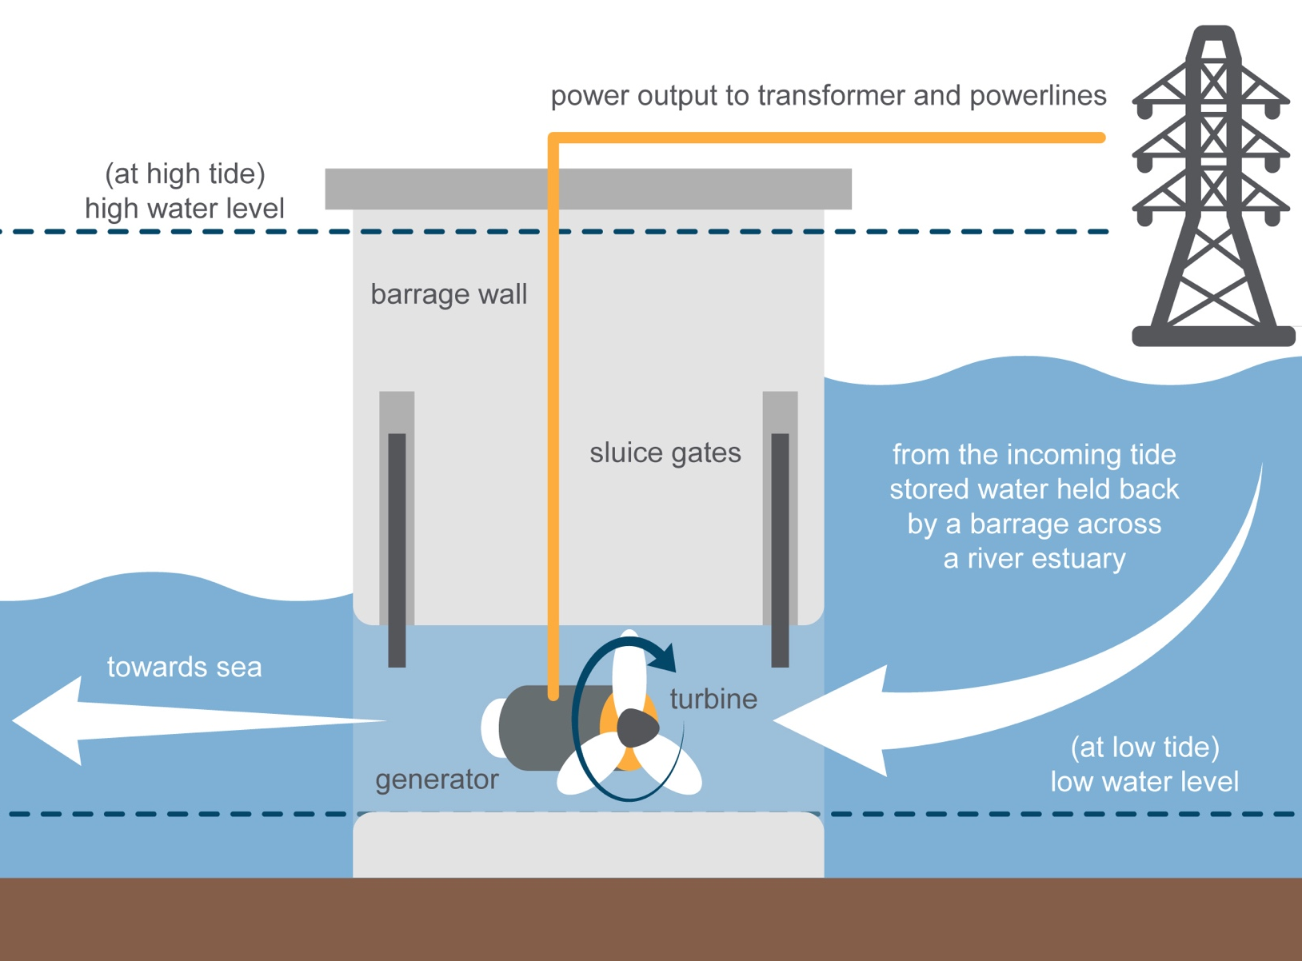
Tidal Energy
Renewable Energy
Energy from the sea
Tidal energy is a type of hydro power that converts the natural rise and fall of the tides into electricity. If you have visited a beach in the UK you will probably have noticed the tides go in and out.
Tides are caused by the combined effect of the gravitational pull of the moon, sun and rotation of the earth. Tidal electricity can be created from several different ways.
Advantages
Reliable renewable source of energy, two tides every day in UK
No pollution, caused by electricity production
Low energy cost once set up
Large potential energy
Disadvantages
Some systems require a tidal barrier or dam to be built
Requires suitable location and very costly to build barrages
Concerns about impact on marine life.
There are times when the water is not moving meaning no power can be generated.

Slide 5
Wind Energy
Renewable Energy
Energy from the wind
An increasing amount of energy is being produced using wind power in the UK. Wind passes over the blades of a wind turbine causing them to turn, the rotating shaft turns a generator that converts the kinetic energy into electrical energy. This then passes through a transformer, which steps up the voltage so it can be transported on the National Grid.
Advantages
Clean renewable source of energy
Relatively low set up cost per unit of electricity generated
Large potential both on and offshore in the UK
Wind farms tend to produce more electricity in the winter when demand is also higher
Interesting facts: Wind power is the UK’s biggest source of renewable energy and makes up 20% of the UK’s electricity. Electricity from renewable biomass plants made up 12% of the energy system, while solar panels contributed 6%.
Ten years ago fossil fuels made up 80% of the UK’s electricity supply.
Disadvantages
Wind power is unreliable, if the wind is too light no power is generated, if it is too strong generators can overheat so blades must be stopped.
Some people do not like the look of them and think they harm the beauty of remote countryside and coasts.
They can potentially harm some birds
Some people don't want them built near their homes because of the visual impact and noise

Slide 6
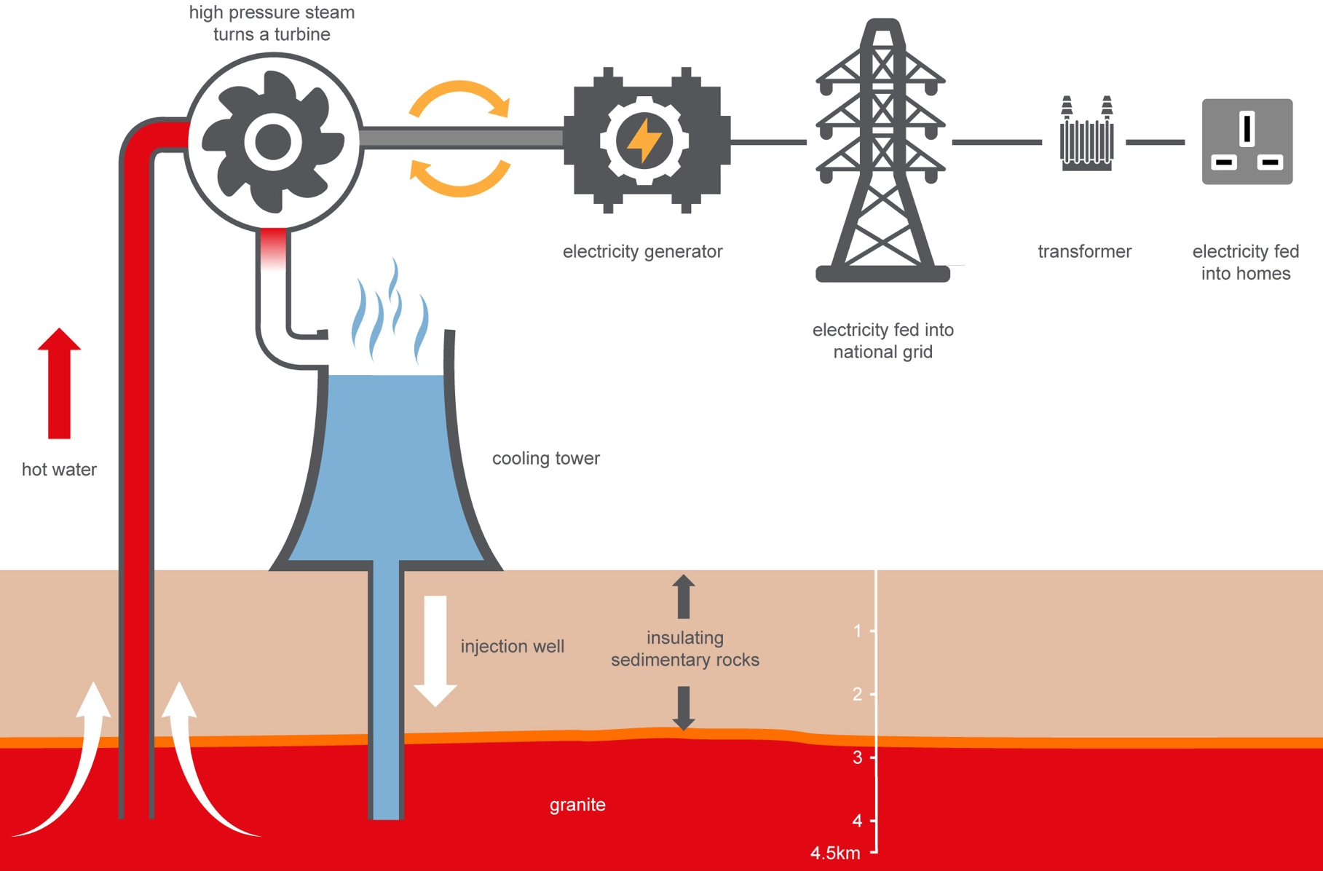
Geothermal Energy
Renewable Energy
Energy from the earth:
Geothermal energy of the Earth's crust comes from the original formation of the planet and from radioactive decay of materials.
A small number of countries are able to make use of geothermal energy to generate electricity.
Advantages
Clean and renewable
No air pollution or CO₂ produced
Minimal damage the environment
A constant source of energy
Case study Iceland generates 34% of its electricity from geothermal energy. In Iceland where shifting tectonic plates and volcanic activity have pushed heat from the Earth’s core toward the surface, in the form of steam or hot water they have been able to use this to power turbines and generate electricity.
Disadvantages
Only a few places in the world are suitable where the earth's core is close enough to the surface to make use of geothermal energy
Expensive and difficult to drill deep into the ground

Slide 7
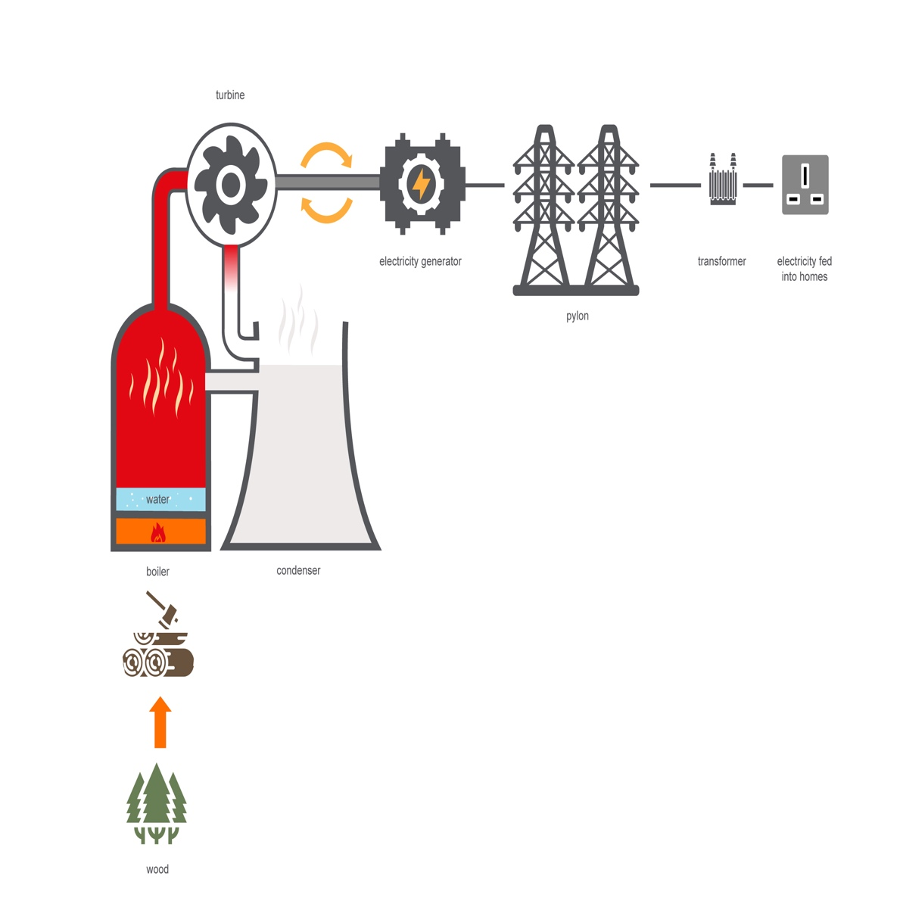
Biomass Energy
Renewable Energy
Energy from plants
The chemical potential energy produced by photosynthesis and stored plants and trees can be turned into heat energy by burning them. Biofuels emit carbon dioxide when they are burnt. However plants absorb the same amount of CO₂ when they are growing making then carbon neutral. The transport and manufacture of biofuels requires energy. Waste plant materials from food can also be used for biofuel.
Advantages
Carbon Neutral fuel as CO₂ absorbed when growing so do not add to the overall CO₂ in the atmosphere
Can be used to replace the burning of fossil fuels like coal in power stations
A renewable source of energy
Interesting facts: Electricity from renewable biomass plants made up 12% of the Uk’s energy in 2019, while solar panels contributed 6%.
Ten years ago fossil fuels made up 80% of the UK’s electricity supply.
Disadvantages
Emits CO₂ and soot when burnt
Bulky to transport requiring large volumes for the same energy output compared to fossil fuels.
Requires energy to transport and process

Slide 8
Biofuels Energy
Renewable Energy
Energy from plants
The chemical potential energy produced by photosynthesis and stored in oil and starch producing plants like corn and sugar cane can be turned into fuel for transport and heating. Biofuels emit carbon dioxide when they are burnt. However plants absorb the same amount of CO₂ when they are growing making then carbon neutral. The transport and manufacture of biofuels like biodiesel does however require additional energy. Waste plant materials from food can also be used for biofuel for example cooking oil.
Advantages
A renewable source of energy as we can grow more plants
Can act as a direct replacement for fossil fuels
Disadvantages
CO₂ produced when burnt
Requires land to grow crops which could be used for food production
Requires other resources including water and fertilizers
May encourage large scale growing of single crops and land clearance, reducing biodiversity and habitats and damaging ecosystems.
Interesting facts: Waste cooking oil from restaurants and fish and chip shops can be used to make biodiesel for use in cars and lorries.
Most petrol in the UK now contains 5% ethanol, a plant-based biofuel. This is required under the Government's Renewable Transport Fuels Obligation.

