Slide 1
LESSON 1
Energy Resources
What powers the America’s Cup boat allowing it to sail at up to 60mph?
Where does energy come from?
Notes:
Teacher notes:
The big question for this lesson is, ‘where does our energy come from?’ and is the first of a series of two lessons on energy and power.
Teacher / Technician Equipment notes:
There is a worksheet available to support this lesson available from the STEM Crew resource page.
The practical activity will require a simple electric motor and a multimeter. To extend the activity an AA battery and connecting wires will be required.

Slide 2
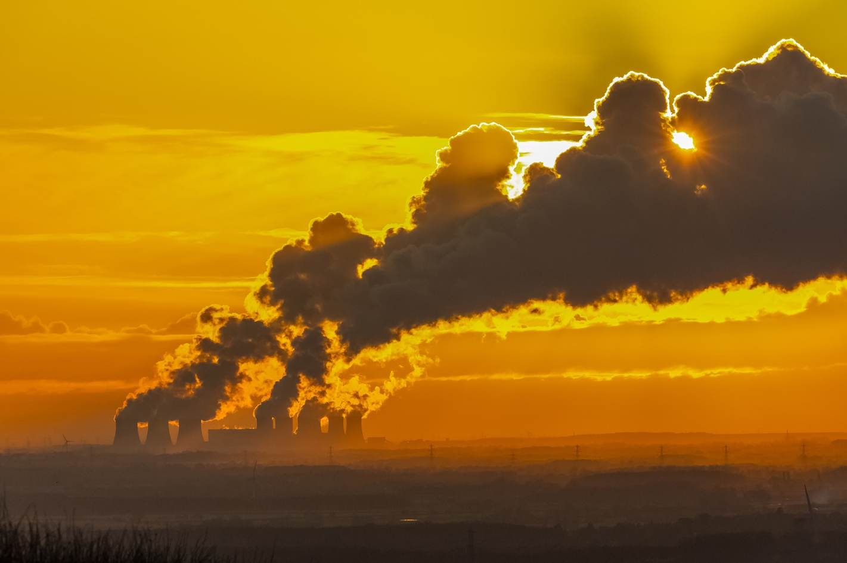
Energy Resources - Learning Objective
Keywords:
Fossil fuels Non-renewable Renewable Finite
Define what fossil fuels are
Explain how power is generated from fossil fuels and nuclear power
Describe the difference between renewable and non-renewable energy sources
Evaluate fossil fuels as an energy resource
Notes:
Teacher notes
The lesson is designed to support Science, Design Technology, Product Design and Geography curriculum learning.

Slide 3
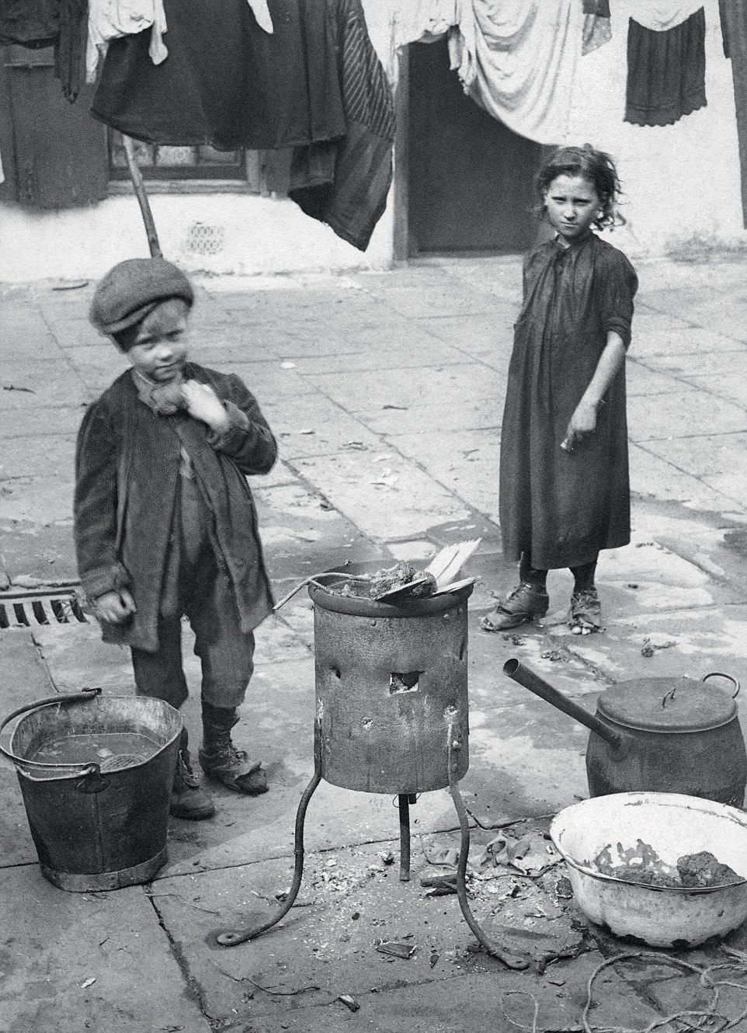
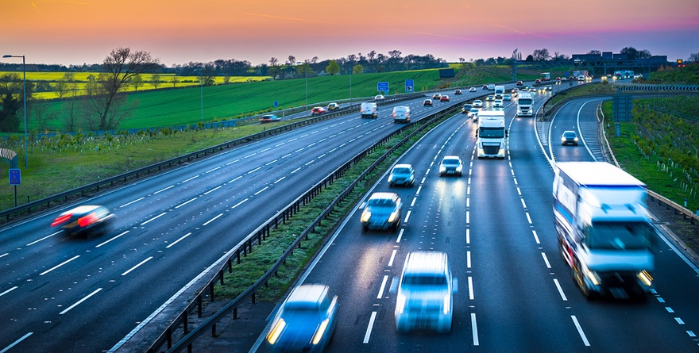
Energy Resources
Every day we use energy sources to make our lives easier
Think how different life would have been 150 years ago
No cars or buses
No electricity, television or phones!
No central heating
No washing machines or hot showers
Talking Partners Make a list of all the things you have used energy sources for so far today?
Notes:
Teacher notes
Encourage students to think about the full range of activities including getting to school, heating, cooking, showering etc.
You could get students to do some independent background research into how life has changed thanks to better use of science and design and technology to help improve the safety and quality of our lives. Try websites like https://londonphotowalks.uk/think-youve-bad-day/ for some fascinating insights.
Lloyd’s Register played a key role in improving the safety of vessels at see more info can be found on the Lloyds Register Foundation Heritage Education site at www.hec.lrfoundation.org.uk

Slide 4
Energy Resources
Now we travel by train, car and bus and fly off on holiday. We live in warm centrally heated houses and use electricity to charge and run many appliances in the home.
The America’s Cup boats get their energy from the wind and the work done by the sailors on board.
Have you ever stopped to think … Where does our energy come from?
Talking Partners Make a list of as many energy sources as you can.
Notes:
Teacher notes
Lead into getting students to think about the extent on which to rely on the use of energy and fossil fuels is in modern society.

Slide 5
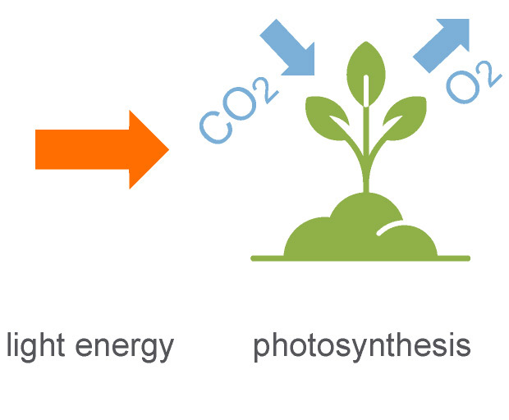
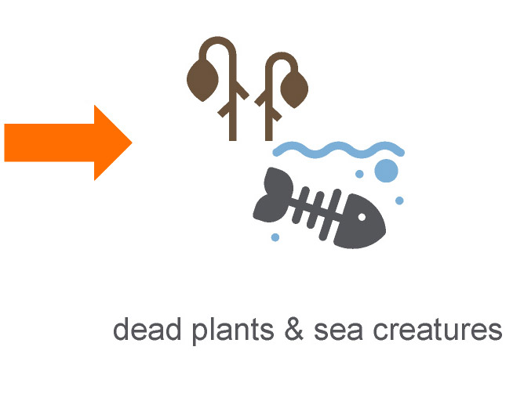
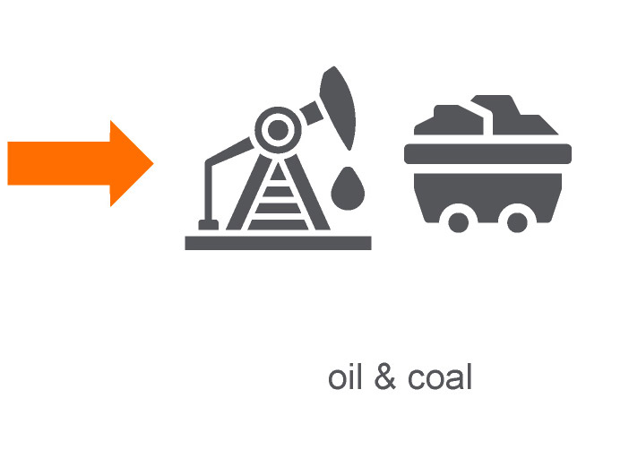
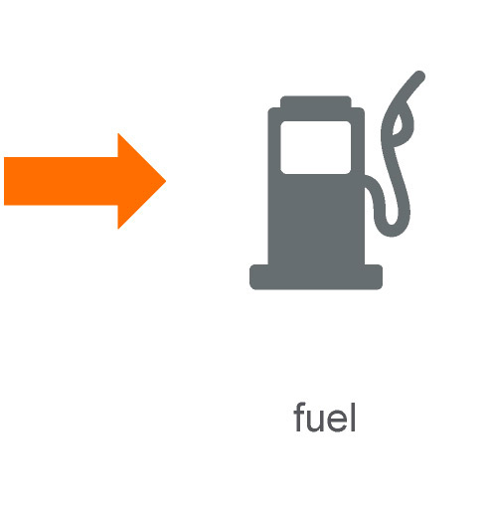
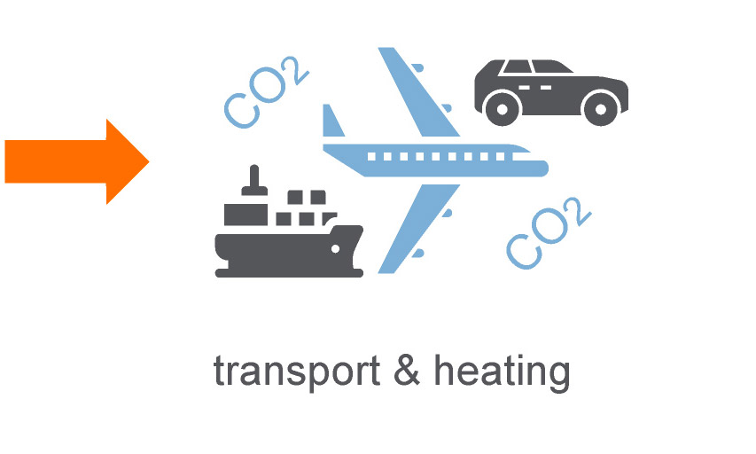
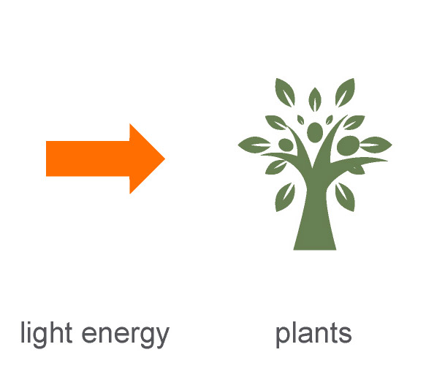
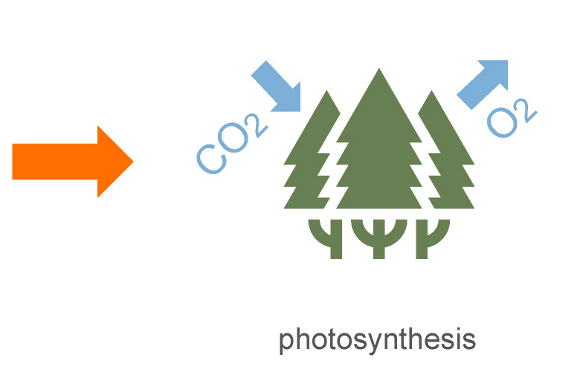
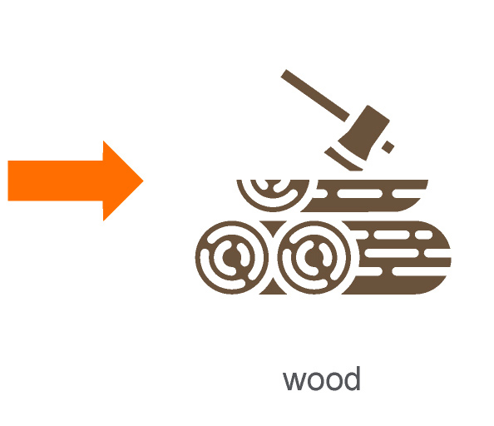
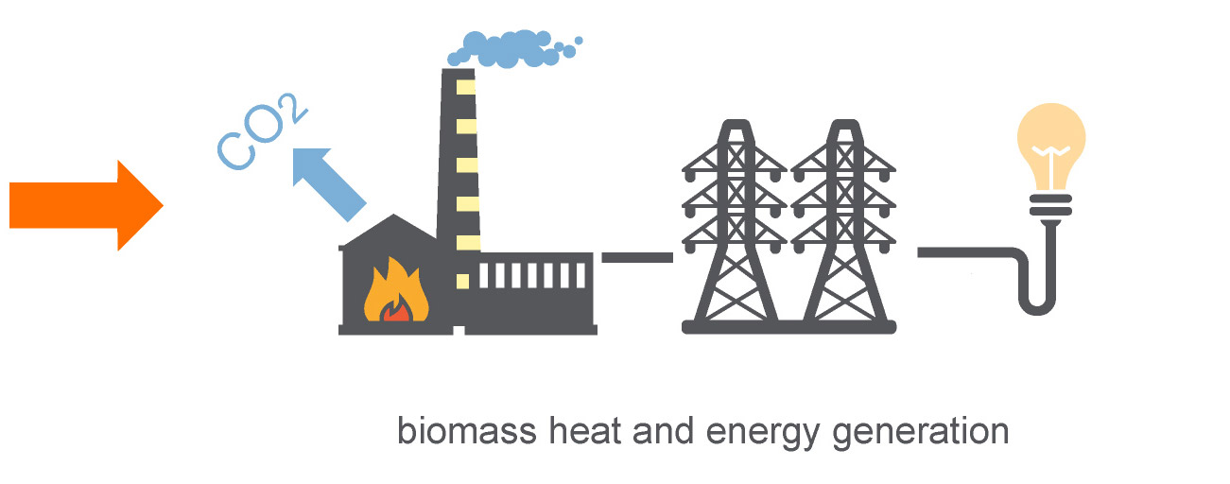
Where does our energy come from?
The vast majority of the energy we use ultimately comes from the sun
1
Millions of years
Energy from sun
Fossil fuels – Oil, Gas & Coal
2
Energy from sun
Biomass (e.g. Wood)
Notes:
Teacher notes
Depending on your situation there are several options for delivering this section other than just working through each example with students on the board or screen shared for home learning:
Option 1: You could print and cut each stage up and ask students either individually or in small groups to sort them into a correct order starting with the sun.
Option 2: Alternatively you could print copies of each of the six examples of conversion transfer routes of the suns energy and place them around the edge of the room. Working in small groups (2-3), each member of the group must go up one at a time and select a conversion method not yet covered and in a limited time (60 sec)make notes before returning to the group and explaining their selected route to the rest of the group to allow them to make notes.
Option 3: If working from home the images could be provided electronically for students to sort into the correct order before sharing their screen or presenting to the rest of the class.
Ask students to think about the timeline that would go with each of the examples as you go through then, leading on to the idea of resources being renewable or non-renewable

Slide 6
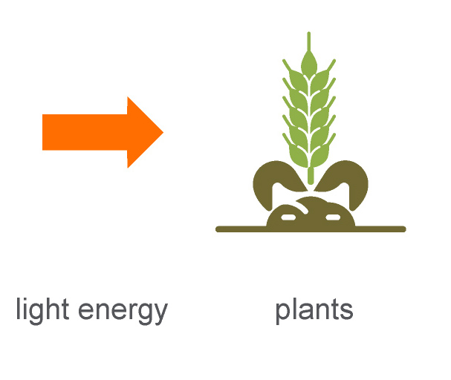
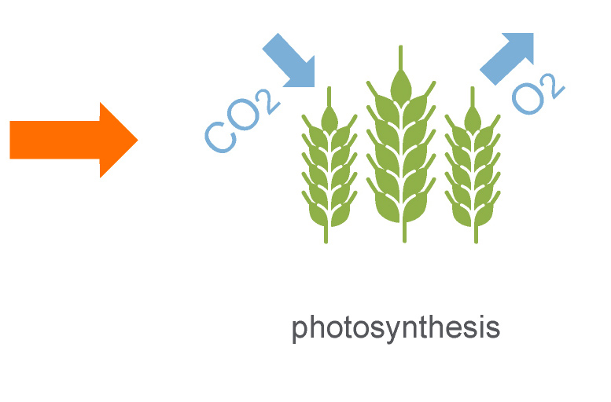
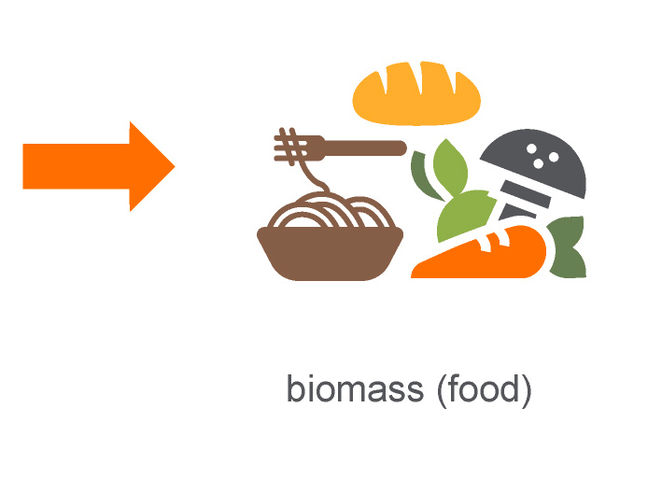
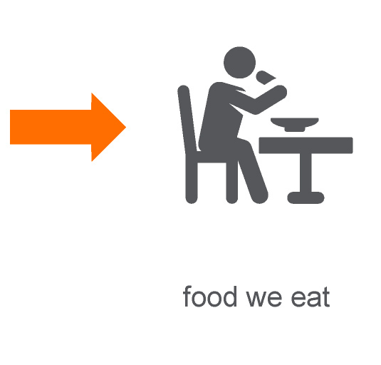
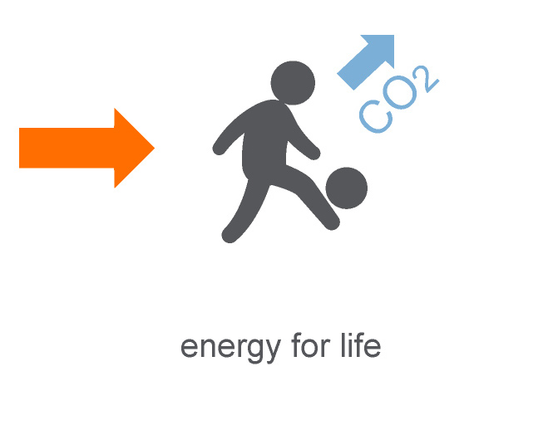
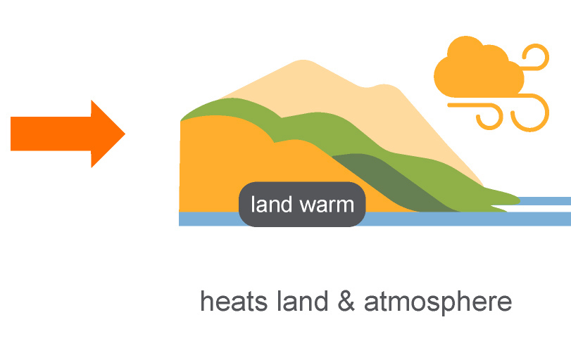
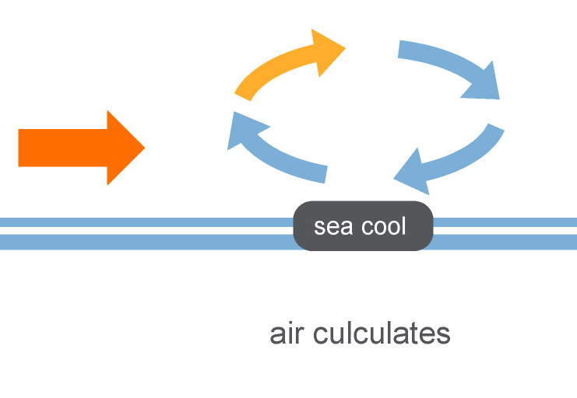
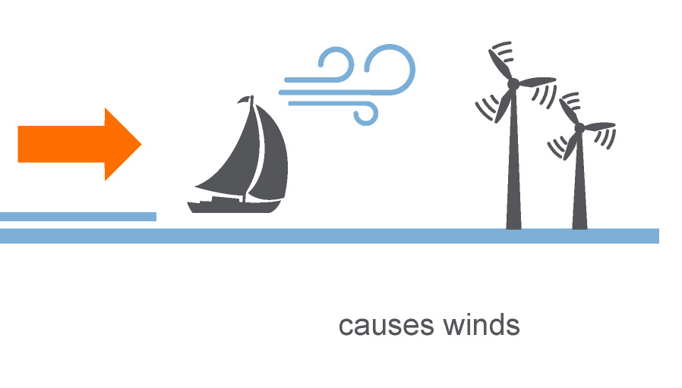
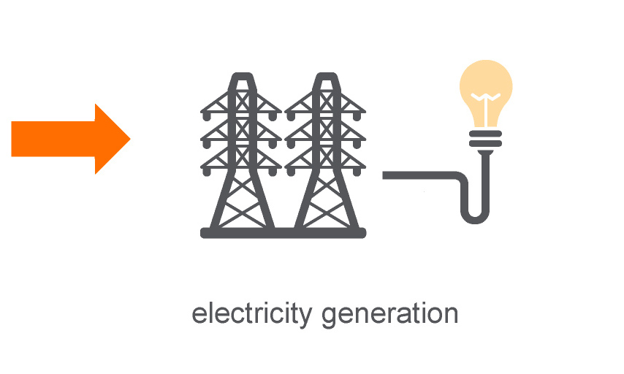
Where does our energy come from?
The vast majority of the energy we use ultimately comes from the sun
3
Energy from sun
Food
4
Energy from sun
Wind Power
Notes:
Teacher notes
See previous notes on options for delivery

Slide 7
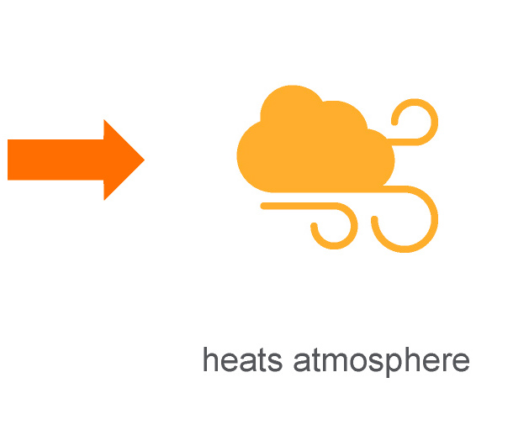
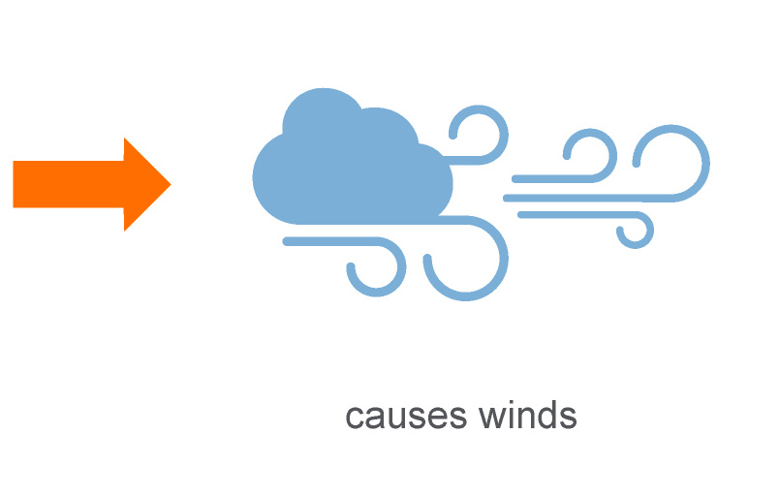
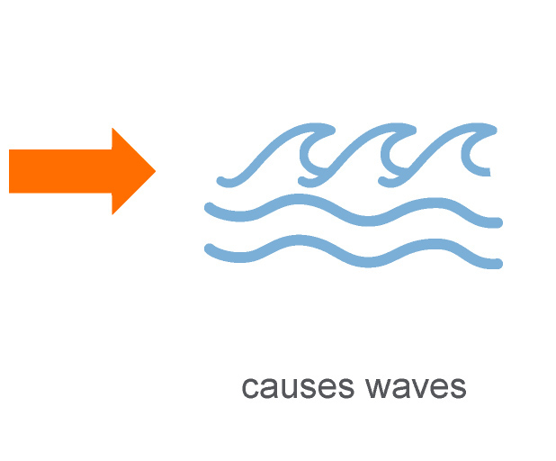
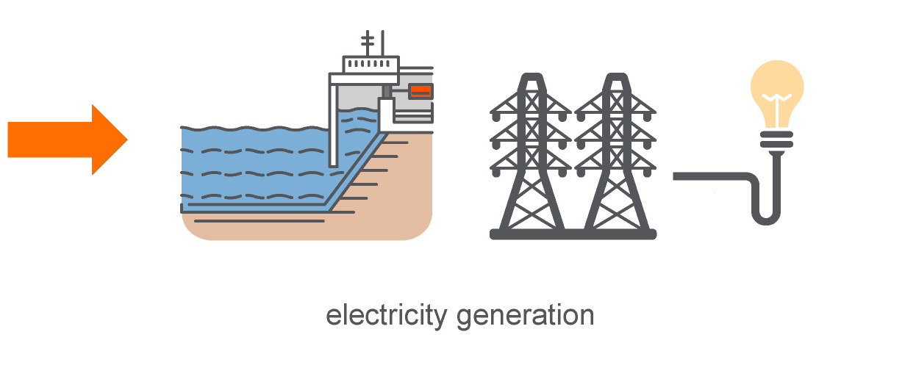
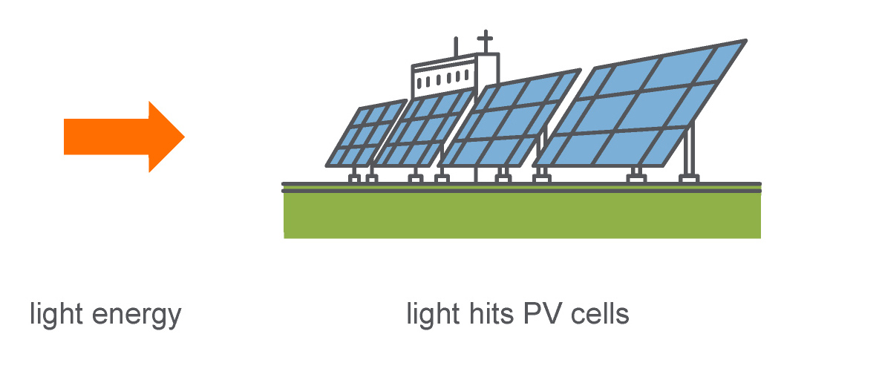
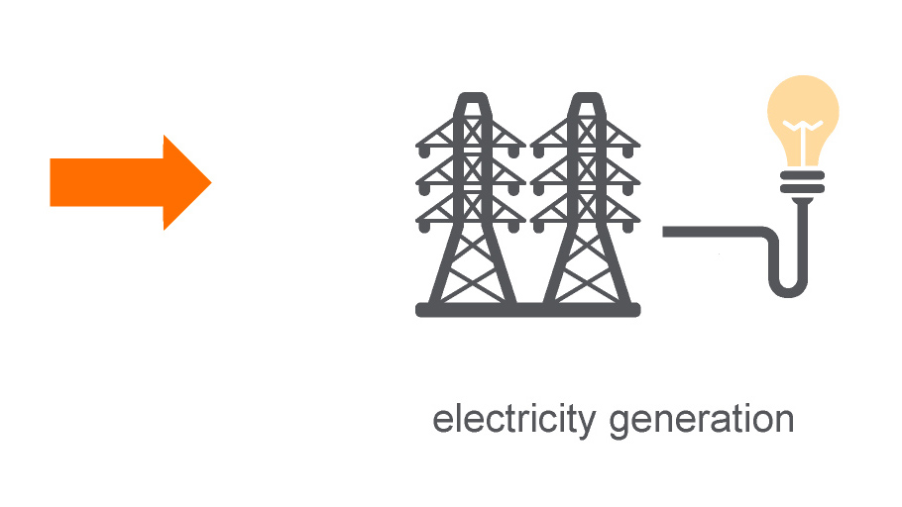
Where does our energy come from?
The vast majority of the energy we use ultimately comes from the sun
5
Energy from sun
Wave Power
6
Energy from sun
Solar Cells
Challenge: Can you think of any energy that does not ultimately come from the sun?
Notes:
Teacher notes
See previous notes on options for delivery
Challenge question:
Earths geothermal and nuclear (energy in atoms available from atomic decay and from nuclear fission from uranium/thorium) did not originate from the sun. Most predate the formation of our solar system as we know it today.
Tidal energy could be argued to not come from the sun as it is largely influenced by the gravitational pull of the moon however the sun does still influence tides by its gravitational pull, this would make a good extension activity to challenge more able students more details can be found here: https://oceanservice.noaa.gov/education/tutorial_tides/tides02_cause.html#:~:text=Gravity%20is%20one%20major%20force,Sumich%2C%20J.L.%2C%201996).&text=Tidal%20forces%20are%20based%20on%20the%20gravitational%20attractive%20force.

Slide 8
Energy Resources – Fossil fuels
What are the problems with fossil fuels?
Fossil fuels are a non–renewable energy resource
Fossil fuels are formed from the fossilised remains of plants and animals over millions of years
To release the energy from fossil fuels they must be burned.
Burning fuels produces greenhouse gasses and other pollutants
Once the fuel is burnt it cannot be replaced as it takes millions of years to form,
It is a finite resource - one day it will run out!
Notes:
Teacher notes
Encourage students to think about the issues with fossil fuels. Use the question to assess prior knowledge, making links to learning in science, DT and Geography. Many students will already be aware of the issues with fossil fuels, including CO₂ greenhouse gasses and particles.

Slide 9
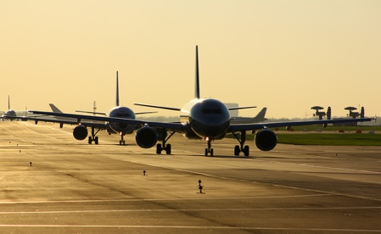
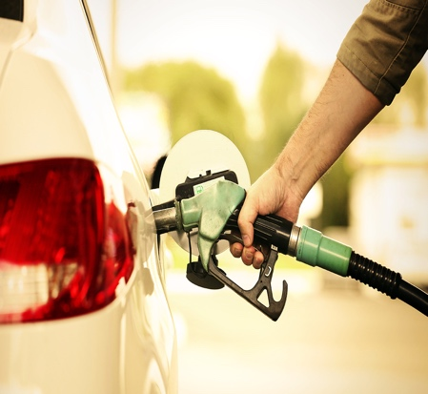
Energy Resources – Fossil fuels
Much of our energy in the UK comes from fossil fuels
We use it in three main ways:
• Transport
• Heating
• Electricity
Why are fossil fuels so relied upon for our energy needs?
They contain a large amount of stored energy
They provide an easily transported energy source
Readily available through drilling and mining
The energy they store is easy to access through burning
Notes:
Teacher notes
Encourage students to think about the issues with fossil fuels. Use the question to assess prior knowledge, making links to learning in science, DT and Geography. Many students will already be aware of the issues with fossil fuels, including CO₂ greenhouse gasses and particles.

Slide 10
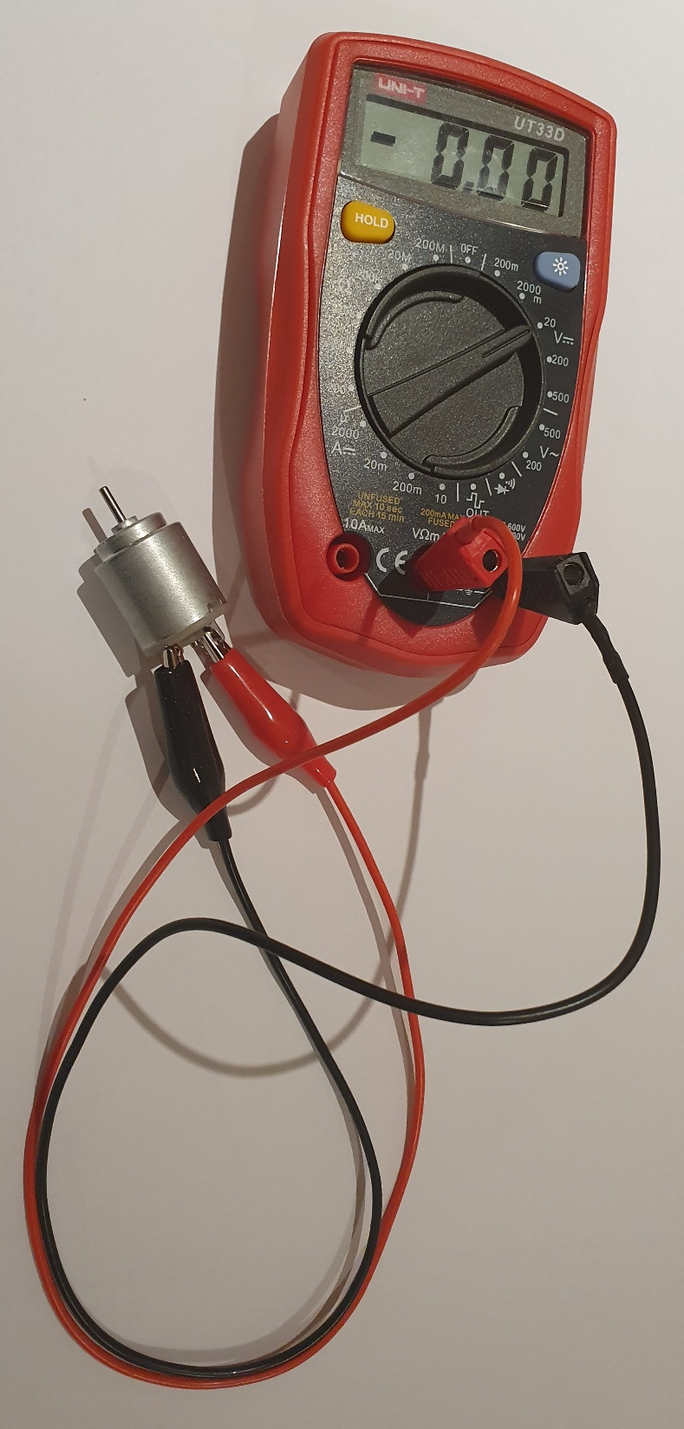
Energy Resources – Generating electricity
How is electricity generated?
Practical challenge
Using a multimeter and an electric motor can you generate electricity?
How can you push the electrons around the circuit like water being pumped down a pipe?
Who can generate the highest voltage and what do you have to do to achieve this?
Notes:
Teacher notes
This investigation can be done with a variety of different equipment depending on the equipment available to you. It could be done as a class or online demo or search for a suitable video to show how a generator works.
The PowerPoint is editable to allow you to change the image accordingly.
You might want to recap electrical circuits and electron flow by giving students an AA battery and wires along with their motor to see if they can make the motor spin without teacher input, allowing the opportunity to check and interleaf prior learning. Before then going on to look at electricity.

Slide 11
Energy Resources – Generating electricity
Most forms of electricity generation involve rotating a turbine which turns a generator
Notes:
Teacher notes
Following the investigation help students make the link to commercial electricity production using the diagram above.

Slide 12
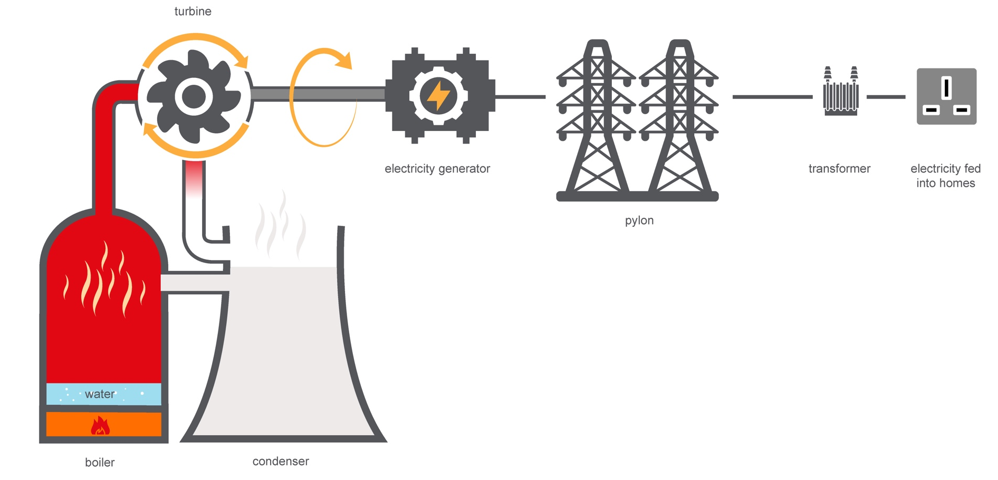
Energy Resources – Generating electricity
3
For the last 100 years fossil fuels have been used to generate electricity from the chemical energy stored within them
4
5
6
Fuel burnt. Chemical energy turned into internal (heat) energy
Water boils creating Super-heated steam
High pressure steam turns a turbine (steam cooled in condenser and returned to boiler)
Rotating shaft from turbine turns the electricity generator
Electricity fed into national grid (step down transformer reduces voltage)
Electricity fed into homes
2
1
Notes:
Teacher notes
Having experimented with generating electricity with an electric motor, take students through the generating process using fossil fuels as above, each stage is animated separating the 5 different stages.
A work sheet of this image is provided in the STEM Crew resources folder for students to complete and make notes on.

Slide 13
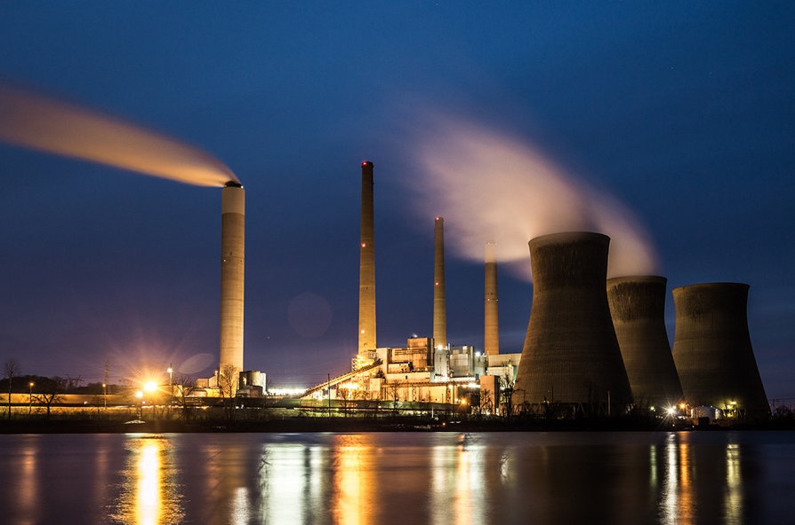
Fossil fuels – Generating electricity
Advantages
Coal, oil and gas have been readily available and cheap
Fossil fuels contain a large amount of stored energy
Output can be increased and decreased relatively easily to meet demand for electricity
Disadvantages of fossil fuels
CO₂ is produced when fossil fuels are burnt, which is a greenhouse gas and contributes to global warming
Burning coal produces sulfur dioxide which causes acid rain that kills plants and damages buildings
They are a finite resource that will eventually run out
They take millions of years to form and are therefore a nonrenewable resource
Interesting facts:
In 2010 fossil fuels made up 80% of the UK’s electricity supply in 2019 it had reduced to 42%.
Notes:
Teacher notes

Slide 14
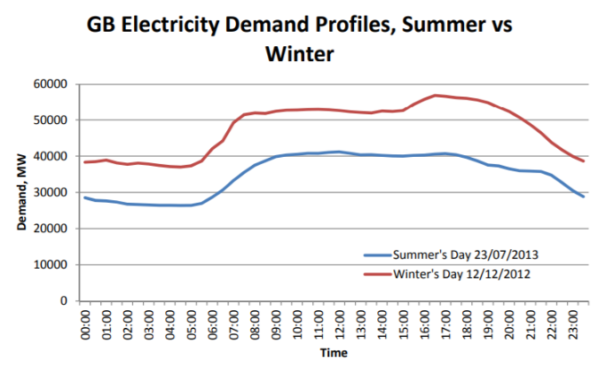
UK Electricity Consumption
The images below show demand profiles for a winters day and summers day showing similar profile but 36% higher demand in winter. Electricity demand is usually lower in the night hours with reduced domestic and commercial consumption. In both seasons there is a visible surge in demand in the morning.
Looking at the two images why is there a surge in consumption in the morning?
The Demand in the morning rises when people wake up and begin using electrical appliances such as showers, toasters and kettles as well as turning on the heating especially in winter.
Notes:
Teacher notes
Why not encourage students to research
https://assets.publishing.service.gov.uk/government/uploads/system/uploads/attachment_data/file/295225/Seasonal_variations_in_electricity_demand.pdf
https://hec.lrfoundation.org.uk/

Slide 15
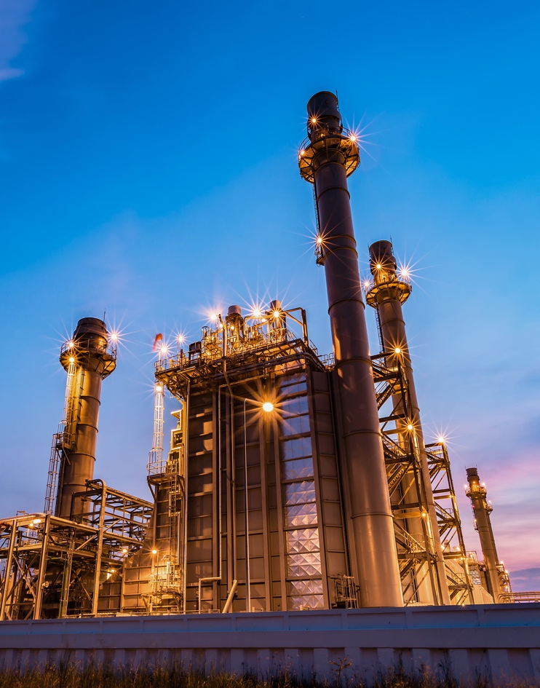
Energy Resources Plenary Review
Review questions:
Explain how fossil fuels are used to produce electricity. [3]
Write a brief letter to your MP explaining why you believe coal fired power stations should be replaced [5]
Notes:
Teacher notes

Slide 16
Electricity Production - Answers
Part of Power Station | What happens here? | What energy occurs here?
Furnace | Gas, coal, oil or biomass is… ____________________ | ___________________ energy in the fuel | is transferred to | ___________________ energy
Boiler | Water is heated and turned into… ____________________ | ___________________ energy | is transferred to | ___________________ energy of the moving steam
Turbine | Super heated __________ turns the blades of the turbine _______________ | The ________________ energy of the moving steam | is transferred to | ___________________ energy of the turbine
Generator | A coil is _____________ inside the magnetic field to produce an electric ____________ | ___________________ Energy of the moving coil | is transferred to | ___________________ energy in the wires for use in homes and industry
Notes:
Teacher notes
Answers to student worksheet, the work sheet is available to download from the STEM Crew website.

Slide 17
Where does the energy in the wind that powers Britannia to 60mph originally come from?
Notes:
Teacher Notes
Conclusion
Come back to the initial question, encourage students to draw on their learning from the lessons to explain why where our energy stores come from.
As students to use key words.
Key concepts

Slide 18
Taking it further - Energy Generation Nuclear Power
Case study- Lloyd's Register
The Lloyd's Register has not only played a key role in making shipping safer over the last 250 years but has also used the expertise and long experience of testing to help develop sustainable energy resources across the world
Calder Hall Nuclear power station (Sellafield)
Through its long experience of testing pressure vessels, Lloyd's Register won a leading reputation for its technical knowledge of atomic energy. From the 1950s, nuclear reactors in the UK such as Bradwell, Berkeley, Calder Hall and Chapel Cross all came under Lloyd's Register.
Calder Hall was the first nuclear power station inspected by Lloyd's Register (LR) and the first full-scale nuclear power plant in operation anywhere in the world. It opened in 1956 and LR surveyors continuously monitored the plant over the next two years to ensure its safety.
The gas-cooled reactor, Calder Hall, consisted of 4 Magnox reactors, 2 turbine halls and 4 cooling towers.
Magnox is a type of nuclear production reactor designed to run on natural uranium with graphite as the moderator and carbon dioxide as the heat exchange coolant.
The heat generated by nuclear reaction was used to turn water into steam, which was then transferred via insulated pipes into a turbine hall. The steam turbine drove a generator to produce electricity.
After 47 years of safe operation, Calder Hall was closed-down in 2003. In its lifetime it had produced enough electricity to power the whole of England and Wales for 3 months. The Lloyd's Register has not only played a key role in making shipping safer over the last 250 years but has also used the expertise and long experience of testing to help develop sustainable energy resources across the world.
Notes:
Teacher notes:
The Lloyd's Register has not only played a key role in making shipping safer over the last 250 years but has also used the expertise and long experience of testing to help develop sustainable energy resources across the world.

Slide 19
Where does our energy come from?
Notes:
Teacher Notes:
Conclusion:
Refer to the big question at the beginning: Where does our energy come from?
Extension:
Students could extend their learning by researching other energy sources used at INEOS TEAM UK.
Alternatively they could apply their findings to other areas of everyday life and make suggestions for renewable energy swaps.

