Slide 1
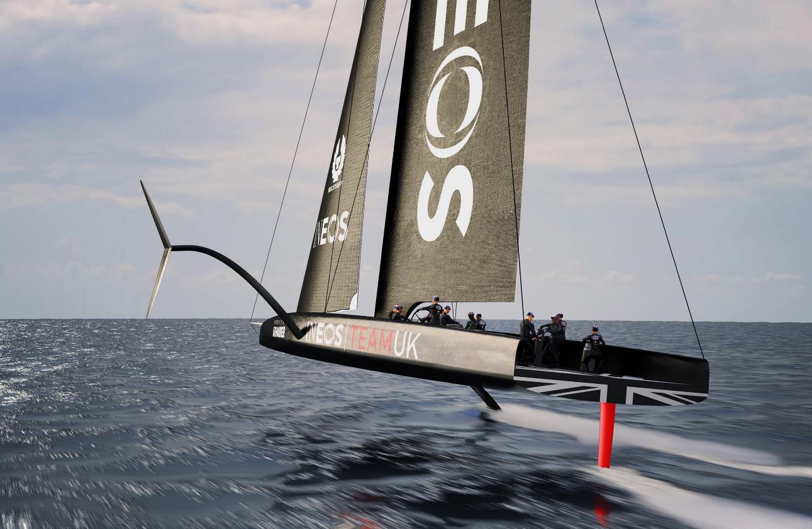
Materials:
Practical Investigation

Slide 2
Materials
Learning Objectives
Know the properties of different materials.
Know how the properties of each material relate to its uses in the America’s Cup Challenge.
Explain how the materials are chosen in the design process for their specific properties.
Describe how external environmental factors (e.g salt water) will have an impact on materials used.

Slide 3
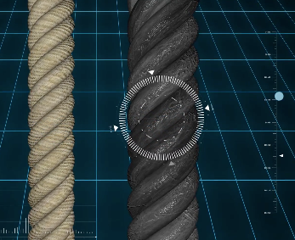
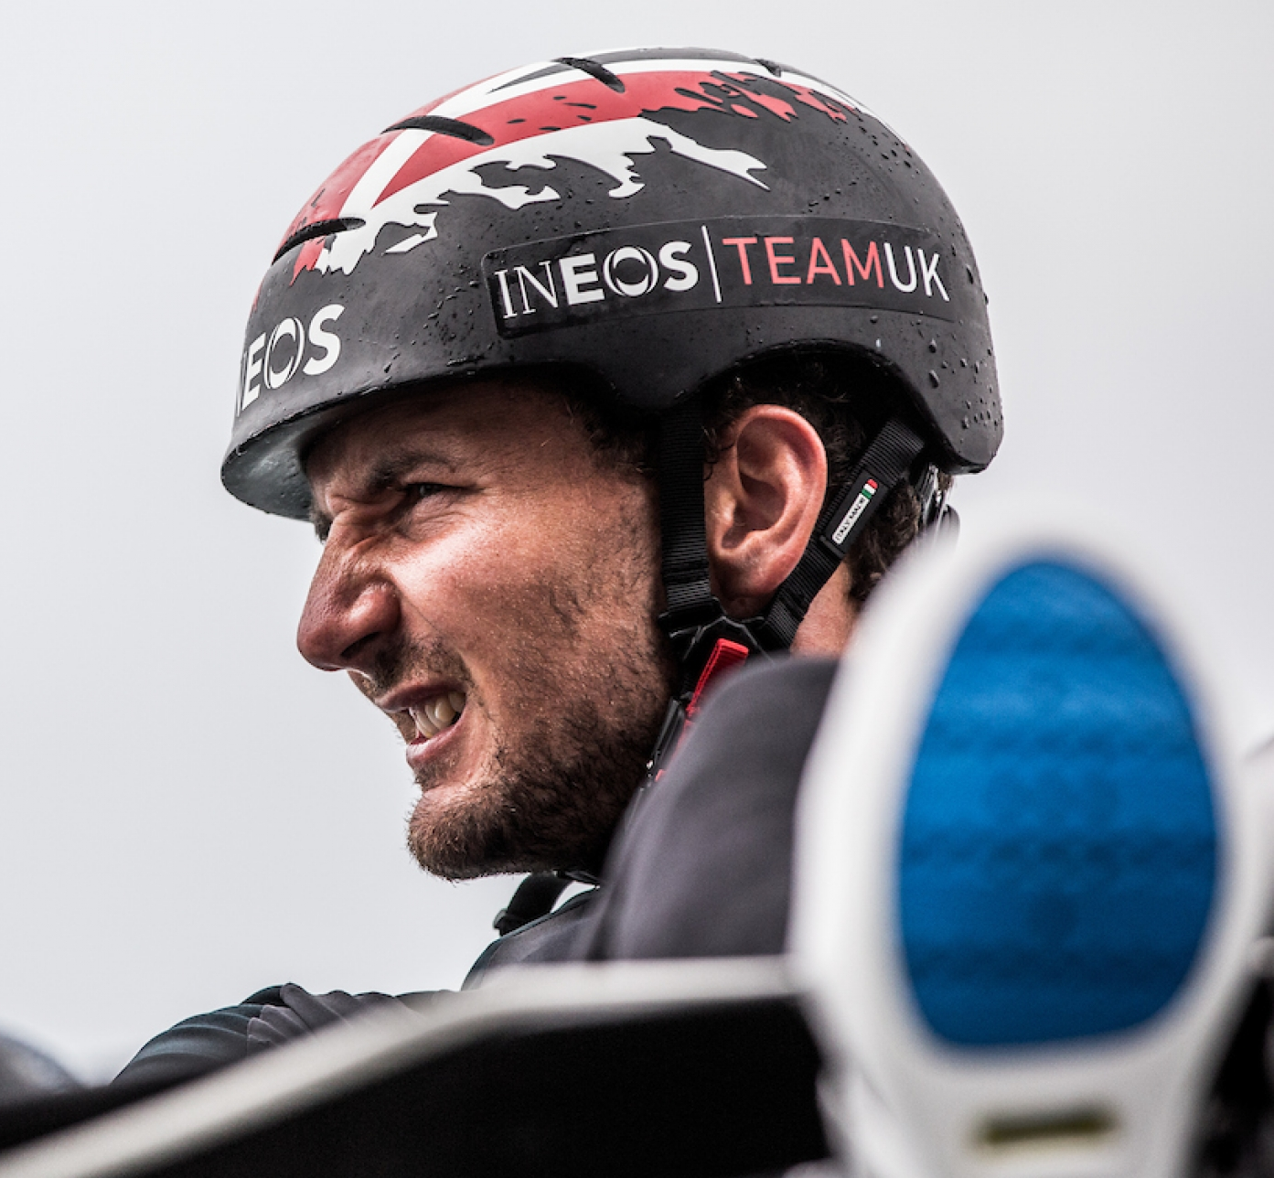
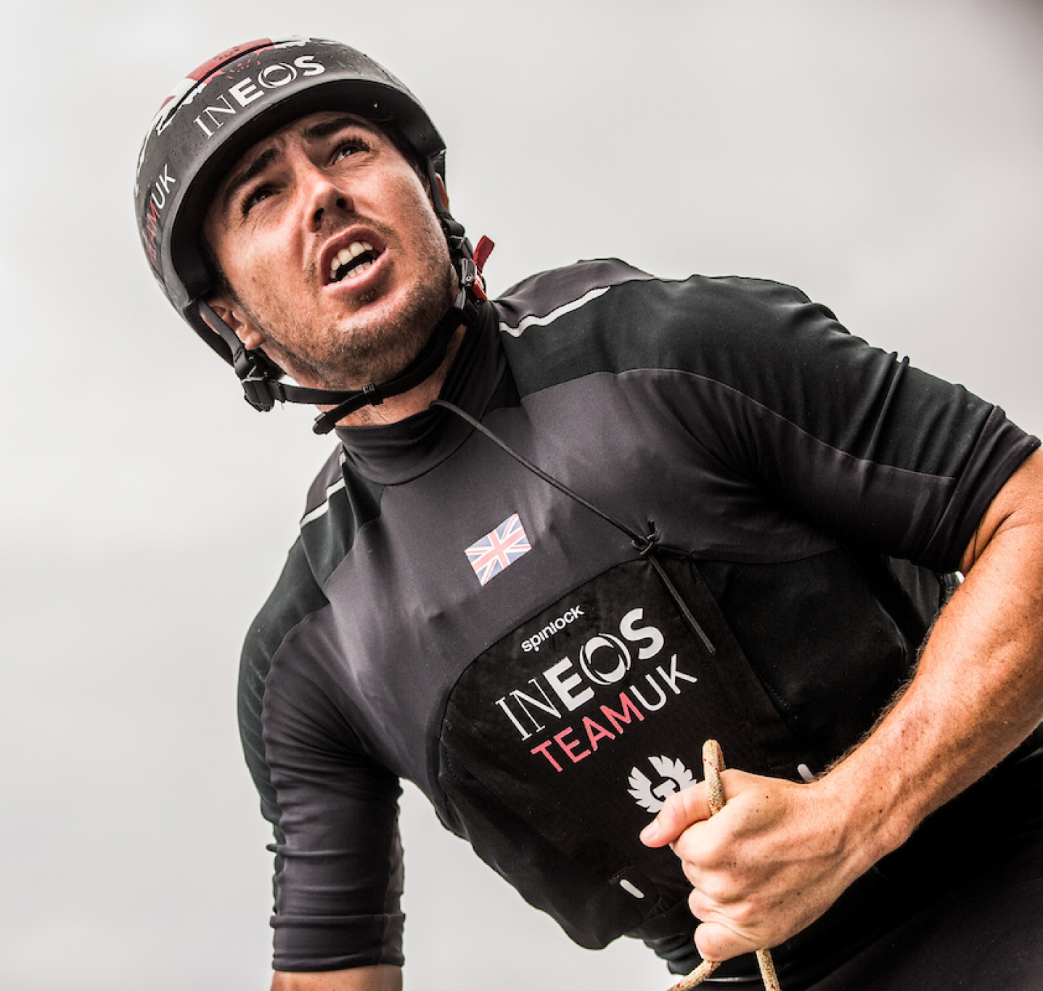
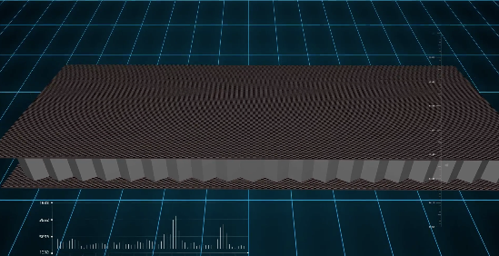
Materials
Properties of Materials
What are their properties?
Which materials are used where?
ABS Thermoplastic Helmet
Clysar
Neoprene life jacket
Lycra
Carbon Aluminium Honeycomb

Slide 4
Materials
Properties of Materials
On the worksheet, describe the different materials.
What words might describe them?
What do you notice?
What might they be used for?
What properties should they have?
Why a honeycomb structure?

Slide 5
Materials
Properties of Materials
Which materials are used where?
Jib
Wing Sail
Hydrofoils
Hull
Rudder

Slide 6
Materials
Design a Boat Using the Materials You Have Been Given
Goal: carry as much weight as possible. Use the iterative design process.
Why is it a problem? Who is it a problem for?
What solutions already exist? What are their pros and cons? What other solutions or improvements can you think of? Which is the best solution and why? How would you do it?
How did it work? What went well and what didn’t? What would you change?

Slide 7
Materials
Results
Team | Mass added (g) | Position

Slide 8
Materials
Evaluation
Which materials worked well?
Which didn’t?
What could work better next time?
  Would you use different materials?
  What would you change about your design process?

Slide 9
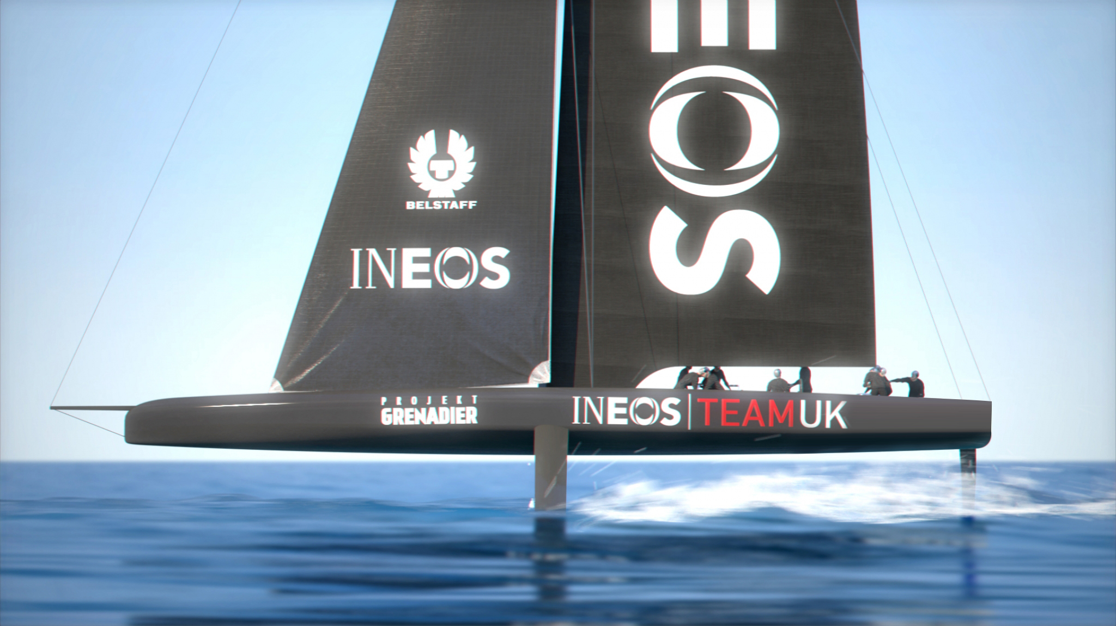
Materials
Back to the real world…
How much weight did your boat support?
The INEOS TEAM UK America’s Cup boat needs to withstand strong winds and movement loads – the AC 75 boat can support a vertical down force at the base of the mast of 58,000Kg (The weight of 46 Minis!).

Slide 10
