Slide 1
Lesson 2 – Bacteria and preventing the spread of pathogens
Notes:
Teacher notes
This presentation is designed to be shown as a slideshow, not in preview mode, as answers to questions and activities are animated at appropriate points during the presentation.
The teacher notes provide guidance and options for activities during the lesson which can be included or not as appropriate for your group and context.

Slide 2
HOW DO YOU KEEP WINNING IN SPORT?
It’s 2015, the INEOS Grenadiers (formerly Team Sky) cycling team had another very successful winning season

Slide 3
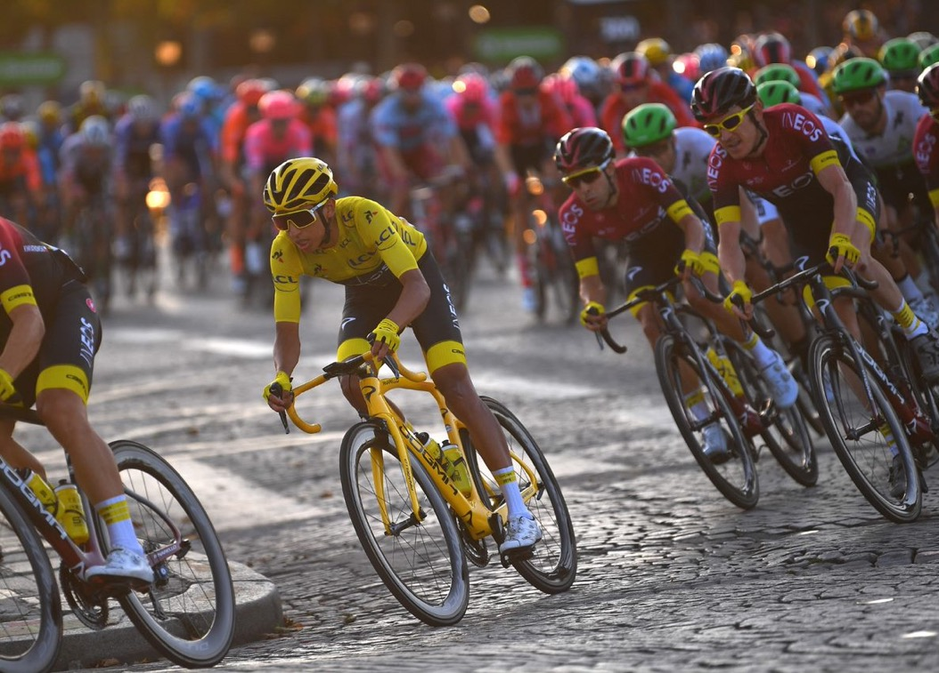
…but in their determination to stay ahead of all the other teams, they spotted a problem.
A review of the season showed that critical training and competition time was being lost and time on a bike was being taken away; not just a few, but many days.
WHY WAS THIS?
Notes:
Teacher Notes
Encourage students to think about what might cause days to be lost, make the link to school and why time is lost in school due to illness, family events, injury, difficulties with transport etc.
See detailed notes on following slide to make the link to the issues identified by Team Grenadier(Sky)

Slide 4
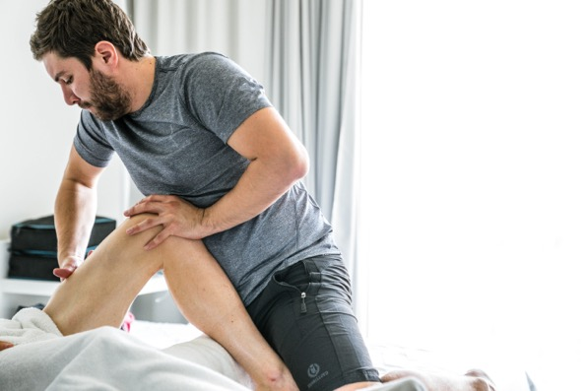
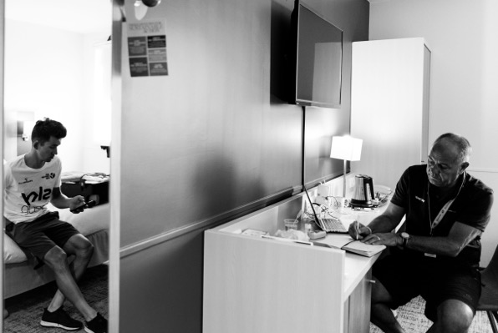
WHY WAS SO MUCH TIME BEING LOST?
At that time, a lot of attention was being given to treating riders for upper respiratory tract infections to get them back riding as soon as possible.
In looking at all the risks factors that might reduce the time that riders can spend on a bike, the question came up:
What if we could stop losing days to illness by reducing the risk of riders getting ill in the first place?
Notes:
Teacher notes
Adding background to how Team Sky (now INEOS Grenadiers) took a scientific approach to staying ahead of the opposition in the highly competitive world of a professional cycling will help add context to the learning from this session.
The team recognised that while time on the bike was necessary, time on its own is not sufficient to produce the adaptation required to achieve the highest levels of performance. However, more time would allow the coaches and support team to craft the dimensions of adaptation: the effort, the design of the environment, and the technical and tactical dimensions of a winning performance.
In 2016, the team conducted a detailed review to identify all the risk factors that would reduce the time that riders could spend on a bike; these included:
● Weather and equipment selection
● Mechanical failures and bike preparation
● Travel and transport issues
● Injury from chronic loading
● Illness
● Accident/crashes
● Ineffective planning and uninformed decision making
While all of these were being considered, it was days lost to injury and illness that developed the main focus of the zero days concept.
You could ask students to try and identify some of the factors listed above that lead to lost training time, particularly for a team that spends a large amount of time traveling around the world to compete. Making the link to traveling and illness would help students appreciate the increased risk factors. Asking them if they have ever been ill on holiday and why was that?

Slide 5
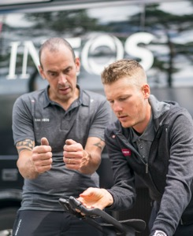
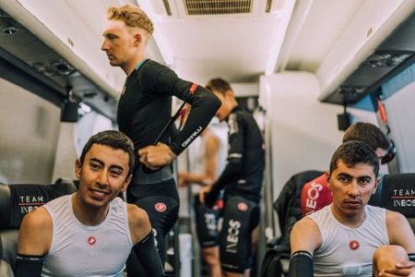
WHY WAS SO MUCH TIME BEING LOST?
It was this thought that led to the concept of zero days lost and the start of Zero Days initiative
‘Identify and eliminate all the vulnerabilities, threats and risks that reduce the time that riders can spend on a bike.’
To win, in moments that matter in Grand Tours require riders to be 100% healthy. Unlike in other team sports, at the crucial stages it is all down to the performance of one rider – any physiological and psychological problems at this point can be the difference between a team winning
or losing.
Notes:
Teacher notes
Adding background to how Team Sky (now INEOS Grenadiers) took a scientific approach to staying ahead of the opposition in the highly competitive world of a professional cycling will help add context to the learning from this session.
The team recognised that while time on the bike was necessary, time on its own is not sufficient to produce the adaptation required to achieve the highest of all levels of performance. However, more time would allow the coaches and support team to craft the dimensions of adaptation: the effort, the design of the environment, and the technical and tactical dimensions of a winning performance.
In 2016, the team conducted a detailed review to identify all the risk factors that would reduce the time that riders could spend on a bike; these included:
● Weather and equipment selection
● Mechanical failures and bike preparation
● Travel and transport issues
● Injury from chronic loading
● Illness
● Accident/crashes
● Ineffective planning and uninformed decision making
While all of these were being considered, it was days lost to injury and illness that developed the main focus of the zero days concept.
You could ask students to try and identify some of the factors listed above that lead to lost training time, particularly for a team that spends a large amount of time traveling around the world to compete. Making the link to traveling and illness would help students appreciate the increased risk factors. Asking them if they have ever been ill on holiday and why was that?

Slide 6
JOIN INEOS GRENADIERS IN TRYING TO ACHIEVE ZERO DAYS LOST
What causes the spread of disease and what can we do to prevent it!
Notes:
Teacher notes
Explain to students that in order to be able to reduce the number of days lost to illness the team had to gain an understanding of the different types and causes illness and how they can prevent the spread of infection.

Slide 7
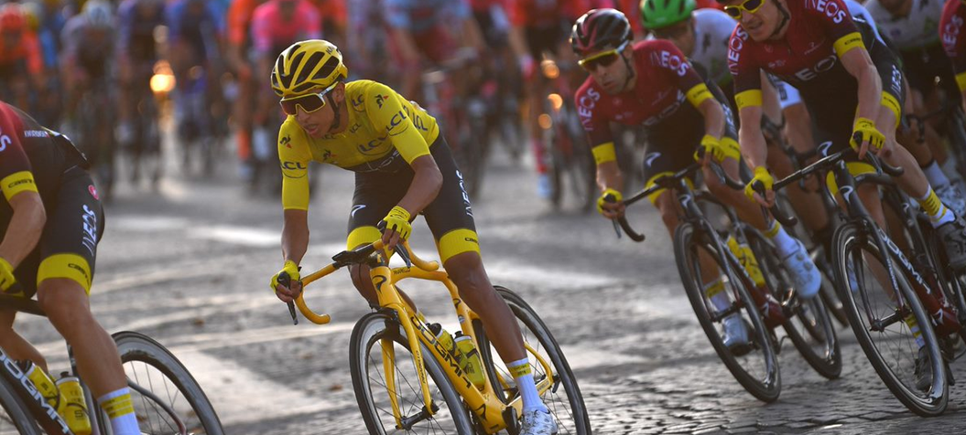
LEARNING OBJECTIVES
Describe how bacteria cause illness.
Explain how bacteria live and reproduce.
Compare how viruses and bacteria reproduce and make us unwell.
Explain how the spread of pathogen can be reduced or prevented.
Keywords:
Bacteria
Disease
Pathogen
Infectious
Toxins
Protists
Eukaryotes
Notes:
Teacher Notes
Definitions for each of the key words are provided in the final slide to help review learning and check key notes from the session.

Slide 8
THINKING ABOUT THE SPREAD OF PATHOGENS
Can you remember the four ways pathogens can be spread and think of an example of each?
Contaminated food
Indirect contact
Direct contact
Airborne
Water
NOTE: Each of these methods down, we will need to know these if we are going to stop transmission.
Notes:
Teacher Notes
Click to reveal the spread of pathogens from last lesson
Once notes take explain to students that having looked at Viruses last lesson, we are now going to look at Bacteria, fungi and protists. Starting with bacteria.

Slide 9
FEATURES OF BACTERIA
They are living cells.
They are prokaryotes - single celled organisms.
They do not have a true nucleus, but a circular strand of DNA.
Notes:
Teacher notes
Explain to students that having looked at Viruses last lesson we are now going to look at Bacteria, fungi and protists. Starting with bacteria

Slide 10
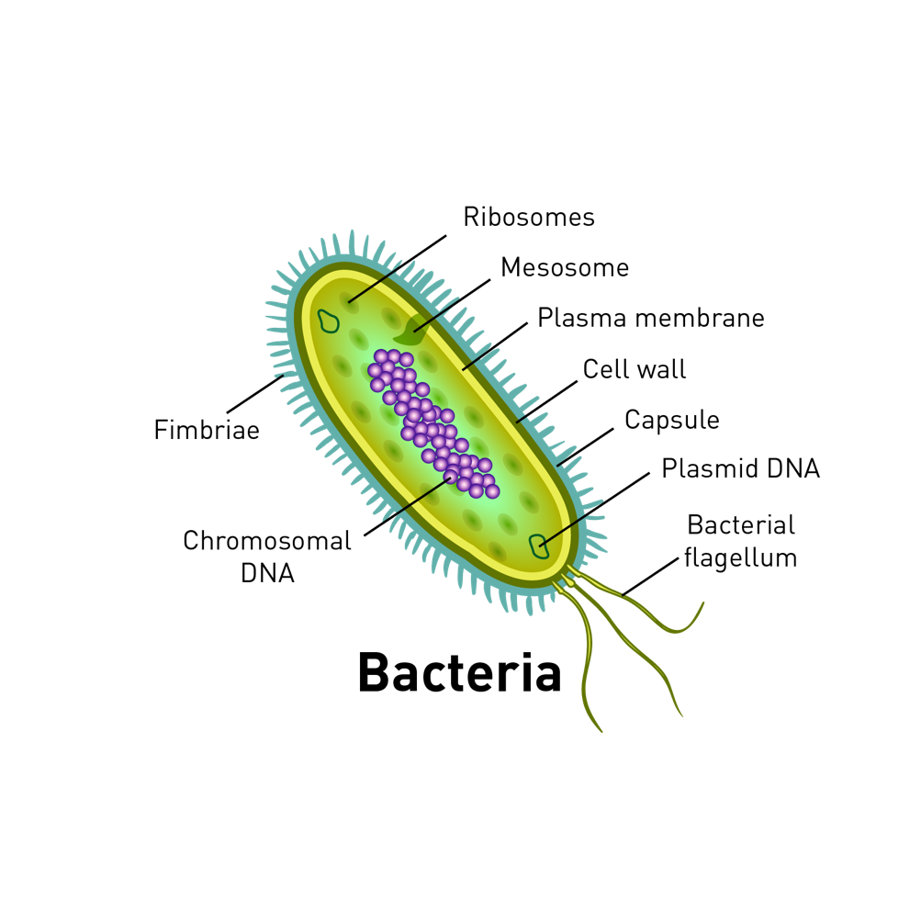
FEATURES OF BACTERIA:
They do not contain mitochondria.
Some have a tail, known as a flagellum, to help them move.
They produce toxins that damage cells and tissues.
Up to 0.01mm (10,000nm) long.
Examples include:
Food poisoning, salmonella,
Cholera
Gonorrhea
Malaria
Asthma
Notes:
Teacher notes
To make the learning more active this slide could be printed and placed around the classroom, working in small groups one member of the group is given 20 seconds to go and read the information on the sheet and report back to the rest of the group what they have found out about Bacteria. Repeat 3 times with different members of the group reporting back and all taking notes. At the end select one member of the group to feed back to the class or attempt to draw the diagram on the board from the information they have gained.
Then compare with the actual slide making sure students have complete notes using the slide.

Slide 11
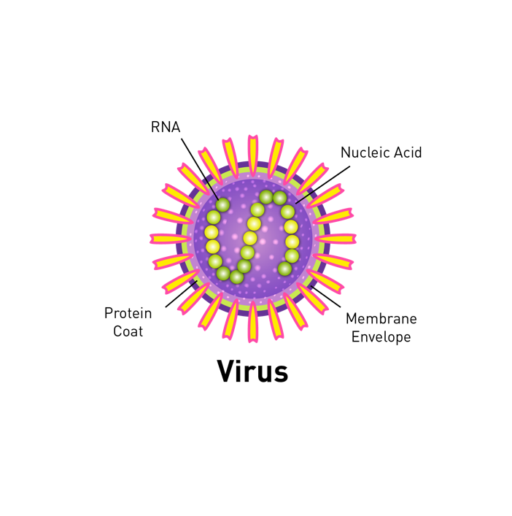
WHAT'S THE DIFFERENCE?
Both viruses and bacteria can make us ill, thinking back to what you know about viruses, what are some of the differences and similarities between the two pathogens and how they make us unwell?
TASK: Use the worksheet to note the similarities and differences
V

Slide 12
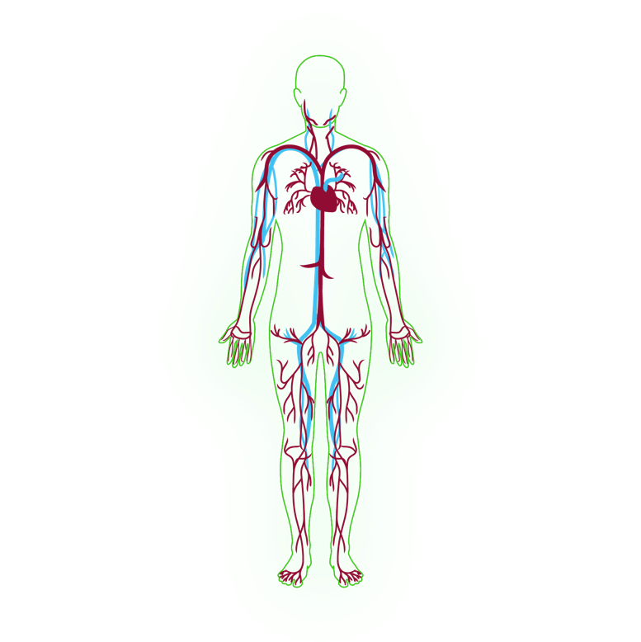
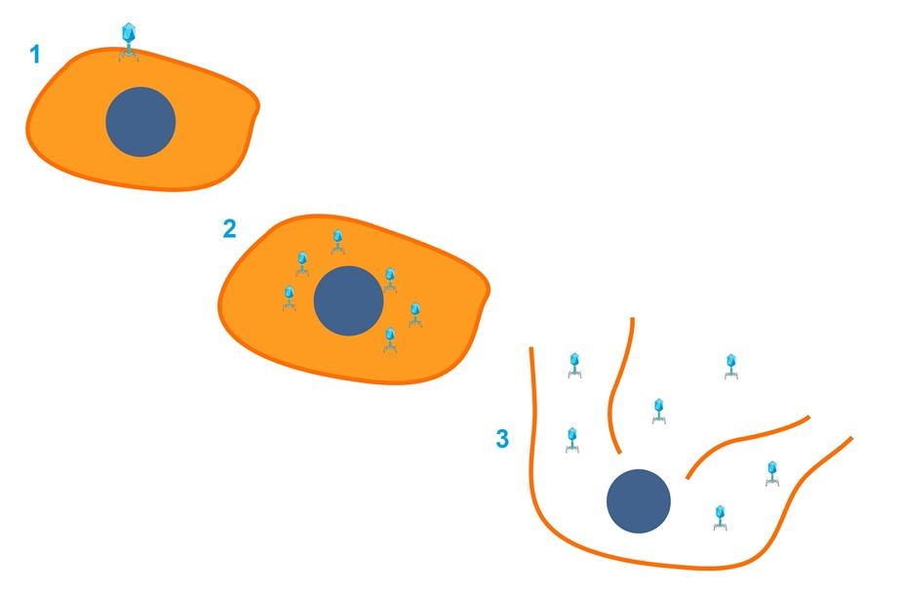
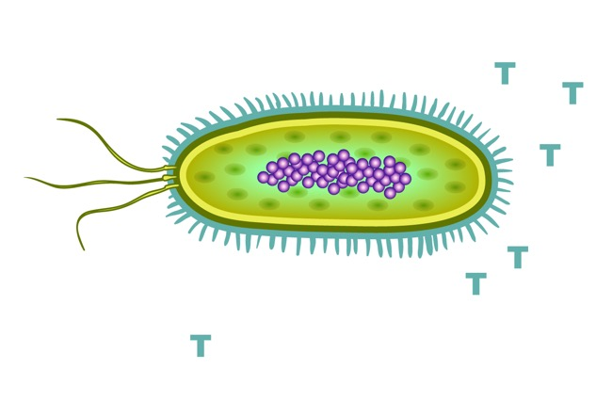
HOW DO PATHOGENS MAKE US FEEL UNWELL?
BACTERIA
VIRUS
= Toxins
Notes:
Teacher notes
Print a copy of this slide for students to label and write brief notes to describe how viruses and bacteria make us feel unwell.

Slide 13
CHECKPOINT TASK
TASK: Write a short paragraph to describe the main differences between bacteria and viruses. (5 marks)
Notes:
Teacher notes
GCSE style question

Slide 14
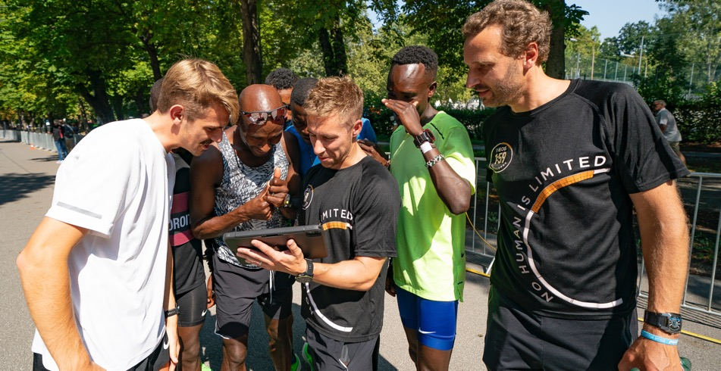
CHECKPOINT TASK
As a team member of the Zero Days program you need to know about all four pathogens to be able to advise the sports teams on how pathogens cause illness and how to reduce the risk of illness.
TASK:​
You are going to become an expert in either Protists or Fungi.​
Write down the key information about your microbe.​
Once you have become an expert you are going to share your information with others in the group.
Notes:
Teacher notes
For school based lessons print the information slides for Protists and Fungi and get students to work in pairs. One student researches Fungi and the other researches Protists. If facilities allow, students could extend their research using the internet or text books depending on availability. Allow students a set amount of time before getting them to teach their partner about their pathogen using their own notes diagrams or other creative ways .
Home working
The same task can be set if students are working from home to independently research Fungi and or Protists. The sheets could be provided in printed form or online. You could take advantage of the opportunities home working allows by encouraging creative ways of communicating their learning through the use of video, animation modelling etc.

Slide 15
FEATURES OF FUNGI
Fungi are eukaryotes.
Unlike bacteria they have evolved a huge range of appearances from single cell yeasts to multicellular mushrooms.
The cell wall of fungi is made from chitin.

Slide 16
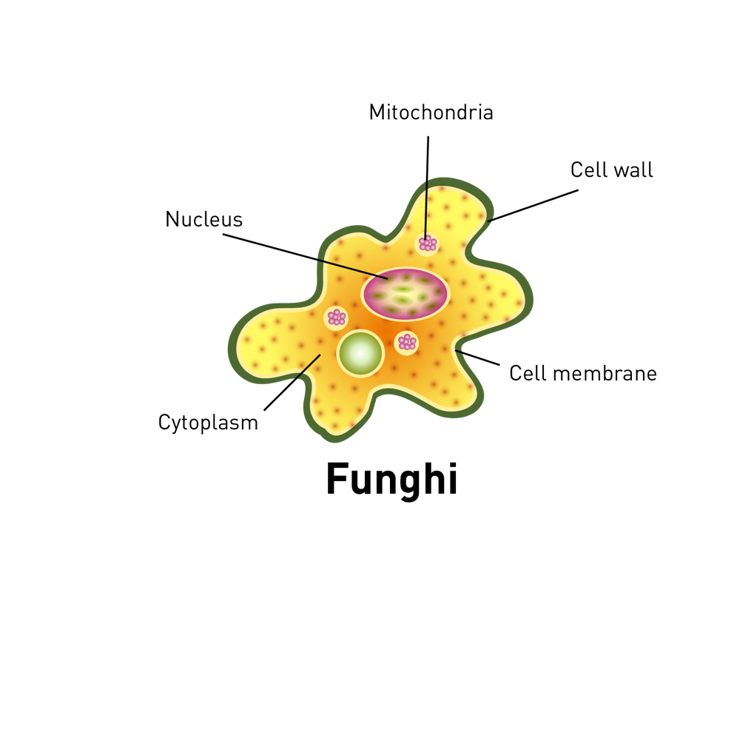
FEATURES OF FUNGI:
Fungi use saprotrophic nutrition - they secrete enzymes to digest food and then absorb it.
Fungi have thread like structures called hyphae.
Hyphae can produce spores enabling the fungus to be easily spread.
Examples include: Athletes foot, toadstools, mushrooms and moulds.
Notes:
Teacher notes
This slide could be printed and placed around the room for students to gather information on their pathogen before reporting back to other members of the team.
Alternatively it could be used as a starting point for home working research.

Slide 17
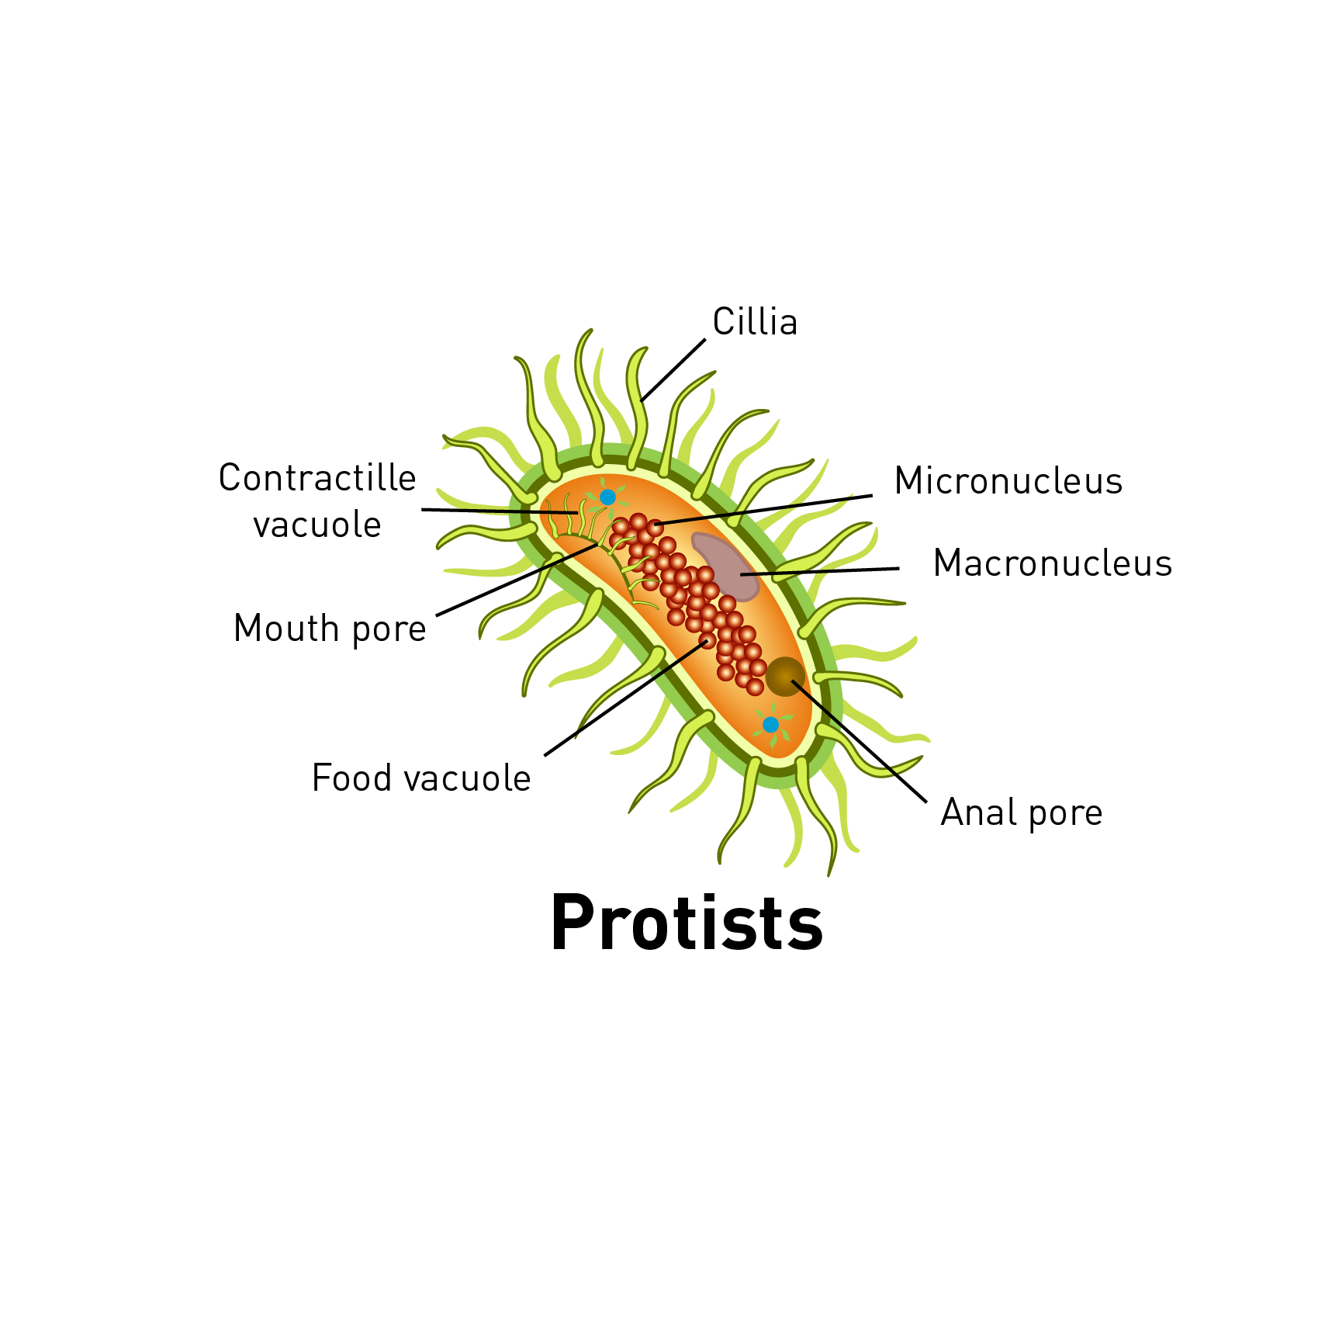
FEATURES OF PROTISTS:
Protists, or protozoa, are eukaryotes.
They are single celled organisms.
They can be parasitic; this means they live on or inside another organism causing harm.
They can be animal-like, plant-like, or fungi-like.
Malaria is a well-known illness caused by protists and transmitted by mosquitos.
Notes:
Teacher notes
This slide could be printed and placed around the room for students to gather information on their pathogen before reporting back to other members of the team.
Alternatively it could be used as a starting point for home working research.

Slide 18
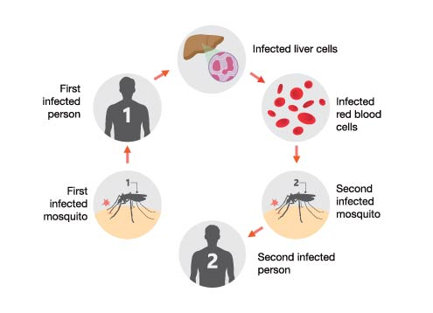
LIFE CYCLE OF MALARIAL PROTISTS
A healthy person is bitten by an infected mosquito.
The parasite is injected into the blood stream.
The parasite invades the liver and red blood cells causing the illness to develop.
If a mosquito feeds on the blood of an infected person, the parasite enters the mosquito.
When the mosquito feeds on a healthy person, the parasite is passed on.
Notes:
Teacher notes
This slide could be printed and placed around the room for students to gather information on their pathogen before reporting back to other members of the team.
Alternatively it could be used as a starting point for home working research.

Slide 19
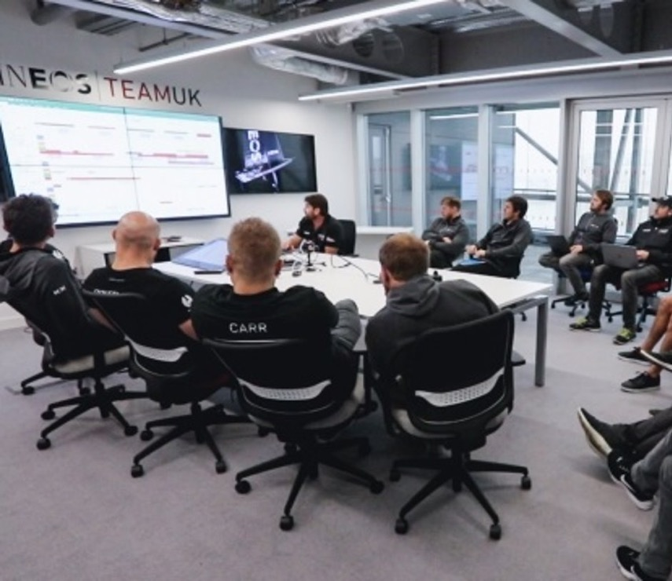
HOW CAN WE PREVENT INFECTION?
Zero Days is all about preventing illness. If you were responsible for briefing one of the INEOS sports teams, make a list of the actions you would suggest individuals take to avoid getting ill.
TIP: Think about the ways in which pathogens are spread and how you can stop team members being infected.
Notes:
Teaching notes
Students could work individually or as a group to produce their list.
If time allows or students are working from home, they could use more creative ways of communicating their message through use of video, posters, social media posts or presentation.
The next slide has suggested strategies that students can check their work against.

Slide 20
HOW CAN WE PREVENT INFECTION?
Wash hands thoroughly with soap and water.​
Avoid touching your eyes, nose and mouth with your hands, as this could allow viruses from surfaces you touch to enter the body.​
Avoid close contact with people.​
If you are ill, report it and stay home.​
Cough or sneeze into your elbow or a tissue and throw it in the bin. ​
Clean and disinfect frequently touched surfaces.
Notes:
Teacher notes
Use the checklist to help students review their responses.
INEOS Grenadiers summarise their approach and the responsibility of everyone in the team using three words:
PREPARE, PROTECT, CONTROL

Slide 21
POSTER IMAGES
When they are signed off

Slide 22
CALL TO ACTION
From the advice you have prepared for INEOS Sports teams to help them achieve zero days lost due to illness, what strategies could you use at school to help protect your school and its community from illness?​
Whose responsibility is it to do these things?
120–140 nm
Do the basics brilliantly!​
Keep your school and community safe to create a winning team!​
Notes:
Teacher notes
In addition to the science, the key takeaway should be that we all have responsibility for each other's health in exactly the same way as INEOS team members all take responsibility to do the basics brilliantly to help keep everyone safe and successful.

Slide 23
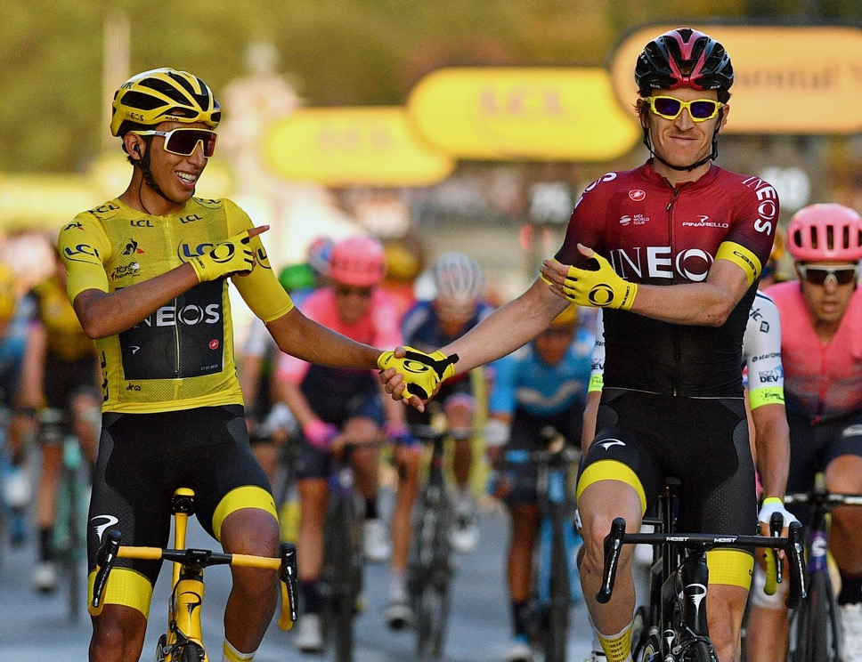
WERE YOU SUCCESSFUL?
Describe how bacteria cause illness.
Describe how bacteria live and reproduce.
Compare how viruses and bacteria reproduce and make us unwell.
Explain how the spread of pathogens can be reduced or prevented.

Slide 24
KEY WORDS
BACTERIA - are all single-celled. The cells are all prokaryotic, which means they do not have a nucleus or any other structures which are surrounded by membranes.
DISEASE - Something that negatively affects a living thing.
PATHOGEN - A microorganism (virus, bacteria, protist or fungus)that can cause diseases in animals and plants.
INFECTIOUS - A Communicable Disease that can be passed (transmitted) between living things. It can also be known as an infectious disease
TOXINS - harmful chemicals released by bacteria that make us feel unwell.

