Slide 1
SMALL IS ChallengE
Technology for the future
Notes:
This presentation accompanies a set of Small Is challenge pupil activity sheets and a technology/product timeline poster.
They can be downloaded at - practicalaction.org/schools/small-is-challenge.

Slide 2
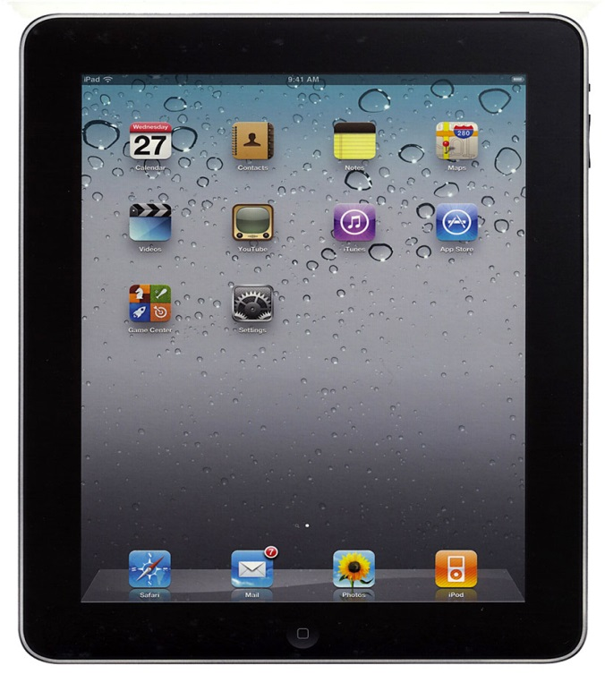
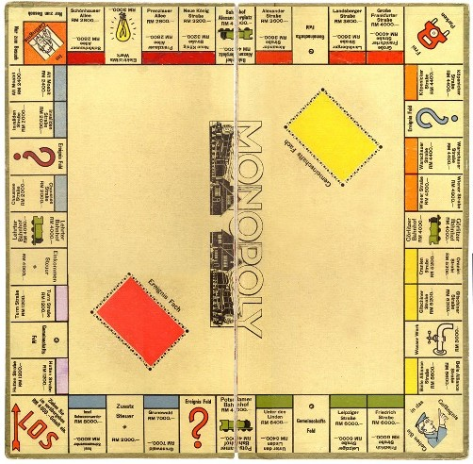
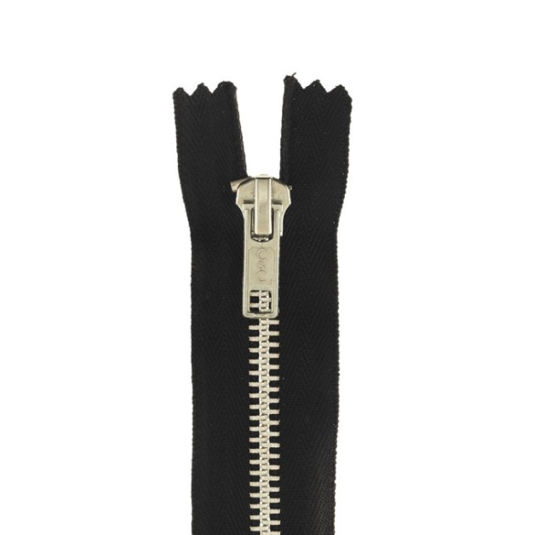
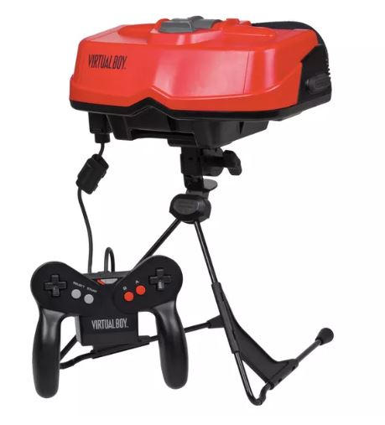
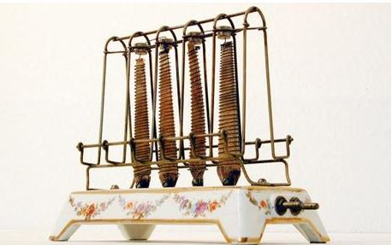
Apple ipad
World wide web
Monopoly
3D computer game
Zip
Electric toaster
Notes:
Ask pupils to guess the year these technologies/products that they are familiar with were invented.

Slide 3
2010
1990
1934
1987
1917
1919
Notes:
The dates have been sourced from - thoughtco.com/invention-timelines-4133297

Slide 4
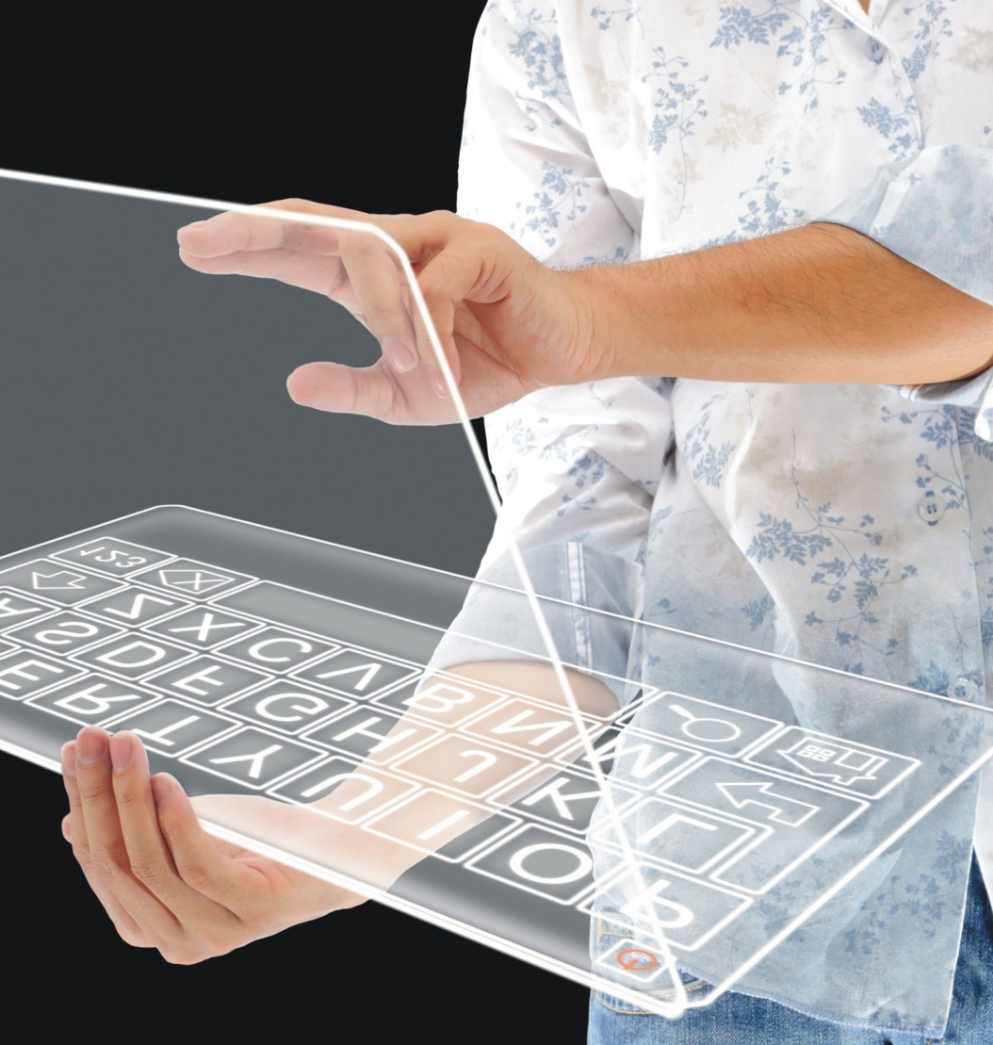
Starter activity
In small groups, mind map as many new technologies or products that you can think of that have been launched over the past five years.
Include areas such as:
Food
Transport
Communication technology
Clothes
Toys
Notes:
You might choose to run this as an extended research task where pupils can spend time finding out about new technologies/products.

Slide 5
Technology timeline
Look at the Technology timeline in your classroom and use it as inspiration to help you select a product or technology that interests you. Complete the following activity sheets and feedback to your class.
Research: 100 years of inventions
Research: Recording the past
Notes:
Pupils can choose a technology from the timeline or any other technology or product of their choosing.
Hand out the Pupil activity sheets (one per pupil)
One interesting idea for a classroom display is to put pupils completed 100 years of inventions sheets above and below the Technology timeline poster, then use string to connect to the year the products were invented.

Slide 6
The future
So far, we’ve looked at technologies from the past 100 years.
Now we want to think about the technologies and products people might need and want in the future.

Slide 7
Who’s responsible?
Notes:
There are many people around the world thinking about technologies we might need and want in the future.
Ask the pupils to think of the range of Scientists, Designers, Technologists, Engineers and Maths professionals that might be involved in developing ideas for new products/technologies in the future.
For case study examples of STEM professionals working in international development go to - practicalaction.org/schools/stem-careers

Slide 8
Sustainable Development Goals
In 2015, the United Nations called a meeting with leaders from over 30 countries.
They identified 17 Sustainable Development Goals (SDGs) to end global poverty.
Many of the goals such as Zero hunger and Clean water and sanitation need technology to help reach their targets by 2030.
Notes:
The Sustainable Development Goals are also commonly known as the Global Goals.
To find out more about the targets behind each one look at the display materials go to practicalaction.org/schools/sdgs
If you have time, we recommend that you run the Global Goals string activity and Who’s responsible? They help to get the pupils thinking about the roles of Scientists, Technologists, Engineers and Maths professionals in developing technological solutions to many of the targets.
More information can be found at globalgoals.org

Slide 9
SMALL IS CHALLENGE

Slide 10
Small is challenge
Your challenge is to develop an idea for a technology or product that will help people to live more sustainably now and in the future.
Notes:
If you decided to link the challenge directly to the SDGs, you might want to specify that the
design for their technology/product should be feasible to help reach the SDG targets before 2030.

Slide 11
Starting points for the challenge…
You might decide to look at one or two of the Sustainable Development Goals to help you to identify a problem that needs an ingenious solution.
Notes:
A number of the SDGs are dependent on STEM skills and technologies to develop solutions to reach the targets by 2030.
They include Zero hunger, Clean water and sanitation, Affordable and clean energy, Sustainable cities, Climate action, Sustainable production and consumption

Slide 12
Three things to consider during your challenge…

Slide 13
1. Is your technology or product needed?
Many new technologies and products are developed to meet our ‘wants’ rather than things we ‘need’.
The things we buy and use have a massive impact on people and the environment.
Notes:
We suggest you ask pupils to have a think about the technologies and product they feel are really needed rather than wanted.

Slide 14
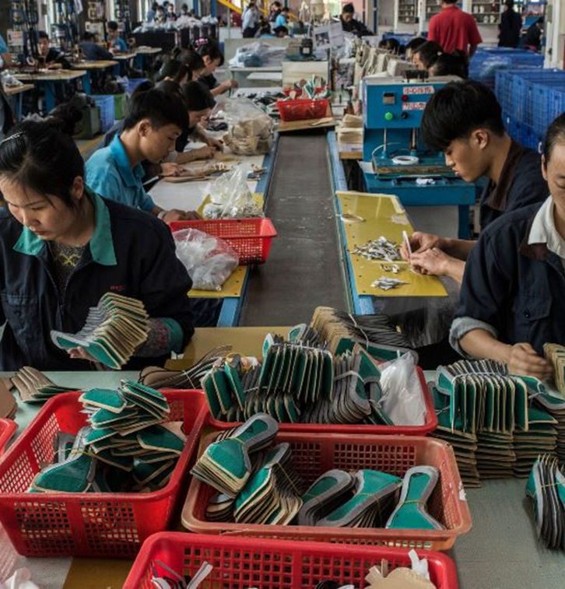
2. What impact does your idea have on people?
Technology can have a major
impact on people’s lives.
We would like you to think about the effect on people involved throughout the whole lifecycle of the technology (from production through to final disposal) including people living elsewhere in the world.
Notes:
You might want to extend pupils thinking around the impact of technology on people with our Winners and Losers activity. It can be downloaded at practicalaction.org/schools/winners-and-losers

Slide 15
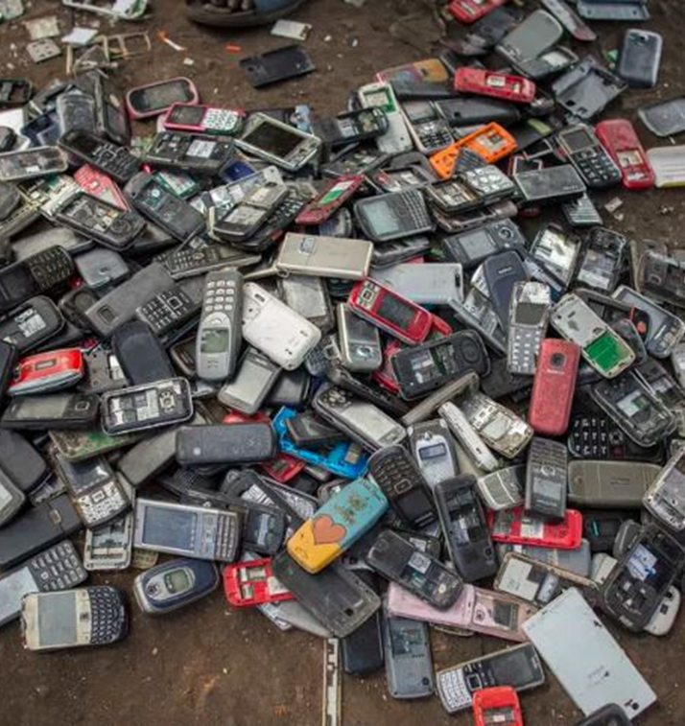
3. What affect does your idea have on the environment? Here are a few things to help you to reduce the environmental impact of your technology. Try to: - use renewable materials and energy where possible - design it in a way that it can be repaired and easily disassembled for recycling.
Notes:
If your pupils are not familiar with doing a lifecycle analysis of products/technology, then you might want to introduce them to the concept with our activity Product Lifecycle Analysis. It can be found at practicalaction.org/schools/product-lifecycle-analysis

Slide 16
Good LUCK with your ideas
Notes:
When pupils are ready to get started hand out the sheets below and encourage them to draw and annotate their designs to include materials:
Technology for the future: Initial ideas
Technology for the future: Final ideas
Allow pupils to share their own ideas and feedback on the ideas of others.
You may like to display pupil ideas by extending the Technology timeline poster, and connecting images of their ideas to the point they think they could be possible.

Slide 17
“The most sustainable way is to not make things.
The second most sustainable way
is to make something very useful, or to solve a problem that hasn’t been solved”
Thomas Sigsgaard

Slide 18
We hope you have enjoyed developing your ideas.
Why not put them in a time capsule and open it after five years.
Thank you for helping to develop sustainable solutions for our future.

