Slide 1
STOP THE
SPREAD
A STEM challenge tackling a global problem…
the spread of communicable diseases
Notes:
The focus of this challenge is on improving hygiene as a way of reducing the spread of communicable diseases. It is important that pupils understand that hand washing is just one of the methods of prevention.
To find out more about what is being done to tackle this challenge go to:
www.gatesfoundation.org/What-We-Do/Global-Development/Water-Sanitation-and-Hygiene

Slide 2
No one wants to get ill
Think about the last time you were ill.
Was it a cough or a cold ? Something worse like measles? What is the worst illness you have had?
There are lots of different diseases. Some happen everywhere whilst others, like malaria, occur more in developing countries where people do not have access to clean water and good hygiene and sanitation.
1

Slide 3
How do we get diseases?
communicable Diseases
Communicable diseases are diseases caused by micro-organisms that penetrate the body’s natural barriers.
In two minutes brainstorm all the different diseases you know, here and around the world and divide them into communicable diseases and non-communicable diseases.
Non-communicable Diseases
2
Notes:
In pairs, ask pupils to make a list of any diseases/illnesses they know about and to divide them into communicable (e.g. malaria, AIDs, flu, glandular fever) and non- communicable (e.g. cancer, diabetes, scurvy, muscular dystrophy). Explain that in their challenge they will be focusing on communicable diseases.

Slide 4
How do infectious diseases spread?
Any ideas?...
Brainstorm in two minutes!
3
Notes:
Ask pupils to think about the different ways communicable diseases spread. Show the slide to see how many they identified.

Slide 5
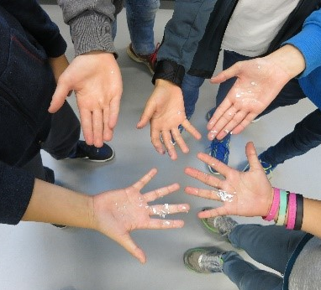
Let’s shake hands?
Your Stop the Spread challenge will focus on preventing diseases that are spread by hand to hand contact.
To help get you thinking about this topic you are going to do two short activities to discover more about…
How quickly communicable diseases can spread.
What you can do to reduce the spread of infection.
4
Notes:
Explain that this challenge will focus on diseases that are spread by human contact. Run one or both starter activities, demonstrating how diseases are spread and how handwashing may or may not help reduce that spread. See Teacher’s guide for instructions.
NB. These activities work best in larger groups.

Slide 6
Infectious disease – a global problem
Has anyone heard of the Global Goals or Sustainable Development Goals?
In 2015 The UN put together a set of 17 Sustainable Development Goals (SDGs) or Global Goals to end poverty by 2030.
Two focus on the prevention of infectious diseases… so it is a really important issue!
Global Goal 3: Good health and well-being.
Global Goal 6: Water and Sanitation.
5
Notes:
Find out what the pupils may already know about the Sustainable Development Goals (SDGs) or Global Goals, discuss.
In 2015 the UN set out 17 SDGs. These aim to end global poverty by 2030.
The following are most closely linked to preventing the spread of communicable diseases:
SDG 3 - Health and Well-being
One of the targets is: By 2030, end the epidemics of AIDS, tuberculosis,malaria and neglected tropical diseases and combat hepatitis, water-borne diseases and other communicable diseases.
SDG 6 – Water and Sanitation
– One of the targets is: By 2030, achieve access to adequate and equitable sanitation and hygiene for all and end open defecation.
For information on the SDGs go to www.globalgoals.org
For activities to engage pupils in the SDGs go to www.practicalaction.org/schools/sdgs

Slide 7
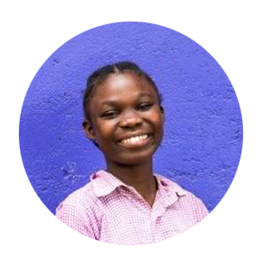
What is already being done?
Educating children https://vimeo.com/169209845
Child-to-child training Read the case study from Kenya.
Briefly discuss some of the things that can be done to reduce the spread of disease in communities such as those in Kenya.
6
Notes:
Watch the video and ask pupils to look at the case study to help them understand what is already being done to help ‘stop the spread’. This will help with the communication part of their challenge later.

Slide 8
STOP THE SPREAD
Notes:
.

Slide 9
Your Stop the Spread challenge
Imagine you work for a charity and have received some funding to help pupils in a school in Kenya reduce the spread of disease in their school.
Your challenge is to:
Build a model of a hand washing device that could go in their playground which will enable them to capture rainwater then use it to wash their hands.
Develop education materials which will help children aged 8-11 understand why hand washing is important. This could be a poster, animation, game, play, leaflet.
8
Notes:
Introduce the details of the challenge. Emphasize that the second part, which is about research and communication, is as important as building the model

Slide 10
How will you be judged?
You will be judged on the following:
Teamwork – Did you have different roles and work collaboratively?
Research – How did you use your research to help you in your tasks?
Designing – Did you do good, annotated initial and final designs?
Model – How creative was your model? Did you use sustainable material where possible? Did you stick to the budget? How well did it do in the test?
Education Materials – What and how did you communicate to the pupils? Are your materials engaging for 8-11 year olds?
9
Notes:
Explain that after the challenge groups will present to the rest of the class for peer-to-peer assessment according to certain criteria. Hand out ‘Evaluating the Work of Others’ worksheet and again emphasize the model is only part of the challenge.
If pupils are working towards a CREST Discovery Award make sure they have a Discovery passport and fill it in as they go along.

Slide 11
Key things to remember
For your hand washing device
Remember it must be able to both collect and dispense water.
It must use water efficiently (water is scarce in Kenya).
Think about how to avoid cross-contamination.
You have a budget – 125 credits, use it wisely!
Use locally available, sustainable materials when possible.
11
Notes:
You may like to leave this slide up as a prompt for pupils when carrying out the challenge.
• Divide the pupils into groups of 3-5.
• Explain the challenge, hand out the ‘Drop by Drop’ student pack to each pupil and allow time to ask questions. Remind them that as well as producing a model of a hand washing device they will be designing education material for primary pupils and presenting their work to the rest of the class. The test for the model will be pouring 250 ml of water onto the model and then demonstrating how it would be used to wash hands.

Slide 12
Key things to remember
For your education materials
Be creative, children are more likely to remember something presented in an interesting, fun way.
Do your research to get key facts and figures.
8-11 year olds in Kenya may have low levels of literacy.
Make sure your main messages stand out.
Consider using more than one way of getting your message across. Game, poster, song, play etc.
12

Slide 13
What do they do in Kenya?
Engineers in Kenya have come up with a simple design for a hand washing station which is widely used and looks like this…
It’s called a ‘Tippy Tap’. It only dispenses water, it doesn’t collect it.
How does your model compare to this? Do you think your model is better?
13
Notes:
After evaluating their own designs, show pupils this tippy tap design used in Kenya. Ask them to compare their own design to this one. Is there any element form thei design they would incorporate into their own? Conversely, do they think some of the ideas they had had would improve the tippy tap design?
For more information about the tippy tap go to https://www.tippytap.org/the-tippy-tap

Slide 14
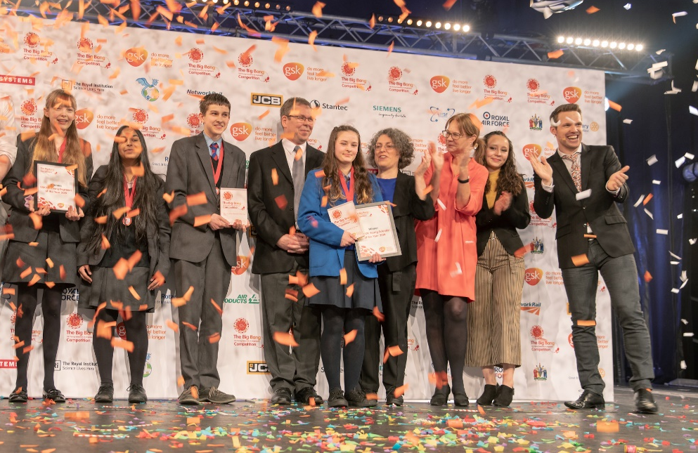
CREST Awards Stop the spread is perfect for a CREST Discovery Award. It can also be used to gain a Superstar award (primary) and as a context for Bronze–Gold Awards (Secondary) Big Bang Competition You can enter your challenge into the Big Bang Competition, either at regional events or on-line. 200 projects are chosen every year to attend the national Big Bang Fair in Birmingham. Prizes include industrial/scientific site visits, mentoring, cash, and the chance to represent the UK in International competitions.
This could be you next year!
10
Notes:
Stop the spread can be linked to a number of great initiatives such as CREST Awards, the Big Bang Competition, Great Science Share for schools and British Science Week. More information in the Teacher’s guide.

Slide 15
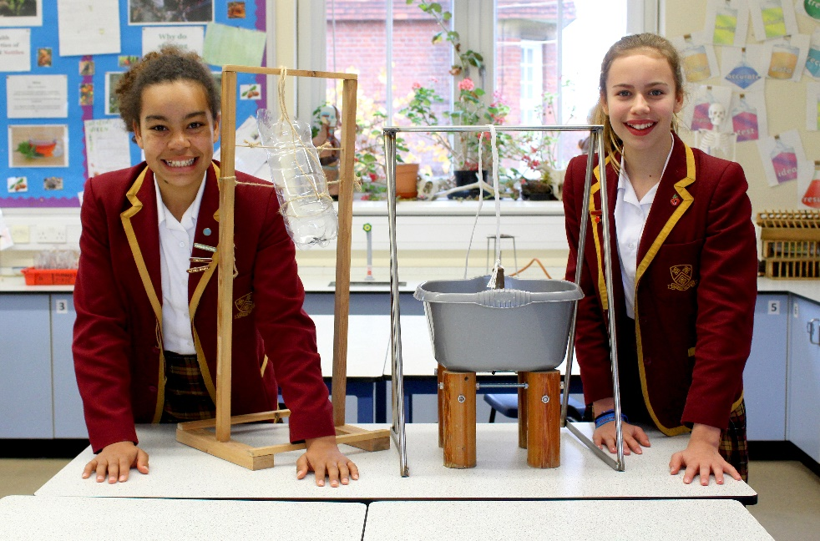
British Science Week
Now you have completed the Stop the spread why not try some of Practical Action’s other STEM challenges on a special week in March each year? How about the Squashed tomato challenge, Floating garden challenge, Regreen the desert, the Solar challenge or Ditch the dirt?
Great Science Share for Schools
A great opportunity for you to share your science projects with other schools, all on one special day in June each year.
10

Slide 16
We hope you enjoyed Stop the spread
For more information and resources go to:
practicalaction.org/schools

