Slide 1
SUSTAINABLE DEVELOPMENT GOALS QUIZ
practicalaction.org/schools
Notes:
This quiz is designed to help pupils become familiar with the issues and solutions linked to the Sustainable Development Goals (SDGs) also known as the Global Goals.
In 2015 the United Nations (UN) met with leaders from over 30 countries to work out how to solve some of the world’s biggest problems. They identified 17 Goals to end poverty in the world by 2030 and called them the: Sustainable Development Goals (SDGs) or Global Goals for short.
For activities around the SDGs go to:
Practicalaction.org/schools/sdgs
worldslargestlesson.globalgoals.org
For information on the SDGS and how to get involved we recommend:
Globalgoals.org
un.org/sustainabledevelopment/sustainable-development-goals
The questions in this quiz are taken from a number of sources. For more questions on the individual goals go to:
afd.fr/en/ressources/quiz-better-understanding-sustainable-development-goals-sdgs

Slide 2
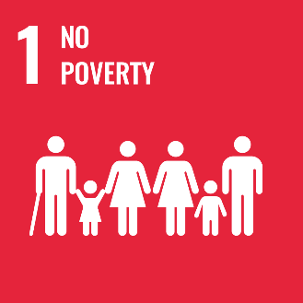
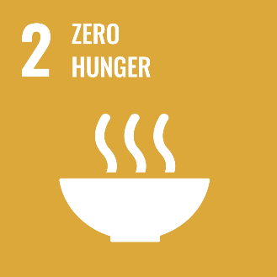
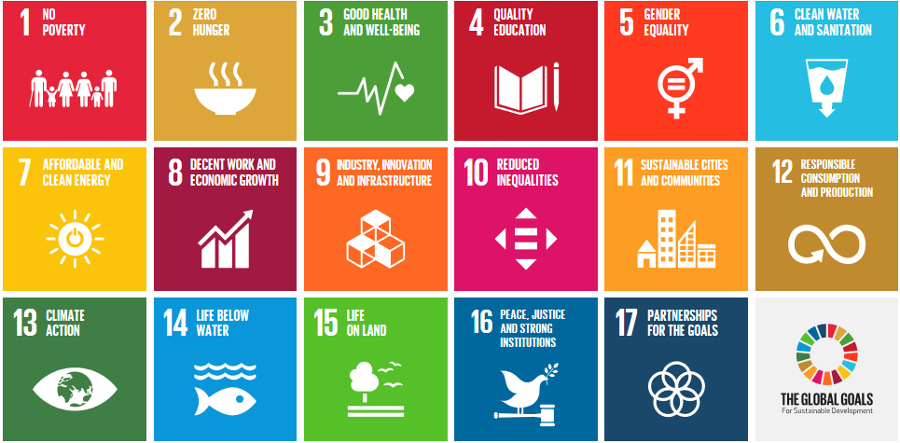
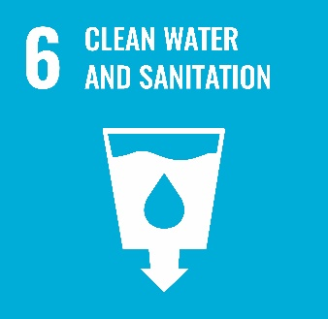
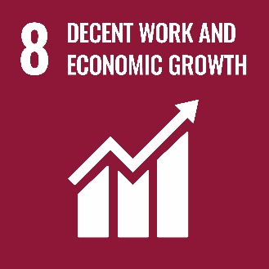
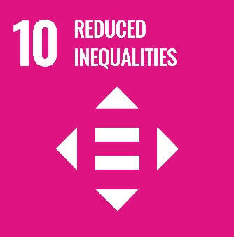
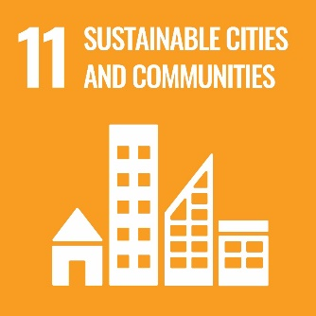
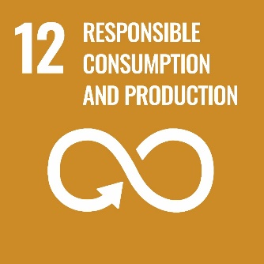
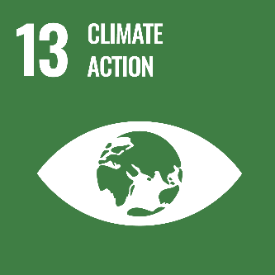
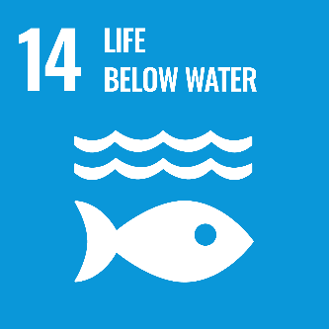
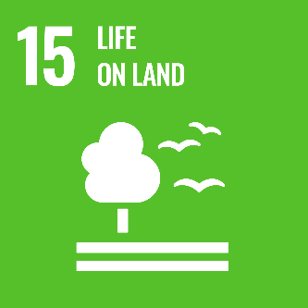
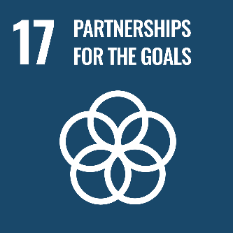
The Sustainable Development Goals (SDGs)
Notes:
These are the 17 SDGs
Click on a Goal go to the question for that Goal. Press return for the answer. To go back to this slide, click on the SDG icon in the bottom right of each slide.
You could play the quiz in a number of ways including:
- As a class, pupils play individually or in pairs. Ask pupils to choose the order they want to answer the questions. You may decide to only ask 10 questions.
- Divide class into 4 teams. The teams take it in terns to choose an SDG to ask a question on. If they get it right they get 2 points, if they get it wrong and another team gets the correct answer, that team gets 1 point.

Slide 3
The SDGs or Global Goals are a set of goals set by the United Nations to end poverty by which year?
2050
2030
2070
b. 2030
3
Notes:
As bonus questions you could ask…
How many SDGs are there?
Answer: 17
To the nearest billion, how many people are there in the world?
Answer: 8 (7.8 in 2020)

Slide 4
The definition of extreme poverty is when people earn:
1.9 dollars a day
1.25 dollars a day
5 dollars a day
a. 1.9 dollars a day
3
Notes:
This amount was set by the World Bank International.
If a person earns less than this then their standard of living is unsustainable and they are considered to be “extremely poor”.
Set in 2005 at 1.25 dollars a day, this threshold was raised in 2015 to 1.90 dollars to take increases in the cost of living into account.
SDG 1 fact ….More than 700 million people still live in extreme poverty
For information and advice on how to get involved in SDG 1 go to globalgoals.org/1

Slide 5
How many people in the world suffer from hunger?
1 in 10
1 in 5
1 in 20
a. 1 in 10
3
Notes:
815 million people suffer from hunger, or 11% of the world’s population.
The vast majority of hungry people live in developing countries.
SDG 2 fact – A third of the world’s food is wasted, yet over 800 million people are undernourished.
For information and advice on how to get involved in SDG 2 go to globalgoals.org/2

Slide 6
What is main cause of death in children 5 years or younger in the developing world?
Malnutrition
War
Communicable diseases e.g. cholera, COVID-19
a. Malnutrition
3
Notes:
Over 50% of deaths among pre-school children in developing countries are the result of the underlying effects of malnutrition on an illness.
SDG 3 fact – Vaccinations resulted in an 80% drop in death from measles in 2000-2017
For information and advice on how to get involved in SDG 3 go to globalgoals.org/3

Slide 7
How many children around the world are forced to work ?
1 in 30
1 in 15
1 in 7
c. 1 in 7
3
Notes:
It is estimated that globally there are 218 million child laborers aged 5 to 17 with 152 million of these children working under hazardous conditions.
When children are working they are not able to receive a good education.
theworldcounts.com/stories/child-labor-facts-and-statistics
SDG 4 fact – over 600 million children don’t get a basic level of education in reading and mathematics.
For information and advice on how to get involved in SDG 4 go to globalgoals.org/4

Slide 8
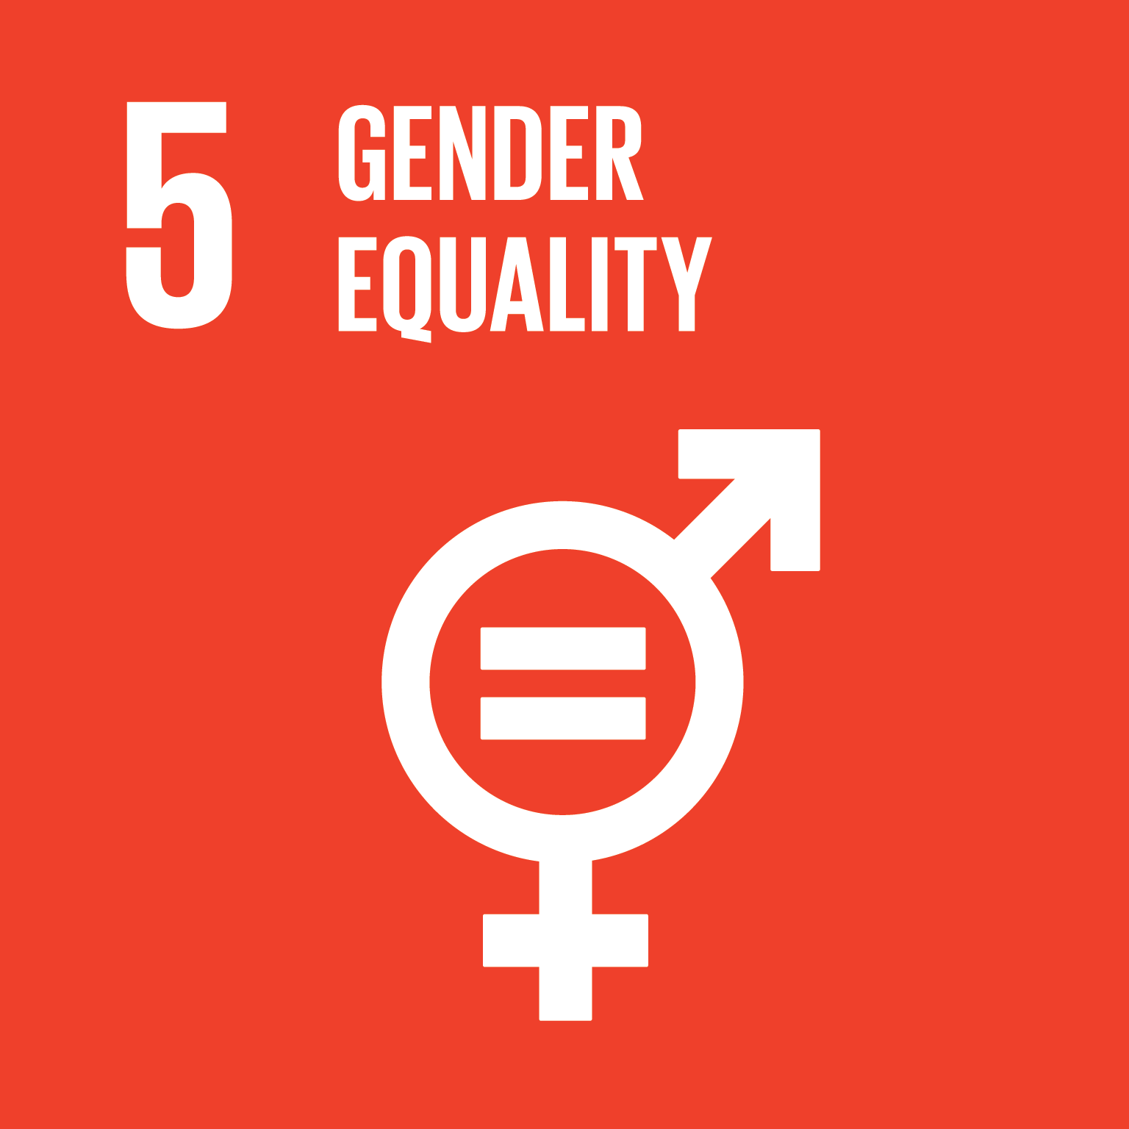
Which of the following are important in gender equality?
Equal pay for men and women
Girls receiving the same level of education as boys
Women being able to receive loans to start a business
All 3
3
Notes:
These are all included in the 5 targets for SDG 5. Lack of gender equality is not just a human rights issue, it is a waste of the world’s human potential. SDG 5 is about achieving gender equality and empowering women and girls.
SDG 5 fact – 1 in 3 women have experienced physical and/or sexual violence
For information and idea on how to get involved in SDG 5 go to globalgoals.org/5

Slide 9
Where does 90% of waste water from human activity go?
It is treated and recycled
It is held securely in watertight tanks
It is discharged back into the rivers and seas without being treated
c. Discharged back into rivers and seas
3
Notes:
2 billion litres of wastewater used by humankind are discharged each day into the rivers and seas, or more than 23,000 litres per second.
Each year, 730 billion litres of wastewater is discharged into nature because of leaks, a lack of treatment plants, etc.
SDG 6 fact – Lack of water affects more than 40% of the world’s population
For information and advice on how to get involved in SDG 6 go to globalgoals.org/6

Slide 10
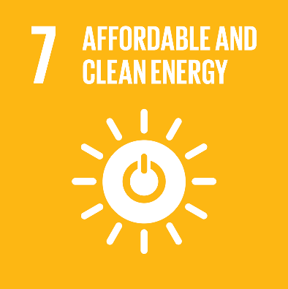
What is the most used renewable energy in the world?
Solar
Wind
Hydro
c. Hydro
N.B. Hydro makes up approximately 1/5 of global electricity production
3
Notes:
In 2020…
Hydropower accounts for 19% of total global electricity production
Solar energy accounts for 3% of global electricity production.
Wind power is estimated at 4% of global electricity production.
For up to date information on energy consumption in the UK go to:
https://www.gov.uk/government/statistics/electricity-section-5-energy-trends
SDG 7 fact – 3 billion people (over 1/3 of the population) don’t have access to clean cooking fuel and technologies
For information and advice on how to get involved in SDG 7 go to globalgoals.org/7

Slide 11
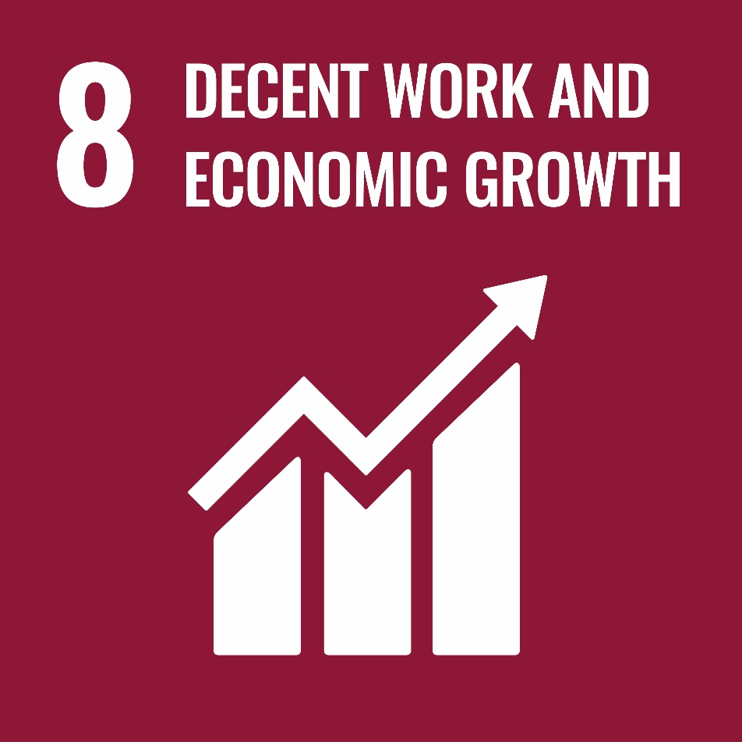
Which of the following are criteria for ‘decent work’?
A safe place to work
Social protection for families
A lunch hour
Appropriate wages
a, b, and d
3
Notes:
Decent work is work that offers dignity to the person doing it, i.e. due respect but also a balanced family life. It includes access to productive and appropriately paid work, safety at work and social protection for families, better personal development prospects and social integration, equal opportunities and treatment for all, etc.
SDG 8 fact - 1/5 of young people are not in education, training or employment
For information and advice on how to get involved in SDG 8 go to globalgoals.org/8

Slide 12
Which of these cities are often included in the top 10 ‘greenest’ cities in the world?
Amsterdam, Netherlands
Miami, USA
Berlin, Germany
Johannesburg, South Africa
a. Netherlands and
c. Berlin
3
Notes:
Different criteria are used by different organisations to measure how ‘green a city is, but they usually include the percentage of public green spaces, how much energy is from renewable energy. how much of the population use public transport to get to work, level of air pollution, availability of recycling and water consumption.
Find out more on these websites
https://www.bestcities.org/news/2020/04/22/the-worlds-greenest-cities
https://www.gvi.co.uk/blog/top-5-green-cities-world-2020
SDG 9 fact - Roads, water, electricity and sanitation facilities are still scarce in many developing countries
For information and advice on how to get involved in SDG 9 go to globalgoals.org/9

Slide 13
How much of the world’s wealth does the richest 1% of the population have?
15%
30%
50%
c. 50%
3
Notes:
In 2017, the richest 1% of the world’s population held 50.1% of the world’s wealth. (The poorest 70% of the world’s working age population people together hold only 2.7% of the global wealth)
SDG 10 fact – Almost 2 in 7 people have experienced discrimination on at least one of the grounds established by international human rights law.
For information and advice on how to get involved in SDG 10 go to globalgoals.org/10

Slide 14
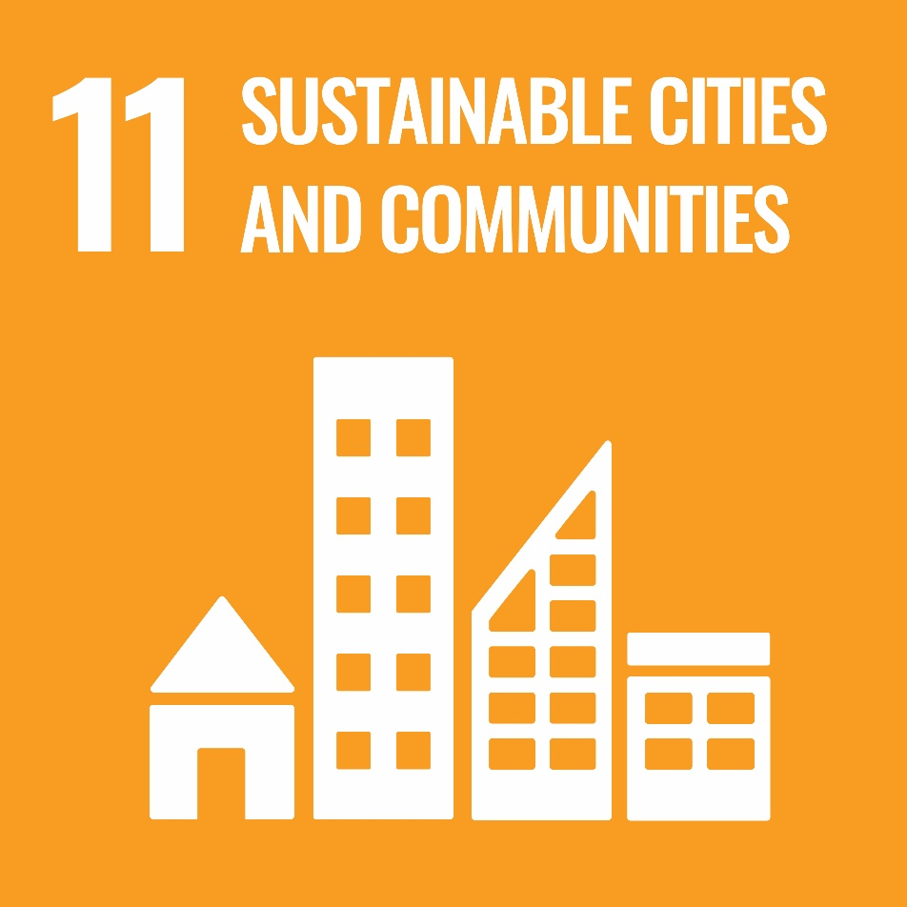
From highest to lowest which type of transport is the most polluting on a 10Km journey in a city?
a. Underground b. Bus
c. Car d. Tram
e. Bicycle f. Motorbike
e,d,a,b,f,c
3
Notes:
One of the targets in SDG 11 focuses on affordable sustainable transport systems for all, another on reducing the environmental impact of cities. Other targets include include affordable and safe housing and strengthening efforts to protect and safeguard the world’s cultural and natural heritage.
SDG 11 fact – More that half the world’s population is living in cities, and that is expected to rise to 60% by 2030
For information and advice on how to get involved in SDG 11 go to globalgoals.org/11

Slide 15
What proportion of the world’s food is wasted or thrown away?
1/3
1/6
1/10
1/3
N.B. This is more than 1.3 billion tonnes per year
3
Notes:
Wastage is a chronic problem across the world. One-third of the food produced for human consumption ends up lost or wasted, i.e. 1.3 billion tonnes per year. The proportion of food wasted has doubled since 1974.ACT -
SDG 12 fact – By 2050 we will need the equivalent of 3 planets to sustain our current lifestyles.
For information and advice on how to get involved in SDG 12 go to globalgoals.org/12

Slide 16
Write down 5 (or more) things that you can do to reduce your own impact on climate change.
Too many to list here!
Go to un.org/en/actnow to get ideas, then download the app to join the campaign and share your own actions.
3
Notes:
These can include:
Eat less meat
Eat the food you buy, throw less away (1/3 of all food bought in the UK is wasted)
Reduce heating in your home ( in UK’s 30 million homes heating contributes 20% of the carbon footprint)
Switch off lights and other electrical appliances when not in use…and unplug them.
Speak up! Tell other how important it is that we take action on climate change
Reduce your use of water e.g. showers rather than baths
Reduce the number of flights you take
Buy fewer clothes, shop second hand and/or upcycle
Use bicycles and public transport where you can.
Buy sustainable products or products from recycled materials where you can, including clothes
Recycle your plastic, paper, cardboard etc.
Eat ‘ugly’ fruit and veg. 40% of fruits and veg are deemed by supermarkets as too ugly toe eat and get thrown away.
Grow your own food
Use renewable energy in your home
Choose food and other products that are not packaged in plastic
SDG 13 fact – Global emissions of carbon dioxide have increased by almost 50% since 1990
For information and advice on how to get involved in SDG 13 go to globalgoals.org/13
Pupils may like to look at this lazy person’s guide to saying the world un.org/sustainabledevelopment/takeaction and track their own actions by downloading the act now app from un.org/en/actnow.

Slide 17
True or false?
At the current rate there will be more plastic in the oceans that fish by 2050.
True
N.B. There is more than 150 million tonnes of plastic in oceans at the moment and that could double by 2050
3
Notes:
More than 150 million tonnes of plastic waste is floating in the oceans and this could double by 2050. If no action is taken, this waste will weigh more than all the fish put together.
SDG 14 fact - Over 3 billion people depend on marine and costal biodiversity for their livelihood.
For information and advice on how to get involved in SDG 14 go to globalgoals.org/14

Slide 18
Stopping forests disappearing is really important in combatting climate change because…
They are green spaces to walk in
Trees provide oxygen
We need wood to build houses and other products
b. Trees provide oxygen
N.B. Over half of oxygen in the atmosphere is produced by ocean phytoplankton.
3
Notes:
The main systems that produce a surplus of oxygen are forests in formation and sea algae.
An Interesting fact is that the ocean phytoplankton alone provides more than half of all atmospheric oxygen.
SDG 15 fact – Forests are home to more than 80% of the world’s species of animals and plants.
For information and advice on on SDG 15 go to globalgoals.org/15

Slide 19
What group of people have the nickname ‘blue helmets’?
Cyclists
Police officers in the navy
UN peace keeping soldiers
Volunteers in refugee camps
c. UN peace keeping soldiers
3
Notes:
Blue helmet is the name given to soldiers working in the context of a UN peacekeeping mission. The name comes from the fact that they wear a “UN blue” helmet. This enables them to be clearly distinguished from other soldiers.
SDG 16 fact –The Global Peace Index (GPI)* reported Iceland, New Zealand, Portugal, Austria and Denmark as the top 5 most peaceful
countries in 2020
* The GPI report is produced by the Institute for Economics & Peace (IEP) and measures the relative position of nations' and regions' peacefulness.
For information and advice on how to get involved in SDG 16 go to globalgoals.org/16

Slide 20
What does UN stand for?
Urban Network
United Nations
Undeveloped Nations
b. United Nations
N.B.193 out of the 197 countries in the world are members ☺
3
Notes:
The intergovernmental organization known as the United Nations was founded in 1945 following the Second World War to replace the League of Nations. Its aim was to prevent wars between countries and ensure dialogue. Almost all countries on the planet are members (193 out of 197).
SDG 17 fact – International cooperation and external finance are crucial to help developing countries cope with the impact of COVID-19
For information and advice on how to get involved in SDG 17 go to globalgoals.org/17

