Slide 1
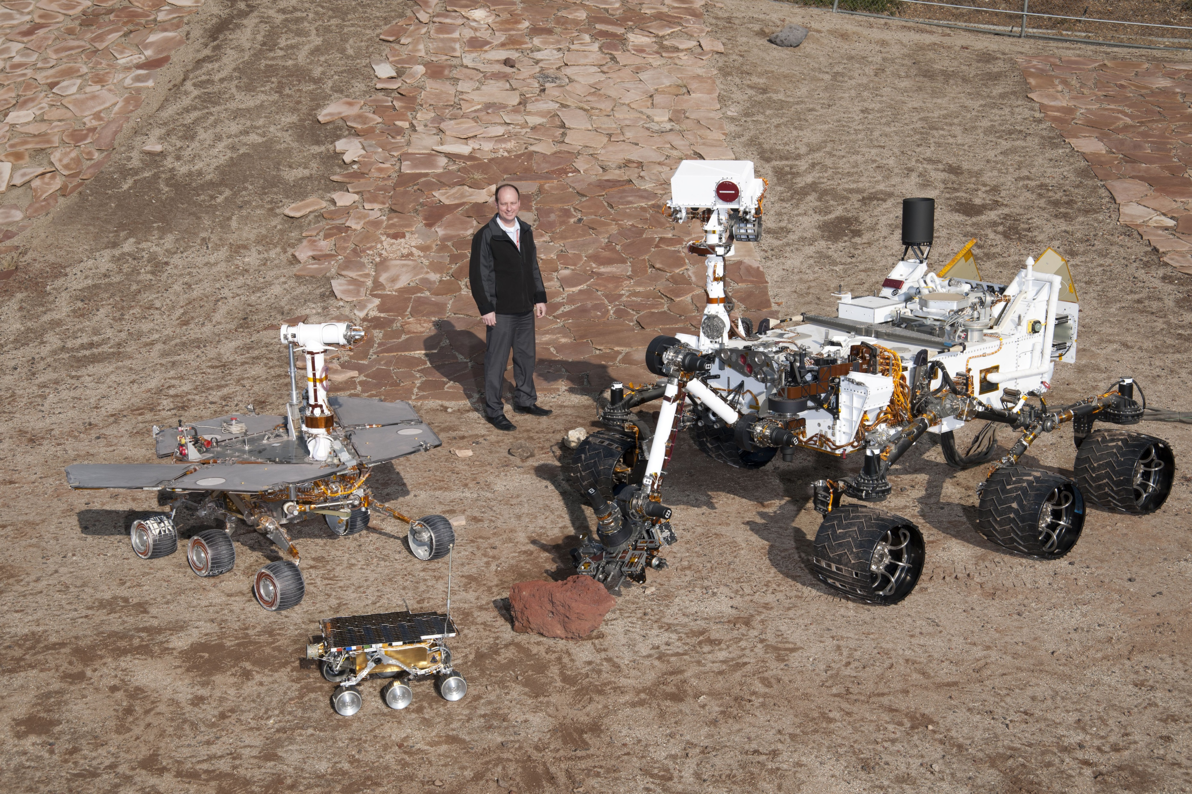
Comparing Mars rovers

Slide 2
We will:
collect, analyse, evaluate and present data and information.
understand that infographics aim to communicate information using pictures and words.

Slide 3
Astronomical answers
What information can you find from the handout or next slide?
How useful is the information?
Was it easy or hard to find the information? What made it easy or hard to find the information?

Slide 4
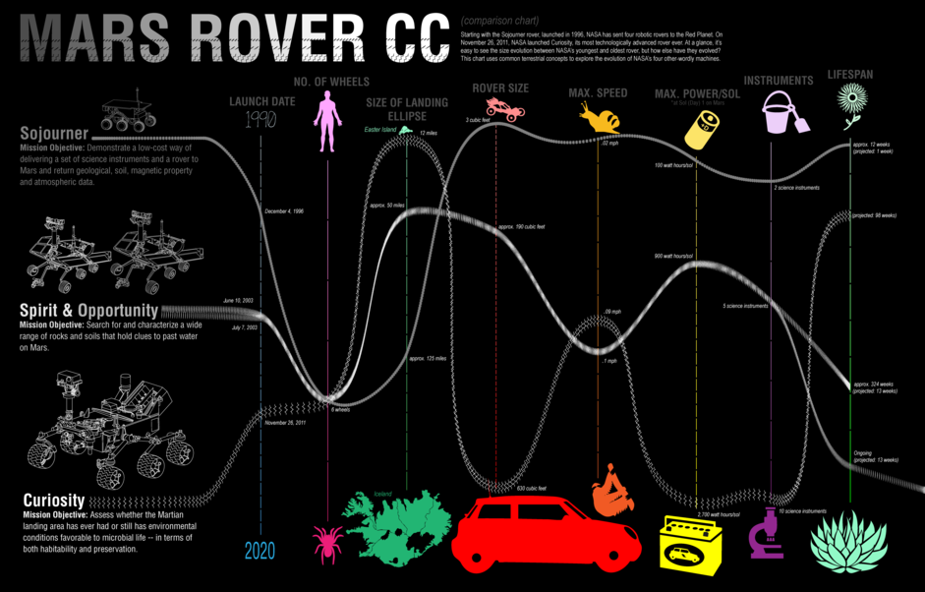

Slide 5
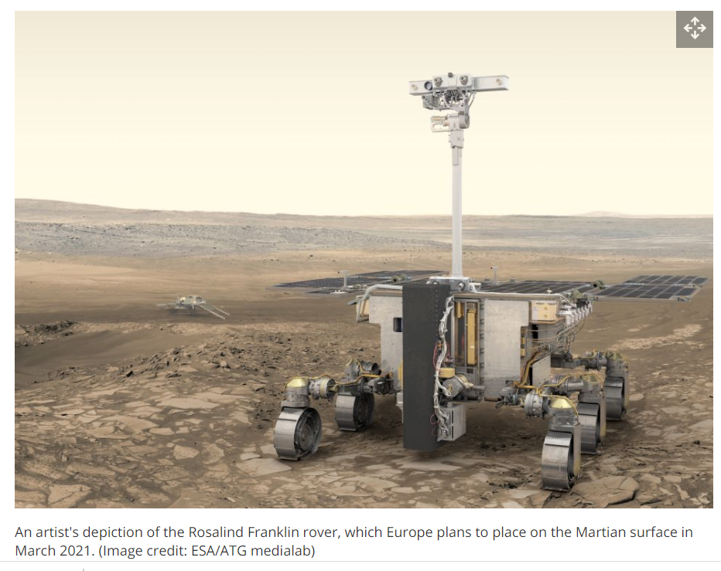
Rosalind Franklin
Launch date 2022
6 wheels
Landing ellipse 104km by 19km
Max speed 70m per sol*
Weight 300kg
*sol = 1 Martian day
= 1.027 Earth days

Slide 6
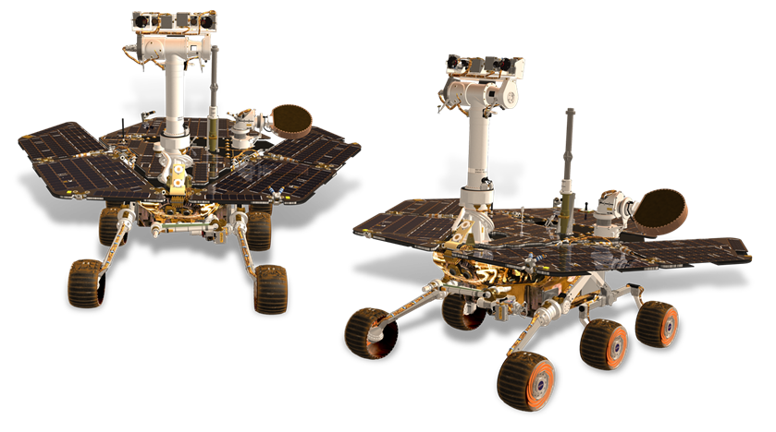
Comparing Mars rovers
Design your own infographic to compare Rosalind Franklin to other Mars rovers.
Share some ideas about how you might do this.

Slide 7
Plenary
Evaluate the infographic a friend has produced.
Is it easy to understand?
Does it communicate the information clearly?

