Slide 1




BEAT THE FLOOD
A challenge to design and build a home before the floods arrive on Watu island
Notes:
Introduce the challenge.
Explain that pupils will be using their STEM skills to try and solve a problem faced by
communities in a country in a different part of the world.

Slide 2
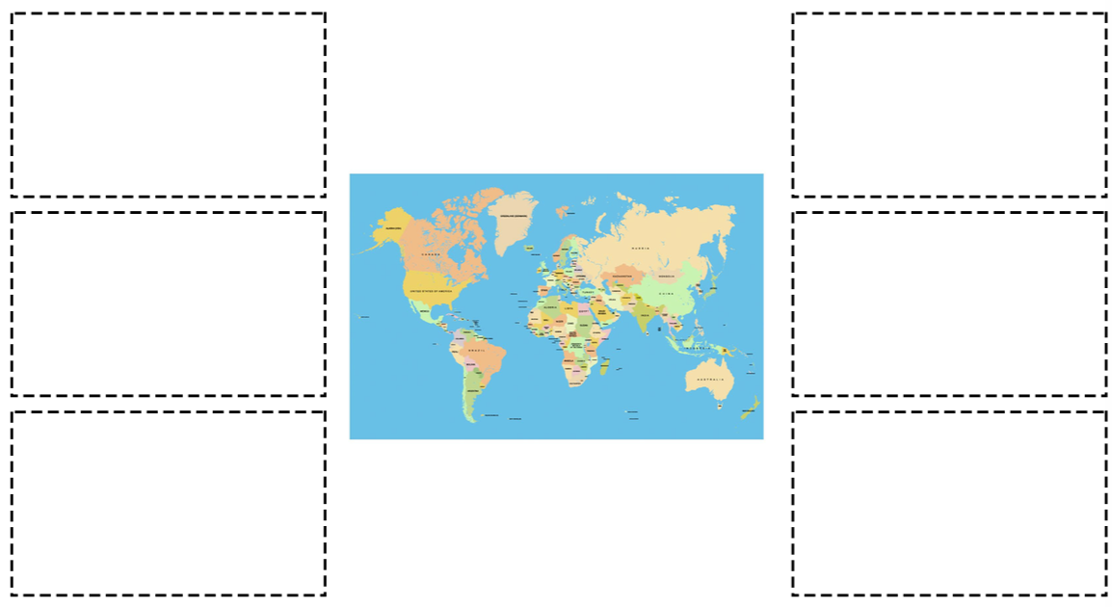



Where in the world?
Look at the photographs and decide where they belong on the world map.
Notes:
Divide the class into small groups and hand out the Where in the world pictures and World map (N.B. this needs to be printed on A3).
Ask pupils to match the photos to countries.

Slide 3

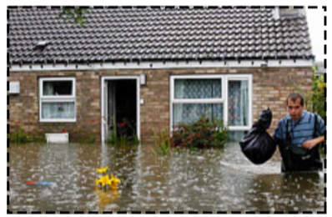
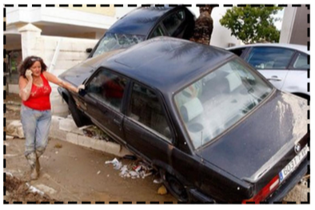
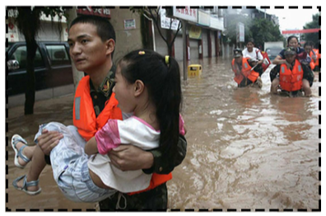
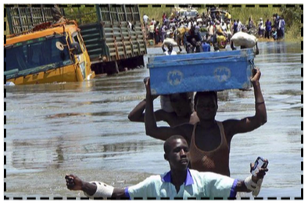
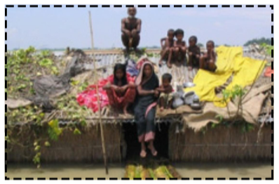
Notes:
Discuss that flooding is a problem faced across the world, including the UK.
Prompt questions could include:
- Have you ever had any experience of dealing with flooding?
- Do you think some countries experience more flooding than others?
- Do you know what might cause flooding, or make it worse?

Slide 4
Choose one photo from Europe and one from a developing country that interests you.
What would life be like for the people in these pictures whose homes have been flooded?
Who do you think is most devastated by the effects of flooding and why?
Notes:
Ask pupils if they think the impact of flooding would be different for people in different parts of the world?
You may wish to develop word clouds to summarise the feelings of the people whose homes have flooded in Europe and in a developing country.

Slide 5
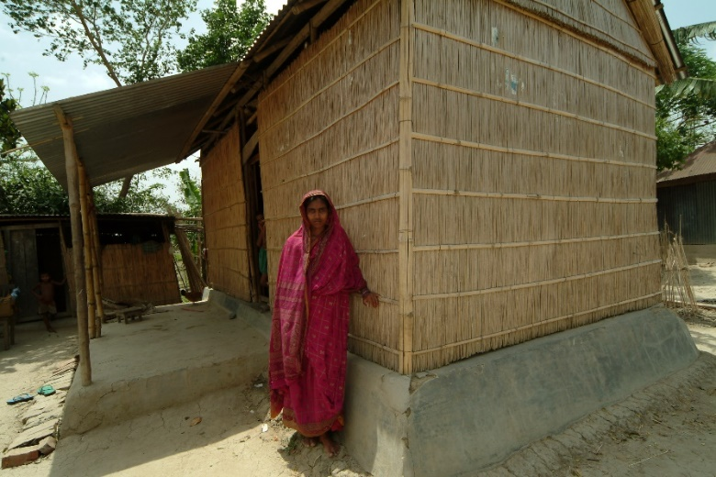
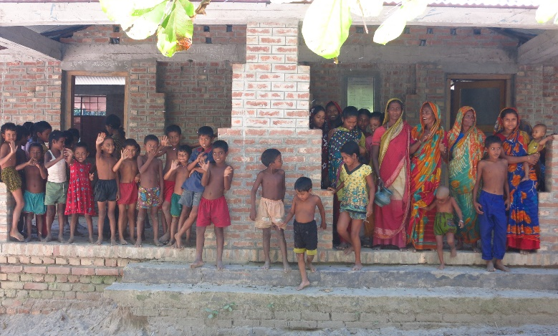
The reality
People living in poverty suffer most from the effects of flooding. Poverty makes it more difficult for people to cope with flooding and recover from the effects as they have less money and support to rebuild their homes and buildings.
But…
If people are prepared for flooding, flooding will have a less negative impact on their lives and they will be able to recover from it more quickly.
Notes:
You may wish to stress that flooding is devastating for anyone...but some in countries such as Bangladesh people are feeling the severe impact of climate change to a much greater degree. There has always been a rainy season in Bangladesh, but now the rain lasts for longer and is heavier than in the past…with devastating effects. Recovery is also harder because the people there live in poverty.

Slide 6

Many people around the world face
problems like suffering from flooding
that trap them in poverty.
In 2015 the United Nations (UN)
met with leaders from over 30
countries to work out how to solve
some of the world’s biggest problems.
They identified 17 Goals to
end poverty in the world by 2030
and called them the:
Sustainable Development Goals
(SDGs) or Global Goals for short.
1
Notes:
Pupil should now be aware that flooding is a global problem.
Introduce the Sustainable Development Goals (SDGs) also known as the Global Goals.

Slide 7

The Sustainable Development Goals (SDGs)
Notes:
This is the full set of SDGs. You may want to print this out for display and/or to hand out. An explanation of each Goal is provided as a pupil activity sheet.
SDG 11 Sustainable cities and communities is the Goal mostly closely linked to this challenge.
There are two activities recommended in the Teacher’s notes that you can carry out to aid understanding and engagement with the SDGs. Others can be found at practicalaction.org/schools/sdgs

Slide 8
Your
BEAT THE FLOOD
Challenge
Notes:
If time permits please give pupils the opportunity to do the starter activities on structures and testing materials for properties before embarking on the main challenge.
Explain that the aim of the challenge is to design and build a model of a flood –proof house for a fictitious island called Watu island.

Slide 9
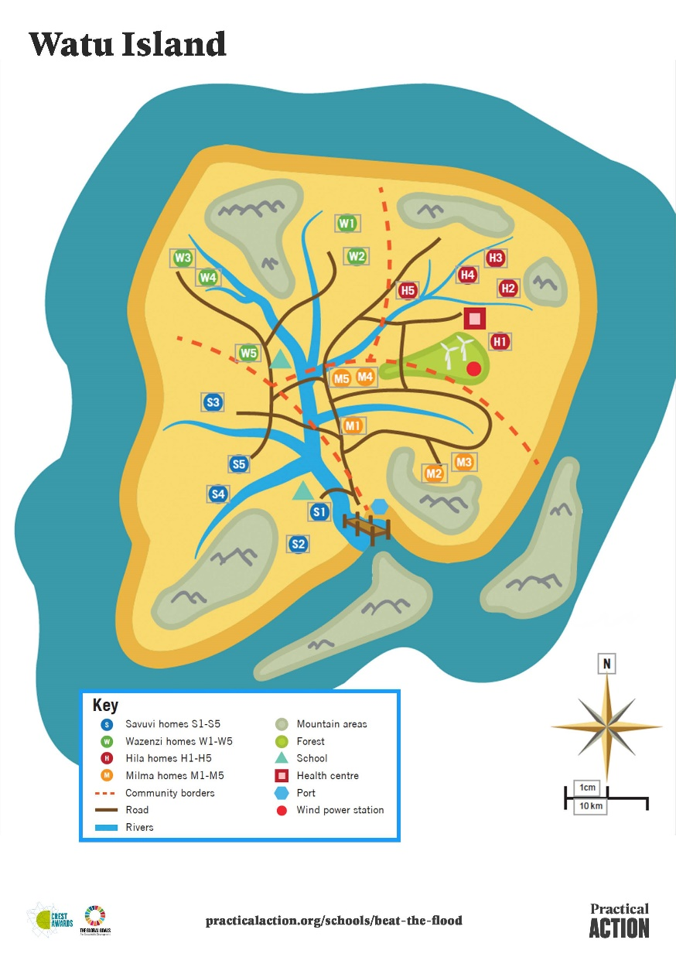
Watu Island
You are a community living on Watu; a small island in the Indian Ocean.
Over the past 5 years you’ve seen a massive increase in rainfall, causing many of the island’s rivers to flood at least twice a year.
Your traditional homes made from earth floors, wooden frames and topped with corrugated iron roofs are regularly damaged or lost as they’re not designed to withstand flooding.
As a group of islanders you want to beat the floods by making sure your homes are flood-proof before the next rainy season.
Notes:
Divide pupils into small groups
Hand out the Watu island map and a community card to each group.

Slide 10
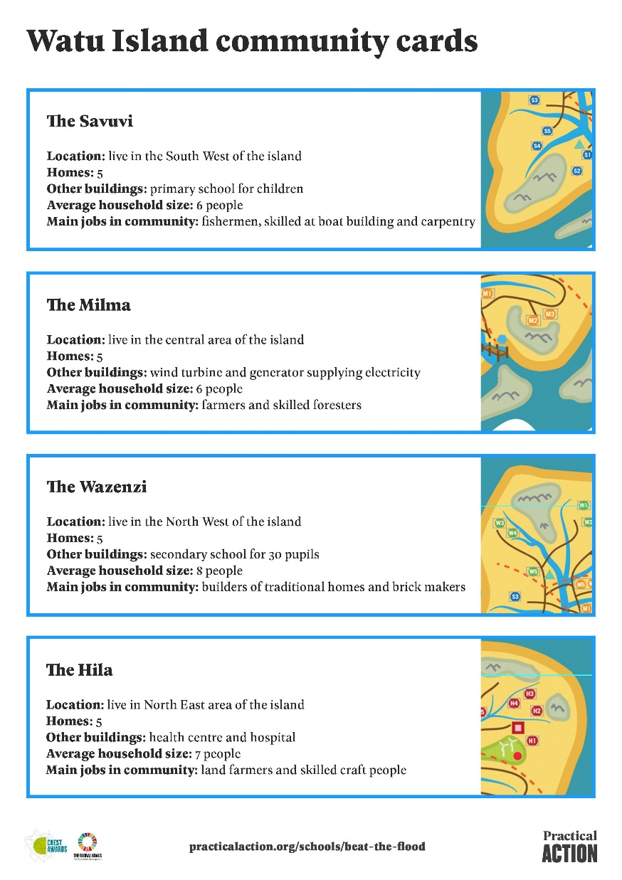
Who’s at risk on Watu?
Look at the map of Watu and your community card to find out about the area where you live.
Which of the homes and areas in your community are at risk of flooding?
Discuss in your group or class and mark the homes most at risk on your map.
Where might you build your new house?
Notes:
Have a discussion with your class about what makes some areas and people at higher risk of floods that others. It may include proximity to a river bank, terrain, building such as schools, health centres may also be more vulnerable when dealing with younger or elderly people.
For more able or older pupils – you might want to encourage pupils to look at some of technologies used by communities in flood-prone areas, such as early warning systems and evacuation procedures.

Slide 11
A few things to remember
.
Do your research…to see what features are common in flood-proof houses. Watch this video by Ortis Deley to get you started http://bit.ly/pasbtf.
Use the knowledge you gained from testing materials to help chose the right materials for your flood-proof home. They should be strong and waterproof.
Your home will need a strong structure to withstand the wind that comes with the rain during flooding.
The bottom of your house will need to be especially protected from water during flooding as for long periods of time it may be submerged in water
Think about the cost of your home. Use locally-resourced, sustainable materials where possible.
Design, make and test
a model of a system
that can transport tomatoes in a way that won't squash them!
Combine
Good luck!
Notes:
Hand out all the relevant pupil activity sheets and encourage pupils to work though their ideas and the specifications before building their model. Show them the video from Practical Action and Ortis Deley filmed in Bangladesh.
When pupils start to develop their ideas encourage them to look at the materials information cards, to see how modelling materials represent ‘real-life’ materials. For example, lolly sticks represent planks of wood.
We suggest you give a maximum budget of £500 and encourage them to reducing cost where possible by using locally available materials. You could also introduce a sustainability element.

Slide 12
At the end of your challenge you will have 3 minutes to present or ‘pitch’ your work on designing and building your model home
Remember to leave time to work out how you are going to do this.
Notes:
We suggest that pupils present their model to the rest of the class reflecting on how well they worked together, problems they solved, etc. (this will be necessary if you are planning for your pupils to gain a CREST Discovery award).
Hand out the Team feedback sheets, one per pupil so they know what criteria they will be working to.

Slide 13
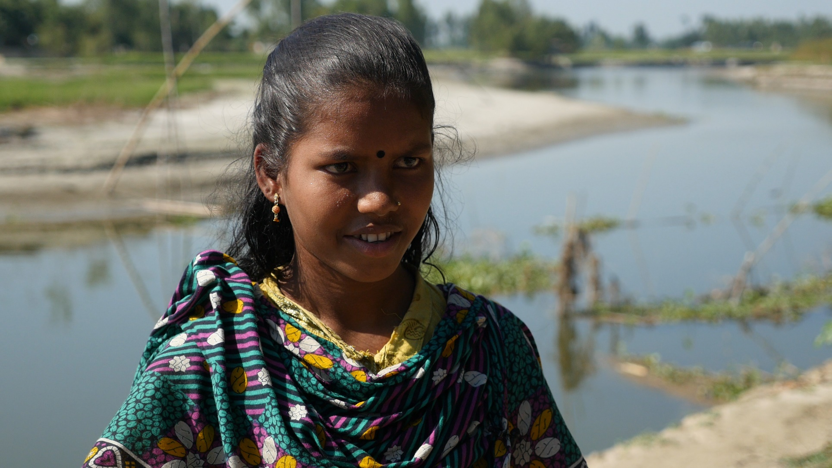
Solutions in Bangladesh
In North western Bangladesh, many families live in fear of the rainy season which is leading to increased flooding of many of the rivers that criss-cross the country. Shilna (age 14) lived in one of those areas and her house was washed away.
‘’I was really frightened listening to the rain on the roof of my house. I was pleased that I kept my school books dry’.
Shilna feels lucky that she and her mother moved into to a new flood-proof home provided by Practical Action. You will have seen Shilna if you watched this video http://bit.ly/pasbtf
Notes:
This is a brief case study of Shilna, who appears on the ‘Beat the Flood’ video on YouTube

Slide 14
Celebrating Success

Slide 15

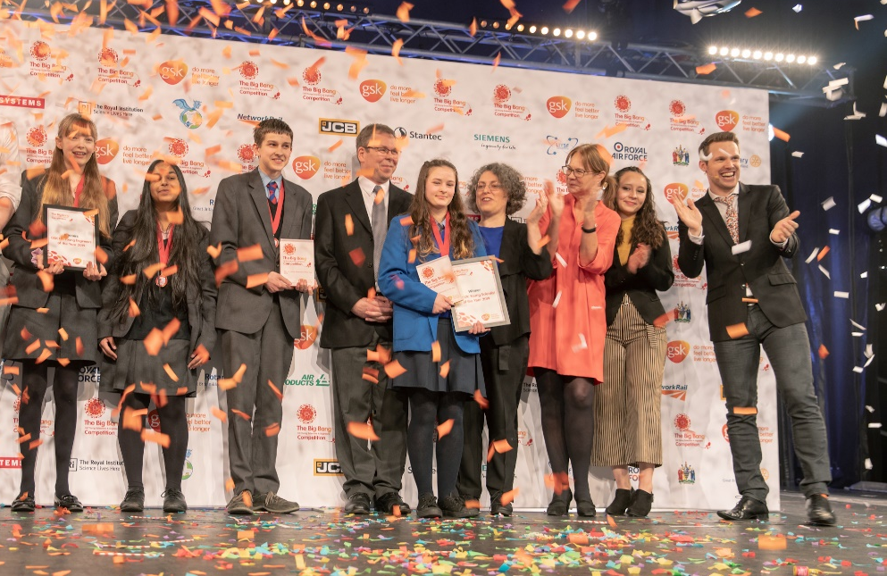
CREST Awards
Beat the Flood is perfect for a CREST Discovery Award. It can also be used to gain a Superstar Award (primary) and as a context for
Bronze, Silver and Gold Awards (Secondary).
Big Bang Competition
You can enter your challenge into the Big Bang Competition, either at regional events or online.
200 projects are chosen every year to attend the national Big Bang Fair in Birmingham. Prizes include industrial/scientific site visits, mentoring, cash, and the chance to represent the UK in International Competitions.
This could be you next year!
Notes:
CREST
Taking part in Beat the Flood is a great way for pupils to gain a CREST Award. The challenge is aligned to the Discovery Award, but can be used to gain a Superstar Award or as the starting point for a Bronze, Silver or Gold Award. More details in the Teacher’s Guide.
Big Bang Fair and competition
Pupils who have taken part in a STEM challenge can enter their work into the Big Bang competition. This is a great way for pupils to showcase their work to other pupils and adults at a regional Big Bang event.
If they become finalists they will be invited to attend the National Big Bang Fair which takes place in March each year. Both of these are amazing, inspiring experiences for young people.
competition.thebigbangfair.co.uk

Slide 16







We hope you enjoyed taking part in the Beat the flood STEM challenge.
For more information and resources go to:
practicalaction.org/schools

