Slide 1
Solar
Challenge
Discover how solar energy can transform the lives of people around the world

Slide 2
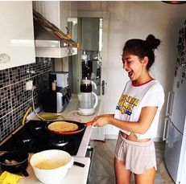
It’s electric
Think of the activities that you have done so far today that use mains electricity or a battery.
Activity: Make a note of them and decide if they are powered by mains electricity or battery.
Activity | Appliance | Mains? | Battery? | Rechargeable
Making tea | Electric kettle | √ | x | x
2
Notes:
You could extend the chart on the PPT slide on a whiteboard to develop a list of the different appliances pupils think of. Then, encourage them to
consider whether the appliances are powered by battery or mains electricity.
Some pupils may suggest that some appliances can use both (e.g. laptop computer). Acknowledge this as a valid point but encourage them to distinguish between something charged from the mains as opposed to something that uses batteries that are already recharged. Discuss rechargeable batteries
too.

Slide 3
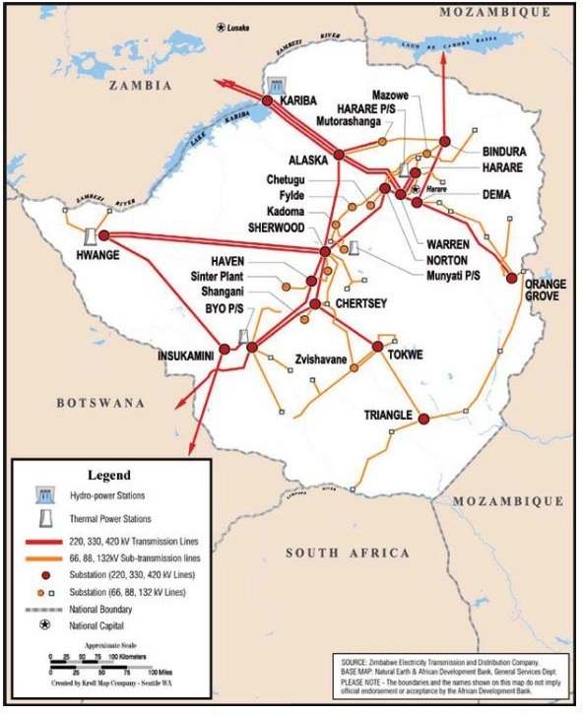
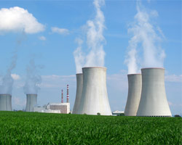
Electricity in the UK
Electricity is generated in a number of different ways, and the percentages form these sources changes over time.
Guess the percentage contribution of electricity in the UK supplied from:
Fossil fuels (oil, gas and coal)
38% (down from 57% in 2017)
Nuclear (from nuclear reactors)
15% (down from 20% in 2017)
Renewable energy (such as hydro, wave and solar energy)
47% (up from 23% in 2017)
3
Notes:
These stats are of April – June 2020
For up to date information on energy consumption go to:
https://www.gov.uk/government/statistics/electricity-section-5-energy-trends
…and change the data on the slides.
UK. If time permits, encourage the pupils to identify the overhead National Grid cable lines around the school and community

Slide 4
Making
THE
NATIONAL GRID

Slide 5
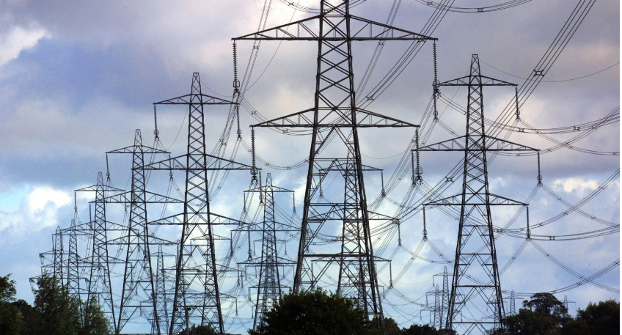
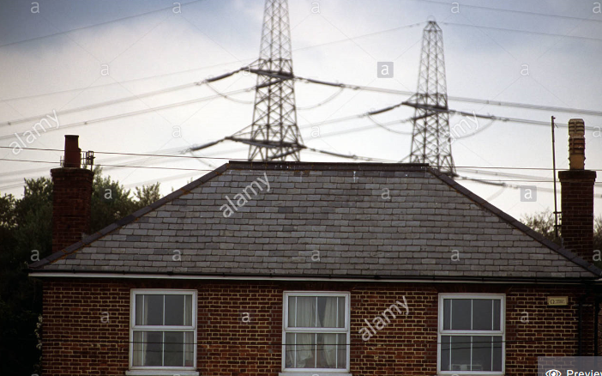
How does the electricity get to where it is needed? Electricity gets transmitted to homes, hospitals, businesses, etc., through a series of overhead and underground cables. This called the National Grid.
In the UK, there are over 4,500 miles of overhead and nearly 1,000 miles of underground cables!
5
Notes:
Now pupils have identified how important energy is this activity helps them understand that whilst in most parts of the world the National Grid provides electricity, sometimes people living in rural areas do not get electricity. This brings the issues of ‘fairness’, and equal access to light.

Slide 6
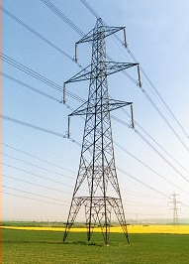
Making the National Grid
Activity
Imagine you are an electricity pylon and the string you have been given is an electric cable.
Use the string to connect as many people as possible to the power stations to bring electricity to all towns and villages in the UK.
Question
Why is it a good idea wherever possible, to have more than one connection between a town or village and the National Grid?
Making a
National grid
6
Notes:
Now pupils have identified how important energy is this activity helps them understand that whilst in most parts of the world the National Grid provides electricity, sometimes people living in rural areas do not get electricity. This brings the issues of ‘fairness’, and equal access to light.

Slide 7
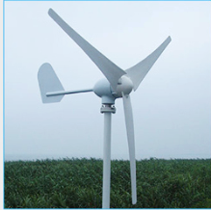
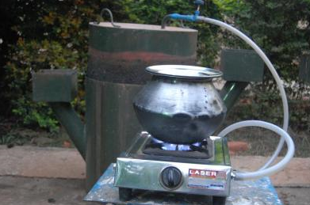
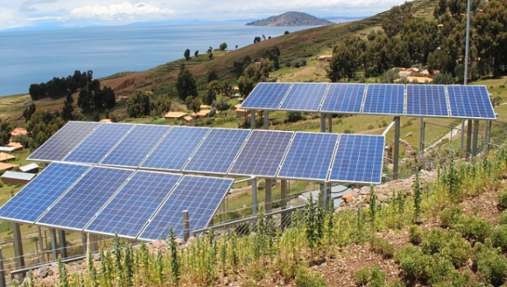
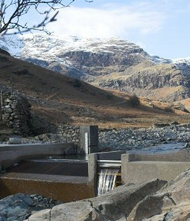
Renewable energy
In areas of any country where the National Grid does not reach there are a number of options for generating electricity. How are people accessing energy in the picture below?
Making a
National grid
7
Notes:
This is a good time to discover what pupils know about renewable energy. You may like to show our renewable energy poster at this point. You can request a free poster from schools@practicalaction.org.uk.

Slide 8
SOLAR ENERGY

Slide 9
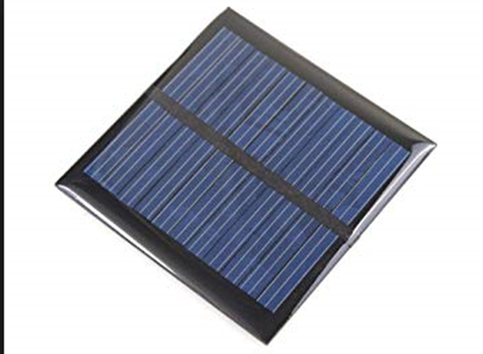
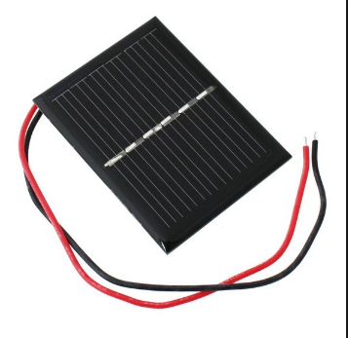
Solar energy
In this project we will be focusing energy created by the sunlight know as ‘solar energy’. So let’s get started by exploring how solar energy is generated.
Here are some examples of solar cells
Have you seen solar cells before? Where might you find them and what might they being used for?
Making a
National grid
9
Notes:
The next 2 slides are intended to promote a discussion on solar power, to find out what the pupils’ existing knowledge is an to build upon that.

Slide 10
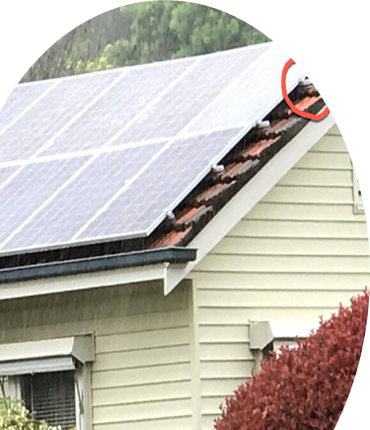
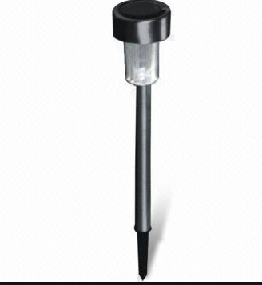
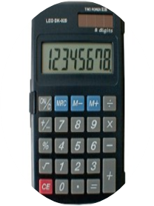
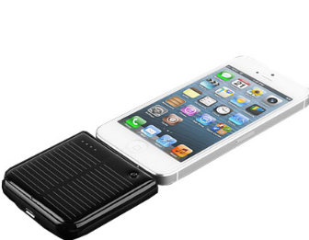
Uses of solar cells
Solar cells are used in a variety of ways. Some are fixed within appliances and others used as separate cells to power appliances.
Why do you think solar cells are used in these situations?
Making a
National grid
10

Slide 11
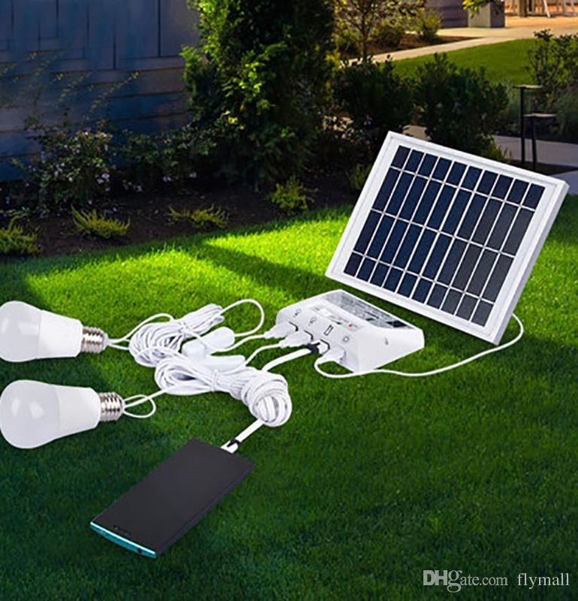
Exploring the use of solar cells
Activity
You are now going to construct, test and evaluate circuits using solar cells.
In particular, you are going to explore:
How you can use solar cells to power bulbs, buzzers and motors
How the amount of light falling on a solar cell affects the electricity it produces
What happens if a number of solar cells are connected together.
Making a
National grid
11
Notes:
This slide leads into the three pupil activities:
Getting the power
How much light?
Turning up the power

Slide 12
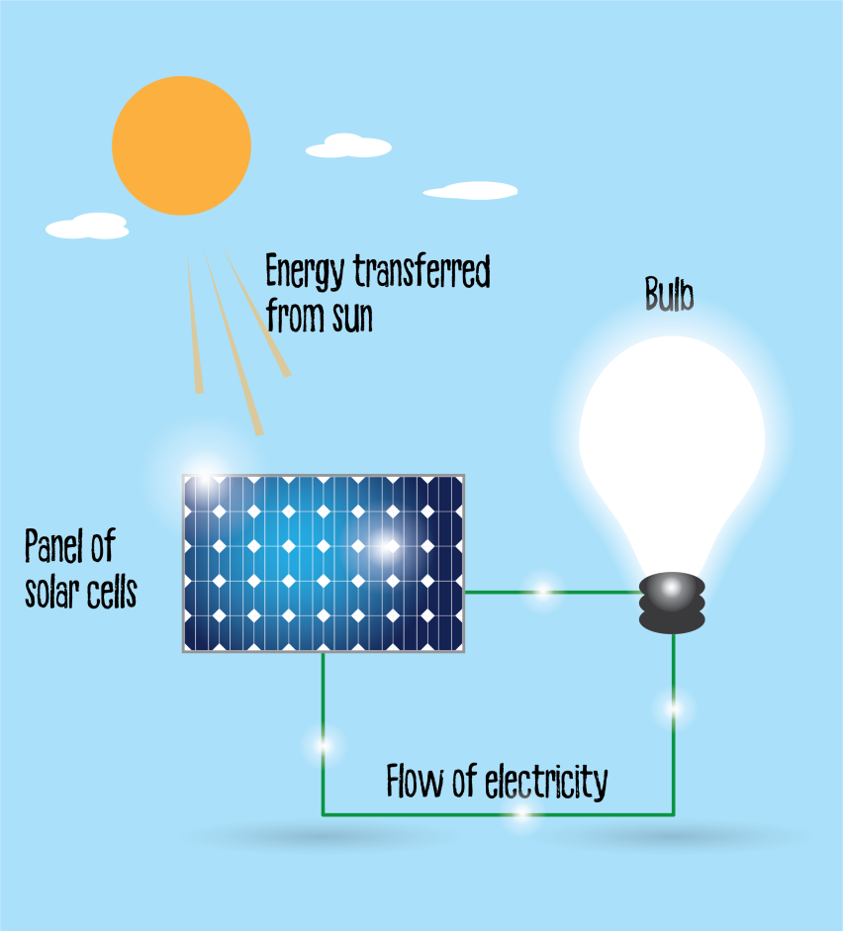
Recap: Solar cells activity
Solar cells capture energy from light and convert it into an electricity. This electricity can be used for a variety of tasks including powering a bulb and motor.
Solar cells:
depend upon a constant supply of light
produce more electricity if the light is stronger
produce more electricity if the area of the solar cell is larger.
Making a
National grid
12

Slide 13
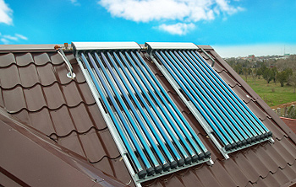
Heat from sunlight
So far we’ve looked at solar cells, which produce electricity. This can be used in a variety of ways.
However, this isn’t the only way of using the energy from sunlight. It can also be used as a source of heat.
Some solar panels don’t produce electricity. Instead they trap heat, which can be used heat a home or water.
Making a
National grid
13
Notes:
It is useful to help pupils understand the different between using solar panels to produce electricity, and to heat up water.

Slide 14
The Sustainable Development Goals (SDGs)
In 2015 the United Nations (UN) called a meeting with leaders from over 30 countries to work out how best to work together to solve some of the world’s biggest problems. They identified 17 goals to end poverty in the world by 2030. They called them: The Sustainable Development Goals, also called the Global Goals.
Notes:
Introduce the Sustainable Development Goals, also known as the Global Goals.
Do this by explaining that in 2015 the United Nations identified the same problems the pupils have come up with, plus a few more as essential in solving world poverty. The United Nations then came up with 17 Global Goals which they agreed to work towards to help solve world poverty by 2030. These are also sometimes called the Sustainable Development Goals or SDGs.

Slide 15
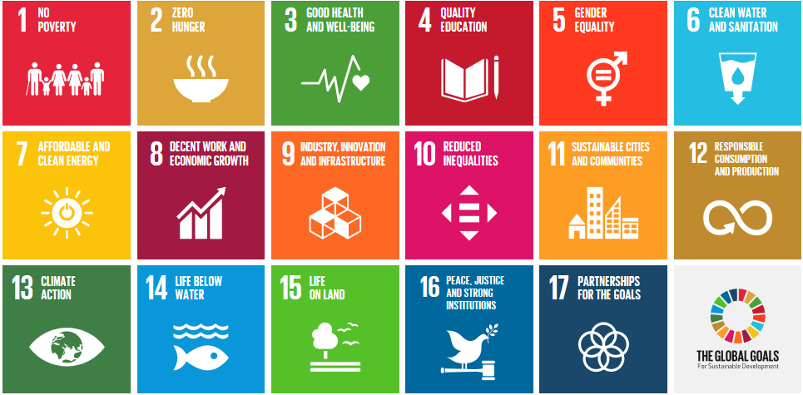
The Sustainable Development Goals (SDGs)
Notes:
These are the 17 goals
You may like to print out this page to give to pupils as well as the Sustainable Development Goals activity sheet, and/or use for Display. There are a lot more image available on the internet.

Slide 16
Your
SOLAR CHALLENGE

Slide 17
Guess where
Up until now we have thought about the use of solar energy in the UK, but now we are going to find out about how its used in another country.
Can you guess which country we will be exploring?
Clue: sixteen official languages
Clue: national football team is nicknamed The Warriors
Clue: borders South Africa
Clue: capital city is Harare
Clue: the flag
Making a
National grid
17

Slide 18
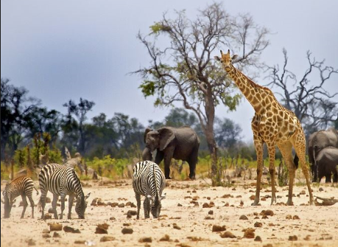
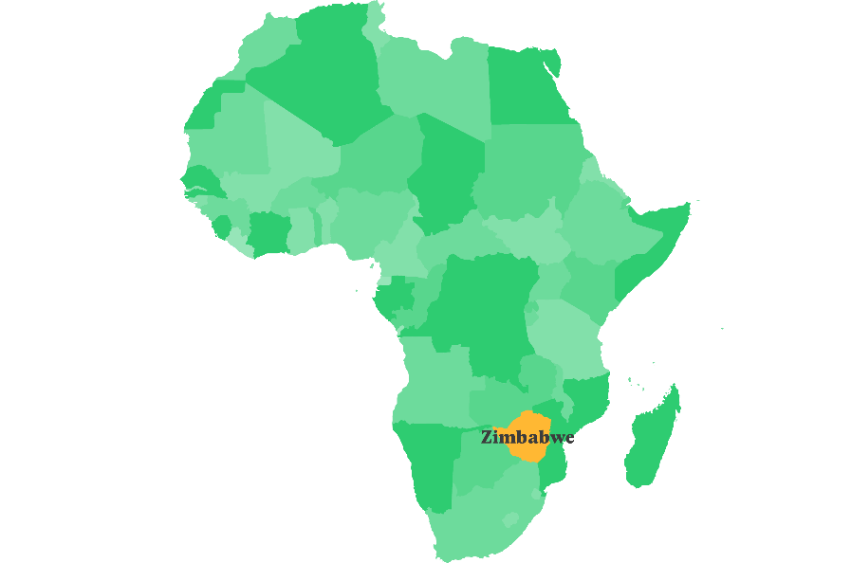
Zimbabwe
Zimbabwe is a country in southern Africa.
The country is well known for the world’s largest water fall ‘Victoria Falls’ and its wildlife parks.
What else do you know about Zimbabwe?
18
Notes:
This slide promotes discussion on finding out what pupils already know about Zimbabwe.
You may like to ask them to indicate where it is on a map and globe.

Slide 19
Electricity in Zimbabwe
In Zimbabwe today most of the country’s electricity is generated from hydro-power, where energy is generated from fast flowing water.
The Zimbabwe Electricity Suppliers Authority run the national electricity grid, but it only goes so far! Many rural areas have no access to the national grid.
Guess what % of the population do not have access to electricity?
In 2017 it was just over half the population!
19

Slide 20
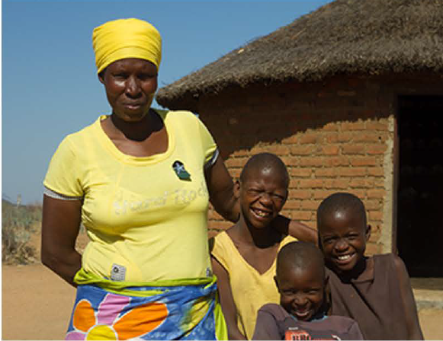
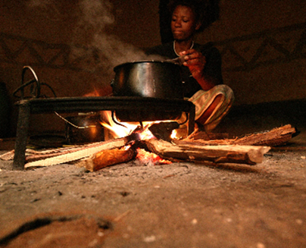
Gwanda - Zimbabwe
Gwanda district is located in southern Zimbabwe. It is an area that experiences long periods of drought. This has led to poor harvests and as a result many people are going hungry.
Many of the households are headed by women as the men leave to find work in the larger cities.
‘There is no water and as a result we are producing very little in our garden. It’s not enough to feed my family’.
In this rural area there is no access to mains
electricity, so people use wood or kerosene
oil to cook and light their homes and
community buildings.
Making a
National grid
20

Slide 21
.
.
Sustainable Development Goals (SDGs)
Remember the Sustainable Development Goals?
In the district of Gwanda, organisations including Practical Action are working to develop solutions to help reach the Global Goal targets.
Global Goal 2 to end hunger and ensure access to nutritious and sufficient food all year round, in particular for people living in poverty.
Design, make and test a model of a system that can transport tomatoes in a way that won't squash them!
Global Goal 5 to give women equal rights to economic resources, as well as access to ownership and control over land and natural resources, in accordance with national laws.
Global Goal is 7 to ensure that everyone has access to affordable, reliable and modern energy services.
21
Notes:
Now is a good opportunity to recap knowledge and understanding of the Sustainable Development Goals introduced earlier.

Slide 22
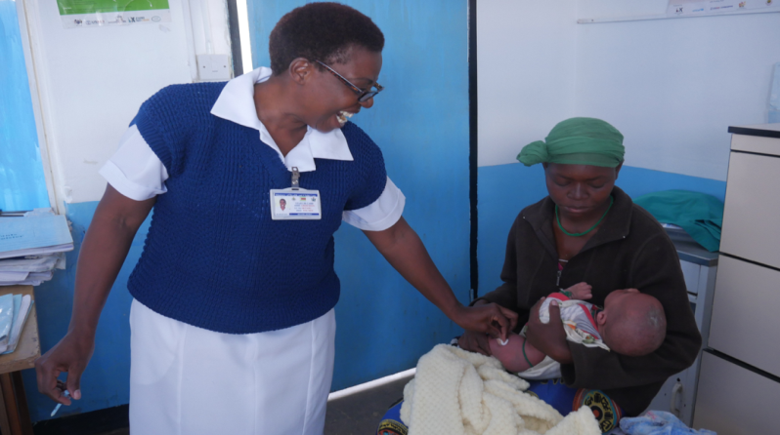
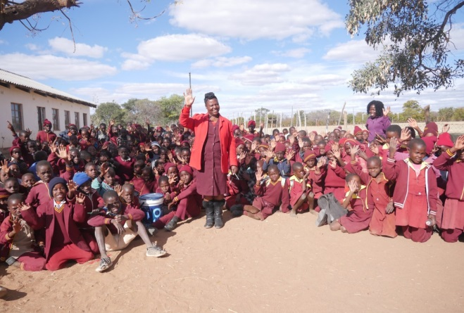
Your solar challenge - making decisions
People living in Gwanda district have just had the great news that Practical Action have received funding to install solar cells to generate electricity in a number of villages.
Your challenge is to explore how best to use ten solar cells to bring electricity to a community in Gwanda.
You have a limited supply of energy from the solar cells…so use it wisely!
22

Slide 23
What you need to do!
Research and investigate
This includes finding out:
What are the main things people living in Gwanda need and want to use electricity for?
How much energy do the different electrical appliances use?
Developing ideas and decisions
You will only have so much energy and it’s not enough to run everything!
You will have to make decisions about what you can run and what you can’t.
Think carefully about which are the more important appliances. You will need to make clear what you have decided and why.
Modelling solutions
Use the map and/or make a model of the village to show where you would place the solar cells to power which appliances.
Making a
National grid
23
Notes:
Divide pupils into small groups and hand out the pupil activity sheets related to the main challenge at this point.

Slide 24
Feedback
Presenting your ideas - Communication
You will be asked to give a 2-3 minute presentation on your work.
Try to include the following:
The problem/challenge you were addressing.
Some of your research findings from the community about their needs and wants.
Your map and/or model, with a clear explanation of how you used your ten solar cells/100 units of energy to meet the needs of the community.
Comparing plans
You can then compare your plan with that of other groups. See what you have agreed on, and what you have different ideas about.
Making a
National grid
24
Notes:
We suggest that pupils present their model to the rest of the class reflecting on how well they worked together, problems they solved etc. (this will be necessary if you are planning for your pupils to gain a CREST award). Hand out the Team feedback sheet at this point
Allow time for pupils to work on their presentations as well as building their model.

Slide 25
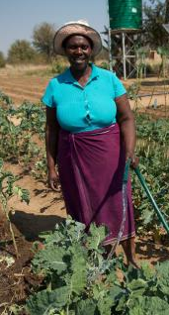
Sunny solutions in Zimbabwe
Your challenge is based on a real life project where the solar cells will make a big difference to people’s lives.
In another region of Zimbabwe called Gwanda
families were struggling to feed their families due
to drought. When the community there received funding they decided to use most of their solar cells to run a solar powered water pump, enabling them to irrigate their crops to grow food all year.
Betty a farmer here feels her life has been transformed. ‘I now spend most of my time in the garden, it has become my source of livelihood. I am now finally secure. In my village I'm now well known for selling vegetables.’
25
Notes:
The real community in Gwanda decided to use their entire allocation of solar cells to install a solar irrigation system. In addition to being able to grow
enough food all year round to feed themselves and prevent malnutrition (especially amongst children), any additional foods could be sold at markets bringing additional income.

Slide 26
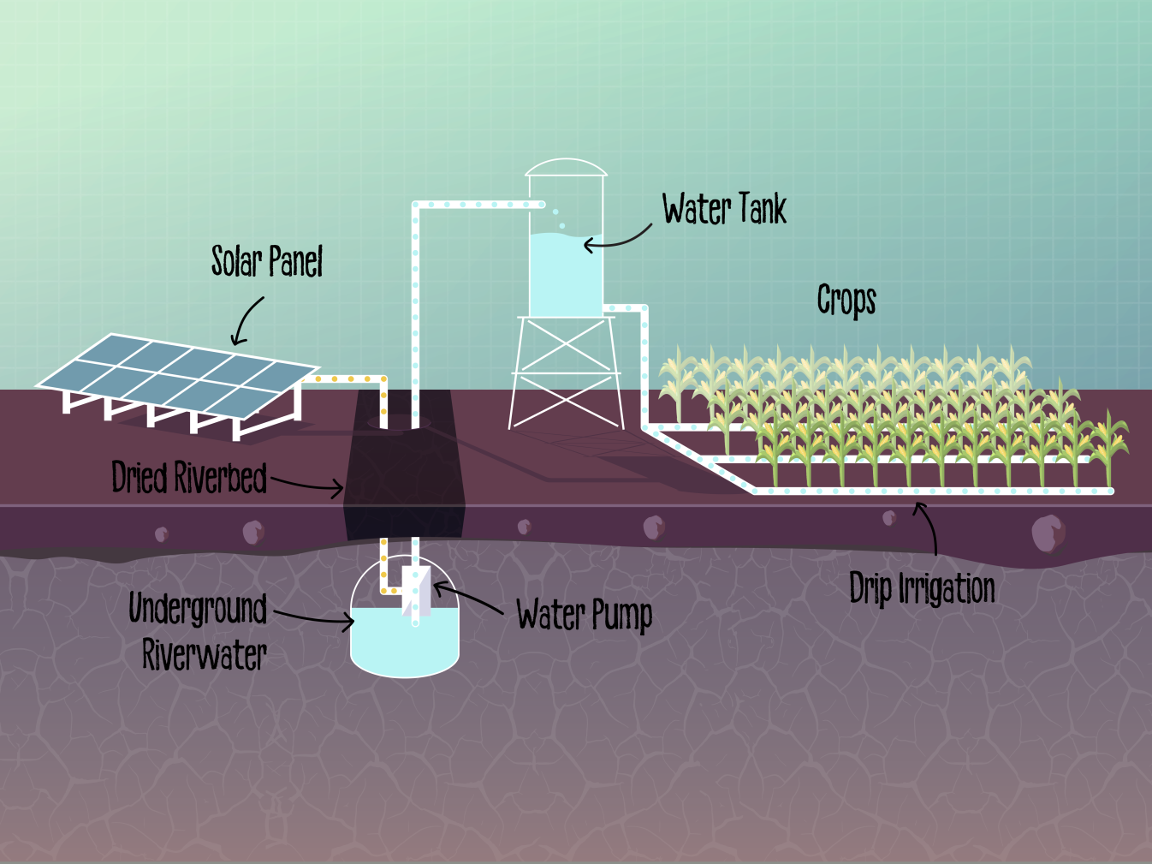
Here’s how the solar irrigation pump works for Betty and her community.
26
Notes:
For more detailed technical information on solar energy, including using solar energy to pump water go to :
https://practicalaction.org/schools/technical-briefs-energy/

Slide 27
Celebrating
SUCCESS

Slide 28
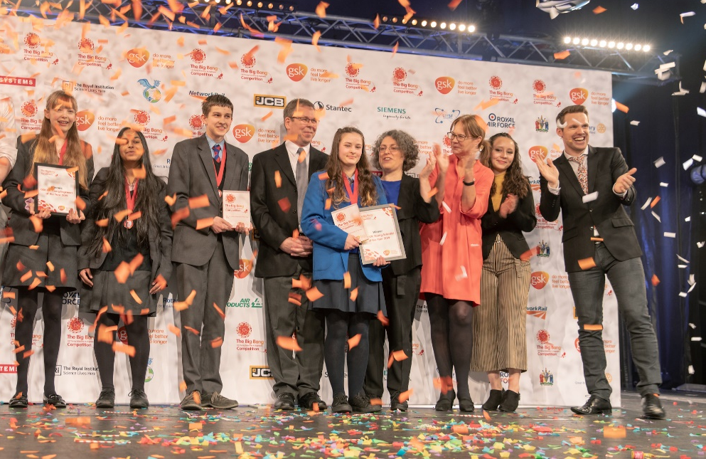
CREST Awards The Squashed tomato challenge is perfect for a CREST Discovery Award. It can also be used to gain a Superstar award (primary) and as a context for Bronze–Gold Awards (Secondary) Big Bang Competition You can enter your challenge into the Big Bang Competition, either at regional events or on-line. 200 projects are chosen every year to attend the national Big Bang Fair in Birmingham. Prizes include industrial/scientific site visits, mentoring, cash, and the chance to represent the UK in International competitions.
This could be you next year!
28
Notes:
CREST
Ditch the dirt is a great way for pupils to gain a CREST Award. The challenge is aligned to the Discovery Award but can be used to gain a Superstar Award or as the starting point for a Bronze, Silver or Gold Award.
Big Bang Fair and competition
Pupils who have taken part in a STEM challenge can enter their work into the Big Bang competition. This is a great way of pupils showcasing their work to other pupils and adults at a regional Big Bang event.
You may also like to look at the Great Science Share and British Science Week initiatives. More information in the Teacher’s guide.

Slide 29
We hope you enjoyed the Solar challenge
For more information and resources go to:
practicalaction.org/schools

