Slide 1


DITCH the dirt
Discover how access to clean water is a problem in many parts of the world, then design and build your own water filter.

Slide 2
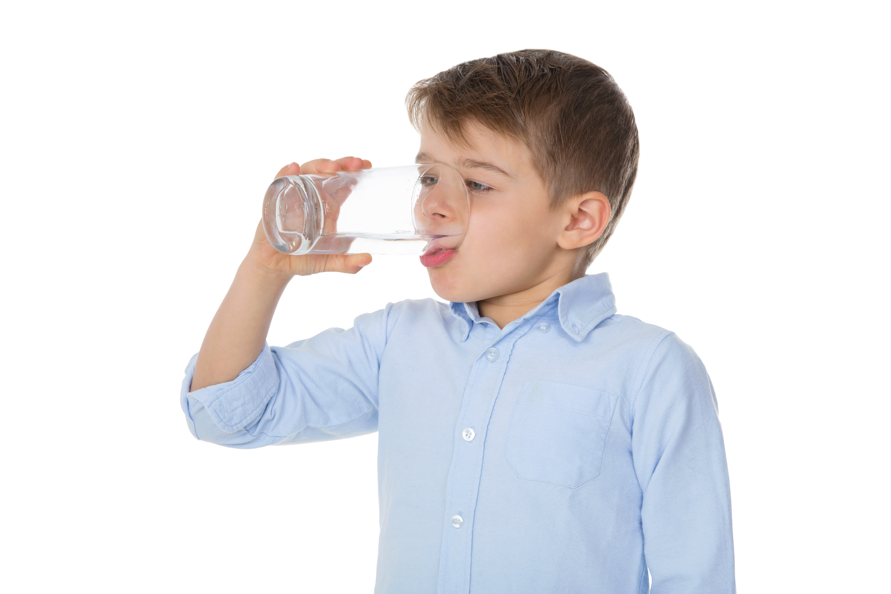
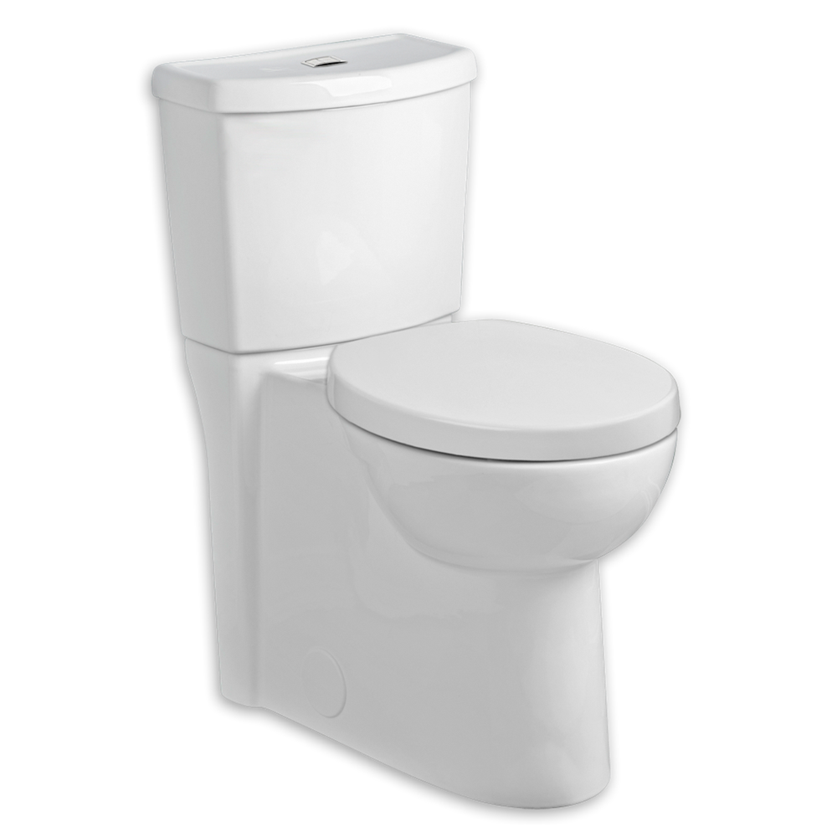
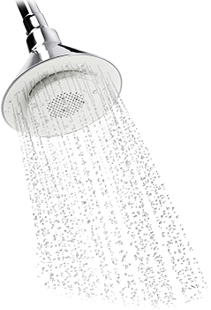


How much water do you use?
Make a note of the activities you have done today where you have used water. Look at a two-litre bottle and estimate how much water you think you used.
How much water is used on average to carry out the activities below?
Drinking water
2 litres
Cleaning teeth
24 litres
Flushing toilet
42 litres
Having a shower
40 litres
An average person in the UK uses 150 litres of water every day.
How would you feel if you had to collect that much water yourself?
2
Notes:
Average stats taken from Waterwise UK 2015
Before launching into the main Ditch the dirt challenge, you might choose to get pupils thinking
about their own use of water before reflecting on what it might be like if they didn’t have clean water piped to
their homes.
To help pupils estimate the water they use have a 2 litre and/or larger 10/20 litre container to hand.

Slide 3
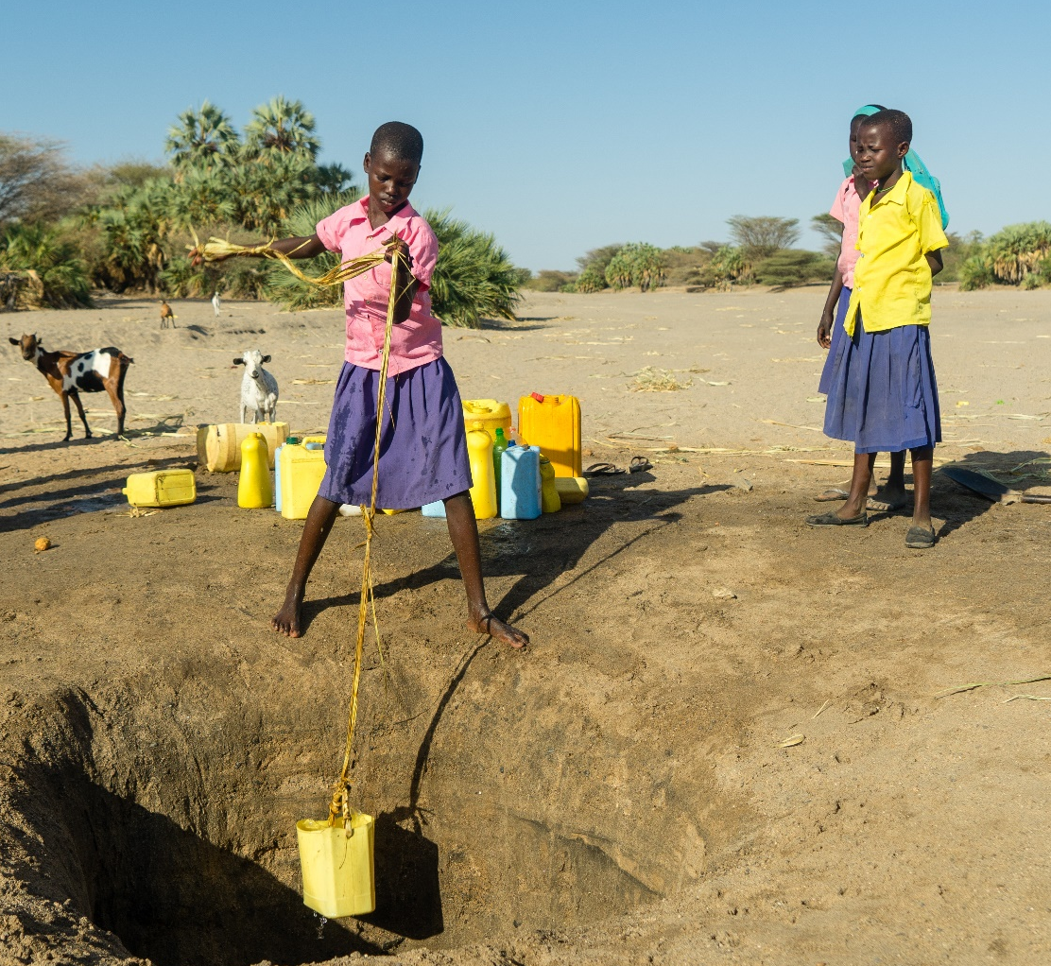
Not on tap
There are 2.4 billion people in the world today who do not have water piped to or close to their homes
Many women and children (especially girls) have to collect water and carry it back to their homes every day.
3

Slide 4
A daily task
Imagine you live in a remote area of Turkana in northern Kenya where there is no piped water.
Your task is to collect the water for your home from ground water holes before you go off to school.
Before you get started decide what equipment you will use to collect your water.
You have 5 minutes to collect as much water as you can.
Be careful not to spill any as each drop of water is precious!
After 5 minutes measure how many ml/litres of water your group has collected.
4
Notes:
You may like to tell children where some but not all of the water holes are before the task.
Prompt questions after the task:
What were the main problems your group had in collecting and carrying water?
Can you think of a way of overcoming those problems?
Answers could include how they worked together, what equipment was used, and what might have helped to carry the water back.

Slide 5

Many people around the world face
problems like not having water that
trap them in poverty.
In 2015 the United Nations (UN)
met with leaders from over 30
countries to work out how to solve
some of the world’s biggest problems.
They identified 17 goals to
end poverty in the world by 2030
and called them the:
Sustainable Development Goals
(SDGs) or Global Goals for short.
1
Notes:
Pupil should now be aware that access to water is a global problem, and that there are many other problems trapping people in poverty.
Introduce the Sustainable Development Goals (SDGs) also known as the Global Goals.

Slide 6
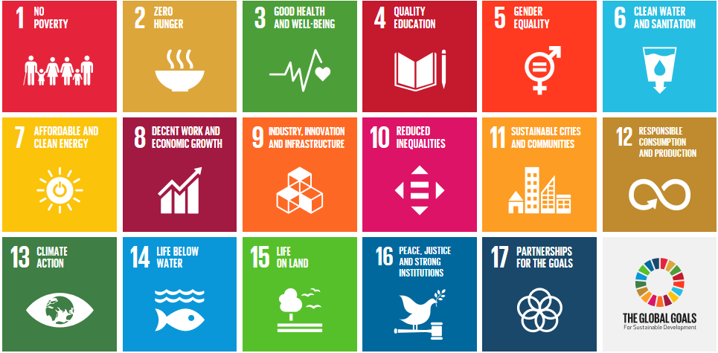
The Sustainable Development Goals (SDGs)
Notes:
Hand out the Sustainable Development Goals worksheet and ask pupils to think about which goals, other than SDG 6, might be linked to some of the problems faced by people living in areas of Turkana who don’t have access to clean water, e.g., goals 3 and 4.
Follow up by carrying out the Global Goals string activity which shows how the goals are interdependent.

Slide 7
Investigating
WATER QUALITY

Slide 8
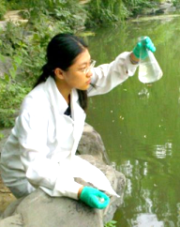
Scientists and engineers play a big part in helping achieve Global Goal 6: Clean water and sanitation.
One thing they do is to check for ‘things’ in the water that make it unsafe to drink; these are called contaminants.
- Physical: e.g. dirt, broken glass, metal, bones
- Biological: e.g. bacteria, viruses, parasites, fungi and toxins from plants
- Chemical: e.g. cleaning fluids, shampoo, polishes
Your task is to investigate the water quality of a variety of samples and think about ways of improving it.
8
Notes:
An important message in this activity is that there are different types of contaminants in water, and they all need to be removed to make water safe to drink.
Hand out the Investigating water quality worksheet and all relevant equipment for the task.
You may like to follow this up with the optional starter activity Investigating sieving. Again, hand out the Investigating sieving worksheet and all relevant equipment.

Slide 9
Your STEM challenge
Ditch the Dirt

Slide 10
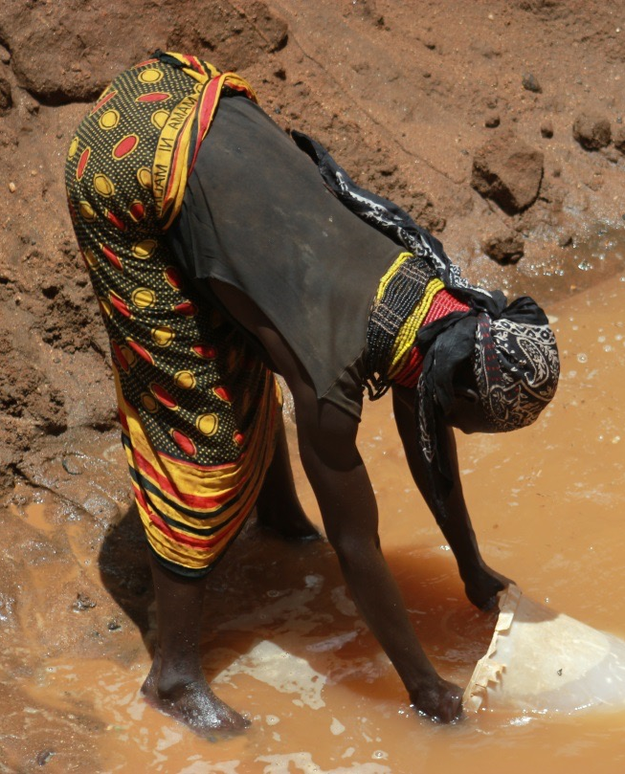
The challenge
To design and build a water filter that could be used by people in Turkana.
Important information
Teamwork: Real scientists work in teams; make sure everyone in your team is involved.
Work safely: Mop up spills, wash your hands and DO NOT drink the water (it may look clean but is not safe to drink).
Challenge criteria: Make sure your filter can filter at least 100 ml in 5 minutes.
10
Good luck!
9
Notes:
Divide the class into small groups. Explain that they will have a set time to develop their filters before the final challenge. Hand out the Ditch the dirt challenge sheets.
Ask them to record the results of their test on the Ditch the dirt challenge activity sheet.

Slide 11
How thick should you make each layer?
What order should the layers go in?
What materials should you make the layers out of?
Things to think about in your design.
??
How can you control the flow of the water?
How many layers should you use?
Notes:
Before starting you may like to get pupils thinking about different factors in their design.
You can give pupils free rein in their design, but for younger pupils show them how to design a simple filter by cutting approximately 15 cm off the base of a 2 litre plastic bottle and placing the base under the neck of the bottle to catch the filtered water.

Slide 12
At the end of your challenge you will have 3 minutes to present or ‘pitch’ your work on designing and building the water filter.
Remember to leave time to work out how you are going to do this.

Slide 13
Worldwide
SOLUTIONS

Slide 14
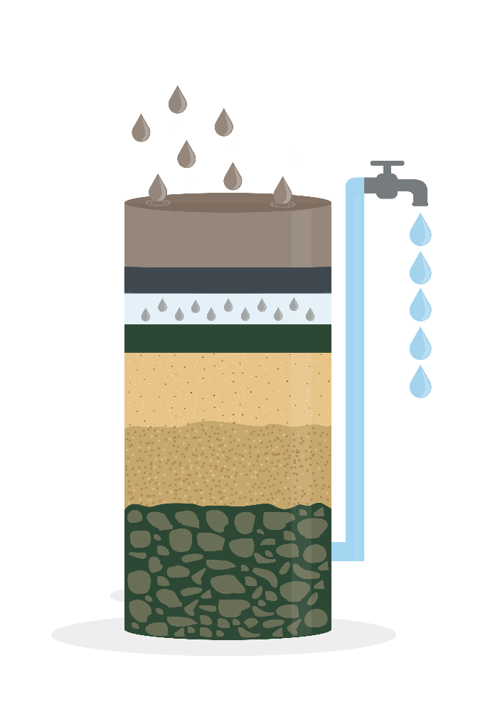
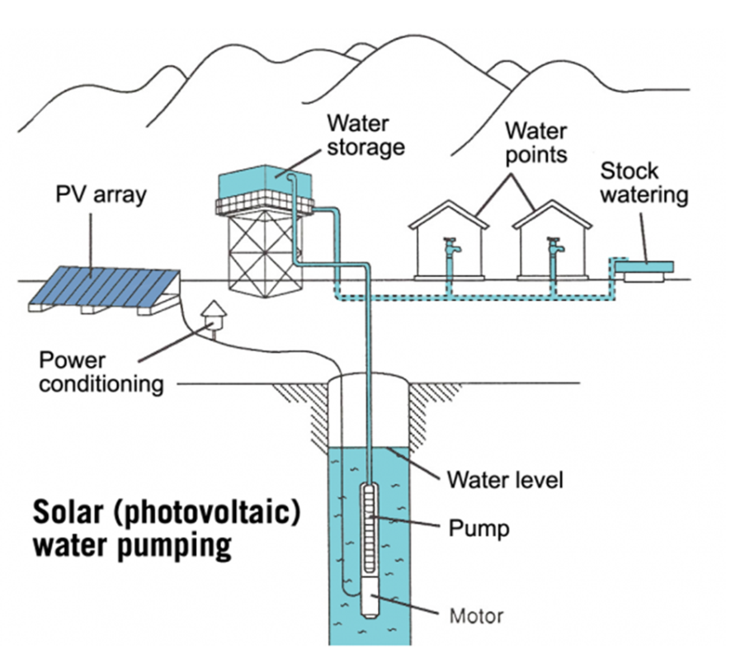
.
Water solutions
Practical Action has worked with communities around the world, including in Turkana, to develop different ways to get clean water that is safe to drink.
Bio-sand filters
These have a thin biofilm on the top which removes high levels of contaminants such as protozoa and metals such as zinc and lead.
Solar water pumps
A solar-powered pump raises water clean enough to drink from under the ground.
Design, make and test
a model of a system
that can transport tomatoes in a way that won't squash them!
Bio-sand filter
14
Solar water pump

Slide 15
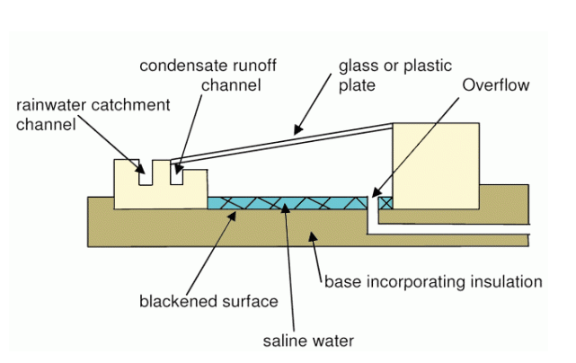
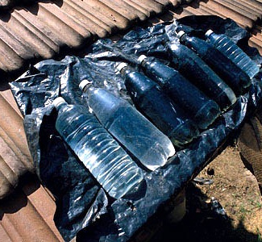
Solar distillation
In places such as Sri Lanka where the main water supply is sea water, a solar water distiller can be used. Water from the sea evaporates, condenses on the lid then runs down a collection pipe to produce water free from contaminants and safe to drink.
Solar Disinfection
A really low-cost solution is to leave contaminated water in plastic bottes in direct sunlight for at least 6 hours or until the water reaches 550 C. A combination of heat and ultraviolet radiation destroys a wide range of micro-organisms.
.
Design, make and test
a model of a system
that can transport tomatoes in a way that won't squash them!
Solar water distiller
Question: Why are the bottles placed on black plastic?
Solar disinfection
15
Notes:
Technical briefs giving more details of water and sanitation solutions can be found at:
https://practicalaction.org/schools/technical-briefs-water-and-sanitation/

Slide 16
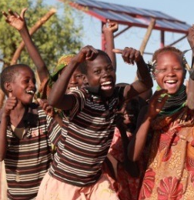
A world that works better for everyone
Whatever ingenious solution is used, having access to clean drinking water has so many benefits, including:
reducing the number of illnesses from waterborne diseases such as typhoid and cholera
reducing the danger of collecting water for women and children
increasing the number of girls who are able to go to school
enabling women to have time to run a business and grow food.
9
Notes:
Recap what the benefits of clean water are. You may like to revisit the Sustainable Development Goals at this point. What particular goals are linked to the four benefits of clean water highlighted above?

Slide 17
Celebrating
SUCCESS

Slide 18

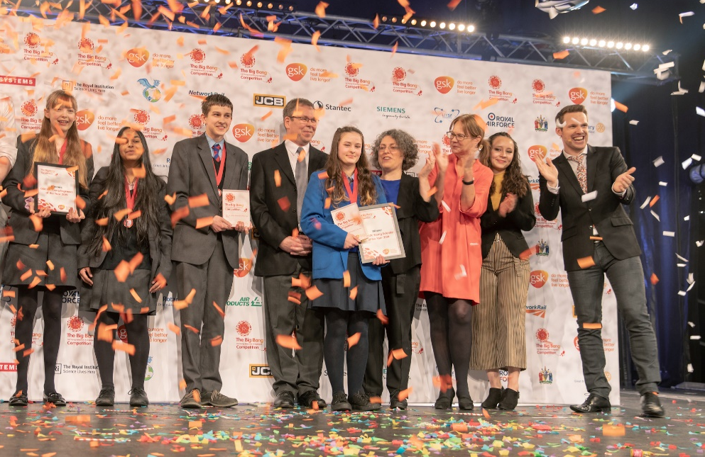
CREST Awards
Ditch the dirt is perfect for a CREST Discovery Award. It can also be used to gain a Superstar Award (primary) and as a context for
Bronze–Gold Awards (Secondary).
Big Bang Competition
You can enter your challenge into the Big Bang Competition, either at regional events or online.
200 projects are chosen every year to attend the national Big Bang Fair in Birmingham. Prizes include industrial/scientific site visits, mentoring, cash, and the chance to represent the UK in international competitions.
This could be you next year!
18
Notes:
CREST
Ditch the dirt is a great way for pupils to gain a CREST Award. The challenge is aligned to the Discovery Award but can be used to gain a Superstar Award or as the starting point for a Bronze, Silver or Gold Award.
Big Bang Fair and competition
Pupils who have taken part in a STEM challenge can enter their work into the Big Bang competition. This is a great way of pupils showcasing their work to other pupils and adults at a regional Big Bang event.
You may also like to look at the Great Science Share and British Science Week initiatives. More information in the Teacher’s guide.

Slide 19











We hope you enjoyed Ditch the dirt
For more information and resources go to:
practicalaction.org/schools

