Slide 1
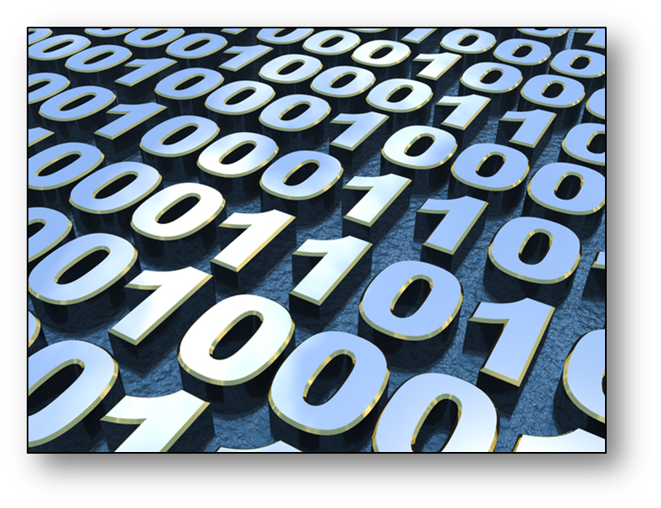
Data Representation

Slide 2
Objective of the session
Understand how computers store bitmap images.
Explain the different types of file compression that are available.
Identify factors that will affect the quality and file size of an image.

Slide 3
File compression
As you have seen, files increase in memory size dramatically when they require a higher colour depth.
That can cause problems when using the images in webpages or when transferring them as larger files take longer to transfer or load on the screen.
There are two ways to compress a file:
Lossy
Lossless

Slide 4
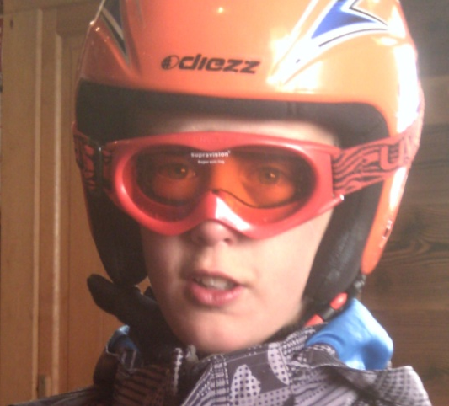
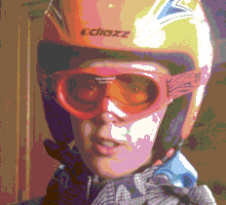
Lossy
This is when the file is compressed but loses some of its quality when this happens. The most common way is to reduce the colour depth from 24 bits to 8 bits but this can make the image appear granulated or have unusual colour blocks showing. JPEG is a lossy file compression type.
Original image
Compressed image

Slide 5
Lossless
If we were going to send the following image then there are blocks of similar colour.
Instead of sending the pixels individually for example for the first row they may save it as :
red, red, red, blue, blue, red, red, red
They could reduce the memory this takes up by saving the same line as:
3 x red, 2 x blue, 3 x red

Slide 6
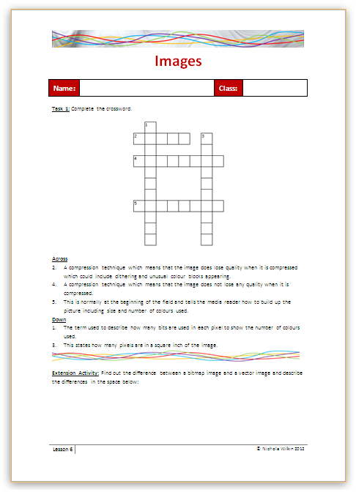
Activity
Complete the crossword on bitmap images (Worksheet_Images).

Slide 7
Text compression Activity
Not only images can be compressed.
Work through ‘You can say that again! – Text Compression’ to learn about another type of compression.
Consider: Why must text compression be lossless?

Slide 8
Extension
If you want to take this further research how and why compression is used in media streaming.

