Slide 1
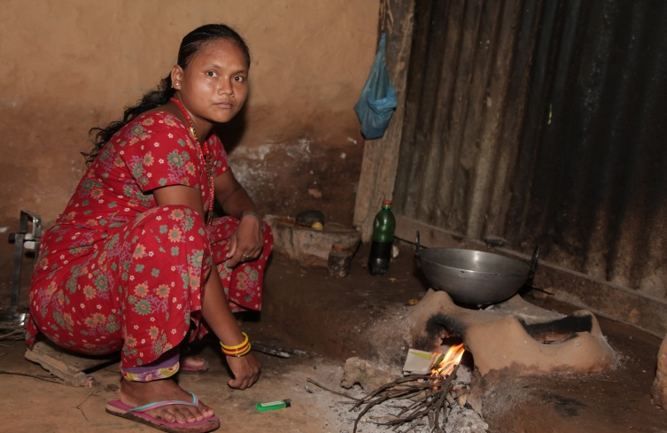
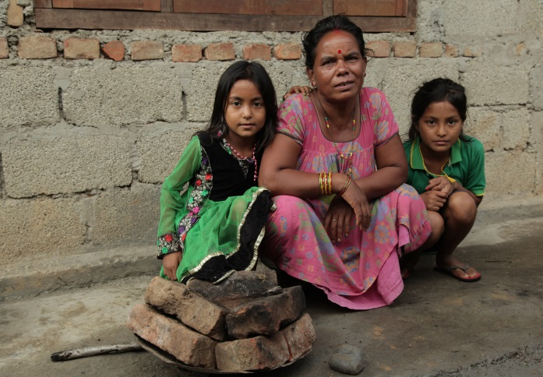
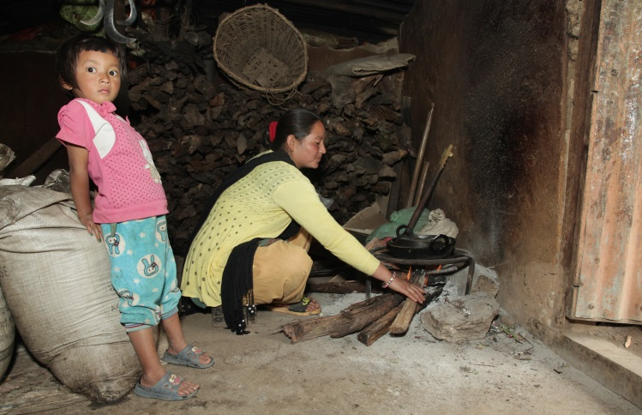
practicalaction.org/schools/smoky-homes

Slide 2
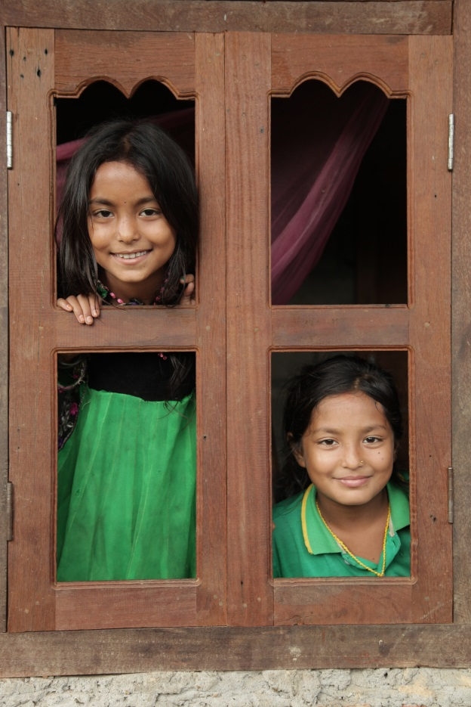
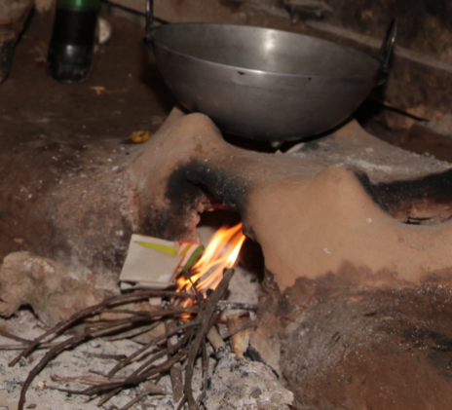
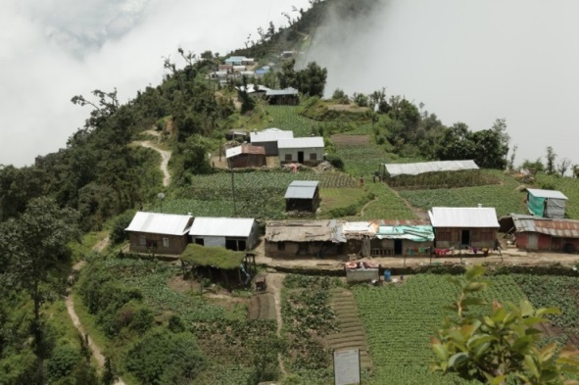
Life in Nepal
Hi, we are sisters Shanoli and Rensi and we live in a small village in Makwanpur District in Nepal.
Our family has just finished rebuilding our home after it was destroyed by the earthquake in 2015.
Before the earthquake, we had a traditional stove in our house, like the one above.
Although it produced a lot of smoke which made us cough, it was less smoky than the open fire using three-stones or bricks our grandma now uses to cook for us.
Notes:
.

Slide 3
Cooking for our family
This is my grandmother, Bimala. She cooks for all ten of us in our family .
Although I help her with the cooking, it can take her up to three hours to cook one meal on this three-stone fire.
These days, I always cook outside our home. If I don’t the children and I get breathing and eye problems caused by the smoke. Everything in the house gets dirty too.
In the monsoon (rainy) season my grandma has to use an umbrella to stop the fire from going out before our food is cooked.

Slide 4
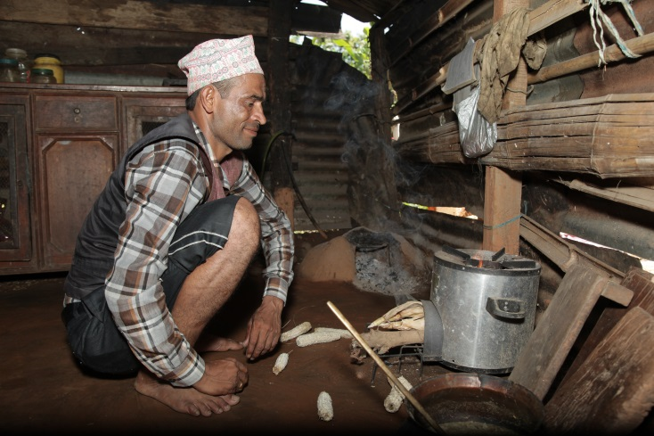
What is the problem?
How many people in the world do you think cook or heat their homes on an open fire or traditional stove?
3 billion
Activity
Look at the photographs from Nepal and mind map any problems that traditional cooking methods cause for people and the environment.
Notes:
3 billion people (fact from WHO 2016 factsheet)
A photograph activity sheet is available to support this activity. The photos are also available on FlickR www.

Slide 5
Killer facts: True or false?
Check your answers as to whether your Killer facts were true or false.
Indoor smoke from fires is a bigger killer than AIDS and malaria combined.
True (4.3 million people die from it each year)
Most people affected by indoor air pollution are women and children.
True (as more women and children are involved in cooking)
3. An open fire in your kitchen is the equivalent of breathing in the air from 200 cigarettes an hour.
False (the real fact is 400 cigarettes per hour)
4. 3 billion people worldwide cook or heat their homes over an open fire or traditional stove.
True
Globally half the deaths of children under 5 are caused by respiratory problems, such a pneumonia, caused by household air pollution.
True
There is nothing that can be done to stop indoor air pollution.
False
Notes:
An activity sheet Killer facts: True or False is available to run this activity.
You might like to show the first 1.27 mins of a video clip to show some of the problems caused by traditional cooking methods in Nepal. http://www.youtube.com/watch?v=y0HXGqHvbUM
Facts available sourced from fact from WHO 2016 factsheet and http://www.who.int/features/2014/clean-household-energy/en

Slide 6
What is the solution?
I’d like us to have a new improved cook stove so that we can cook indoors again. I have seen one at my friend’s house and would love to have one.
They are quite different from our old traditional stove and I’ve heard they cook the food more quickly. They also have a hood, that is like a chimney where all the smoke goes.
If we had one, it would be less smoky in the house and take us less time to cook meals. That would mean I could study more and my grandma would have more time to take care of our cattle.
What might be the reason why Rensi’s family do not have an improved stove with a hood?

Slide 7
Design and make project
Design and make a model of an improved cook stove and/or stove hood for a family such as Bimala’s.
Use the activity What is important to the community? in Makwanpur to help you decide on the most important design criteria for you to include in your design work.
Evaluate any cook stoves and hoods that have been developed in the past.
Develop a range of design ideas for a cooks stove and/or hood, then decide on a final idea to develop into your model.
Use a range of modelling materials including clay, reclaimed materials such as foil food trays, plastic bottles, etc., to make your model cook stove and stove hood.
Evaluate your final model against your design criteria using the Evaluation web
Notes:
Smoky homes Design and make pupil sheets are available to support this design and make activity.

Slide 8
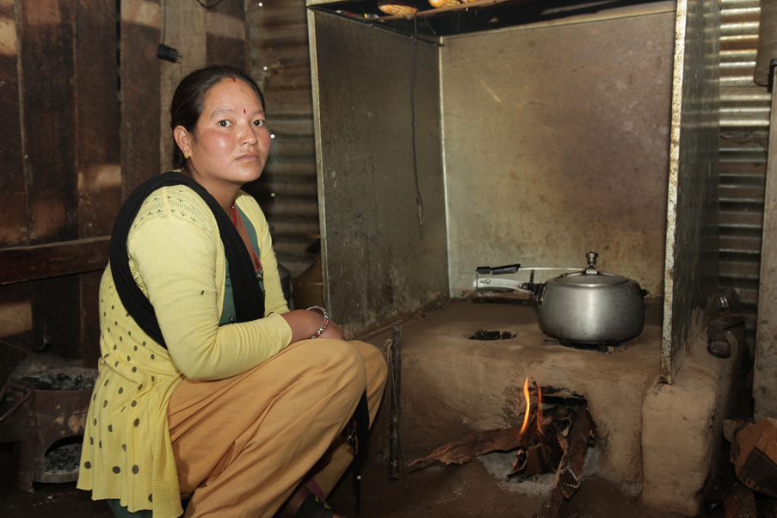
Smart solutions
In Nepal, Practical Action is helping to develop solutions to the problems caused by cooking on fires and traditional stoves.
A range of improved stoves and smoke hoods have been trialled and tested and some families have them installed in their homes.
This smoke hood draws the smoke from the stove and directs it out of the house.
This improved cook stove made from mud and clay uses 50% less firewood than a traditional stove.
Video of improved cook-stoves www.youtube.com/watch?v=y0HXGqHvbUM
Notes:
You might want to show the solutions developed by Practical Action in this video clip from 1.27mins to 3.50mins.

Slide 9
Making a difference
Saraswoti and her family are finding that their recently installed improved stove and smoke-hood is making a big difference to her and her family lives.
The main thing is that we are now free from smoke related illnesses.
Before I had this new stove, I used to spend 3 hours a day collecting firewood.
This improved stove is more efficient and uses half the wood, so gives me more time to farm.
I also get more time to spend with my children, to help them with their homework.

Slide 10
Smoky Homes Quiz answers
How many people in the world cook on open fires?
b. 3 billion
What is the main problem for people with cooking on an open fire?
b. Inhaling smoke
3. Which of these other problems are caused by cooking on open fires?
c. a and b
4. In Nepal who mainly gets affected by smoke from cooking on open fires?
a. Women and children
5. Using a smoke hood over an open fire means you have less indoor smoke. How much less?
b. 80%
Using an improved stove and smoke hood reduces the amount of firewood needed for fuel so that:
c. Less time is spent cooking
Notes:
The questions to this quiz can be found with the Pupil activity sheets.

Slide 11
Keep in touch
Facebook:/PracticalActionSchools
Twitter: @PA_Schools
practicalaction.org/schools/smoky-homes

