Slide 1



A challenge to design and build a home before the floods arrive on Watu island
practicalaction.org/schools/beat-the-flood
Notes:
If you want to assess the impact of taking part in the challenge on your pupils awareness of global issues ask your pupils to do the quick starter questions beforehand.

Slide 2
Changing climates
Imagine living with the constant danger that your home could be flooded at any time.
Our climate is changing and for many people living near riverbanks, the fear of flooding is never far from home.
Does anywhere close to your home get flooded?
Notes:
You may wish to ask pupils to do some additional research into where most flooding is occurring close to their homes. They could find photos and news articles from their locality and add them to the world map.

Slide 3
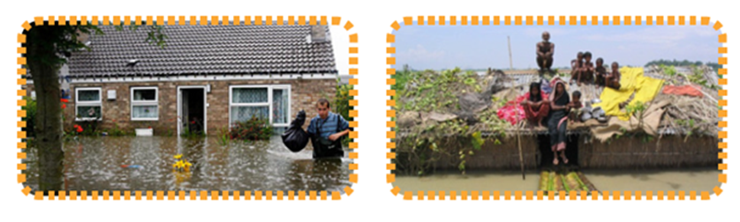
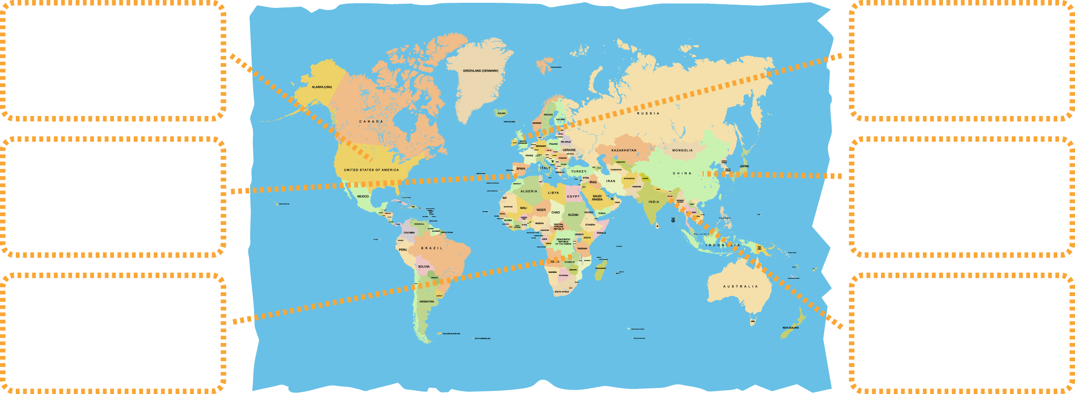
Where in the world?
Activity
Look at the photographs given to you by your teacher and decide where they belong on the world map.

Slide 4
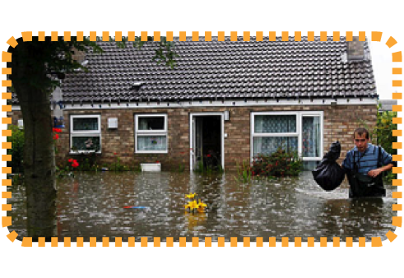

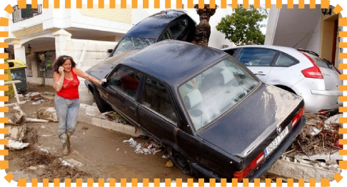
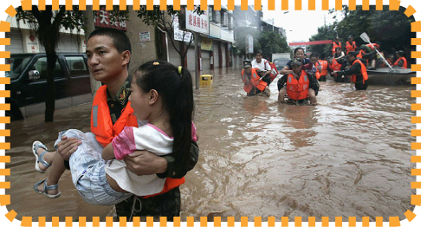
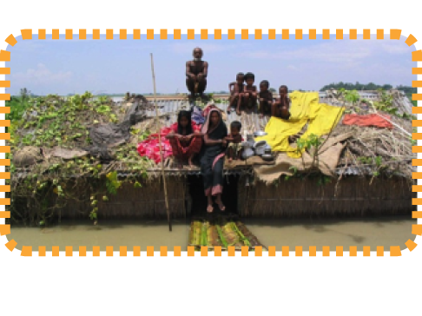
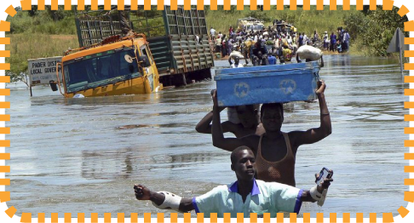
Where in the world?

Slide 5
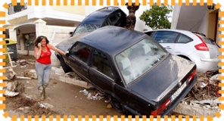
Thoughts on photos…
Choose one photo from Europe and one from a developing country that interests you.
What would life be like for the people in these pictures whose homes have been flooded?
Who do you think is most devastated by the effects of flooding and why?
Notes:
You may wish to develop a word cloud to summarise the feelings of the people whose homes have flooded.

Slide 6
The big fat reality…
People living in poverty are worst affected and suffer most from the effects of flooding
Living in poverty makes it more difficult for people to cope with flooding and recover from the effects as they have less money to rebuild their lives
But…
If people are prepared for floods, they are more likely to recover quickly and less likely to feel disaster
At Practical Action we enable people to learn skills and access technologies to help prepare for floods
Notes:
You may wish to stress that flooding is devastating for anyone...but some in countries such as Bangladesh people are feeling the severe impact of climate change more regularly. At Practical Action, we focus our work on technology justice, enabling people to have access to skills, knowledge and technologies to prepare for changing climates. You may wish to show the video clip at www. https://www.youtube.com/watch?v=GICQpTOsxS8 to give examples of work to support communities in Bangladesh prepare for flooding.

Slide 7
Beat the Flood on Watu Island…
You are a community living on Watu; a small island in the Indian Ocean.
Over the past 5 years you’ve seen a massive increase in rainfall, causing many of the island’s rivers to flood at least twice a year.
Your traditional homes made from earth floors, wooden frames and topped with corrugated iron roofs are regularly damaged or lost as they’re not designed to withstand flooding.
As a group of islanders you want to beat the floods by making sure your homes are flood-proof before the next rainy season.

Slide 8
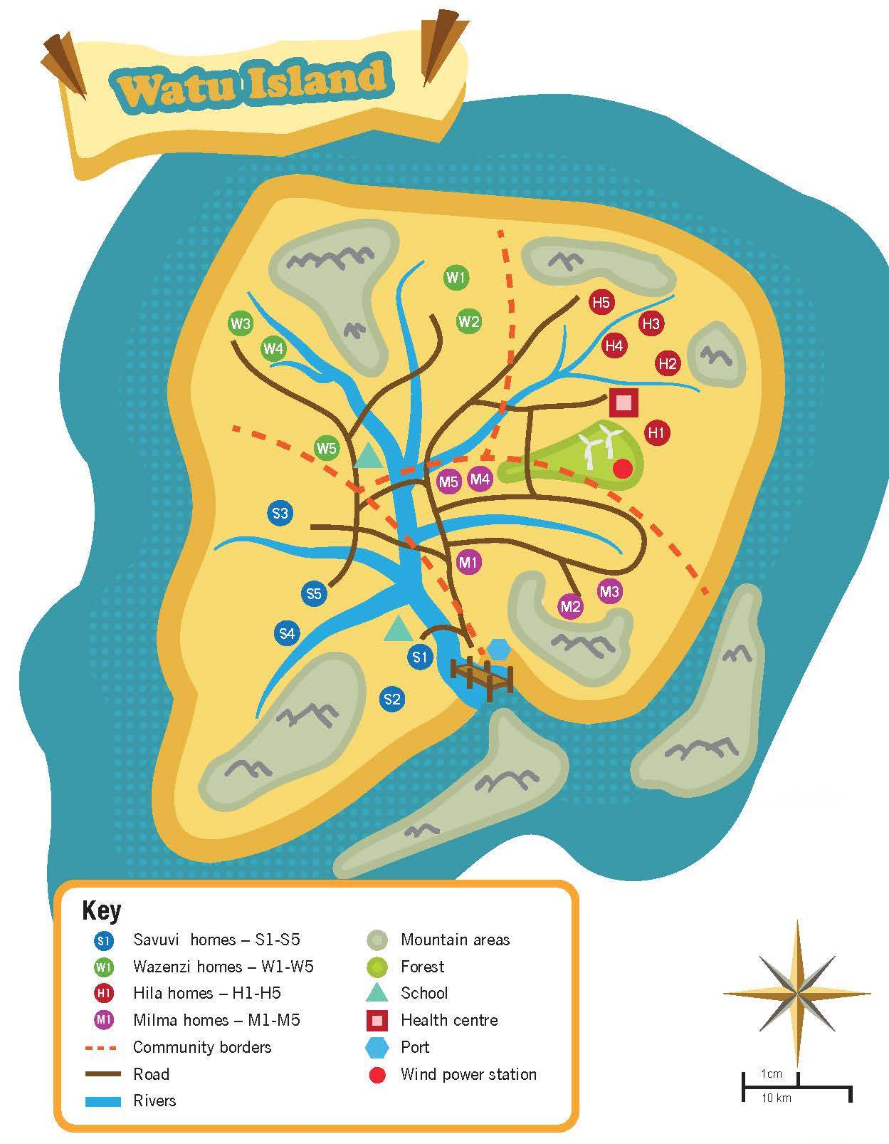
Watu island...
Your class will be divided into four groups.
Each group will represent one of the four communities living on the island.
Look at your map of Watu and your community card to find out about the area where you live.
Are you from the Hilas, Savuvi, Wazenzi or Milma community?
Notes:
Each group will need a map and community card.

Slide 9
Who’s at risk on Watu?
Which of the homes and areas in your community are at risk of flooding?
Discuss in your group or class and mark the homes most at risk on your map.
Where might you build your new house?
Notes:
Have a discussion with your class about what makes some areas and people at higher risk of floods that others. It may include proximity to a river bank, terrain, building such as schools, health centres may also be more vulnerable when dealing with younger or elderly people. For more able or older pupils – you might want to encourage pupils to look at some of technologies used by communities in flood prone areas, such as early warning systems and evacuation procedures. If so, go to http://practicalaction.org/early-warning-in-peru or view http://www.youtube.com/watch?feature=player_embedded&v=G3mUEzm8pdo#at=106

Slide 10
Your Beat the Flood challenge…
Design a home for your community on Watu Island able to withstand the effects of flooding, and make a model of your design so you can test it.
What skills and information will you need to help you develop your new houses?

Slide 11
For your challenge…
Work as a team to complete:
Research - find out about flood-resistant homes, suitable materials and structures, and the material costs for your home
Your teacher will provide you with some information and activity sheets to help your research.
Design sheets - develop a design specification, design ideas
and final design of your flood-resistant home
A model of your home
A flood test - you will need to stand your model in 5cm of
water and squirt with a hose for 2mins from 1m away
A Presentation
Notes:
You may wish to enhance understanding of flood-resistant materials and structures by choosing a few of the materials and structures activities. We suggest that you stress that building homes is an expensive business and that they should keep to a budget of less than £500 for each home. To provide an additional challenge for more able or older pupils, you might want to encourage pupils to look at a wider range of technologies beyond flood proof housing used by communities in flood prone areas, such as early warning systems and evacuation procedures.

Slide 12
Presentation...
At the end of the challenge, your group will be given 5 minutes to present your work to the island community.
Try to include:
Your findings about the areas and homes most at risk in your community
Why you chose the design you developed, including your choice
of materials and structure
How well you worked as a team
How your model stood up to the flood test
What you would do differently if you did it again
If you’ve enjoyed the challenge, ask your teacher about how you can enter your work into our competition or to gain a CREST award.

Slide 13

www.practicalaction.org/beattheflood

