Slide 1
An Introduction to Programming
WITH PSEUDOCODE
Created by P.Jones 2014

Slide 2
A computer is a blank canvas
Waiting for you to instruct.
Plan out with pseudocode
Then program to construct.
Written by P.Jones 2014
Created by P.Jones 2014

Slide 3
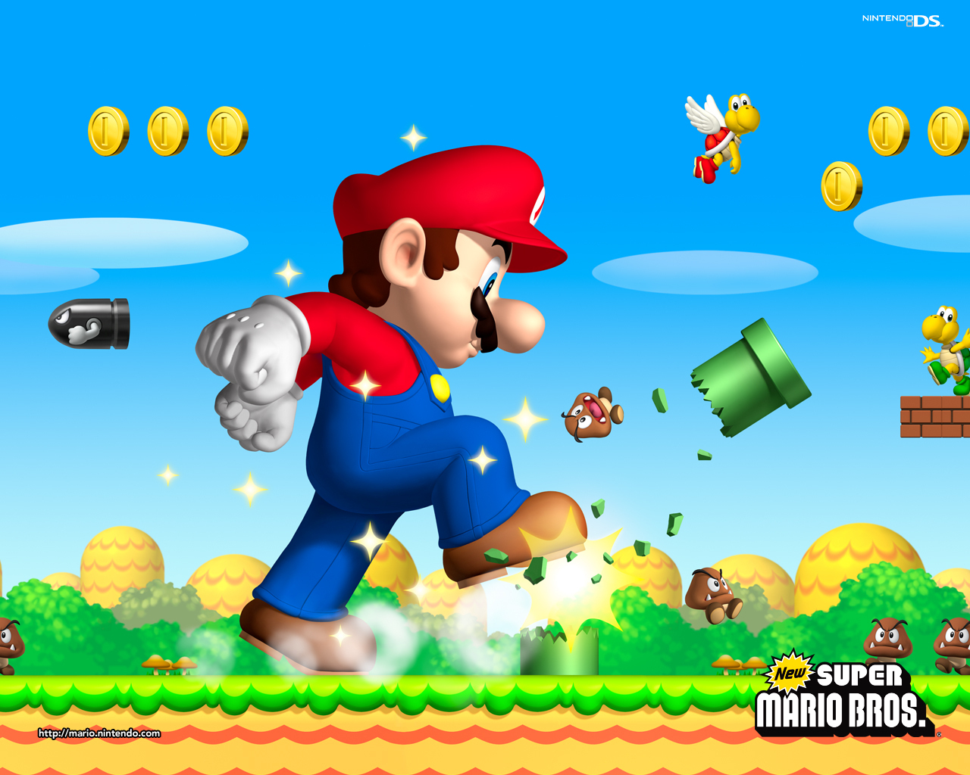
How does the game know to collect these?
How does the game know this will destroy?
How does the game make Mario grow?
How does the game know to break this?
How does the game know to walk on this?
Created by P.Jones 2014

Slide 4
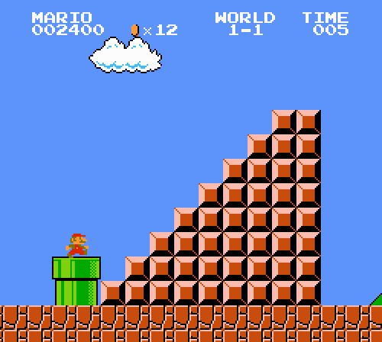
Created by P.Jones 2014

Slide 5
How do I get Minion Stuart to move to D1?
 | A | B | C | D
1
2
3
4
Created by P.Jones 2014

Slide 6
How do I get Minion Stuart to move to D1?
 | A | B | C | D
1
2
3
4
Move right 3 squares
Created by P.Jones 2014

Slide 7
How do I get Minion Stuart to move to D1 then to D4?
 | A | B | C | D
1
2
3
4
Move right 3 squares
Move down 3 squares
Created by P.Jones 2014

Slide 8
How do I get Minion Stuart to move to D1 then to D4, then move to A4 and finally to A1?
 | A | B | C | D
1
2
3
4
Move right 3 squares
Move down 3 squares
Move left 3 squares
Created by P.Jones 2014

Slide 9
How do I get Minion Stuart to move to D1 then to D4, then move to A4 and finally to A1?
 | A | B | C | D
1
2
3
4
Move right 3 squares
Move down 3 squares
Move left 3 squares
Move up 3 squares
Created by P.Jones 2014

Slide 10
What have we just done
You have created a series of instructions to solve a given problem
This is called an Algorithm
When we write it in a list of instructions it is called Pseudocode
Computer Programmers use pseudocode to help plan out the code they will need.
For game making
Creating websites
Control software – robots / machinery
ANYTHING where planning is needed = pseudocode is used to layout the tasks/actions
Key words = Pseudocode and Algorithm
Created by P.Jones 2014

Slide 11
Learning Objectives
Identify the sequence of actions to solve a problem
Determine the order of a sequence to correctly solve a problem
Demonstrate the use of pseudocode to solve a problem
Key words = Pseudocode and Algorithm
Created by P.Jones 2014

Slide 12
Using Pseudocode
Pseudocode can be used to help layout the code
TASK 1
What is the sequence of events to create a square?
You have a selection of instructions in the Session3_02_Instruction Cards document. Cut up the cards and place them in order to create a square
Now write the list of instructions in your workbooks
Key words = Pseudocode and Algorithm
Created by P.Jones 2014

Slide 13
Algorithm Solution written in pseudocode
Move forward 100
Turn right 90 degrees
Move forward 100
Turn right 90 degrees
Move forward 100
Turn right 90 degrees
Move forward 100
Turn right 90 degrees
Created by P.Jones 2014

Slide 14
CHECKPOINT
What have we done so far?
Created an series of actions to solve a given problem.
This is called an Algorithm
Written the list of actions in a numbered sequence
This is called Pseudocode
Key words = Pseudocode and Algorithm
Created by P.Jones 2014

Slide 15
Your Turn
Task 2: In your workbooks think about how to get Minion Stuart to move around the squares and collect the bananas. You will need to move him and also add actions needed to pick up the items.
 | A | B | C | D
1
2
3
4
Extension = Can you add a ‘question to say if the minion reaches a banana?
Key words = Pseudocode and Algorithm
Created by P.Jones 2014

Slide 16
Algorithm Solution written in pseudocode
Move right 2 squares
Pick up banana
Move right 1 square
Move down 1 square
Pick up banana
Move left 2 squares
Pick up banana
Move down 1 square
Move right 1 square
Pick up banana
Move down 1 square
Move left 2 squares
Pick up banana
 | A | B | C | D
1
2
3
4
Key words = Pseudocode and Algorithm
Created by P.Jones 2014

Slide 17
Can you ask a question?
When we think about the way Minion Stuart moves across could we ask a question as he moves from one side to the other?
Move across 3 squares
If you reach a banana
Pick it up
Ask the question – try and start it with an ‘IF’
Ask the question – try and start it with an ‘IF’
Created by P.Jones 2014

Slide 18
Task 3: Let’s give this a go. In task3 in your workbook change your code to ask if the fruit is a banana. If it is then pick it up otherwise leave it.
 | A | B | C | D
1
2
3
4
Key words = Pseudocode and Algorithm
Created by P.Jones 2014

Slide 19
Possible algorithm in pseudocode
Move right 3 squares
IF Minion reaches a banana
THEN pick it up
IF Minion reaches an apple
THEN leave it
This would continue to cover the whole board
 | A | B | C | D
1
2
3
4
This form of pseudocode would help a game designer plan out the code they would need to write to create it.
Key words = Pseudocode and Algorithm
Created by P.Jones 2014

