Slide 1
Spirit of
Innovation
STEAM
RESOURCES
Spirit of Innovation
Year Six
PowerPoint– Batteries & Powertrains

Slide 2
Swapping fuel for batteries
Energy Density
Unleaded Aviation Fuel
Lithium Iron Battery
Therefore battery energy is around 40 times heavier than fuel.
46-48 MJ per kg
1 MJ per kg

Slide 3
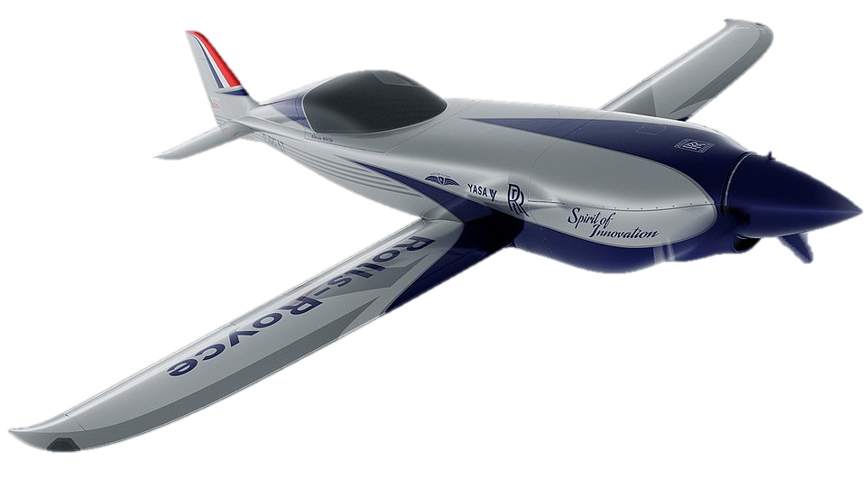
So why is this a problem?
Lift is the key aerodynamic force that enables an aeroplane to fly.
A plane flies when lift equals or is greater than the weight of the plane.
So if you increase the weight of the plane, you have to increase the lift.
This requires more speed. Therefore, more batteries!
More batteries means more weight.
Weight

Slide 4
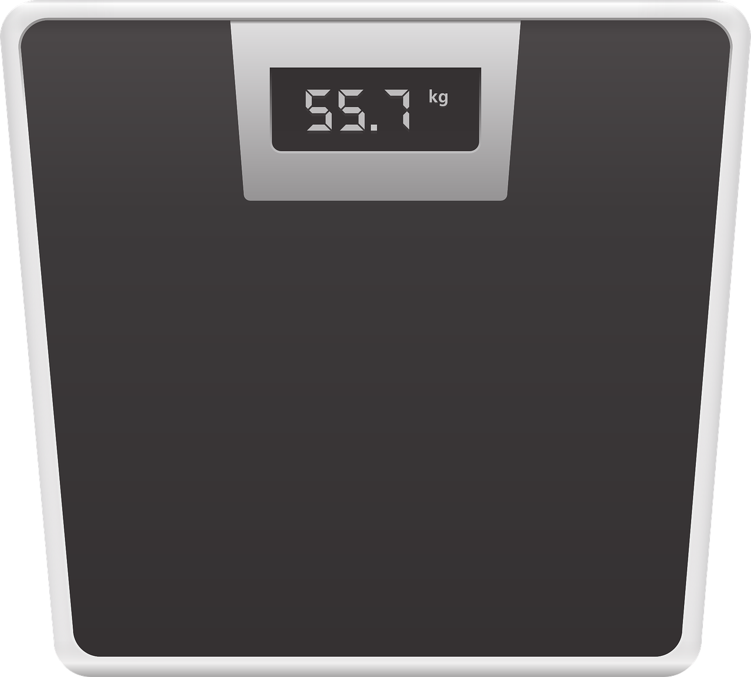
Saving 260kg
For the ACCEL plane it will need around 360kg of batteries. Whereas, the aviation fuel used in this plane would weigh 100kg.
So how can you save the equivalence of 260kg in mass?
260 kg
Use lighter materials:- composite materials like a racing car.
Strip the plane of any unnecessary parts, removal of unrequired seats etc.
Replace the original engine (200kg) with electric motors (130kg). A saving of 70kg.
With the removal of the passenger seat, obviously there is a removal of a passenger (70kg)
*Remember as the fuel is burnt the plane becomes lighter. However, the battery weight remains the same throughout the flight.

Slide 5
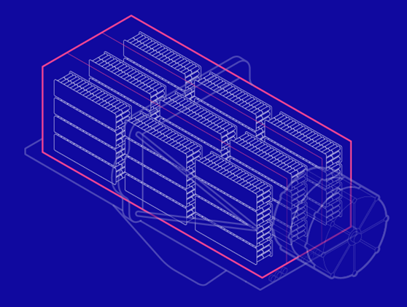
The Batteries
The battery pack is a collection of lithium iron batteries. The batteries are connected in a combination of series and parallel producing the power required.
By changing how many batteries are in series and parallel, you can alter the power and duration characteristics. So you can have lots of power for a short time or power power for more time.
E
E = energy transferred (kWh)
P = power (W)
T = time (h)
P
T
These 6,000 batteries provide 64kwh or energy.
This would keep 12800 LED spotlights running for one hour.
Or run an electric hatchback car for over 300miles.
Battery Facts
Coolant is passed though the battery pack. By using many small cells rather than one big cell effective cooling is achieved. This minimises thermal hot spots and lengthens the life of the battery pack.

Slide 6
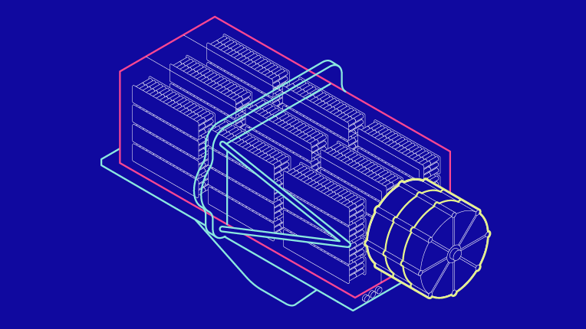
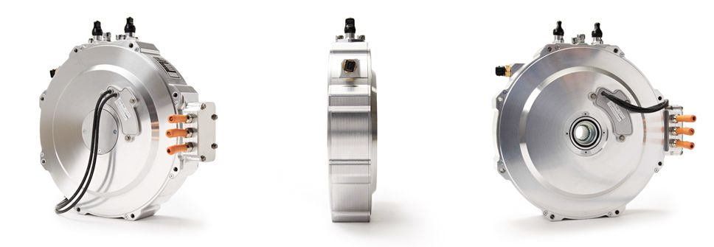
The Motors
For the record attempt, The Spirit of Innovation will use three electric-motors. Combined, these motors will deliver more than 500 horsepower to the propeller at a lower RPM than a conventional airplane, which means increased stability, less noise and greater efficiency.

Slide 7
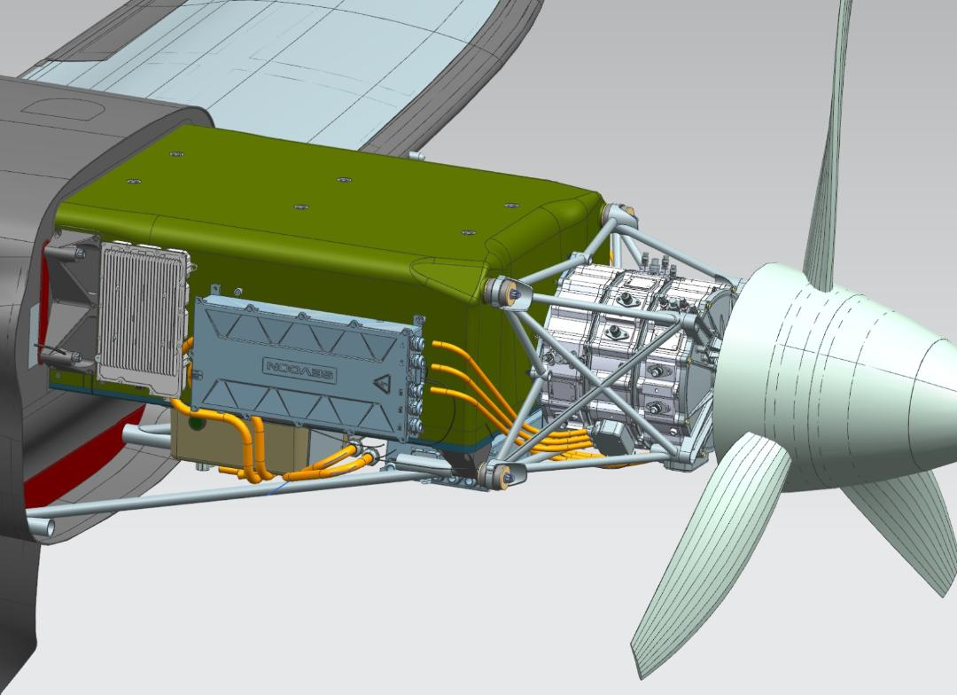
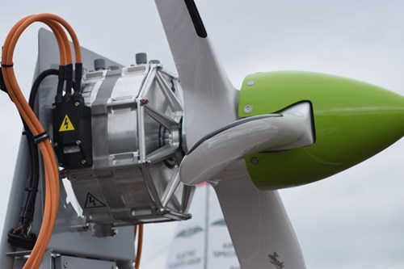
The Powertrain
In The Spirit of Innovation plane, the powertrain comprises four main components that generate thrust. These include the batteries, invertors, electric motors and the propeller.
The all-electric powertrain be 90% energy efficiency with zero emissions.
The three propeller blades
spin at 2,400 RPM

Slide 8
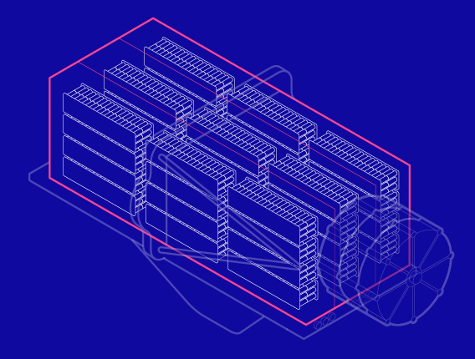
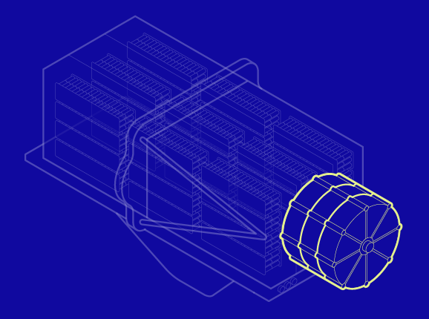
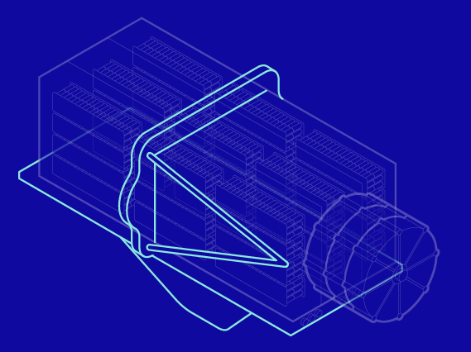
From the 6000 battery pack.
DC Power
The batteries produce DC power
Where will the motor receive power?
AC Power
So before supplying power to the motor it has to be converted into AC
An inverter will be used for this. This electronic device will also control the power frequency:- motor speed.
It can also vary the amplitude of the AC power which in turn will control the motor power output. Hence acting as the brain of the plane.

Slide 9
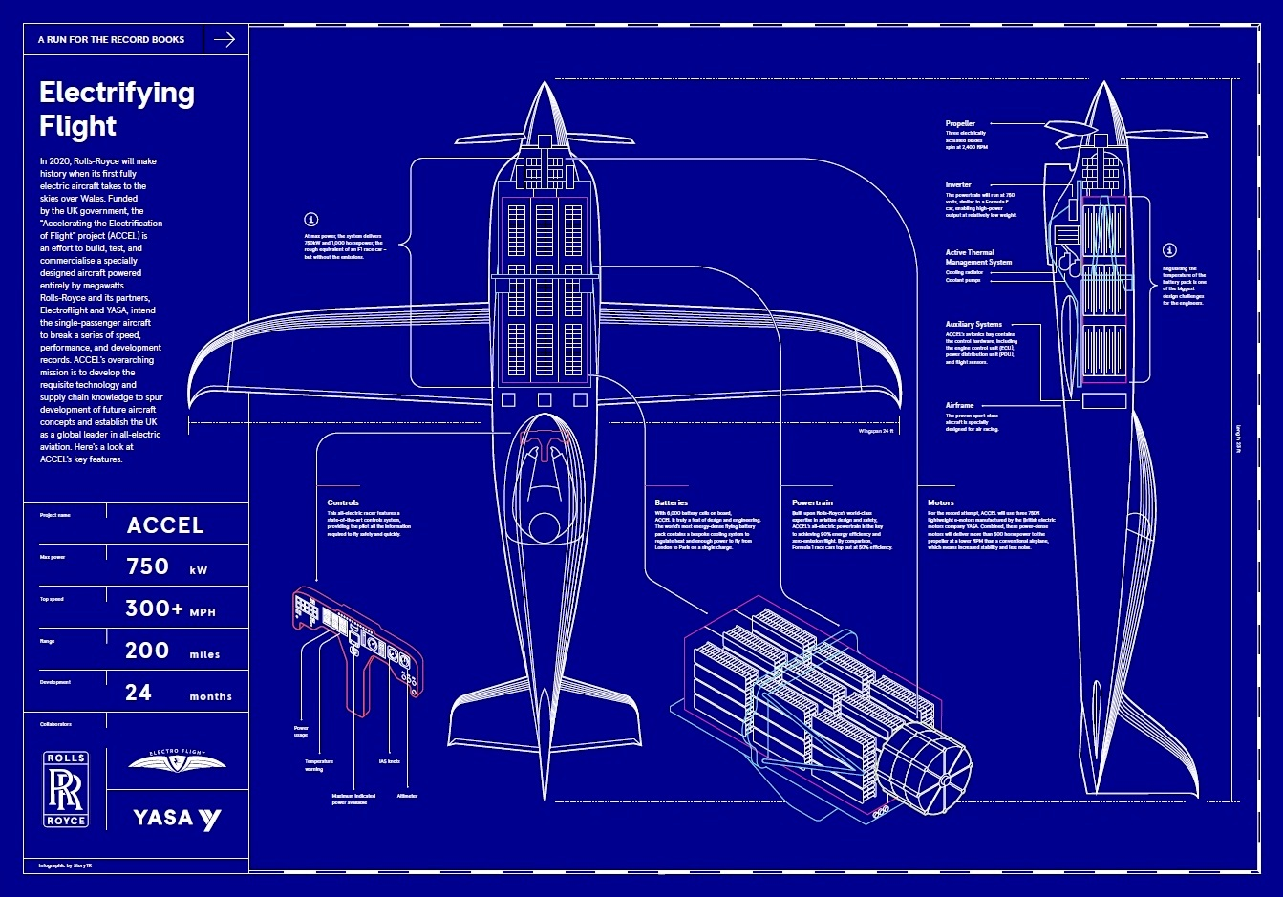

Slide 10
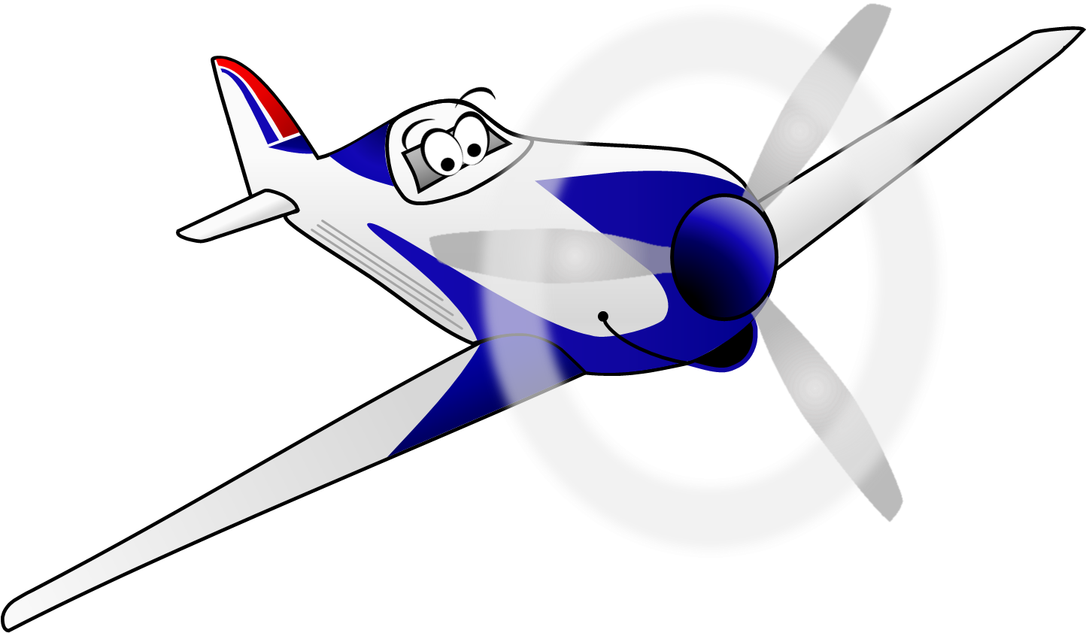
These resources have been brought to you by

