Slide 1
Spirit of
Innovation
STEAM
RESOURCES
Art
Year Two
PowerPoint - An Introduction To Levers

Slide 2
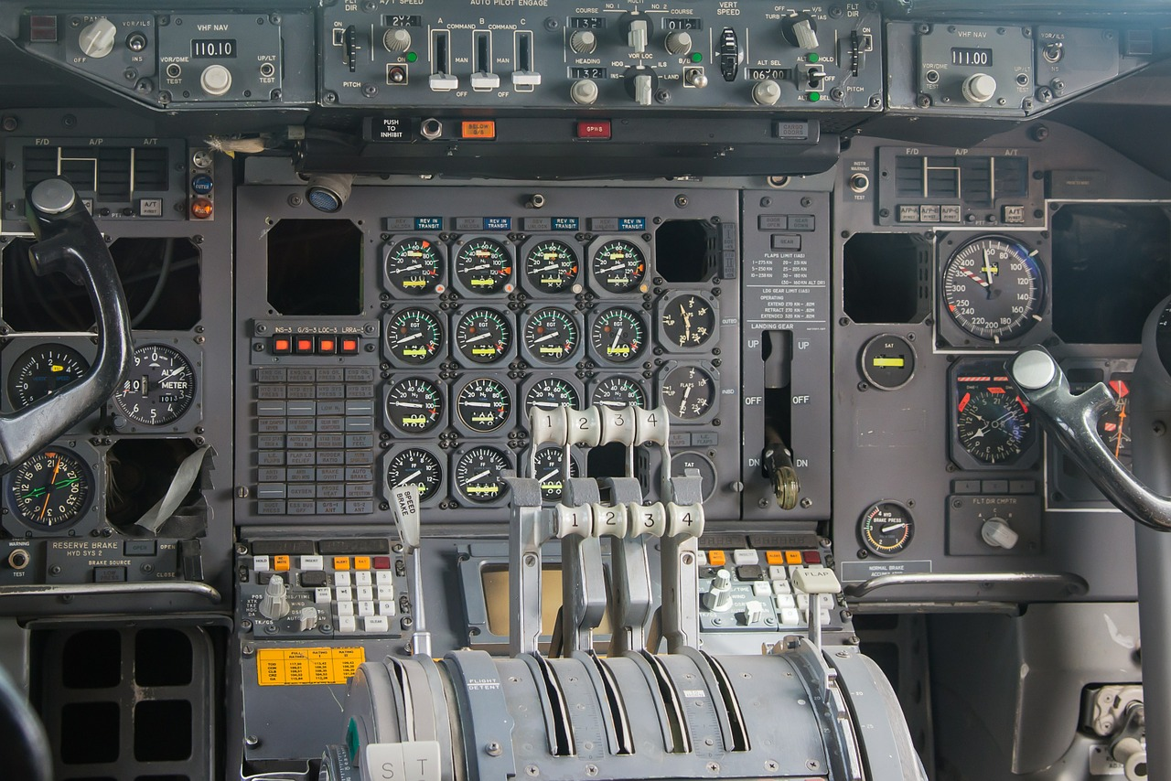
Levers and Linkages
Levers are the simplest of mechanisms.
When a force is applied to one side, the other sides moves in the opposite direction.
Fixed pivot points are called the fulcrum.
By moving the fulcrum the force can be made greater or smaller.

Slide 3
Key Words
Mechanism – creates movement. It is a system of parts working together in a machine.
Lever – a stiff bar that moves based on a fixed pivot point.
Pivot – the central point, where a mechanism turns.
Fulcrum – the name for fixed pivot points
Linkage – a mechanism involving two or more levers

Slide 4
Fixed pivot
Fixed Pivot

Slide 5
Output
Lever
Tab
Tab
Input

Slide 6
Output
Lever
Tab
Tab
Input
Fixed pivot
Loose Pivot
Fixed Pivot

Slide 7
Output
Output
Lever
Tab
Tab
Input
Fixed pivots
Loose Pivot
Fixed Pivot

Slide 8
Output
Fixed pivots
Lever
Tab
Tab
Input
Fixed pivots
Output
Loose Pivot
Fixed Pivot

Slide 9
Fixed pivots
Fixed pivots
Lever
Output
Output
Tab
Tab
Loose Pivot
Fixed Pivot
Input

Slide 10
Output
Tab
Tab
Lever
Input/Output
Fixed pivots
Tab
Tab
Lever
Input/Output
Output
Loose Pivot
Fixed Pivot

Slide 11
Output
Tab
Tab
Lever
Fixed pivot
Input
Lever
Lever
Loose Pivot
Fixed Pivot

Slide 12
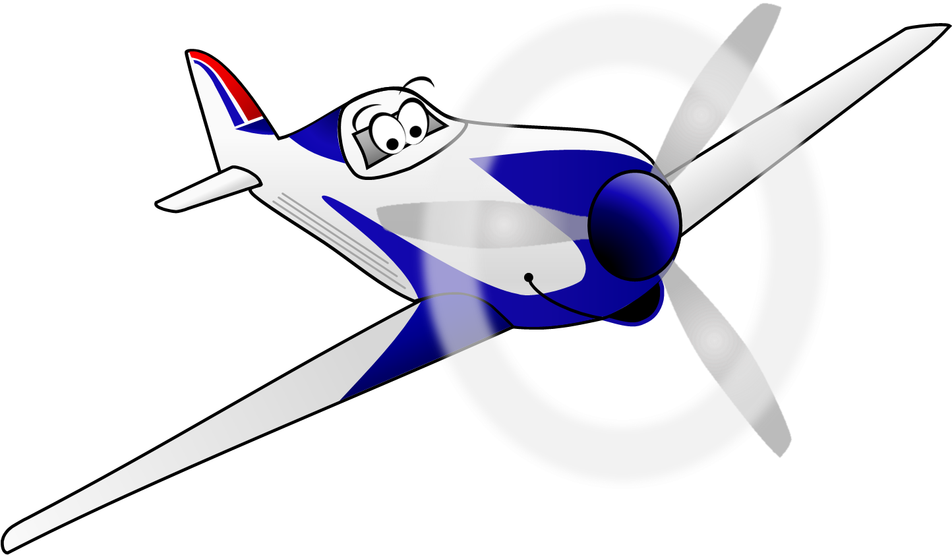
These resources have been brought to you by

