Slide 1
Spirit of
Innovation
STEAM
RESOURCES
Spirit of Innovation
Year Five
PowerPoint – Air Resistance

Slide 2
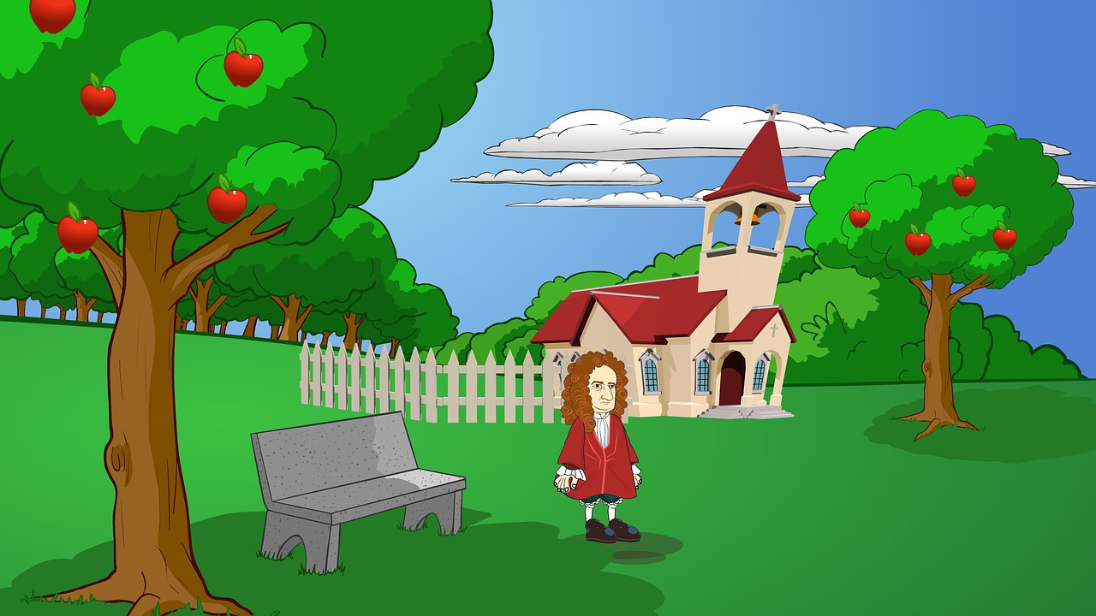
Gravity Recap
Sir Isaac Newton discovered gravity about 300 years ago. The story is that Newton saw an apple fall out of a tree. When this happened he realised there was a force that made it occur, and he called it gravity.
?
Gravity is a force of attraction. It is the Earth pulling on you and keeping you on the ground.

Slide 3
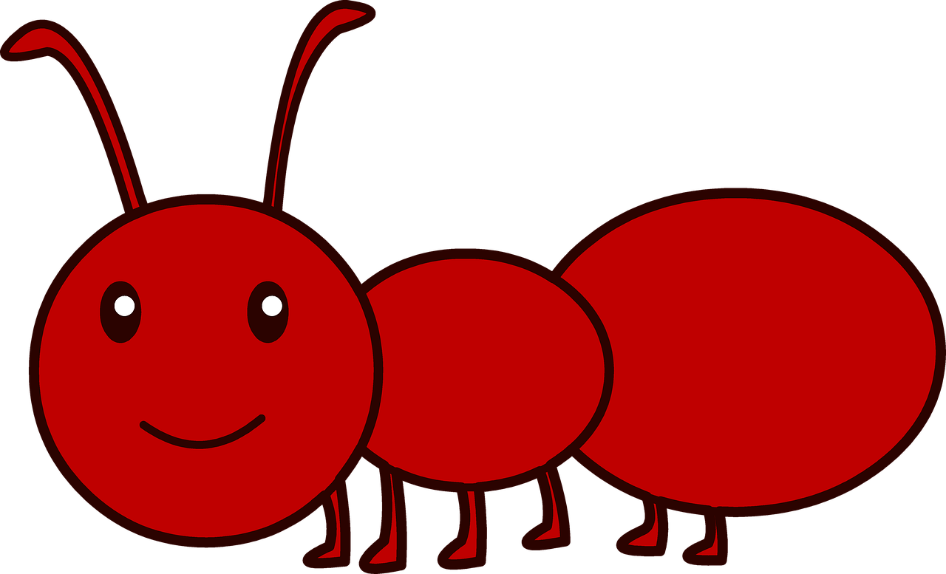
Weight or Mass?
The weight of an object is the force caused by gravity pulling down on the mass.
Weight is measured in newtons (N).
Mass is measured in grams and kilograms (g/kg)
Gravity
Gravity
The bigger the object's mass, the more gravity it will have.
The smaller the mass of the object, the less gravity it will have.
Mass always stays the same, while weight changes with changes in gravity.
The weight of something is the value measured at the Earth's surface.

Slide 4
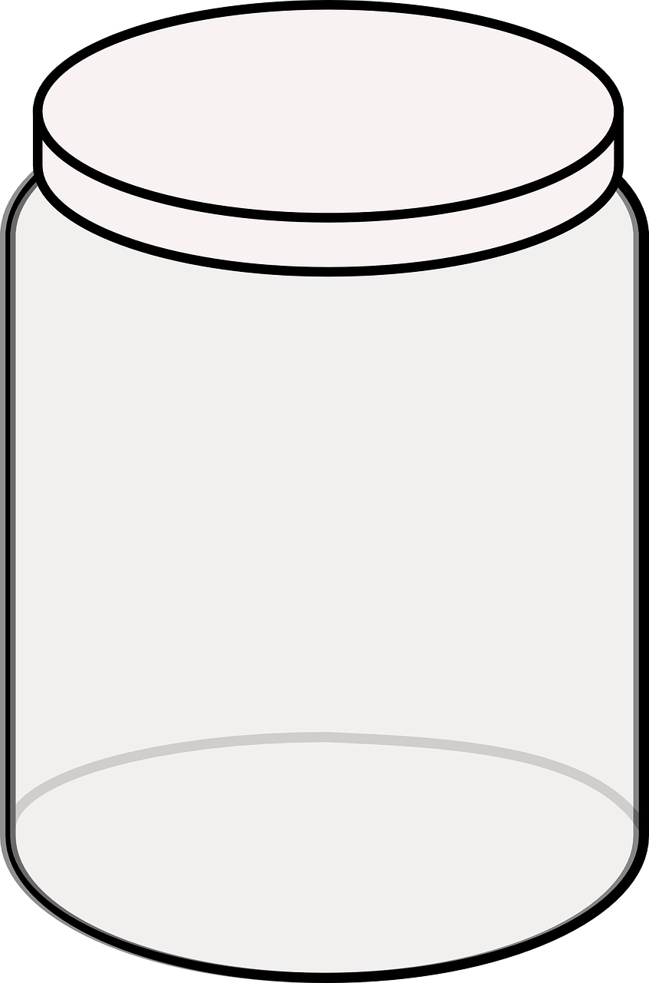
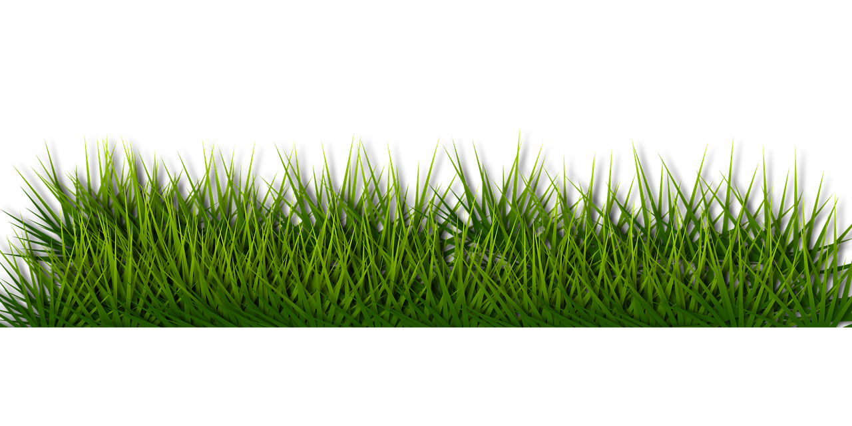
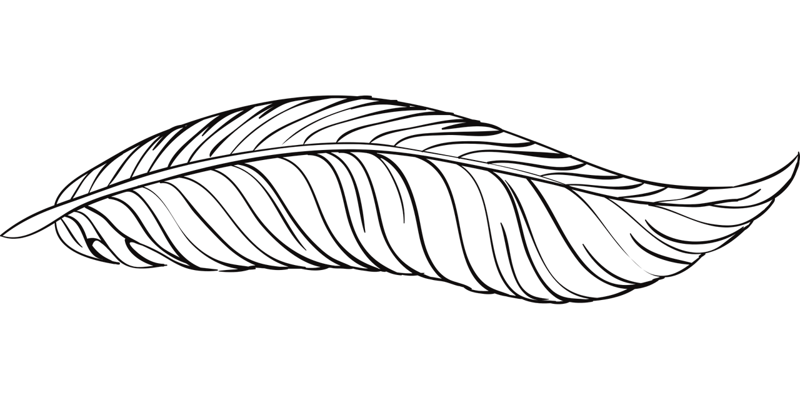
Air Resistance
The mass of an object is important when learning about air resistance.
Gravity is pulling the apple towards the centre of the Earth.
All objects fall at the same rate – only air resistance affects it’s speed.
Air resistance is a friction between air and an object. When the air pushes against the object it slows down.
If you dropped a feather in a container with no air (a vacuum), it would drop as fast as a stone.

Slide 5
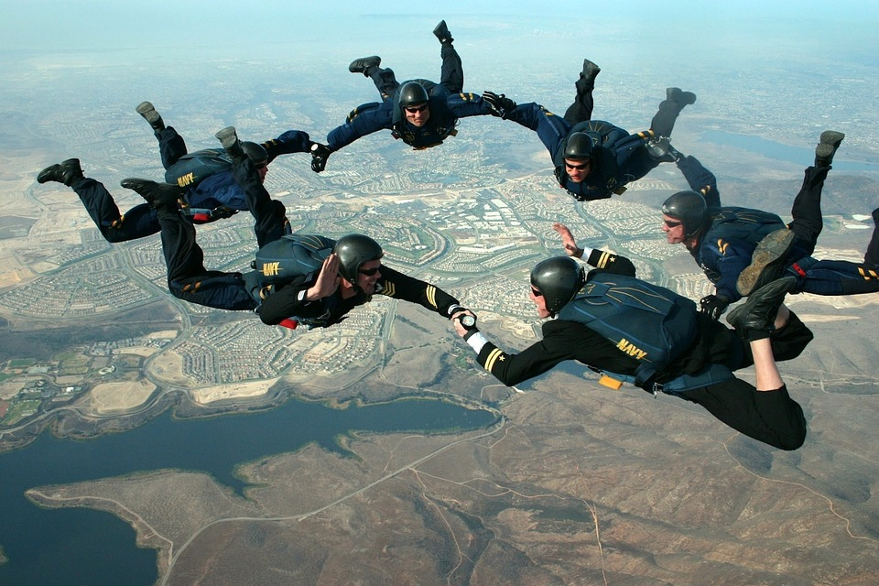
Air Resistance also known as drag
At some point when falling, the friction from the air will equal the force of gravity and the object will be at a constant speed.
Gravity
This is called the terminal velocity.
For a sky diver this speed is around 100 miles per hour!
Air resistance
https://www.bbc.com/bitesize/articles/zxw6gdm

Slide 6
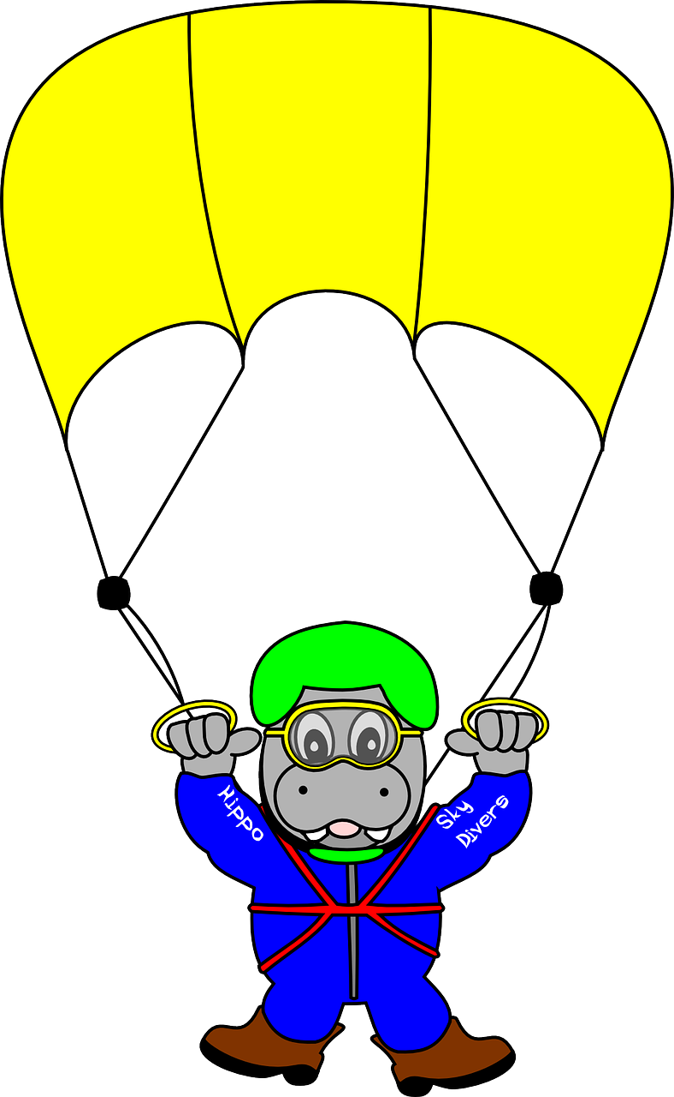
How Does a Parachute Work?
As the parachute
opens the air resistance increases.
There are two forces acting on the falling object.
The greater air resistance allows the parachutist to float to earth gently
Gravity
Now the air resistance is more than gravity.
Air resistance
Gravity
Here the gravity
is more than the air resistance.
Air resistance

Slide 7
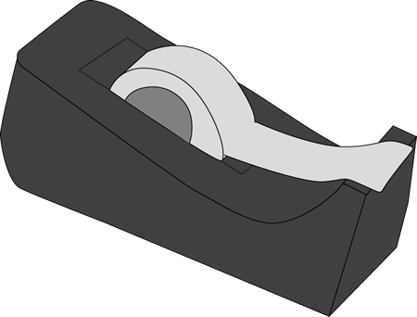
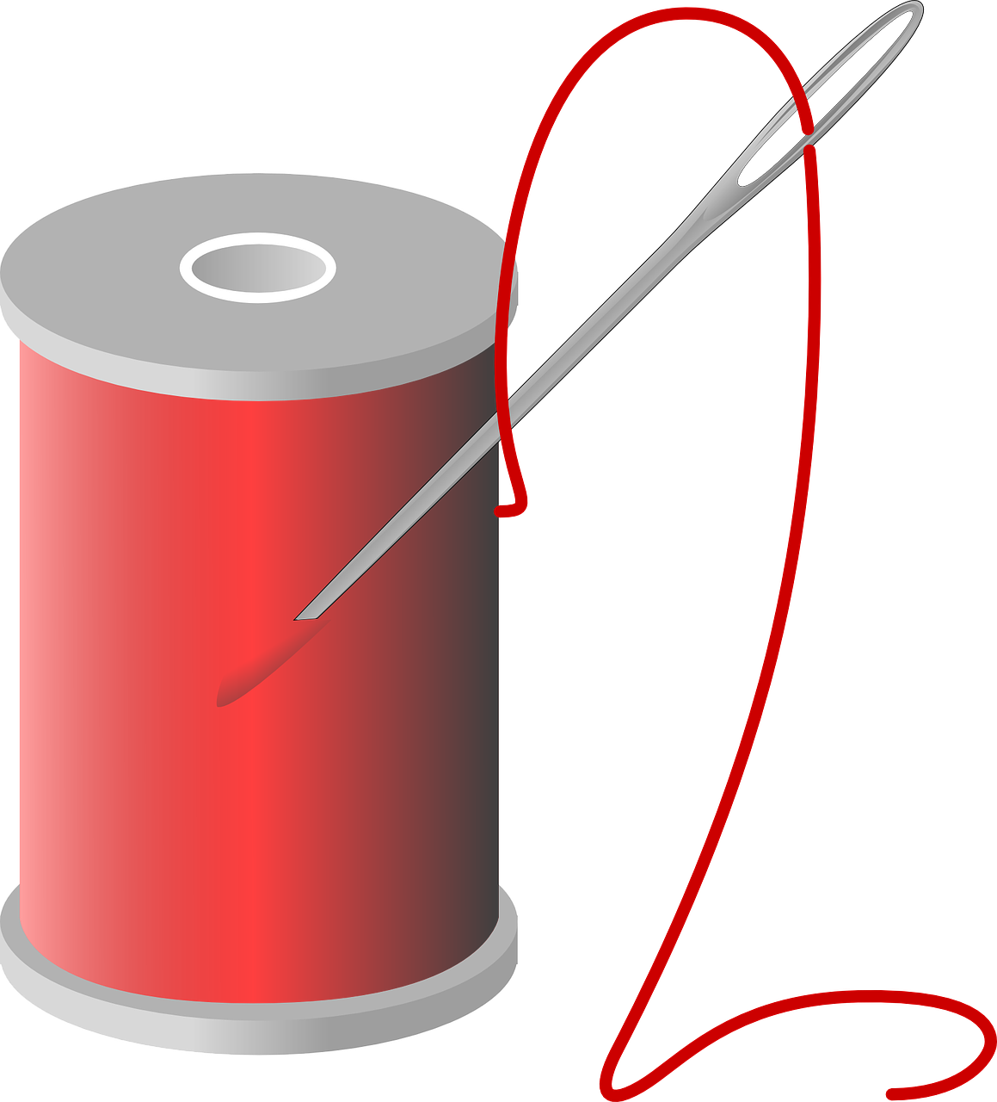
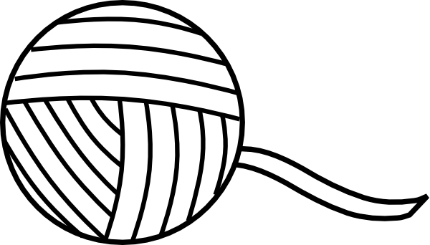
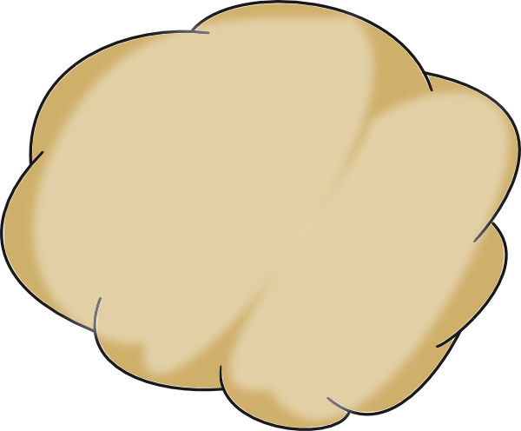
How to make a parachute
Choices of Materials:
Paper cake case
Water dispenser cone
Yoghurt pot
Plastic bag
String
Cotton
Sticky Tape
Blu Tack
Plasticine
Scissors
Single whole punch
Scales
Method:
Decide upon the material that will be using for the parachute’s canopy.
If necessary cut it to shape, cones and cake cases need not be cut.
Carefully pierce holes around the edge. Number of holes depend on the number of strings required
Thread the strings through each hole and fix with sticky tape.
Weigh out a piece of plasticine/blue tac.
Roll it into a ball and fix to the strings
Begin testing!

Slide 8
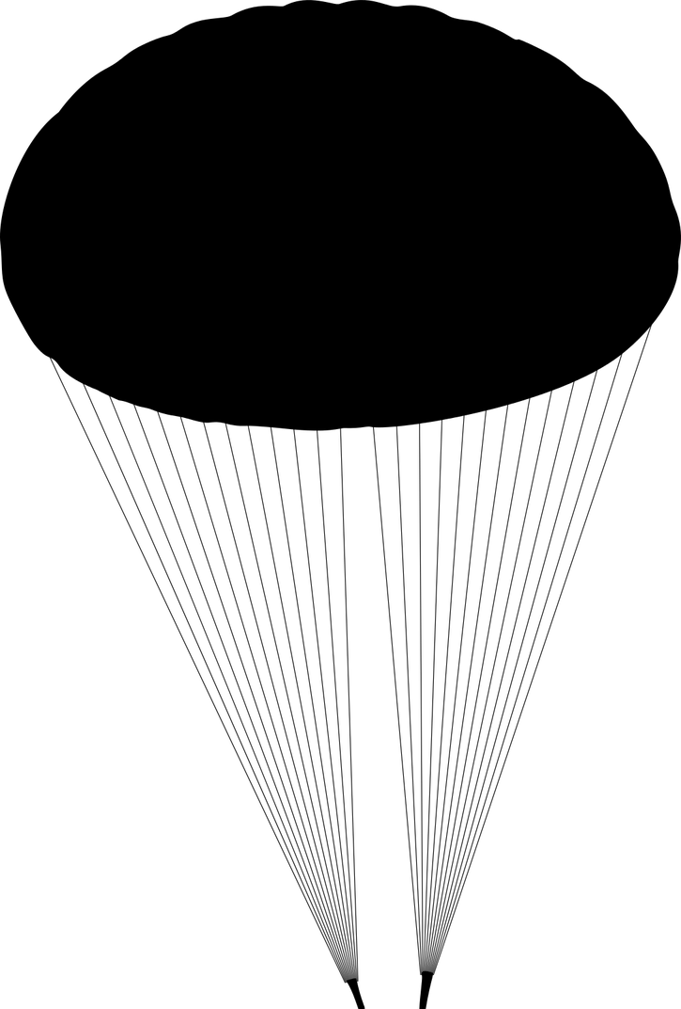
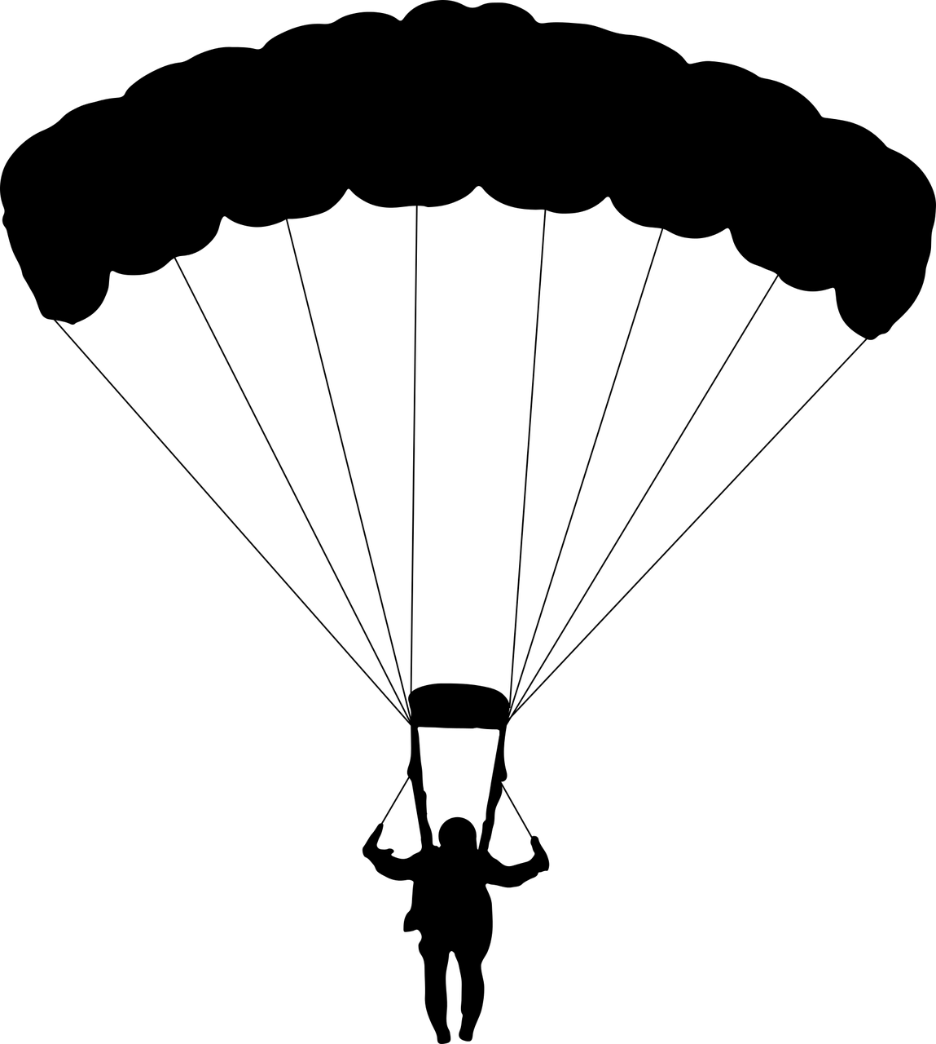
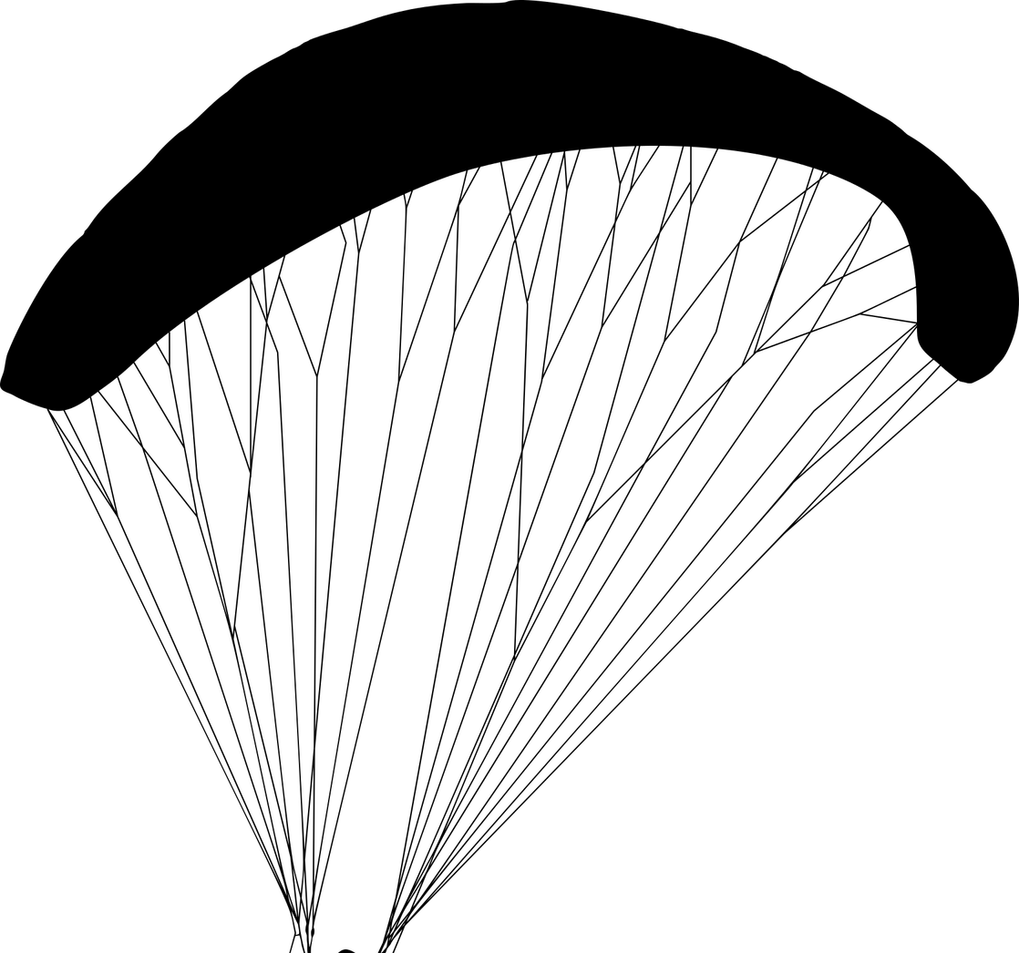
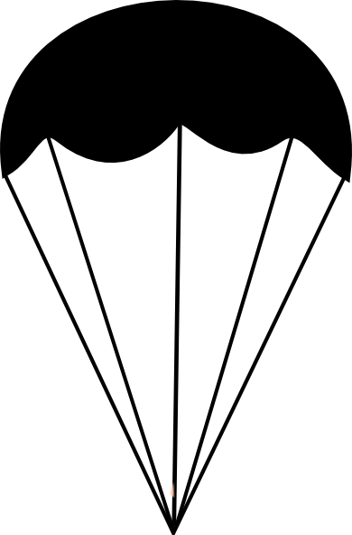
How does the size and the materials affect the speed of the parachute?
How are we going to test the parachutes?
How will we make it a fair test?
How will we record the results?
What do you think is going to happen?

Slide 9
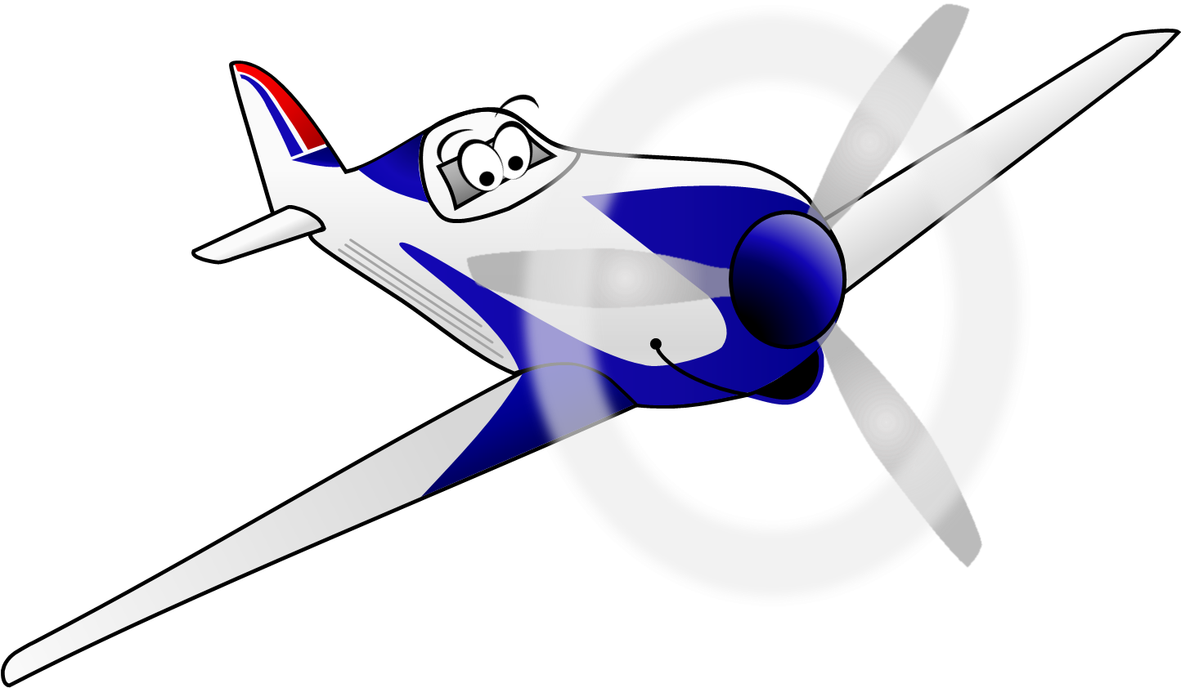
These resources have been brought to you by

