Slide 1
Notes:
Students should now have a sound understanding on the principles behind digital images.
This session introduces a particular type of digital image – those taken by satellites.

Slide 2
Investigating Land Classification
Learning Outcomes
After the session we hope you will:
Have been introduced to satellite images
Appreciate some issues when analyzing satellite images
Have attempted to classify land in a satellite image
Use Python programs to automate land classification
Have written the code to derive statistics from the data
Notes:
It is important to be explicit about the intended outcomes for your students.
Do not assume they will be aware of the purpose of your session.
The specific outcomes from this session are for students will;
Have been introduced to satellite images
Appreciate some issues when analyzing satellite images
Have attempted to classify land in a satellite image
Use Python programs to help automate your classification scheme

Slide 3
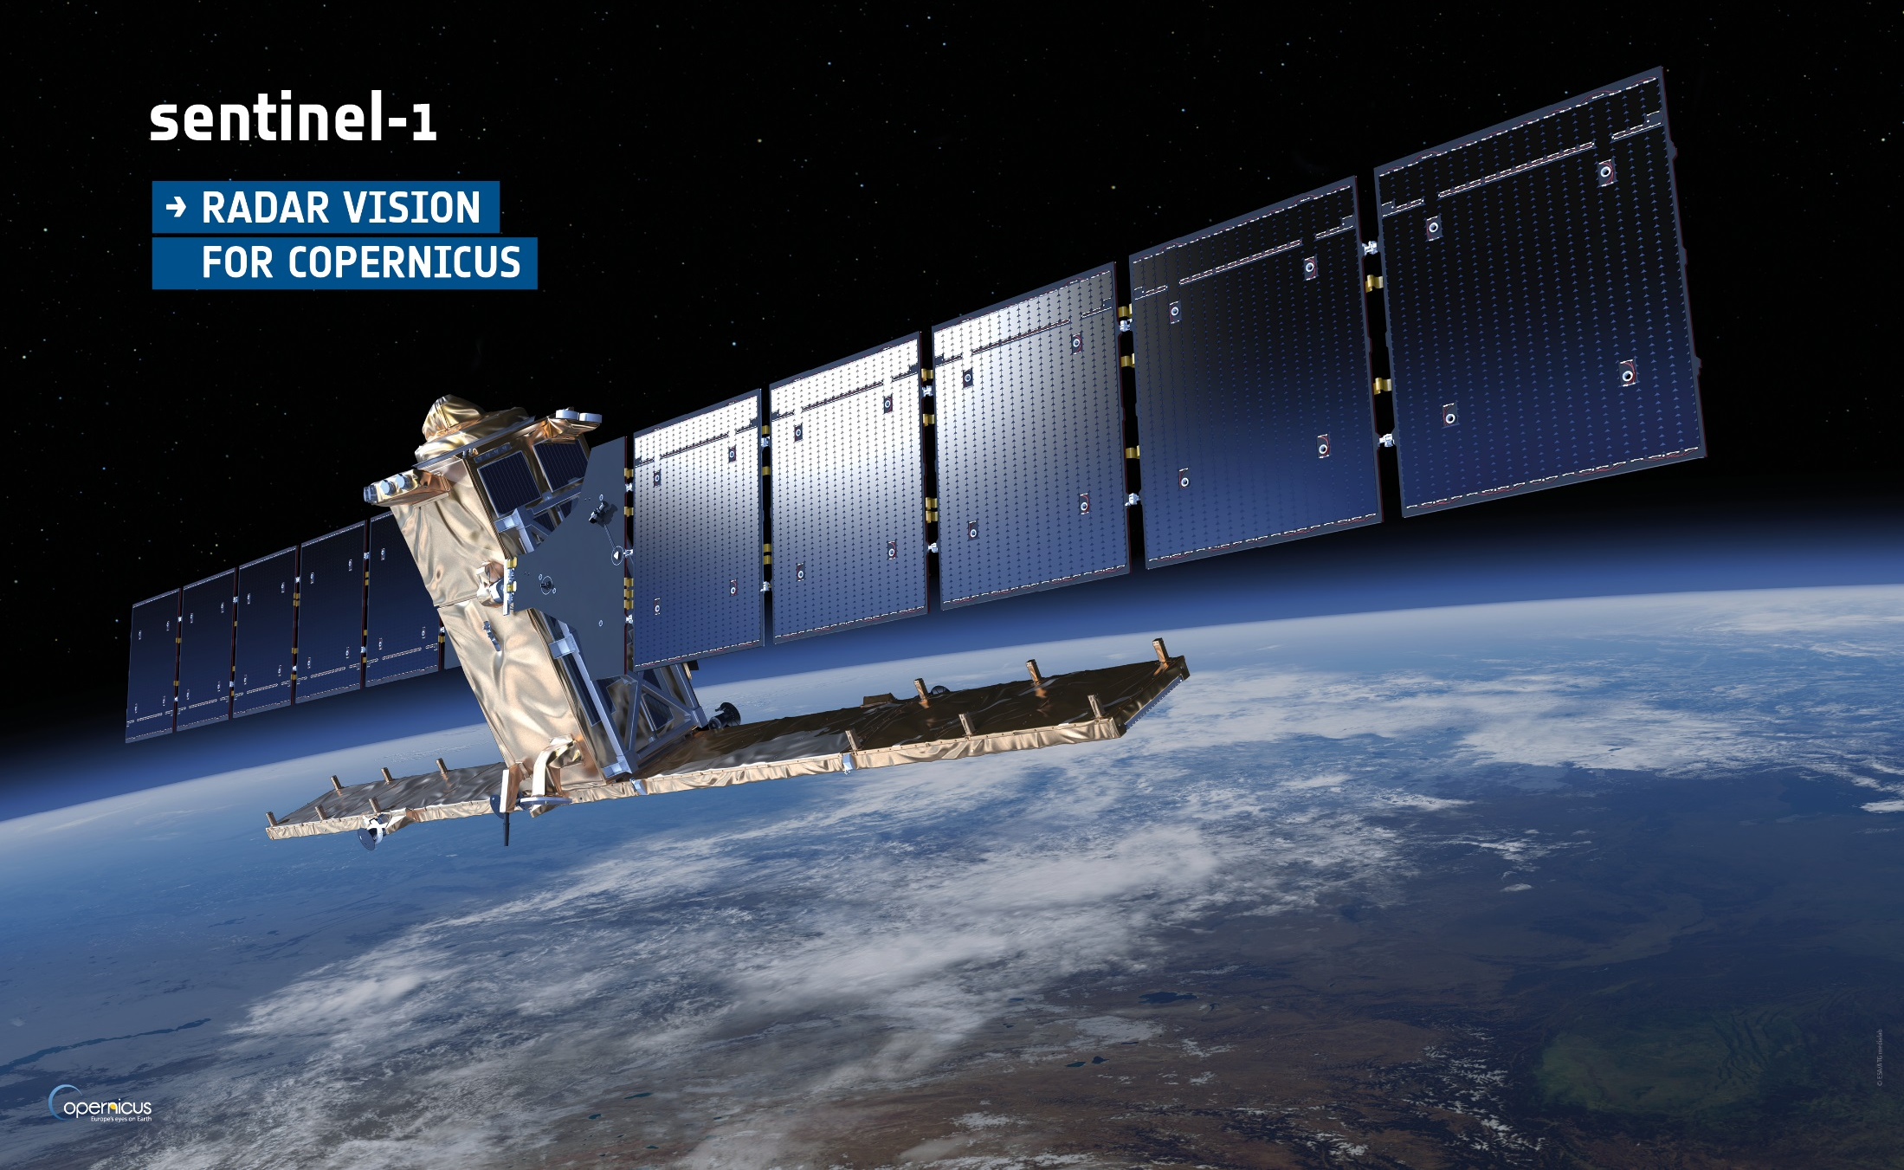
Notes:
The European Space Agency pools the resources of over 20 countries and channels them into developing capacity to explore and use Space.
We’re particularly interested in one aspect of their work – putting satellites into orbit around the earth.
The next three slides show some of their satellites.
The first Sentinel 1 satellite was launched in April 2014 (another followed later).
Sentinel 2 satellites launched on 2015.

Slide 4
Notes:
The first of the Sentinel-3 satellites was launched in Feb 2016.

Slide 5
Notes:
And the latest, the Sentinel-5P launched in 2017

Slide 6
Notes:
They are all part of the Copernicus project; a fleet of Earth Observation satellites. Currently (2018) 14 satellites are in orbit and 26 more are planned.
Other European Space Agency projects are focused on particular science or weather applications.
Copernicus is focused on gathering images and data of the Earth for general use.
Currently the satellites gather 14Tb of data per day.

Slide 7
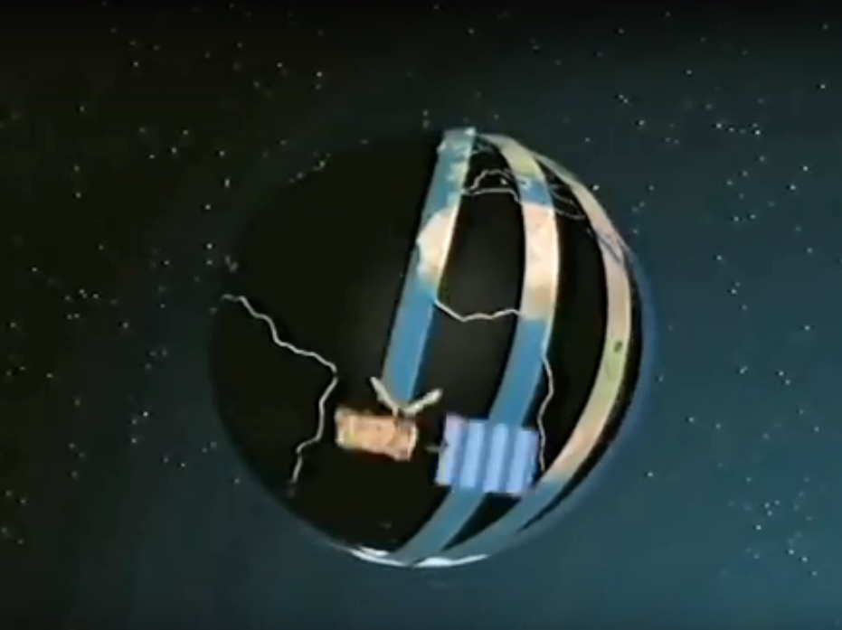
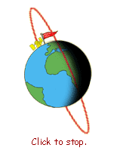
youtu.be/y_jM_BxQGvE
Notes:
Earth observation satellites orbit the earth capturing images of the swath under the flight path.
In reality, the satellite may orbit Earth once every hour-and-a-half or so, going around many times per day.
Putting images from several satellites together, it may take only a few hours to get pictures of just about every square inch of Earth.
This information is used to help scientists understand weather, climate, oceans, volcanos, and vegetation patterns around the world.
In addition, the information helps in search and rescue and in spotting forest fires.

Slide 8
Land Use Classification
bit.ly/1oE6IFT
Notes:
To give students a feel for what is possible, encourage them to look at the land use map developed by a consortium of partners including ESA.
This categorises land use across the globe and is zoomable.
Encourage students to find the North West of England, where the images we’ll use have been taken.
The actual address is http://maps.elie.ucl.ac.be/CCI/viewer/index.php in case the shortened link doesn’t work.

Slide 9
Land Use Classification
Land categories
Notes:
Land cover for NW England is shown here.
Point out the many different categories used.

Slide 10
Land Use Classification
Statistics
Notes:
Land cover for NW England is shown here.
We can also call up various statistics for any point on the map.
Just right click on an area
(click)

Slide 11
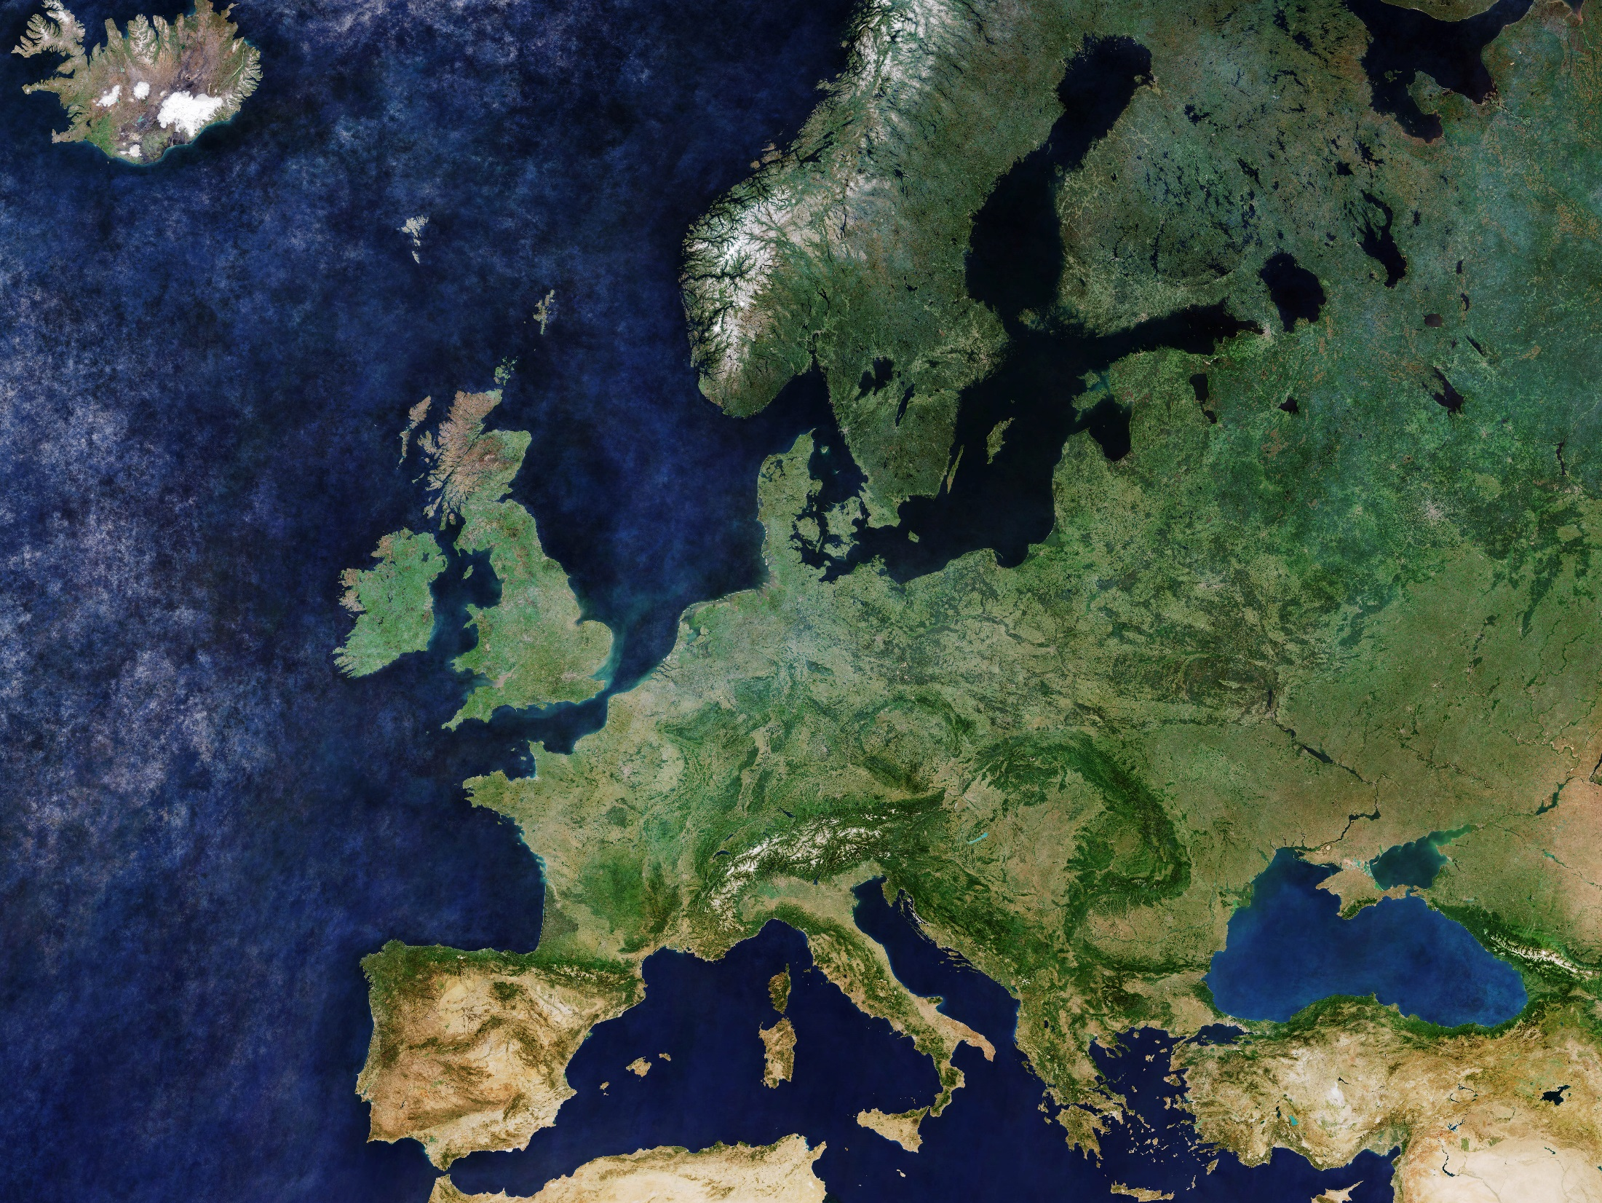
Notes:
The satellites can take incredible digital images of the Earth.
This one, put together from images taken by Sentinel 3A shows the whole of Europe.
(click)
Lets look at just a small part of this image, from the North West of England.
Image from http://www.esa.int/spaceinimages/Images/2018/04/Cloud-free_Europe

Slide 12
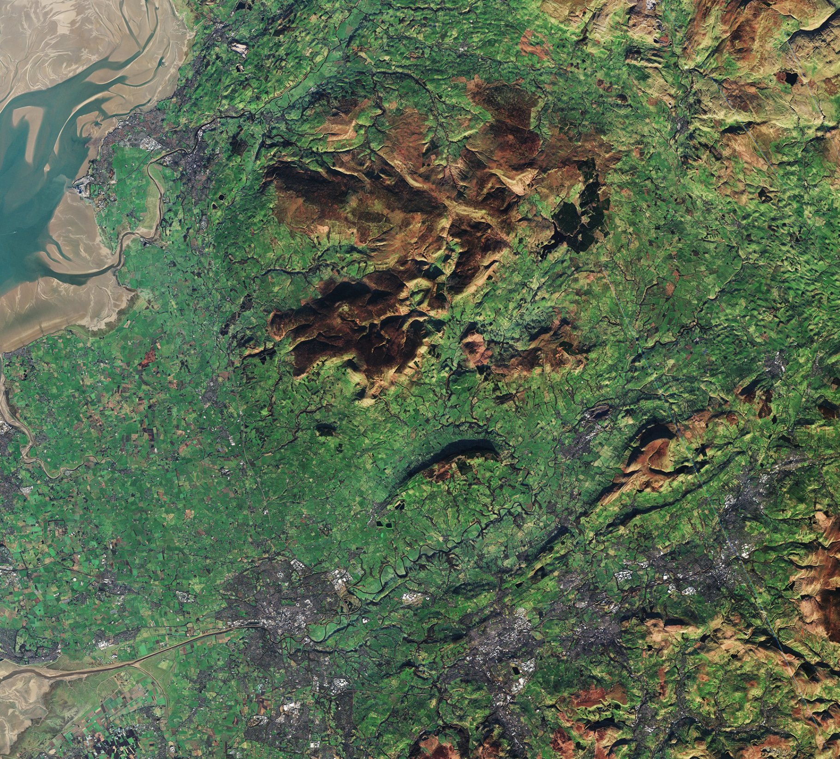
Not all satellite images are clear
Lancaster
Preston
Burnley
Blackburn
Notes:
Here’s a Sentinel satellite image of the area outlined.
You can see the main urban areas, green fields, rough moorland and the mudflats of Morecambe Bay.
(click)
But not all satellite images are this clear.
Image from http://www.esa.int/spaceinimages/Images/2017/09/Northwest_England

Slide 13
Not all satellite images are clear
What is wrong with this image?
Notes:
Here’s the same area photographed in very low light.

Slide 14
Not all satellite images are clear
What is wrong with this image?
Notes:
Sometimes the satellites path doesn’t cover the whole area.

Slide 15
Not all satellite images are clear
What is wrong with this image?
Notes:
And often cloud will obscure the land.

Slide 16
Not all satellite images are clear
Before they can be used images are pre-processed:
Errors rectified
Cloud cover filtered
Cropped
Multiple images aligned
Elements restored
Contrast enhanced
Notes:
So before images can be used they are pre-processed.
A variety of issues will be addressed, such as trying to filter out cloud, aligning and stitching together multiple images (as happened with the Europe image just shown) and so on.

Slide 17
Making Sense Of Satellite Images
1
Pre-processing
Cropping and cleaning
2
Enhancement
Classification and highlighting
3
Analysis
Generating statistics
Notes:
Making use of satellite images is a three stage process.
(click)
Once an image has been pre-processed (essentially cropped and cleaned) it can be digitally enhanced.
This involves manipulating the image to highlight whatever is under investigation.
(click)
Finally, the enhanced image can be subject to analysis, such as deriving simple statistics.

Slide 18
1920
NWsample2
1740
NWsample1
Notes:
The resolution of images varies according to the satellite.
The image we have used was approx 2000 pixels by 1800.
(click)
This is too large for us to process in a reasonable time, so two samples have been cropped from it for students to use in the upcoming investigation.

Slide 19
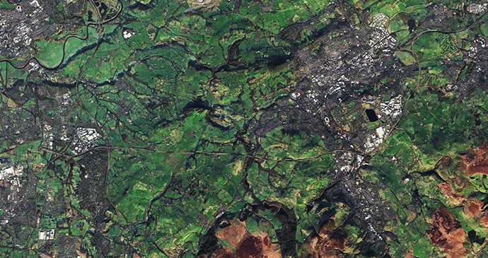
Challenge: How is the land used?
NWsample1.jpg
Built up areas: cities
Notes:
This is NWsample1.jpg, cropped from the large image.
Our challenge is to identify how the land is used.
Ask students to point out different elements of land use.
(click)
For example, the grey areas are built up areas.
Students should be able to suggest other features, the following slide gives further examples.

Slide 20
Challenge: How is the land used?
Fields
Woodland
Rough hillside
Notes:
Green areas represent fields
Brown areas are rough hillside
Dark green is woods

Slide 21
Challenge: How is the land used?
1
Pre-processing
Cropped, ready for cleaning
Notes:
Our challenge is to identify how the land is used.
The image is cropped already, the students first task is to ‘clean’ it.
In the pre-processing stage we want to use Python to sharpen the contrast between the different types of land use.

Slide 22
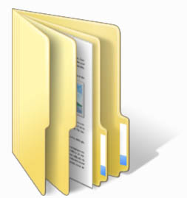
Challenge: How is the land used?
We’ll use python to sharpen the contrast
Take a copy of the resources
Notes:
Ensure everyone has a copy of the resources.
Open JES, and the file 01PreProcessing

Slide 23
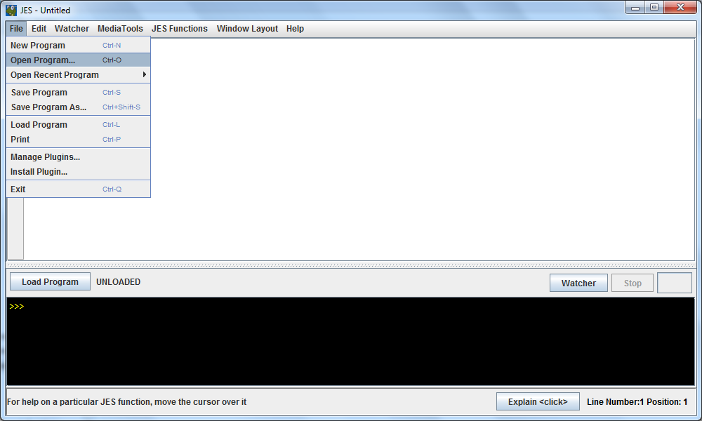
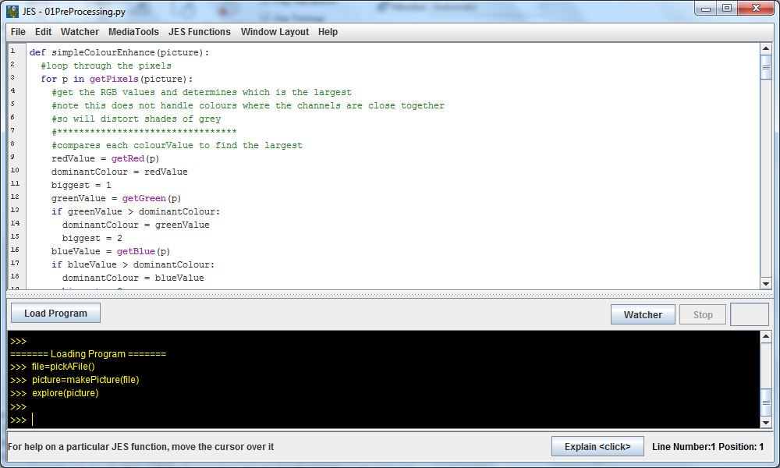
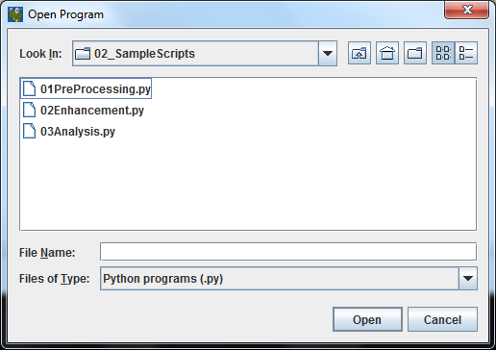
Challenge: How is the land used?
We’ll use python to sharpen the contrast
Take a copy of the resources
Notes:
Ensure everyone has a copy of the resources.
Open JES, and the file 01PreProcessing.
This has several scripts which can be applied to images.

Slide 24
Challenge: How is the land used?
We’ll use python to sharpen the contrast
Take a copy of the resources
Notes:
The image is opened in the usual way.
The Preprocessing file is loaded and any of the procedures can be called and their effects explored.
The challenge is to experiment by applying different procedures to the image to provide a cleaner image for the second stage.
There is no correct way to do this – students need to decide for themselves what to use.
The following slides gives examples of the different techniques being applied.

Slide 25
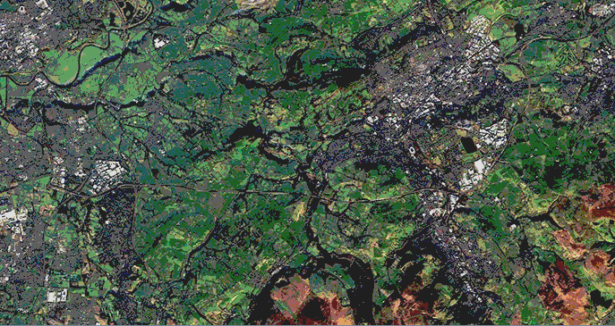
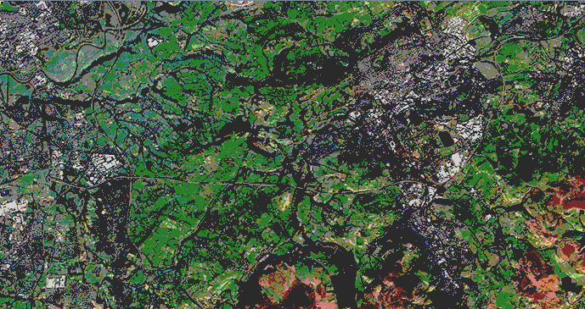
Possible Pre-processing Techniques
Posterizing: reducing the range of colours
Notes:
Students will be familiar with posterizing from the last exercises.
(click)
This shows the procedure SimplePosterize applied to the image. This maps the pixels to just 27 different colours.
Ask students if they can identify any problems with this.
Point out that much of the built up area and woodland have now been assigned the same colours, making it difficult to distinguish between the two.
Emphasise the desired outcome is to increase the distinctions between areas, not blur them.
(click)
The second image has applied the procedure FullPosterize()
Is that better?

Slide 26
Possible Pre-processing Techniques
For each pixel in turn:
Get RGB values
Find which is biggest
Experiment with this
Double its value
Change value for
largest colour channel
Simple Colour Enhancement
Notes:
Let’s study another of the procedures as a group.
Getting students to articulate what it does is a very effective way of assessing understanding.
An explanation is shown on successive clicks.
The key thing is to encourage students to experiment.

Slide 27
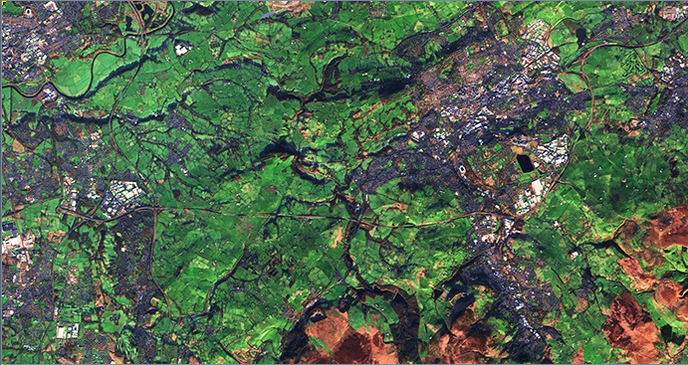
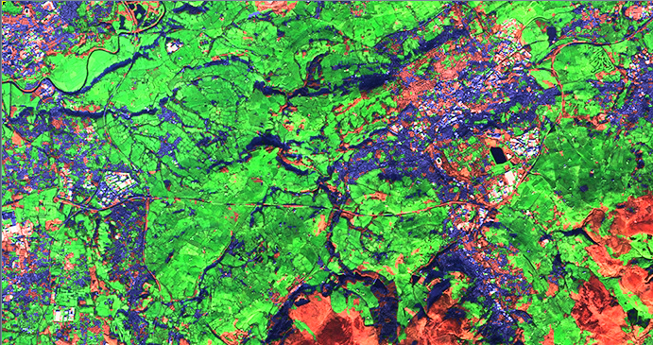
Possible Pre-processing Techniques
Simple Colour Enhancement
Notes:
Here we show the effect of applying an increase of 1.2 to the dominant colour channel
(click) and then the effect when it is altered to 2.
Notice that we seem to have a lot more variation of colour in the built up areas, losing the uniformity of the grey.
Grey values have similar RGB values, so emphasising the dominant channel, even when it is only slightly larger than the others distorts greys.

Slide 28
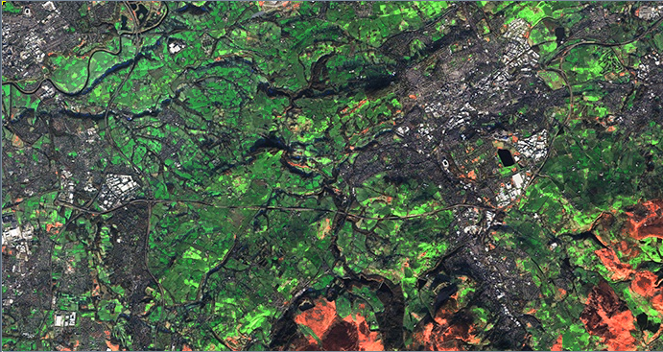
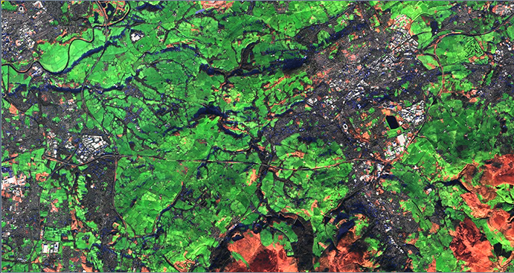
Possible Pre-processing Techniques
Better Colour Enhancement
Experient with threshold
Change OR to AND
Notes:
Here we have a more sophisticated algorithm.
(click)
We’re using the same technique – increasing the dominant colour channel by 50% this time.
However, we’re keeping greys the same by checking if the difference between the RGB values is less than 15.
If any two values are close, we retain the original colour.
Ensure students understand the purpose of abs, for returning the absolute value, regardless of whether it is positive or negative.
(click)
Again we want students to experiment. As well as varying the amount to increase the dominant channel, they can change the evaluation from OR to AND, so retaining only colours where all 3 channels are close (as is the case with greys).
(click)
And we can experiment with the threshold too.

Slide 29
Possible Pre-processing Techniques
Water: river and reservoir
Enhance Grey
Notes:
Shades of grey present a challenge.
If we look carefully at this image we’ll see there are various features that have some grey element.
Water often appears as nearly black, as this reservoir and river show.

Slide 30
Possible Pre-processing Techniques
Housing
Light Industry
Enhance Grey
Notes:
Housing here is a mid grey whilst light industrial estates are a lighter grey.
(click)
Here is a procedure to enhance grey.
Ask students what it will do.
It evaluates a pixels 3 colour channels as before, checking if they are within 15 of each other.
(click)
But what does the second conditional do?
If all the colour channels are over 50, it will set the pixel to a mid grey shade, but leave dark grey shades untouched.
We’ll see the effect on the next slide.
Threshold 15AND, above 50 for each channel, set to 100.100.100

Slide 31
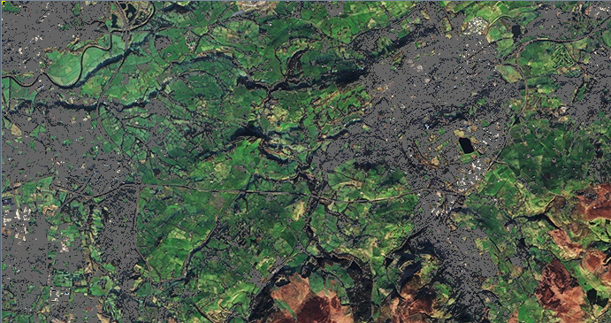
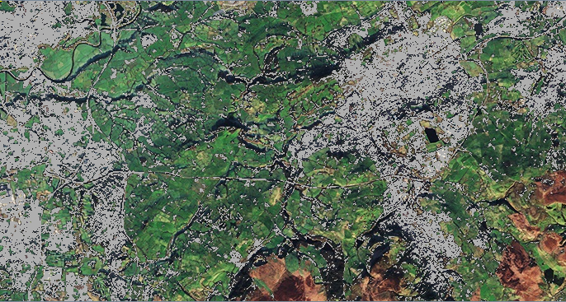
Possible Pre-processing Techniques
Enhance Grey
Notes:
On click we’ll see the transition to a uniform mid grey (100,100,100), with a threshold of 15, and a grey shade above 50.
(click)
A further click shows a transition for the same pixels to a lighter grey shade (175.175.175).
Could students edit this procedure to accommodate two procedures, one for housing and another for light industry, whilst leaving dark greys untouched.
Closer analysis of the pixel values of water and woodland (both dark grey) might allow further subtle enhancements.
The point is to encourage experimentation and evaluation.

Slide 32
Key Task
1
Pre-processing
Cleaner distinctions in images
Experiment, noting what works
Define a new procedure Preprocess(picture)
Preprocess() should call other procedures in turn
Apply new procedure to original and check result
Save as a new image
Notes:
There are no correct methods at this stage.
The purpose is to get students to experiment, applying the procedures given, altering them and becoming confident manipulating images.
Real pre-processing is very sophisticated, so this is more a way to get students to appreciate some of the issues involved.
They may wish to develop their own extra procedures – the ones included are just suggestions.
Ideally, they should adopt a systematic approach, noting what techniques produce the subtle results they want.
Once they know what works, they can combine procedure calls in a ‘super procedure’ which can then be applied to any image.
They may wish to try it on the NWsample2 which includes other land features, such as sea and sand.
Finally, the new image should be saved to be used in the next stage.
A createNewImage() procedure is included if they have forgotten how to write a new image to file.
All procedures are heavily annotated to explain how they work.

Slide 33
Making Sense Of Satellite Images
1
Pre-processing
Cropping and cleaning
2
Enhancement
Classification and highlighting
3
Analysis
Generating statistics
Notes:
Making use of satellite images is a three stage process.
Once an image has been pre-processed (essentially cropped and cleaned) it can be digitally enhanced.
This involves manipulating the image to highlight whatever is under investigation.
That’s the next stage in our challenge.
(click)
Finally, the enhanced image can be subject to analysis, such as deriving simple statistics.

Slide 34
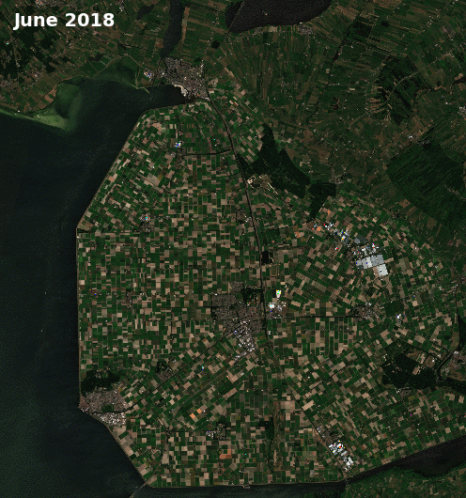
Summer crops
Potatoes
Veg / Flowers
Cereals
Grass
What proportion of crops are potatoes?
What proportion of land is used for crops?
Notes:
This animation gives an idea of the sort of enhancement we wish to achieve.
During the drought in the summer of 2018, many crops were effected.
This animation shows crop classification in the Emmeloord region of the Netherlands based on Copernicus Sentinel-2 data.
Green shows summer crops, red: potatoes, orange: vegetables and flowers, yellow: cereals, and blue: grass.
(click)
Having classified the data in the image, it can then be analysed. For example, we could find out what percentage of the total land given for crops was used for potatoes.
This is a very simple example. The data was actually being used to predict crop failure and shortages as a result of the drought.
Image from https://www.esa.int/spaceinimages/Images/2018/09/Crops_in_the_Netherlands

Slide 35
Challenge: How is the land used?
2
Enhancement
Classification and highlighting
Notes:
This second stage has the most visual impact.
It involves three distinct stages.

Slide 36
Land Classification: 3 stage process
Stage1
Decide categories and investigate colour
Stage2
Assign category key
Stage3
Process image and render pixels
Notes:
The first stage involves some investigation of the preprocessed image to identify the RGB value of different categories.
The second stage assigns a colour key to each category.
Finally the image is processed automatically.

Slide 37
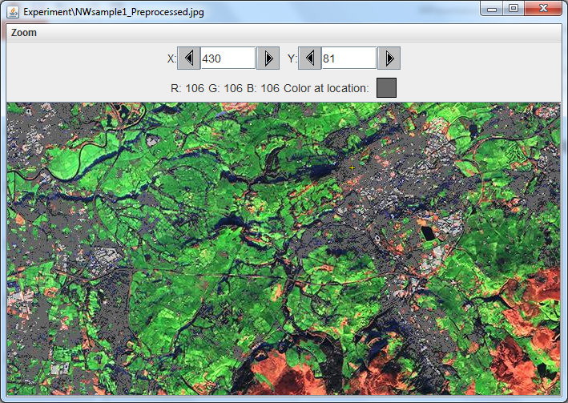
Stage1: land categories?
Housing
Rough land
Woodland
Water
Sea
Sand
Fields
Sample housing pixel: 106,106,106
111,109,114
117,102,104
Notes:
Here is a preprocessed image derived from NWsample1.
Ask students what categories of land they might use?
Remind them about the Land Use utility they looked at (see bit.ly/1oE6IFT )
That had lots of categories, but we will need to keep it simple, just to demonstrate the principles involved.
Some suggestions will appear on clicks
Housing or built up areas is an obvious one.
Light industrial might be another category.
Rough land or moorland, woodland and water are also fairly clear.
If it is coastline, sand and sea may feature.
The largest area here is cultivated fields.
(click)
Once categories are decided you can investigate what colour they broadly are.
Use the Explore Picture Tool for this, selecting several pixels of the same category and noting their RGB values.
Notice they are very unlikely to be identical, but will likely be within a similar range

Slide 38
Stage1: land categories?
Sample housing pixel: 106,106,106
111,109,114
117,102,104
Notes:
In JES, students should open the sample scripts in the file 02Enhancement.

Slide 39
Stage1: land categories?
Sample housing pixel: 106,106,106
111,109,114
117,102,104
Notes:
In JES, students should open the sample scripts in the file 02Enhancement.
Study the procedure called housing().
In it we assign a colour value similar to those we have sampled.

Slide 40
Stage2: colour key?
Sample housing pixel: 106,106,106
111,109,114
117,102,104
Notes:
The second and third lines prompt the user to choose a colour to represent housing.

Slide 41
Stage3: image processing
Sample housing pixel: 106,106,106
111,109,114
117,102,104
Notes:
The third stage is then to process each pixel in the image.
We’re familiar with iterating over the pixels.
As we do so, we extract the current RGB triplet contained in the pixel.
(click)
The key line is the evaluation of the ‘distance’ of the pixel value, from our standard ‘housing’ colour of 100,100,100.
If it is ‘close enough’, we set the colour of that pixel to the colour we chose for the key.

Slide 42
Stage3: image processing
Sample housing pixel: 106,106,106
111,109,114
117,102,104
Notes:
The key line is the evaluation of the ‘distance’ of the pixel value, from our standard ‘housing’ colour of 100,100,100.
If it is ‘close enough’, we set the colour of that pixel to the colour we chose for the key.
This is best understood by reference to a ‘colour cube’, where the Red, Green and Blue values represent the 3 axis, as shown.
Test students understanding of this by asking what colour the far lower corner would represent.
It would be (0,0,0) or black.
The intensity of each colour channel increases as we move away from this point.
(click)
So looking at the cube from the front, the top corner would be white, and the colour intensity would decrease as we move down the axes.
(click)
Any colour is therefore a point in 3D space.
The JES built in function distance() does the heavy maths in working out the distance between two colours.
If they are ‘close enough’ the pixel will be set to the colour of the key.
Image Attribution: User:Maklaan [CC BY-SA 3.0 (https://creativecommons.org/licenses/by-sa/3.0)], from Wikimedia Commons
https://commons.wikimedia.org/wiki/File:RGB_color_cube.svg

Slide 43
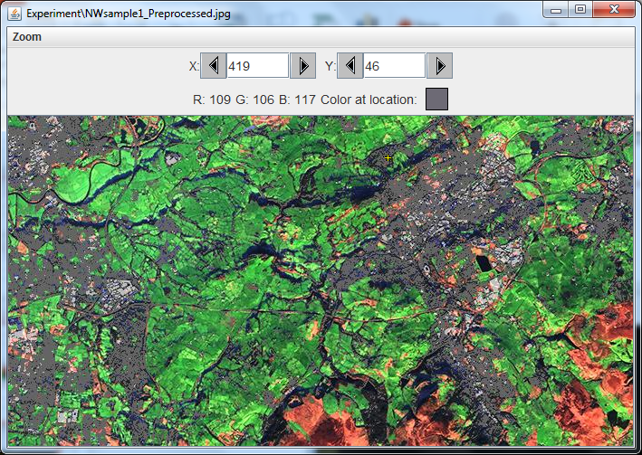
Notes:
We can demonstrate the effect of running this procedure in JES.
Here we’ve connected to the preprocessed image and displayed it prior to any categorisation

Slide 44
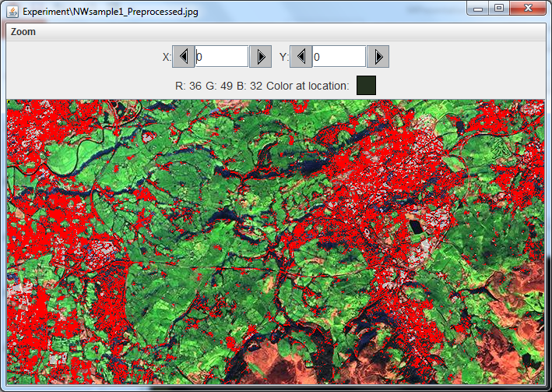
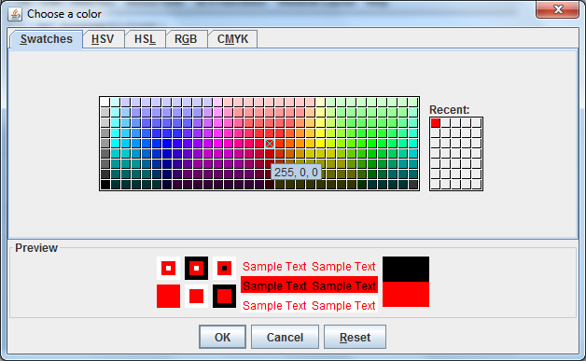
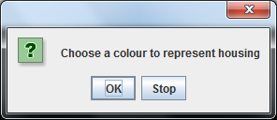
Notes:
We’ve now called the procedure housing().
Line 14 displays a prompt to the user.
(click)
Line 15 opens a colour picker, and we choose red as our key colour.
(click)
It will take some time to evaluate the distance for every pixel but
(click)
Finally it finishes and the explore picture command displays the modified image.

Slide 45
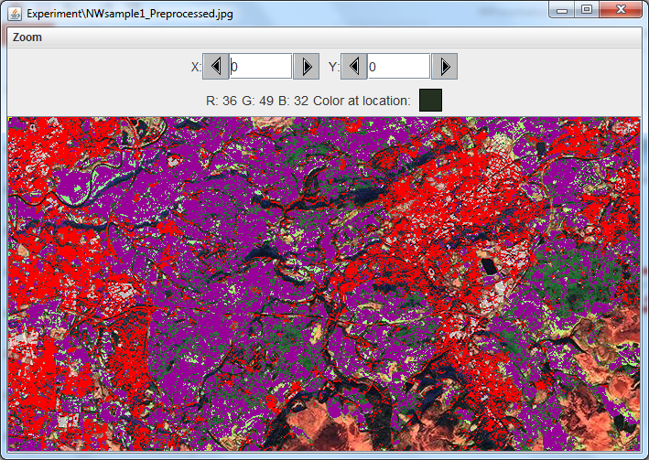
Task 2:
Develop scripts in 02Enhancement.py to complete your own land classification map
Notes:
Direct students attention to the farmland procedure().
Greens often present a bigger challenge as there are many different shades. This can be very useful if we want to identify different crops, but in our case we just want to indicate the general classification of farmland.
(click)
The technique adopted here is to sample several pixels and set two different values for farmland, representing both light and darker greens.
The distance of each pxel is then evaluated against both colours, farmland1 and farmland 2.
(click)
Notice also that we have increased the range within which we accept a pixel as close enough to count.
(click)
This needs some experimentation if it is to be effective.
Notice how we have missed some areas with the current settings.
(click)
The second task is to develop the further scripts in the file 02Enhanceent.py to comlete your own land classification map.
Once working you can test it against the other satellite image provided, NWsample2.jpg.

Slide 46
Key Task
2
Enhancement
Assigns colours to land categories
Experiment with distance thresholds, noting what works
Define new procedures for each land classification you identified
Call all procedures in turn from the assignLandUse() procedure
Save as a new image
Test effectiveness on NWsample2.jpg
Notes:
Students are given a working exemplar for two land categories.
They should be able to experiment with different distance threshold values to increase their effectiveness.
They can use these procedures as templates to develop other categories for any categories they identified.

Slide 47
Making Sense Of Satellite Images
1
Pre-processing
Cropping and cleaning
2
Enhancement
Classification and highlighting
3
Analysis
Generating statistics
Notes:
Once again recap that making use of satellite images is a three stage process.
Once an image has been pre-processed (essentially cropped and cleaned) it can be digitally enhanced.
This involved manipulating the image to highlight whatever is under investigation.
Finally, we can use the enhanced image to derive some information – in our case some simple statistics.

Slide 48
Challenge: How is the Land Used
3
Analysis
Generating Statistics

Slide 49
Challenge: How is the Land Used
How much of the area is used for housing?
What proportion is farmland?
Notes:
There is little point processing images unless we wish to derive useful information from them.
Probably the simplest information we can get from a satellite image such as this one is the proportion of land given over to different uses.
Two simple questions are posed for students.

Slide 50
Challenge: How is the Land Used
getWidth(picture)
Get width of image (in pixels)
Get height of image (in pixels)
Work out total pixels in image
Modify each enhance procedure to:
Count pixels as it changes them
Return total to assignLandUse()
Calculate pixels as % of total
Display result
getHeight(picture)
How much of the area is used for housing?
What proportion is farmland?
Notes:
The solution is fairly straightforward.
A pseudocode description is given,
Each procedure to enhance a particular land category will need a counter variable.
Any pixel whose colour is changed is added to the count.
The result needs to be returned to the main calling function assignLandUse().
It can then be passed to a separate procedure for generating statistics
Here the calculation can take place and a message can be displayed.
A structure diagram is shown on the next slide.
A part complete solution is provided in the resources 03Statistics.py for students who are unsure of how to return a value to a calling procedure.

Slide 51
Challenge: How is the Land Used
assignLandUse
(picture)
picture
picture and
totalHousing
totalHousing
housing
(picture)
statistics
(picture, totalHousing)
Structure diagram outlining values passed between procedures
Notes:
Good coding requires the separation of concerns.
Tasks should be decomposed into the smallest possible elements.
A procedure should only do ‘one thing’.
Smaller procedures are then encapsulated in other procedures, which call the separate elements in turn.
Any data required by the smaller procedures is passed by parameters when it is called.
Any data returned by a function needs to be assigned to a variable.
A hierarchy diagram is shown giving the outline for structuring a solution.
A part complete solution is provided in the resources 03Statistics.py for students who are unsure of how to return a value to a calling procedure.

Slide 52
Taking It Further
Video: www.esa.int/spaceinvideos/Videos/2019/01/Earth_from_space_Zaragoza
Image: www.esa.int/spaceinimages/Images/2019/01/Zaragoza_Spain
Analyse the land use in Zaragoza, Spain
Notes:
If students have time they can attempt an independent investigation.
The challenge is to apply their skills to analyse the land use in Zaragoza, Northern Spain.
There is a short introductory video from the ESA website: Video: www.esa.int/spaceinvideos/Videos/2019/01/Earth_from_space_Zaragoza
The image can be downloaded from: www.esa.int/spaceinimages/Images/2019/01/Zaragoza_Spain
The image will need to be cropped to manageable dimensions.
This could be attempted as a group task with different students taking parts of the image.

