Slide 1
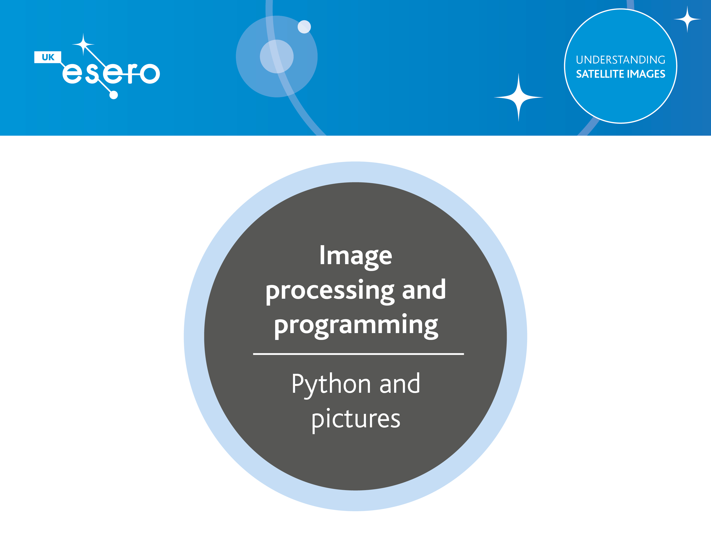
Notes:
Before students can get to grips with Satellite Images, they need a sound understanding on the principles behind processing a digital image.
This session introduces the idea that pixels can be processed using standard programming techniques.

Slide 2
Image Processing and Programming
Learning Outcomes
After the session you will know how to:
Open files in JES, a Python interpreter
Iterate over a list of Pixel objects
Decompose processing tasks into smaller procedures
Implement some useful procedures we can later use with satellite images
Save new images as files
Notes:
It is important to be explicit about the intended outcomes for your students.
Do not assume they will be aware of the purpose of your session.
The specific outcomes from this session are for students to understand how to;
Open files in JES, a Python interpreter
Iterate over a list of Pixel objects
Decompose processing tasks into smaller procedures
Implement some useful procedures we can later use with satellite images
Save new images as files

Slide 3
Image Processing and Programming
Key Idea
1
Coding Visuals
Using Python to program effects
Notes:
The key point in this set of exercises is to familiarise students with the idea that visual effects are implemented using code.
We will use Python to write scripts that iterate over the list of pixel values that constitute the image.

Slide 4
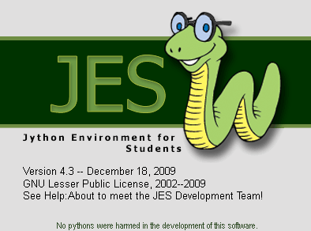
Programming Visual Effects
Using python to manipulate pixel values
Take a copy of 01JES_Sample_Resources
Notes:
JES is a purpose built programming environment, developed by Mark Guzdial who developed the Pixel Spreadsheet utility used in the last series of exercises.
It allows students to write Python scripts but includes some very useful extra functions, specially developed to help students process images.
JES will need installing. It can be downloaded from https://github.com/gatech-csl/jes/releases
It is available free.
It does require Java RunTime Environment (JRE) to be installed on the computer. If you don’t have this, you can download a JES installer package that includes it.
No further installation is required.
The image resources included are provided by Mark Guzdial and licensed under Creative Commons. Other images could be used.
More information about Mark’s work developing Media Computation can be found on the website: https://bit.ly/2Myfn0F
Technical note: JES is a Python implementation developed in Java rather than C, hence Jython.

Slide 5
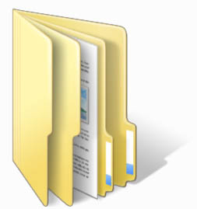
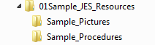
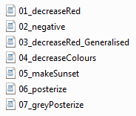
Programming Visual Effects
Using python to manipulate pixel values
Take a copy of 01JES_Sample_Resources
Notes:
01JES_Sample_Resources includes two folder. The sample procedures (some part complete) will be used in the following exercises.
Ensure all students have a copy of these resources.

Slide 6
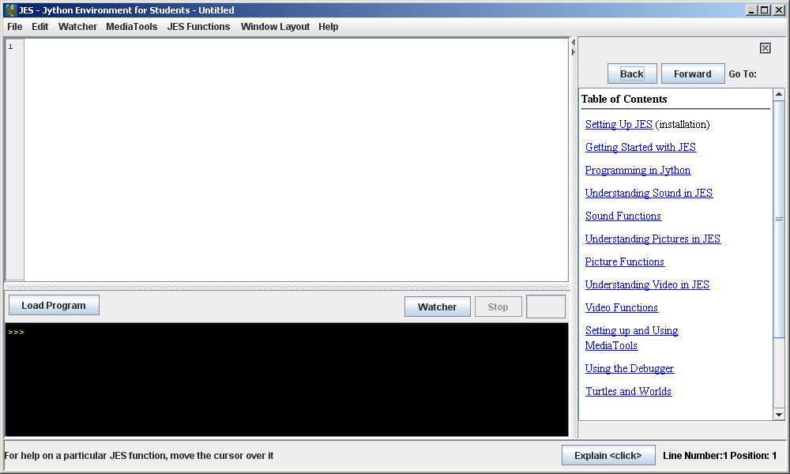
The JES Interface
Editor
Interpreter
Notes:
Spend a moment talking through the interface.
There are two key areas.
The real time interpreter is where students will write and run initial code – rather like IDLE in a standard Python distribution.
(click)
The editor area above is where you can write persistent scripts which can be saved.
We’ll use it to define procedures / functions. When we want to call them from the interpreter, we have to load the file in the editor, using the button.
(click)
The help on the right can be hidden and accessed from the menu bar when needed.
It may not show automatically in your installation.

Slide 7
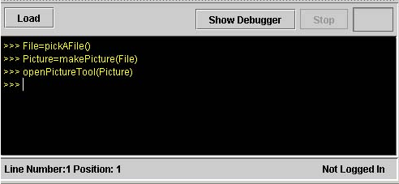
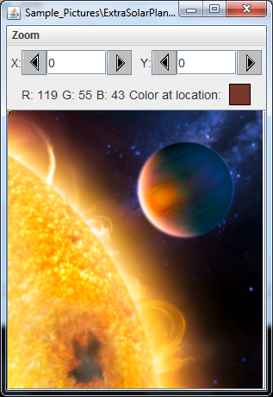
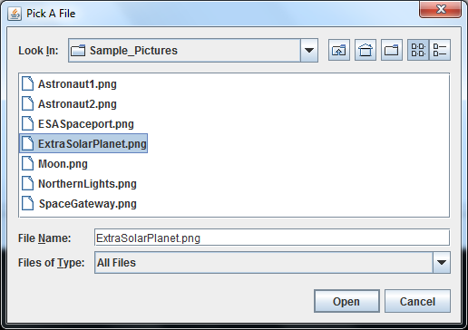
Opening An Image
Notes:
We’ll start by using the interpreter. There are two stages to accessing the pixel values from an image.
First a connection needs to be established with the image file.
The first line highlighted does this.
(click)
The built in pickAFile() function opens a window that allows you to browse to a file.
We’ll use a picture from the ESA’s files that depicts an ExtraSolarPlanet – a planet that orbits a star.
Image from: https://www.esa.int/spaceinimages/Images/2008/03/Extrasolar_planet_HD_189733b
Navigate to the Sample Pictures included in our resources and select ExtraSolarPlanet.png
(click)
The second line does the critical work.
A variable (which we’ve called Picture) stores the result of calling the makePicture() function on the File you selected.
Nothing appears to have happened, but the p[ixel values have been effectively scooped out of the image file.
We now have a variable Picture, which contains the list of pixel values but none of the image file header information.
It is the equivalent of converting the image to a spreadsheet in the last set of exercises.
(click)
A third built in function openPictureTool() is called with our Picture variable as its parameter.
This renders the image in a window with some basic tools to interrogate pixel values. We can selct a pixel co-ordinate and it will display the RGB values.

Slide 8
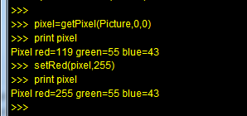
Interrogating An Image
Notes:
We can use the getPixel() function to return the values associated with a particular pixel.
It requires three parameters; the list containing the pixel values and the X & Y co-ordinates of the pixel.
The print command will display the RGB values and they can be checked using the picture explorer tool.

Slide 9
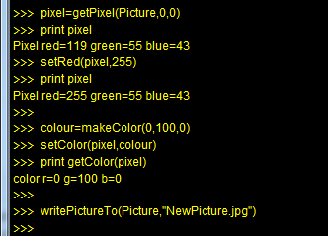
Interrogating An Image
Any picture variable can be examined using the picture tool.
Notes:
As well as getting pixel values, we can set, or alter them using the built in set functions.
Here we show two examples.
The setRed() function is being used to set the red channel of the pixel to its maximum 255.
We use the makeColor() function to assign a triplet of values to a variable called colour.
We then use the setColor() function to assign that triplet to the pixel.
Note the built in functions use the American spelling of color.
(click)
Having made alterations to the pixels we can also write the new image to a file using the writePictureTo() function.
Notice that we can write the image as a different format if we want to. In this case, we’re saving the new picture as a .jpg image, when the original picture was a .png image.

Slide 10
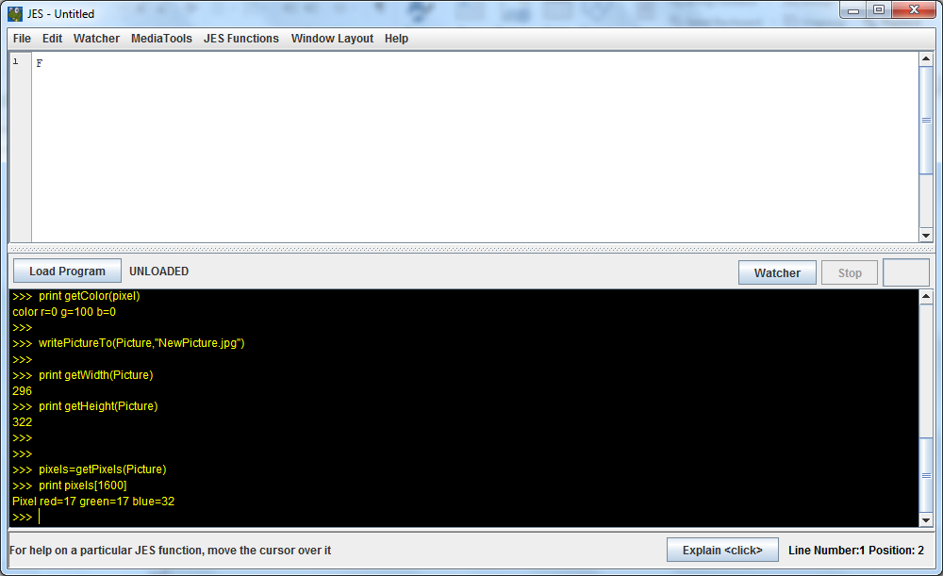
Don’t type: print pixels()
WARNING
Notes:
We can interrogate other attributes from the image, for example using getHeight() and getWidth()
(click)
We can also get the RGB values for a particular pixel in the picture list and display them using print. This is exactly the same as referencing any list value in Python.
Note: Heed the warning.
If we asked the interpreter to print the values of all the pixels in the list it would take a very long time!

Slide 11
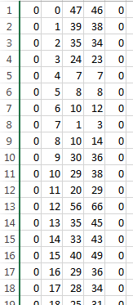
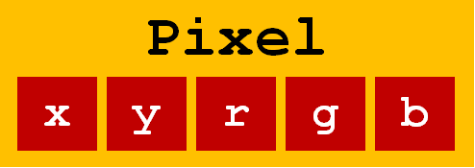
x y r g b
Notes:
We can relate the values previously used in Pixel Spreadsheet to our JES Python list.
The 5 values on a row in Pixel Spreadsheet are the 5 attributes tat make up a Pixel object in JES.
Each row is a new pixel object.

Slide 12
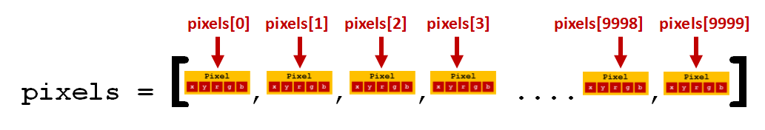
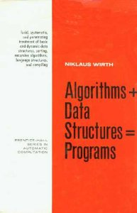
Notes:
Our getPixels() function shown in the slide creates a list of pixel objects, rather like the rows of data in the former spreadsheet.
Each pixel has a particular position in that list.
(click)
A long time ago, computer scientist Niklaus Wirth wrote a book entitled Algorithms + Data Structures = Programs
The title aptly describes what we want to do.
In order to achieve visual effects we need to develop algorithms that will work on the data structure we have; the list of pixel objects that make up the image data.
We will start with some predefined algorithms.

Slide 13
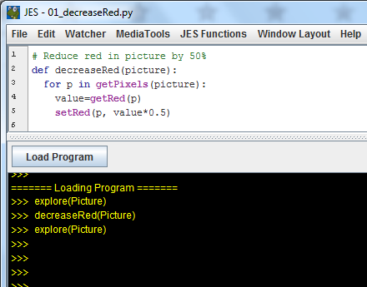
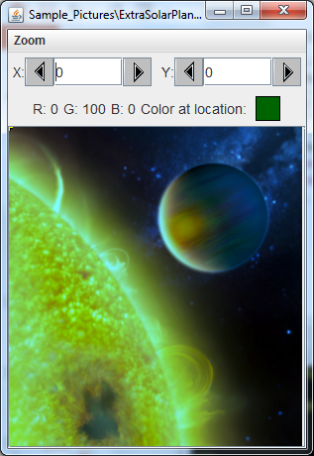
GIMP: Eat Your Heart Out!
Open decreaseRed.py in the Editor
Notes:
Graphics applications such as Photoshop and GIMP have lots of predefined effects you can apply to images, or parts of images.
In reality, each of these effects is implemented by calling a predefined procedure.
We can illustrate the same idea in JES.
With our ExtraSolarPlanet image still in the interpreter, turn your attention to the editor.
Use File – Open to navigate to the Sample Procedures included in the resources and open decreaseRed.py.
The Python file is simply a script containing a single definition for a procedure called decreaseRed.
Spend a moment ensuring students understand what this will do.
The procedure takes a picture as a parameter.
The procedure iterates over the list of pixels by using the getPixels() function we are already familiar with in a counter controlled loop.
For each pixel, it gets the red value, then sets the Red value to half its current value.
(click)
The procedure is just a file displayed in the editor.
(click)
To use it in the interpreter, we need to Load the program using the button highlighted. This is the equivalent of importing libraries in a standard Python interface. Once imported or loaded, we are then able to use the procedure by calling it
(click)
The code in the interpreter is revealed doing just that, with the new image output using the explore(picture) command.
Notice how halving the red channel darkens the image.
Notice the subtlety in the example – the parameter in the procedure definition is ‘picture’.
When we call it in the interpreter, we pass our ‘Picture’ list to this parameter. In other words, we could pass any named list and apply the procedure to it.

Slide 14
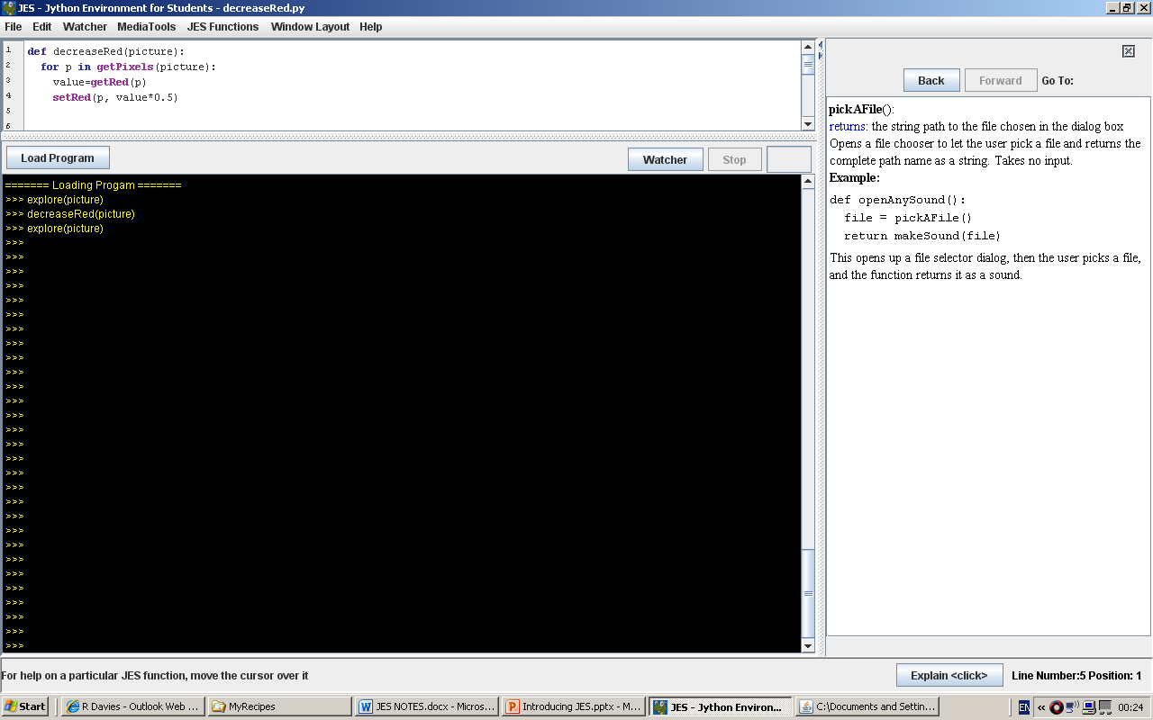
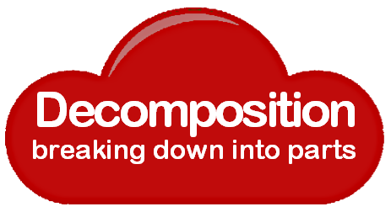
Concepts are key
Notes:
The key to getting to grips with programming is to grasp some of the central concepts underpinning the discipline.
One of those is the idea that we handle complexity by breaking a complex task into smaller, simpler subtasks.
Here we have decomposed the task of decreasing the Red into a sequence of simple steps.

Slide 15

Concepts are key
Notes:
Abstraction is the other side of the coin to decomposition.
Having decomposed the decrease Red task, we have encapsulated it in a named procedure.
Having defined a procedure, in the main code we can simply ‘call’ it by name.
All the detail about how to decrease Red is hidden from the main program, making it easier to understand.
The main code works at a higher level of abstraction.

Slide 16
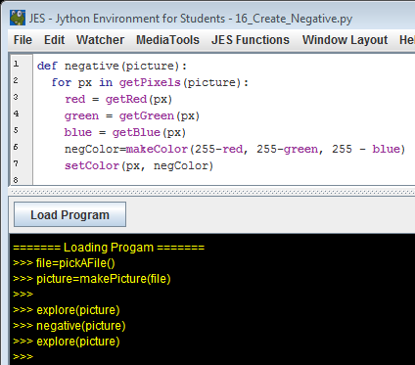
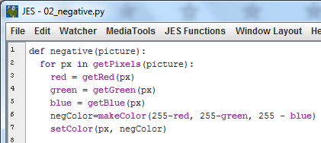
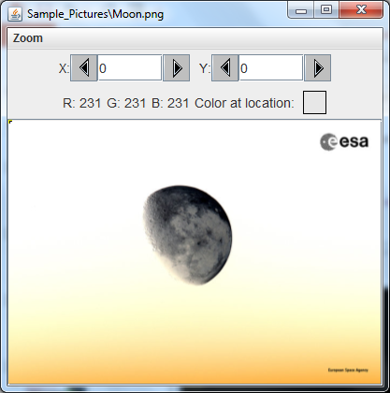
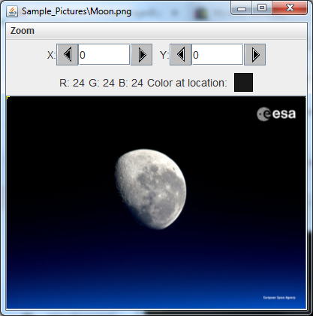
The power of iteration
Notes:
Iterating over each pixel in a list is a powerful tool.
Here we have picked a picture of the Moon, taken by Tim Peake from the Space Station in 2016.
(Image from ESA Gallery: https://www.esa.int/spaceinimages/Images/2019/03/The_Moon_as_seen_from_the_Space_Station )
The picture is rendered using the explore(picture) function.
We have opened the sample procedure 02_negative.py.
Talk through how this works with students – it is the same algorithm we used in the Pixel Spreadsheet challenge.
For each pixel:
The value of each colour channel is subtracted from 255.
A new RGB colour value is created, and assigned to the pixel.
(click)
The procedure is defined in the editor but must be loaded into the interpreter to use.
(click)
Once loaded, we can now call the procedure in the interpreter,
And use the explore(picture) command again to view the result.

Slide 17
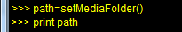
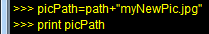
Creating new images
You will need to include a path in your operation to write a new file.
Then concatenate a filename with the path.
Notes:
Creating a new image is straightforward.
First the path and filename need to be concatenated into a variable, here called picPath.

Slide 18
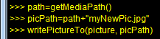
Creating new images
Finally write the picture to the new path/filename.jpg.
Note to make new picture:
makeEmptyPicture(width, height)
Notes:
Finally, the new image is written to the file using the writePictureTo() function.
Note that a new empty picture, or canvas can be created using the makeEmptyPicture() function.

Slide 19
Image Investigations
Read the Image Investigation handout carefully.
Study the remaining sample procedures.
Tackle the practical challenges.
Notes:
Armed with the knowledge covered, students should be able to undertake their own investigations and explorations.
The handout recaps the steps covered and asks students to study the remaining sample procedures provided.
Finally three practical challenges are posed.
Supporting material to explain the remaining 3 procedures and the challenges are outlined on the following slides.
It is left for the teacher to judge whether to use them.

Slide 20

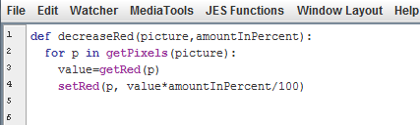
Concepts are key
Notes:
Earlier we studied a procedure to decrease the red in a picture.
The procedure halved the amount of red in a pixel.
Another key concept in computing is to seek to generalise – applying solutions to a specific problem to a more general set of problems.
(click)
So here we have rewritten the decreaseRed() procedure to make the amount variable.
Spend a moment studying it.
(click)
Notice that we have introduced another parameter ‘amountInPercent’ that can be specified when the procedure is called.

Slide 21
Duplicating procedures
Once one colour is defined;
copy and modify to create
def decreaseBlue(pic,amountInPercent)
def decreaseGreen(pic,amountInPercent)
Saved as 04_decreaseColours.py
Notes:
Extending the idea of generalisation, once one colour’s procedure has been defined, we can copy and modify it to produce similar procedures for each colour.
This example is saved as 04_decreaseColours.py in the samples.

Slide 22
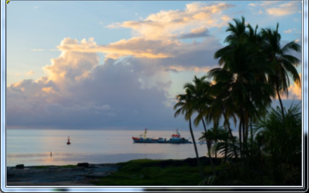
Combining procedures
Saved as 05_makeSunset.py
def makeSunset(pic,amountInPercent):
decreaseBlue(pic, amountInPercent)
decreaseGreen(pic, amountInPercent)
Notes:
Finally in example 05_makeSunset we illustrate how procedures can be combined within bigger procedures.
In this case, a procedure to make a sunset involves calling two previously defined procedures to decrease the blue and green channels.
Here we’re using the image ESASpaceport, which is a photograph of Kourou, French Guiana, home to Europe's Spaceport.
We’ll call the makeSunset procedure and reduce the Blue and Green channels by 35%
Image from https://www.esa.int/spaceinimages/Images/2018/10/Sunset_in_Kourou2

Slide 23
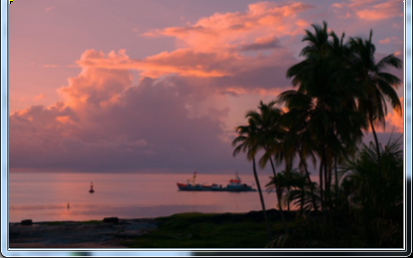
Combining procedures

Slide 24
Challenge 1: Lighten / Darken
def lighten (picture):
for px in getPixels (picture):
colour = getColor(px)
colour = makeLighter(colour)
setColor (px, colour)
Define the function makeLighter(colour)
Define a similar makeDarker(colour) function
Notes:
The first challenge builds on this understanding of combining procedures.
It requires the addition of a makeLighter procedure.
In the example this takes one parameter, the colour triplet, but it could be generalised to include an amount to lighten/darken by.

Slide 25
Challenge 2: Convert to Grayscale
A grayscale occurs when the R, G & B values are the same.
To convert to a grayscale we need to evaluate the luminance (intensity) of a pixel.
This is done by averaging the 3 colour values.
Complete the following function
def grayScale(picture):
for p in getPixels (picture):
Notes:
The second challenge introduces the idea of luminance.
This could be an important concept when students start investigating their own satellite images later.

Slide 26
Challenge 3: Playing With Colour
Write three functions, one to clear the red channel, one the blue, and one the green. Then experiment with combinations of each.
Similarly, rewrite each function to maximize the colour. Is this useful?
Notes:
The final challenge invites experimentation with removing particular colour channels – again a useful technique when analysing satellite images later.
Notice that if all the colour channels are maximised, the final outcome is a white canvas.

Slide 27
Image Processing and Programming
Key Idea
2
Posterization
Mapping values to a smaller set
Notes:
Students should now be familiar with the idea that visual effects can be implemented using code.
They have a repertoire of procedures to alter values in the colour channels by iterating over the list of pixel values that constitute the image.
We now want to take this a step further, introducing a techniques that will be valuable for them once they embark on their climate change investigations.

Slide 28
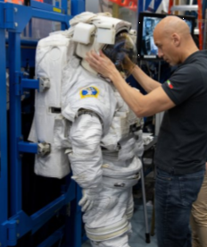
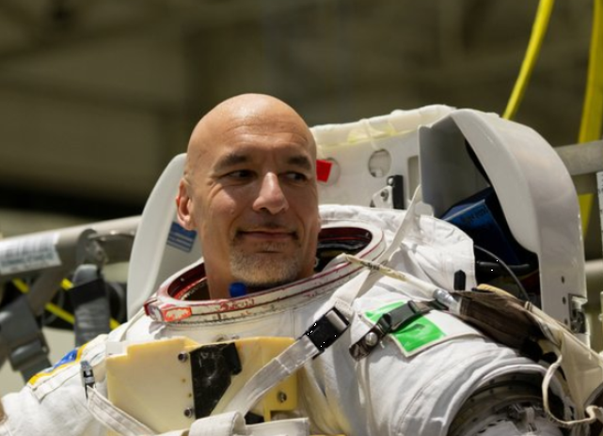
Image Processing and Programming
Key Idea
Notes:
We’ll use a picture of Luca Parmitano, an astronaut to illustrate the technique. The pictures come from the ESA’s gallery. https://www.esa.int/spaceinimages/Images/2019/04/Luca_Parmitano_training_at_NASA_s_Johnson_Space_Center38

Slide 29
Image Processing and Programming
Key Idea
Notes:
There is a second handout in the resources to support this.
Students could embark on this alone or the slides that follow can be used to support it.

Slide 30
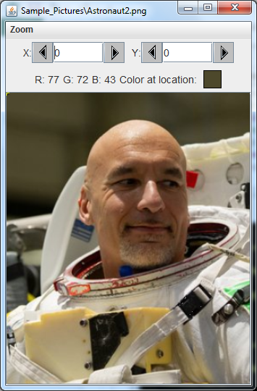
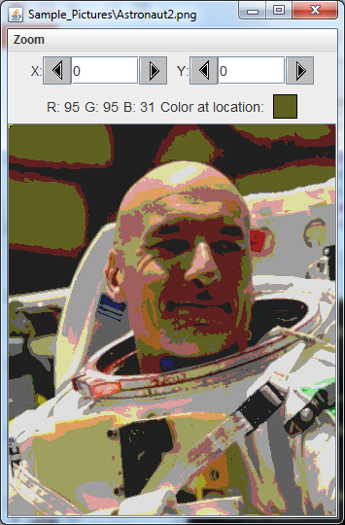
Building cool algorithms
Notes:
Some students might find the algorithms that follow challenging. Don’t attempt to code them initially, but use the slides to discuss the principles behind them.
The first example involves posterizing an image: Taking each pixel value and mapping it to a more limited range.
A click reveals what a posterized image is.

Slide 31
Building cool algorithms
loop through the pixels:
get the RGB values
map values to smaller range
if < 64 set to 31
if > 63 and < 128 set to 95
if > 127 and < 192 set to 159
if > 191 and < 256 make 223
Posterizing An Image
Notes:
The pseudocode illustrates the mapping required to reduce the number of colours in the image.

Slide 32
Building cool algorithms
def posterize(picture):
#loop through the pixels
for p in getPixels(picture):
#get the RGB values
red = getRed(p)
green = getGreen(p)
blue = getBlue(p)
#check and set red values
if(red < 64):
setRed(p, 31)
if(red > 63 and red < 128):
setRed(p, 95)
if(red > 127 and red < 192):
setRed(p, 159)
if(red > 191 and red < 256):
setRed(p, 223)
Posterizing An Image
Notes:
A part solution is shown.
This would need to be extended by copying the code for the red mapping, modifying it to produce similar mappings for the other two colour channels.

Slide 33
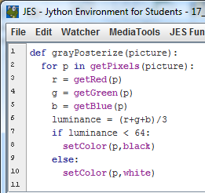
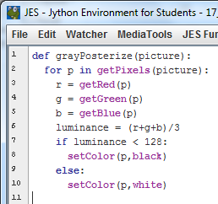
Building cool algorithms
Black and White
Posterizing
Notes:
We can extend the idea to make a black and white posterized image.
The key here is calculating a variable luminance, which is then compared to a threshold value.

Slide 34
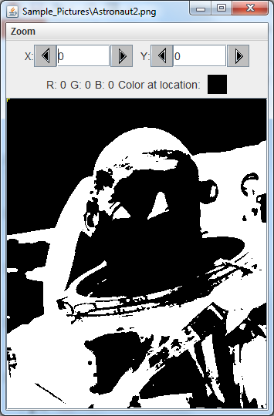
Building cool algorithms
Black and White
Posterizing
Notes:
The threshold of 128 doesn’t produce a very good image..

Slide 35
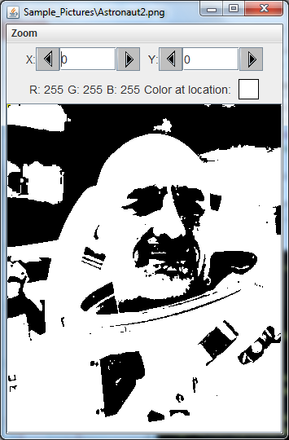
Building cool algorithms
Black and White
Posterizing
Notes:
Here we have set the threshold value to less than 64, resulting in a better image being reproduced.
Experiment with the threshold value to achieve a good image.

Slide 36
Image Processing and Programming
Key Ideas
1
Coding Visuals
Using Python to program effects
2
Posterization
Mapping values to a smaller set
Notes:
In summary, we have covered two key ideas:
We can use Python scripts to alter pixels in an image
We can map values to a smaller range, a technique known as posterization.
These techniques will provide a foundation for analysing satellite images in the lessons ahead.

