Slide 1
Notes:
Before students can get to grips with Satellite Images, they need a sound understanding on the principles behind a digital image.
This session outlines the core concepts.

Slide 2
Understanding Digital Images
Learning Outcomes
After the session we hope you will know:
A bitmap image is rendered from a set of numbers
Binary is used to store numbers in an computer file
A pixel is the key element in bitmap images
Monochrome images require 1 bit to represent each pixel
Full colour pixels are made up of red, green and blue values
There are lots of different image file formats
Notes:
It is important to be explicit about the intended outcomes for your students.
Do not assume they will be aware of the purpose of your session.
The specific outcomes from this session are for students to understand that;
A bitmap image is rendered from a set of numbers
Binary is used to store numbers in an computer file
A pixel is the key element in bitmap images
Monochrome images require 1 bit to represent each pixel
Coloured pixels are made up of red, green and blue values
There are lots of different image file formats
Activities with different file formats will hopefully make this clear.

Slide 3
Understanding Digital Images
Key Ideas
1
Bitmaps
Images as a ‘map of bits’

Slide 4
Cup and Saucer: A Simple Bitmap Image
Pixels
(Picture Elements)
Notes:
The slide displays a simple bitmap image.
A bitmap is an image made up from a grid of pixels.
Each pixel is the smallest picture element.

Slide 5
Cup and Saucer: A Simple Bitmap Image
The colour of each pixel is given by a number.
What numbers could we use for white & black?
Notes:
The colour of each pixel can be coded as a number.
What numbers could we use to represent white and black?
(click)
We could use any numbers, but here we’ve used the simplest possible representation 0 for white, and 1 for black.

Slide 6
An bitmap image file is just a long list of numbers.
How big would this file be?
Hint: There are 8 bits in a byte.
Notes:
A bitmap image is just a long list of numbers.
In this simple, monochrome image, the value of each pixel can be stored as 1 bit.
(1 bit can store only two values, 0 or 1)
So the raw data in this image file would take up 15 bytes (15 rows, each of 8 bits).

Slide 7
Portable Bitmap Format
1
activity
NETPBM format:
several file formats that allow a bitmap to be written in plain text.
They use file extensions
.pbm, .pgm and .ppm
Notes:
We will use GIMP (https://www.gimp.org/) for a practical exercise – a free graphics editor very similar in capabilities to Photoshop. We’ll use it to explore how to draw a picture by writing a series of numbers in a text file.
In the following slides, we will open plain text files (.txt) and save them with a new extension. We can then render them using GIMP.

Slide 8
Portable Bitmap .pbm
P1
# This is an example of a comment
6 10
0 0 0 0 1 0
0 0 0 0 1 0
0 0 0 0 1 0
0 0 0 0 1 0
0 0 0 0 1 0
0 0 0 0 1 0
1 0 0 0 1 0
0 1 1 1 0 0
0 0 0 0 0 0
0 0 0 0 0 0
File Format: .pbm
Black/white only
Notes:
Using Notepad, open the file 01sample_letter from the Text Files folder.
Notice the layout of the characters highlighted. These represent pixel values 0 for white, 1 for black.
In Notepad, save the file with a .pbm extension. GIMP, and some other image editors, will now be able to render the pixel information.

Slide 9
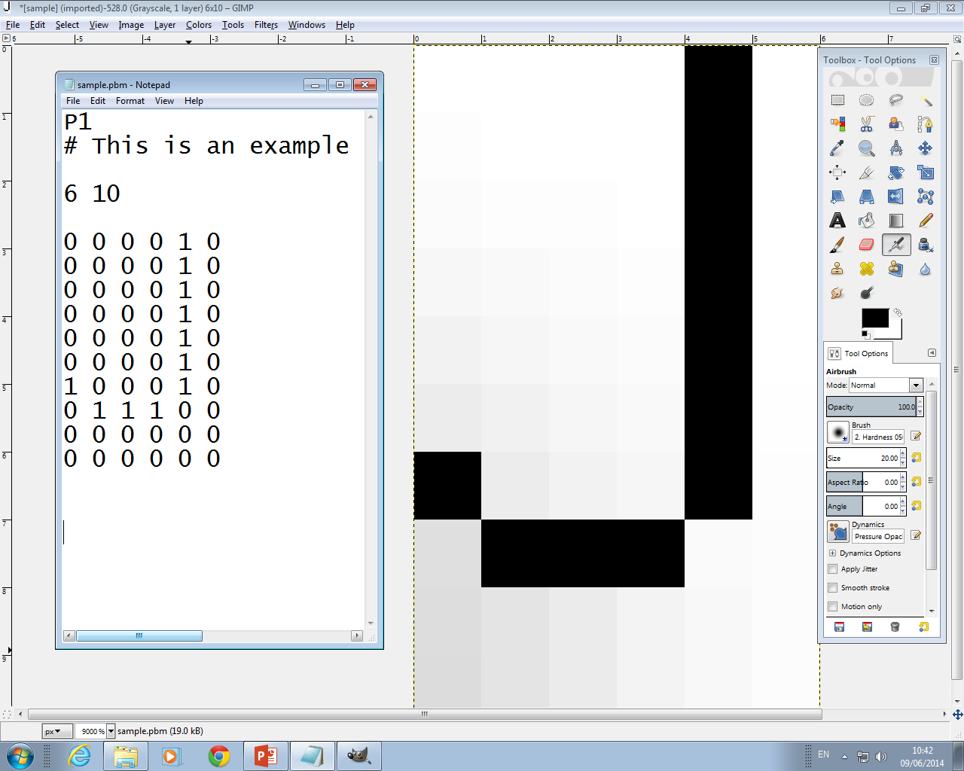
Notes:
Open the file in GIMP and zoom in. It is only 60 pixels so very small.

Slide 10
Portable Bitmap .pbm
P1
# This is an example of a comment
6 10
0 0 0 0 1 0
0 0 0 0 1 0
0 0 0 0 1 0
0 0 0 0 1 0
0 0 0 0 1 0
0 0 0 0 1 0
1 0 0 0 1 0
0 1 1 1 0 0
0 0 0 0 0 0
0 0 0 0 0 0
File Format: .pbm
Black/white only
Notes:
As well as the pixel values, there is other information at the top. Ask pupils what they think this is for. The image editor will ignore comments when rendering the file. The other details make up the file header – essential information for rendering the picture to the right dimensions – 6 pixels per row, and 10 rows. P1 is header detail that tells the computer to render each ascii text value (the digits 1 and 0) as black and white. You’ll find more about the file specification (and example files) at http://people.sc.fsu.edu/~jburkardt/data/pbma/pbma.html .

Slide 11
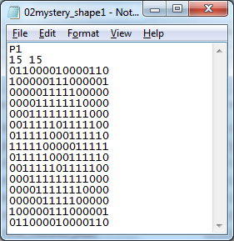
Can you predict what this image is?
And this?
Notes:
Notice that the pixel values do not need to be arranged as they are displayed, as the rendering information (6 by 10) is contained in the file header. To make the point, ask pupils to open 02mystery_shape1 and predict what will be displayed. Then ask them to predict 02mystery_shape2. It is the same data, and will render the same because of the header information.

Slide 12
Is this the same as the image below?
Notes:
To reinforce the point, a third image is included; 02mystery_shape3. This contains exactly the same data, but the header information is different, so it will not render the same.

Slide 13
Understanding Digital Images
Key Ideas
2
Resolution
Images as ‘millions of pixels’

Slide 14
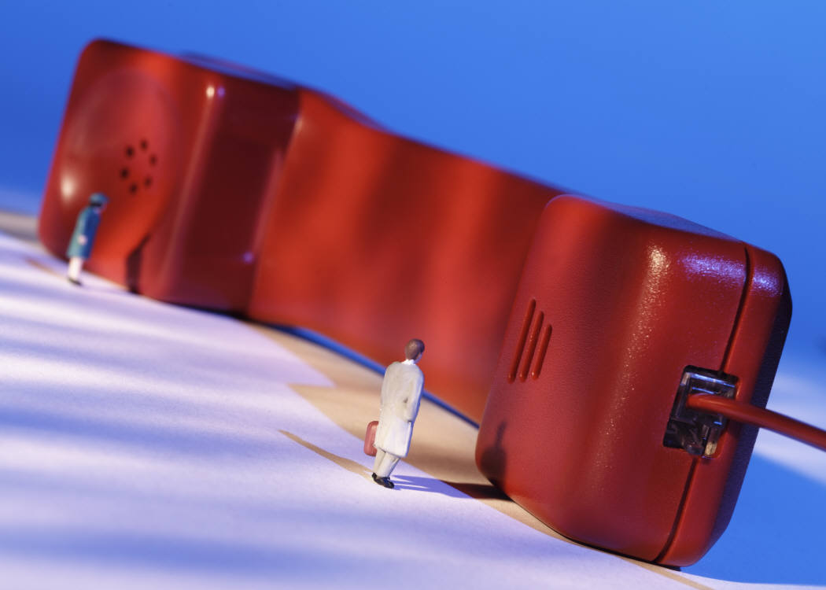
Lets talk phones!
Notes:
Phones are a good starting point for children to ensure they understand the basics of digital images.
A questions and answer session will establish how familiar they are with many of the terms used when discussing digital images.
Image from Microsoft Clipart gallery

Slide 15
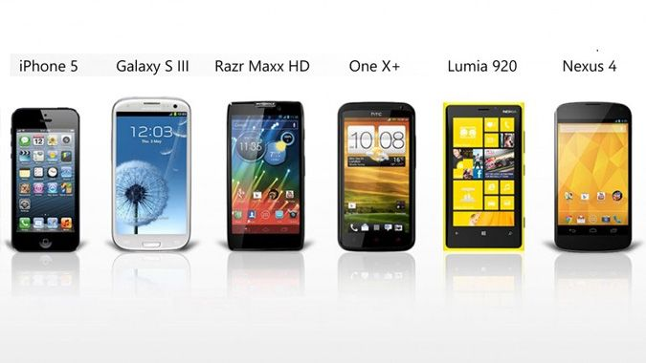
Which has the best screen?
Resources courtesy of CAS Tenderfoot
Notes:
The next 3 slides are designed to get pupils considering how to evaluate a smart phone screen. The Galaxy here has the biggest, but is it the best? Ascertain whether pupils know how the measurement is derived (across the diagonal).
Exercise and images courtesy of CAS Tenderfoot; https://www.computingatschool.org.uk/custom_pages/56-tenderfoot

Slide 16
Which has the best screen?
Notes:
The Lumia has the biggest number here, but what does PPI stand for? (Pixels per inch)

Slide 17
Which has the best screen?
Notes:
Only here do we have the actual resolution of the display.

Slide 18
Which has the best camera?
Notes:
We can also distinguish between the resolution of the display, and the resolution of images captured. We need to unpick what ‘megapixels’ are, and how often these aren’t a precise measurement, rather an indication.

Slide 19
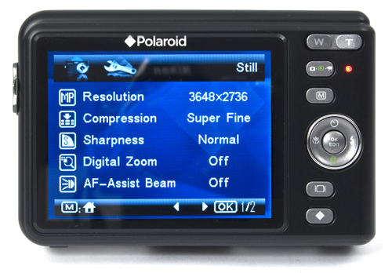
How many
pixels?
9,980,928
Notes:
The number of pixels in an image can be derived from multiplying the resolution figures. In this case, we have nearly 10 million pixels in the image - a 10 megapixel camera.

Slide 20
Screens render images
What is the resolution of your phone display?
What resolution does the camera capture images at?
Image courtesy of Intel Free Press
Cameras digitize images
Notes:
Reinforce the point – a camera digitizes (captures) an image as a series of pixels.
A screen, or image editing software such as GIMP will render that series of pixels.
(click)
As an optional activity, perhaps ask students to find out what the resolution of their phone screen is, and compare it to that of the built in camera.
Image source: https://www.flickr.com/photos/intelfreepress/

Slide 21
Thinking
About
Files
The more pixels,
the greater the resolution.
The greater the resolution, the better the image.
The better the image, the bigger the file!
Notes:
Once resolution is understood, we can introduce the idea of different files sizes. By zooming in on the eye, children can begin to appreciate the number of pixels involved – this tiny image snippet has over 450 pixels!

Slide 22
Understanding Digital Images
Key Ideas
3
True Colour
Images with lots of colour

Slide 23
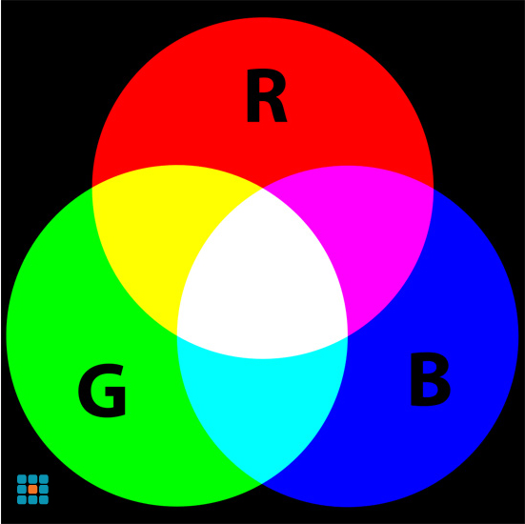
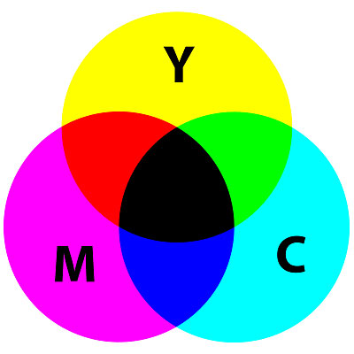
Understanding Colour
Screens add light to create colour
Printers subtract light to create colour
Notes:
When an image is rendered, each pixel is lit by a combination of 3 colours; red, green and blue (RGB). RGB is an additive colour model, that is the light is added to a black screen.
(click)
By contrast, when a picture is printed on white paper, light has to be removed to render the correct colours. Three translucent colours, Cyan, Magenta and Yellow (CMYK – the K represents black) are combined in this subtractive colour model.

Slide 24
Full Colour Bitmaps
How many bits are needed to store a pixel?
Each pixel is made of RGB values in the range 0-255
Examples
Notes:
Given this explanation of full colour representation, ask how many bits (or bytes) are required to store each pixel value.
(click)
Each number will be stored as a binary number.
1 byte will be needed for each colour (because 255 is represented in binary as 1111 1111), so 3 bytes (or 24 bits) are required. In actual fact, a 4th byte usually stores a value for transparency as well.

Slide 25
Full Colour Bitmaps
How would each pixel be represented in a computers memory?
Red Value |  |  |  |  |  |  |  | Green Value |  |  |  |  |  |  |  | Blue Value
128 | 64 | 32 | 16 | 8 | 4 | 2 | 1 | 128 | 64 | 32 | 16 | 8 | 4 | 2 | 1 | 128 | 64 | 32 | 16 | 8 | 4 | 2 | 1
Examples
Notes:
You can use this slide as a class teaching tool, with children being asked to fill in the binary values.
The following 3 slides have answers for each example

Slide 26
Full Colour Bitmaps
How would each pixel be represented in a computers memory?
Red Value |  |  |  |  |  |  |  | Green Value |  |  |  |  |  |  |  | Blue Value
128 | 64 | 32 | 16 | 8 | 4 | 2 | 1 | 128 | 64 | 32 | 16 | 8 | 4 | 2 | 1 | 128 | 64 | 32 | 16 | 8 | 4 | 2 | 1
0 | 0 | 1 | 0 | 0 | 0 | 1 | 0 | 1 | 0 | 1 | 1 | 0 | 0 | 1 | 0 | 0 | 1 | 0 | 0 | 1 | 1 | 0 | 0
Whatever the colour
It take 3 bytes to store 1 pixel

Slide 27
Full Colour Bitmaps
How would each pixel be represented in a computers memory?
Red Value |  |  |  |  |  |  |  | Green Value |  |  |  |  |  |  |  | Blue Value
128 | 64 | 32 | 16 | 8 | 4 | 2 | 1 | 128 | 64 | 32 | 16 | 8 | 4 | 2 | 1 | 128 | 64 | 32 | 16 | 8 | 4 | 2 | 1
1 | 0 | 0 | 1 | 1 | 0 | 0 | 1 | 0 | 0 | 0 | 0 | 0 | 0 | 0 | 0 | 0 | 0 | 0 | 0 | 0 | 0 | 0 | 0
Whatever the colour
It take 3 bytes to store 1 pixel

Slide 28
Full Colour Bitmaps
How would each pixel be represented in a computers memory?
Red Value |  |  |  |  |  |  |  | Green Value |  |  |  |  |  |  |  | Blue Value
128 | 64 | 32 | 16 | 8 | 4 | 2 | 1 | 128 | 64 | 32 | 16 | 8 | 4 | 2 | 1 | 128 | 64 | 32 | 16 | 8 | 4 | 2 | 1
0 | 0 | 1 | 1 | 0 | 0 | 1 | 1 | 0 | 1 | 1 | 0 | 0 | 1 | 1 | 0 | 0 | 1 | 1 | 0 | 0 | 1 | 1 | 0
Whatever the colour
It take 3 bytes to store 1 pixel

Slide 29
Full Colour Bitmaps
Calculate the size of the file to store this image of a satellite
4000 pixels
1 row is 4000 pixels:
4000 X 3 = 12,000 bytes
3000 rows:
3000 X 12000 = 36,000,000 bytes
Covert to megabytes:
36000000 / 100000 = 36 MB
3000 pixels
Whatever the colour
It take 3 bytes to store 1 pixel
Notes:
Use this slide to work through a simple example for calculating the filesize of a raw bitmap.
In reality the file would be larger as it would also need to store some header information as well as the raw data.
Most modern image formats will also compress the data, so if the image was converted to a .jpg file (for example) it would be a lot smaller.

Slide 30
How does a screen render a digital image?
See the principles in a spreadsheet
http://www.think-maths.co.uk/spreadsheet
Image converting code by Andrew Taylor. Website assembled by Rick Steckles and Alison Hover. Phone-screen microscopic image courtesy of Jamie Gallagher.
Notes:
The Think Maths website, initiated by Matt Parker, has a wonderful utility, whereby you upload an image and download a spreadsheet with RGB values in each cell. See next slide.

Slide 31
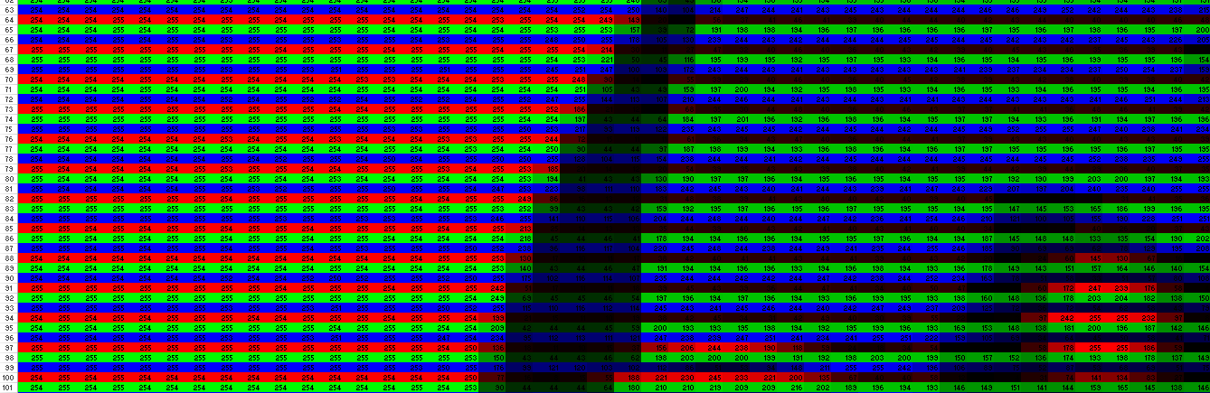
How does a screen render a digital image?
ZOOM OUT
Notes:
One issue is that the site doesn’t acknowledge your photo has uploaded. Simply select the option to retrieve the spreadsheet. Zooming out will reveal the image. Use the spreadsheet 03Climate_Detectives, included in the resources to illustrate this. The ‘greyscale’ is due to the limits of conditional formatting in the spreadsheet. Children may want to investigate how this works: Select a cell, from the Home tab, select Conditional Formatting – Manage Rules.
Students might like to use the website to upload an image of their choice for conversion to a spreadsheet.

Slide 32
2
Understanding Digital Images
Painting By Numbers
activity
Notes:
Let’s go back to using GIMP (https://www.gimp.org/) for another practical exercise.
This time we’ll use it to explore how to draw a full colour picture by writing another, more complicated series of numbers in a text file.
Material developed from CAS Tenderfoot; https://www.computingatschool.org.uk/custom_pages/56-tenderfoot

Slide 33
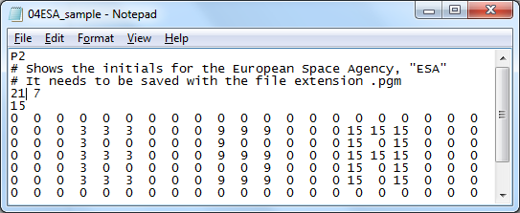
File Format: .pgm
Greyscale only
Notes:
First open 04ESA_sample in Notepad, and study it. Notice it has different header information. P2 specifies different ways to interpret the data that follows. Ask pupils to study it and predict what will be displayed. Notice it has an extra number, 15 in the file header – what might that be related to? Only display the rendered image once they have made predictions. Save the file, but this time with a file extension .pgm. This will render as a grayscale image, with 16 values (0 to 15) of grey. Pupils should experiment by changing the maximum grey value and observing what happens.

Slide 34
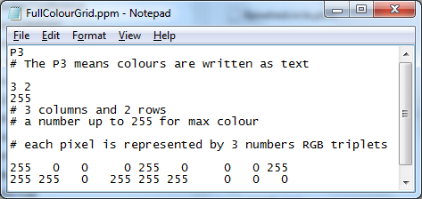
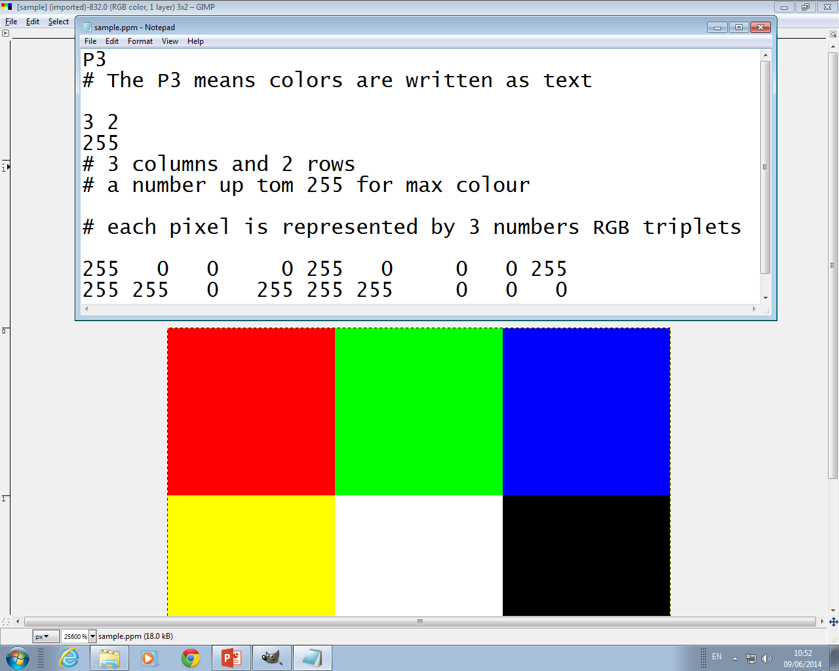
File Format: .ppm
Full colour
Notes:
Finally, pupils should open 05six_coloured_pixels, study it before saving with the extension .ppm. They could use a colour picker utility to predict how it would render.

Slide 35
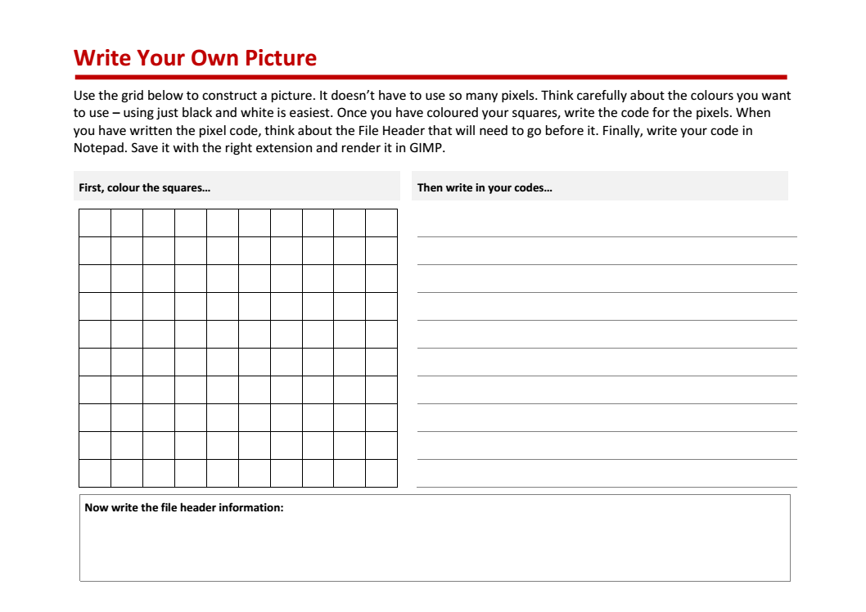
Design on paper
Write in Notepad
Render in GIMP
Notes:
Following the exploration of the different file types, a class activity could be to write their own picture. Two ‘Write_Your_Own_Picture’ design sheets are included in the resources, an easier and harder version. Students need not work with as many pixels as given, a 10 by 10 grid is challenging enough for some. The more able could attempt full colour images, whilst the easiest would be simple black and white images, like the simple binary images attempted earlier.
(click)
The picture is the logo of the European Space Agency. Perhaps students could try to write this as an image?
Extension:
As well as introducing the idea of pixel values being numbers, file header information has also been introduced in this lesson. A further investigation of file sizes using, say Paint will reveal that image files are larger than just the sum of the pixel values. The extra size is due to the information stored in the file header.

