Slide 1
IMMUNE RESPONSE COMPONENT IMAGES

Slide 2

Mast cell
Involved in allergic responses, releasing histamine and other inflammatory molecules. Mast cells sit within skin and mucosal tissues.
Credit: Bret Syfert/Big Picture CC BY

Slide 3

Basophil
Involved in allergic and inflammatory responses. Basophils release histamine like mast cells, but unlike mast cells they circulate in the blood.
Credit: Bret Syfert/Big Picture CC BY
BIGPICTUREEDUCATION.COM

Slide 4

Natural killer (NK) cell
These kill pathogen-infected cells and cancer cells. They release chemicals called cytokines, which alert and attract other immune cells.
Credit: Bret Syfert/Big Picture CC BY
BIGPICTUREEDUCATION.COM

Slide 5

Complement
A set of around 30 proteins in the blood plasma that can be activated by the presence of microbes or antibody–antigen complexes. Complement can destroy pathogens and activate phagocytic cells.
Credit: Bret Syfert/Big Picture CC BY
BIGPICTUREEDUCATION.COM

Slide 6

Neutrophil
Fast-acting phagocytes that flock to the site of inflammation.
Credit: Bret Syfert/Big Picture CC BY
BIGPICTUREEDUCATION.COM

Slide 7

Microphage
Antigen-presenting cells that destroy foreign substances by phagocytosis (engulfing them) and activating other immune cells.
Credit: Bret Syfert/Big Picture CC BY
BIGPICTUREEDUCATION.COM

Slide 8

Dendritic cell
Phagocytic antigen-presenting cells with an important role in alerting T cells to new pathogens.
Credit: Bret Syfert/Wellcome Images
BIGPICTUREEDUCATION.COM

Slide 9

Eosinophil
Phagocytes that also produce enzymes to counteract the inflammatory molecules released by mast cells.
Credit: Bret Syfert/Wellcome Images CC BY
BIGPICTUREEDUCATION.COM

Slide 10

Antigens
Antigens are non-self markers, often proteins, that alert the immune system’s cells to the presence of potential danger.
These antigens may pose no threat on their own – they are just components, such as molecules in bacterial membranes, that raise a flag to immune cells.
Credit: Bret Syfert/Big Picture CC BY
BIGPICTUREEDUCATION.COM

Slide 11
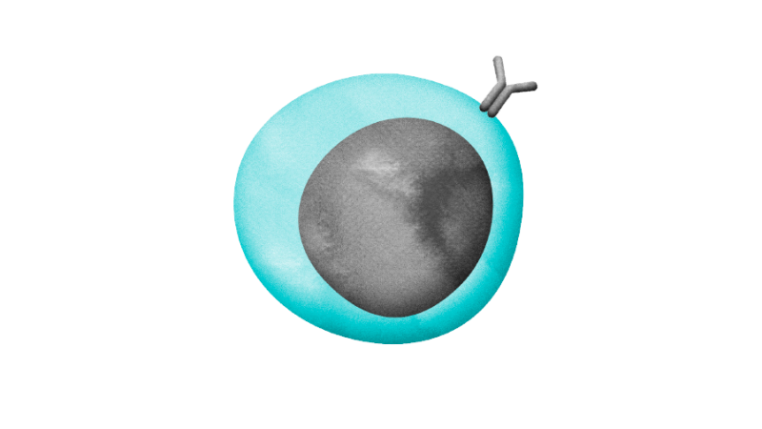
B cell
Named after the bone marrow, where immature B cells are produced. Types include plasma B cells and memory B cells. A type of lymphocyte.
Credit: Bret Syfert/Big Picture CC BY
BIGPICTUREEDUCATION.COM

Slide 12

Plasma B cell
B cells that have been activated to produce antibodies (immunoglobulins). Each B cell makes only one type of antibody.
Credit: Bret Syfert/Big Picture CC BY
BIGPICTUREEDUCATION.COM

Slide 13
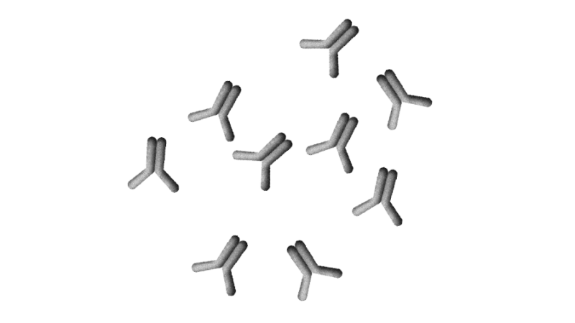
Antibodies
Also known as immunoglobulins (Ig). These are Y-shaped globular proteins, whose secondary structure is based mostly
on beta-pleated sheets. They are produced by plasma B cells to fight against antigens. Types include IgA, IgD, IgE, IgG and IgM.
Credit: Bret Syfert/Big Picture CC BY
BIGPICTUREEDUCATION.COM

Slide 14

Memory B cell
Long-lived B cells that remember past infections by recognising antigens to provide a secondary immune response.
Credit: Bret Syfert/Big Picture
BIGPICTUREEDUCATION.COM

Slide 15
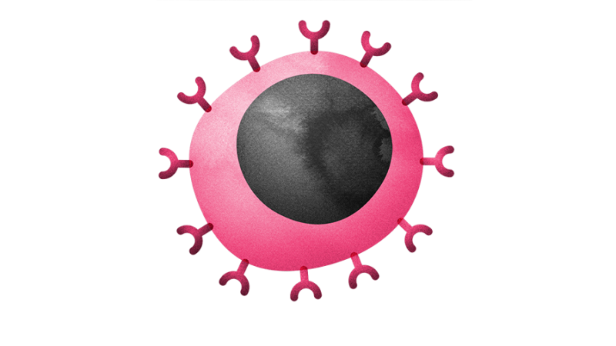
T cell
Named after the thymus, the organ where T cells mature. T cells have a protein called the T cell receptor on their surface.
Types include helper T cells, cytotoxic T cells and regulatory T cells. A type of lymphocyte.
Credit: Bret Syfert/Big Picture CC BY
BIGPICTUREEDUCATION.COM

Slide 16
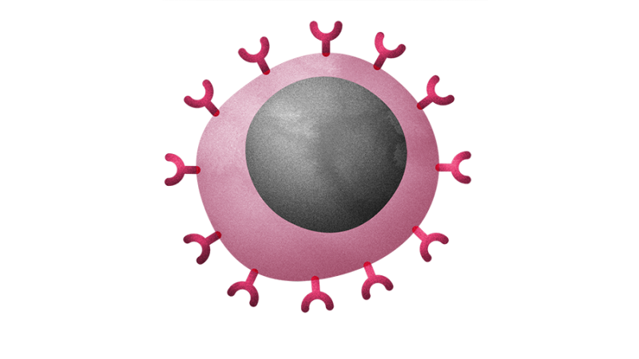
Helper T cell (CD4⁺)
T cells that recognise antigens presented by antigen-presenting cells and stimulate T, B and other immune cells. Also known as CD4+
cells, because of a protein that they express on their cell surface. These are the cells depleted by infection with HIV (human immunodeficiency virus). A type of lymphocyte.
Credit: Bret Syfert/Big Picture CC BY
BIGPICTUREEDUCATION.COM

Slide 17
Cytotoxic T cell (CD8⁺)
T cells that kill infected cells and cancer cells by releasing toxic chemicals. Also known as CD8+ cells,
because of a protein that they express on their cell surface, and as killer T cells. A type of lymphocyte.
Credit: Bret Syfert/Big Picture CC BY
BIGPICTUREEDUCATION.COM

Slide 18
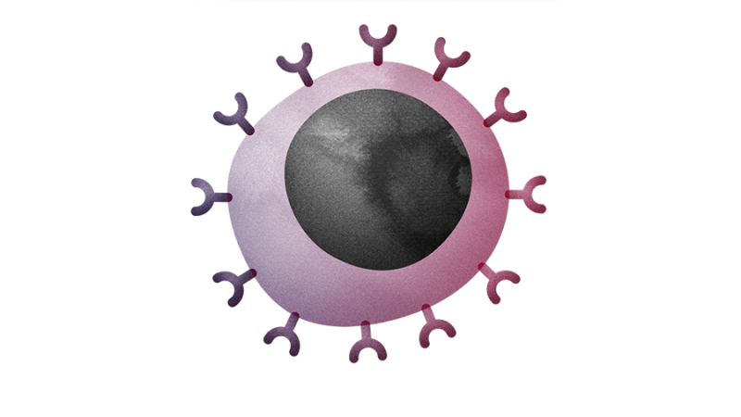
Memory T cell
Long-lived T cells that ‘remember’ past infections to provide a secondary immune response. A type of lymphocyte.
Credit: Bret Syfert/Big Picture CC BY
BIGPICTUREEDUCATION.COM

Slide 19

Perforins
Proteins that cause cells to lyse (burst) by making pores form in the plasma membrane of the cell. Found in the granules of cytotoxic T cells.
Credit: Bret Syfert/Big Picture CC BY
BIGPICTUREEDUCATION.COM

Slide 20
Reusing our images
Images and illustrations
All images, unless otherwise indicated, are from Wellcome Images.
Contemporary images are free to use for educational purposes (they have a Creative Commons Attribution, Non-commercial, No derivatives licence). Please make sure you credit them as we have done on the site; the format is ‘Creator’s name, Wellcome Images’.
Historical images have a Creative Commons Attribution 4.0 licence: they’re free to use in any way as long as they’re credited to ‘Wellcome Library, London’.
Flickr images that we have used have a Creative Commons Attribution 4.0 licence, meaning we – and you – are free to use in any way as long as the original owner is credited.
Cartoon illustrations are © Glen McBeth. We commission Glen to produce these illustrations for ‘Big Picture’. He is happy for teachers and students to use his illustrations in a classroom setting, but for other uses, permission must be sought.
We source other images from photo libraries such as Science Photo Library, Corbis and iStock and will acknowledge in an image’s credit if this is the case. We do not hold the rights to these images, so if you would like to reproduce them, you will need to contact the photo library directly.
If you’re unsure about whether you can use or republish a piece of content, just get in touch with us at bigpicture@wellcome.ac.uk.

