Slide 1
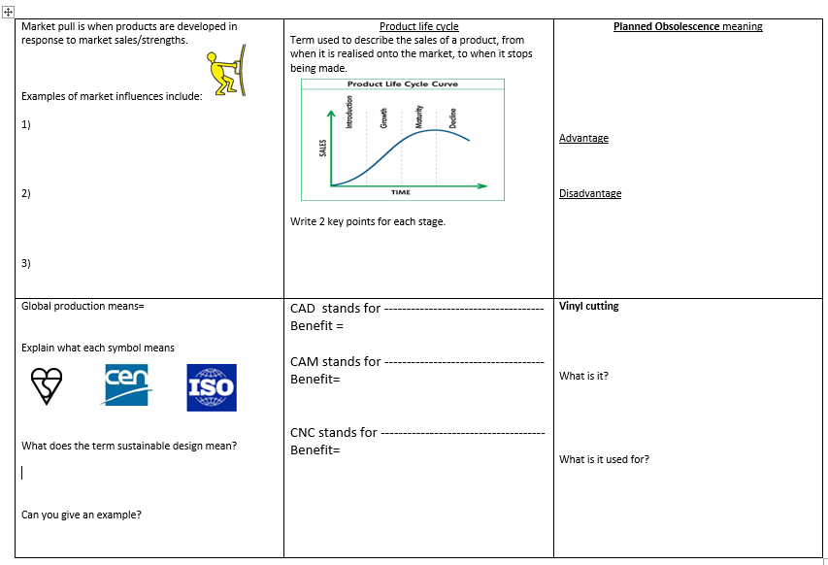

Slide 2
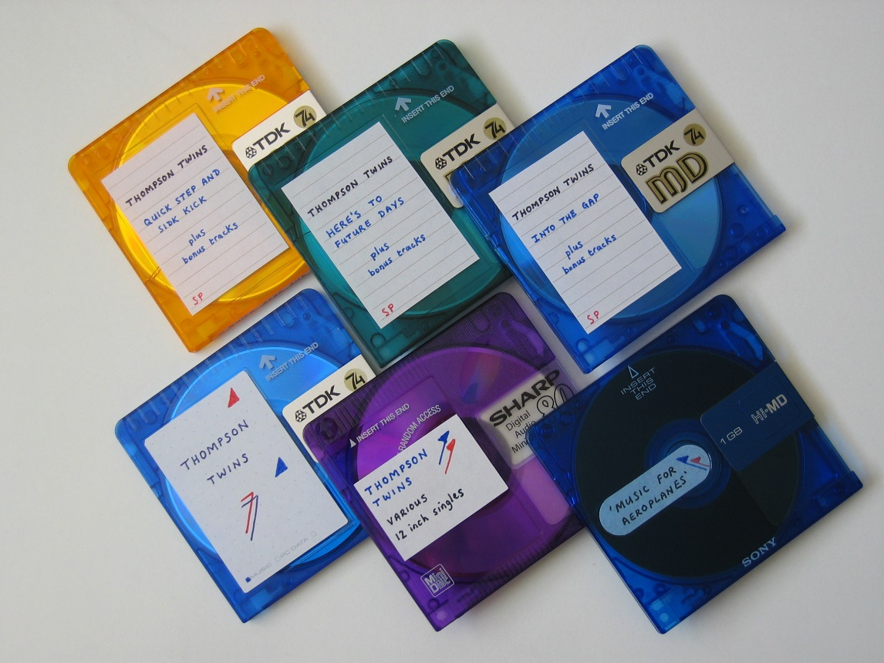
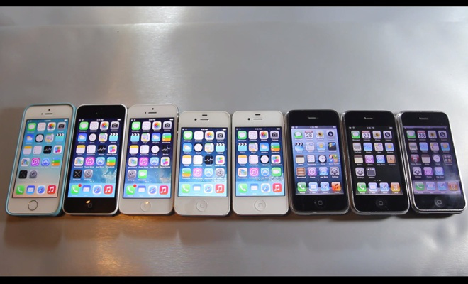
I phone
Mini disks
These came out in the late 1990’s-Sony ceased development of them as sales were not good.
Since first release in 2007- there have been 18 I phones- each one developing in technology.

Slide 3

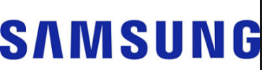
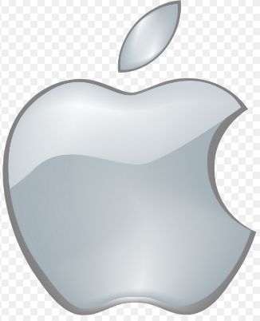
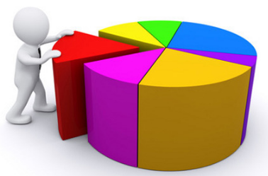
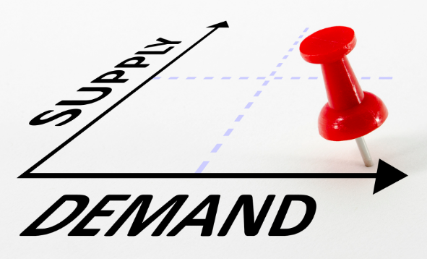
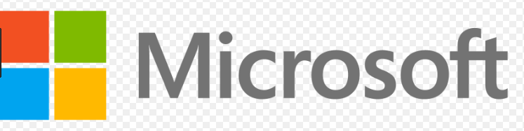
Market Pull
Market pull is when products are developed in response to market sales/strengths.
Examples of market influences include:
A demand from consumers. When sales rise, this creates a demand for the product- this often leads to development of a product. | Market research Companies sometimes test the market first by asking questionnaires, giving free trails or samples. If consumers like the product and feedback is good- the product will be manufactured and sold. | Competition A manufacturer wants to increase their share of the market. (competition is good for consumers)
Notes:
Samsung has long been a major tech corporation. It’s a image on the internet is that Samsung steal all of Apple’s ideas, reproduce them, and sell them for less than Apple sell the original product. I’m sure Samsung would deny this claim, but we know for sure that they are a strong competitor to Apple in the smart phone industry

Slide 4
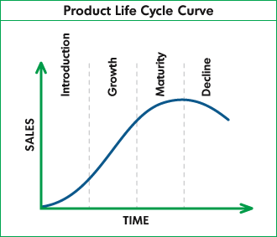
Product Life Cycle
Notes:
Product obsolescence may occur when a company stops producing, marketing or supporting a sold or developed product. The product will no longer be profitable for the company.
Most consumers probably aren’t aware of the product life cycle stages. Even though they make a conscious decision to switch from one product to another, this is more due to personal taste or simply wanting the have the latest and best, rather than an appreciation of which stage of its life cycle a product may be going through.
But if you look at the trends in key markets over the last couple of decades, even just the last few years, consumer demand for particular products can provide some very good product life cycle examples.
Product Life Cycle Examples
3D Televisions: 3D may have been around for a few decades, but only after considerable investment from broadcasters and technology companies are 3D TVs available for the home, providing a good example of a product that is in the Introduction Stage.
Blue Ray Players: With advanced technology delivering the very best viewing experience, Blue Ray equipment is currently enjoying the steady increase in sales that’s typical of the Growth Stage.
DVD Players: Introduced a number of years ago, manufacturers that make DVDs, and the equipment needed to play them, have established a strong market share. However, they still have to deal with the challenges from other technologies that are characteristic of the Maturity Stage.
Video Recorders: While it is still possible to purchase VCRs this is a product that is definitely in the Decline Stage, as it’s become easier and cheaper for consumers to switch to the other, more modern formats.
Another example within the consumer electronics sector also shows the emergence and growth of new technologies, and what could be the beginning of the end for those that have been around for some time.
Holographic Projection: Only recently introduced into the market, holographic projection technology allows consumers to turn any flat surface into a touchscreen interface. With a huge investment in research and development, and high prices that will only appeal to early adopters, this is another good example of the first stage of the cycle.
Tablet PCs: There are a growing number of tablet PCs for consumers to choose from, as this product passes through the Growth stage of the cycle and more competitors start to come into a market that really developed after the launch of Apple’s iPad.
Laptops: Laptop computers have been around for a number of years, but more advanced components, as well as diverse features that appeal to different segments of the market, will help to sustain this product as it passes through the Maturity stage.
Typewriters: Typewriters, and even electronic word processors, have very limited functionality. With consumers demanding a lot more from the electronic equipment they buy, typewriters are a product that is passing through the final stage of the product life cycle

Slide 5
Introduction/launch- Product newly released onto market, first sales slow, consumers start to realise benefits- costs company to launch-little profit.
Growth- advertising takes effect, sales rise, company make profit, competitors may introduce own brand
Maturity- sales level off, market flooded with competitors designs (may be better) Major companies monitor & have new products ready.
Decline, sales drop off, companies decide (reduce profits? Stop making? Launch new one?)
Obsolescence- stop making- New technology's may push this (i.e. cassettes to Vinyl, CD ) It could be a product that people no longer want to buy (like a fad (fidget spinners/loom bands)
Planned Obsolescence – Some companied plan short lives for products ((e.g., a car would not be affordable if every part had to be made strong enough to last 100 years).
Notes:
Product obsolescence may occur when a company stops producing, marketing or supporting a sold or developed product. The product will no longer be profitable for the company.
Buyers need to first become aware of the product
Innovators
Techno-savvies first customers to buy a product, 2.5 % of consumers
Early Adopters
Tend to be opinion leaders. Adopt new products but use discretion, 13.5%
Early Majority
34% of consumers, first part of the mass market to buy the product
Late Majority
Less cosmopolitan and responsive to change, 34%
Laggards
Price conscious, suspicious of change, 16%, do not adopt until the product has reached maturity

Slide 6
Product Life Cycle
Planned obsolescence
Disadvantages
Customers may look for a more durable product
Environmental impact (regular replacing of product)
Benefits
Consumer pressure to purchase again (replace/newer model)
Consumer gets the latest technology.
Product could be more environmentally friendly (materials, energy consumption)

Slide 7

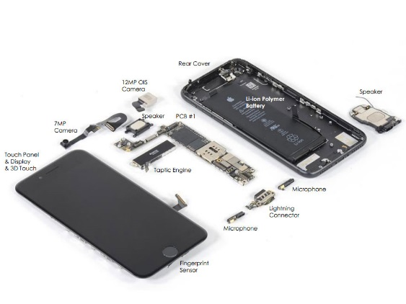
Global Production
GLOBALISATION
This term is used to describe how one product can be produced all over the world.
Circuit boards
South Korea/China/Australia
Chip design
England/
Wales
Wires
South Korea/China/Holland
Advantages
Can support economic growth in poor countries.
Makes products cheaper, therefore lower cost for consumers.
Disadvantages
Carbon foot print (environmental) & ethical/moral considerations.
Screen
South Korea/China/Romania
Components
South Korea/China/Germany
Batteries
South Korea/China/America
Screen
South Korea/China/Romania
Case
USA/China/South Korea
Components of a mobile phone.

Slide 8


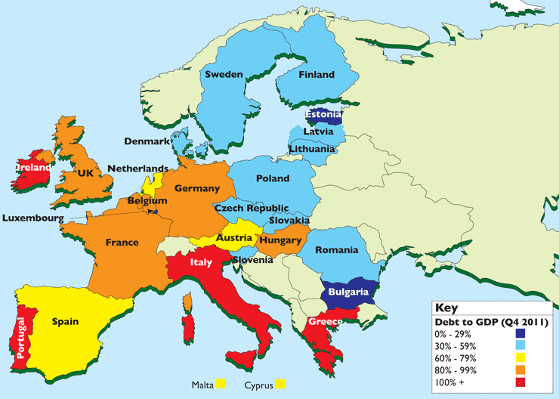


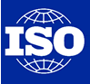
Legislation
Legislative Issues=The act or process of making laws!
WHAT IS A STANDARD?
Put at its simplest, a standard is an agreed, repeatable way of doing something. It is a published document that contains precise criteria designed to be used consistently as a rule or guideline. These help to keep products safe and good quality for the consumer.
Who sets the standards and regulations?
 | British standards Institute “Kite mark” this symbol means a product has passed some tests and regulations. It is awarded and owned by BSI
 | This shows a product has met European standards.
 | This is a international standard setting organisation . The BSI is a member

Slide 9
The consumer rights act covers……
Product Quality
Satisfactory quality Goods shouldn't be faulty or damaged when you receive them.
Fit for purpose The goods should be fit for the purpose they are supplied for.
As described The goods supplied must match any description given to you.
Returning Goods
30-day right to reject
Under the Consumer Rights Act you have a legal right to reject goods that are of unsatisfactory quality, unfit for purpose or not as described, and get a full refund - as long as you do this quickly

Slide 10
Sustainability :Meeting today’s needs without compromising the needs of future generations.
Sustainability-Products are produced in ways that do not use resources that cannot be replaced and that do not damage the environment.

Slide 11
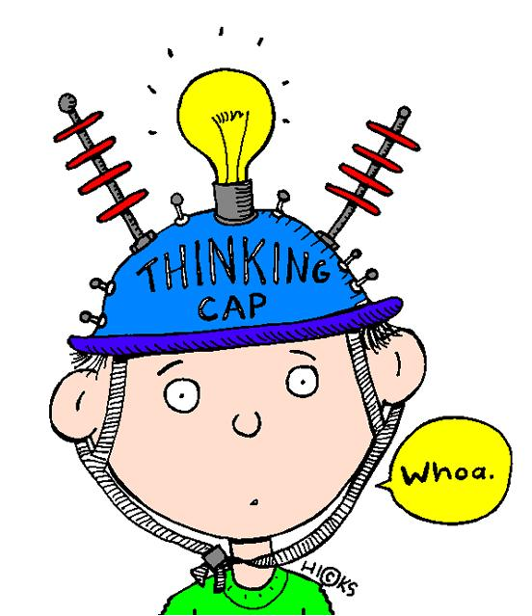
What does CAD stand for?
Computer Aided Design
What does CAM stand for?
Computer Aided Manufacture

Slide 12
What does CNC stands
for?
Computer
Numerically
Controlled
CNC Machining is a process used in manufacturing that involves the use of computers to control machine tools.

Slide 13

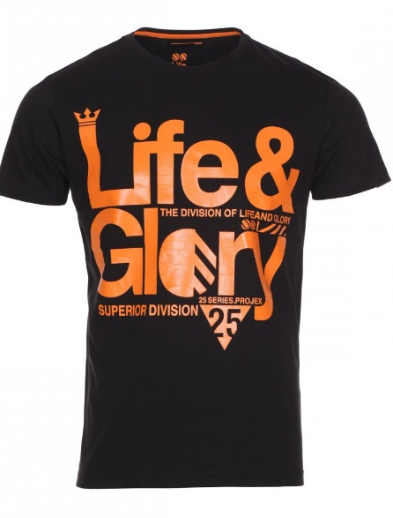
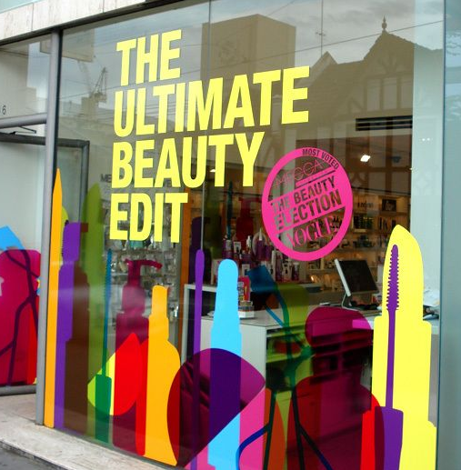
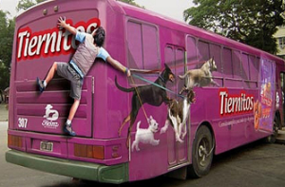
Vinyl cutting
Used for…….graphics for vehicles, shop windows, t-shirts, signage, banners.
A vinyl cutter is a type of computer-controlled machine. Small vinyl cutters look like computer printers. The computer controls the movement of a sharp blade. This blade is used to cut out shapes and letters from sheets of thin self-adhesive plastic (vinyl)
https://www.youtube.com/watch?v=RxuyPtR8Ooo
Notes:
Since self-adhesive vinyl can be cut into almost any shape and size, it is a very versatile decorative material. The vinyl shapes can stick to most flat and curved surfaces including plastic, metal, painted wood, aluminum and some types of concrete walls, and can be removed very easily.
59 seconds clip

