Slide 1
How electronic systems work using the Systems approach.
To be aware of the importance of electronic systems in everyday products.
50% of your final examination grade.
Complete all tasks

Slide 2
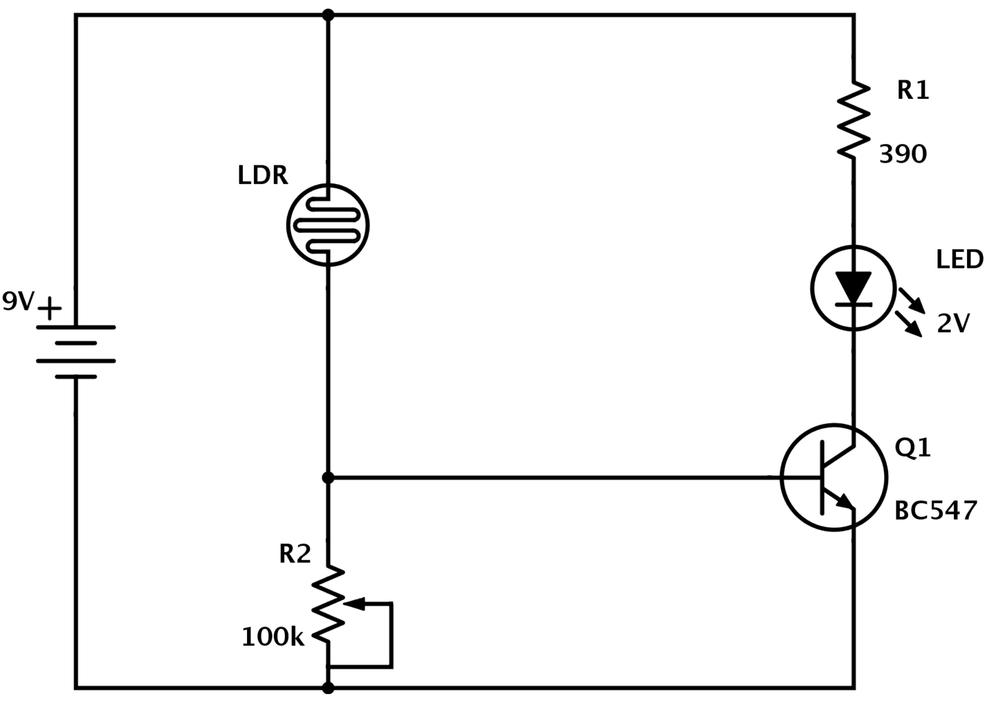
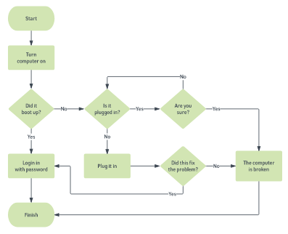
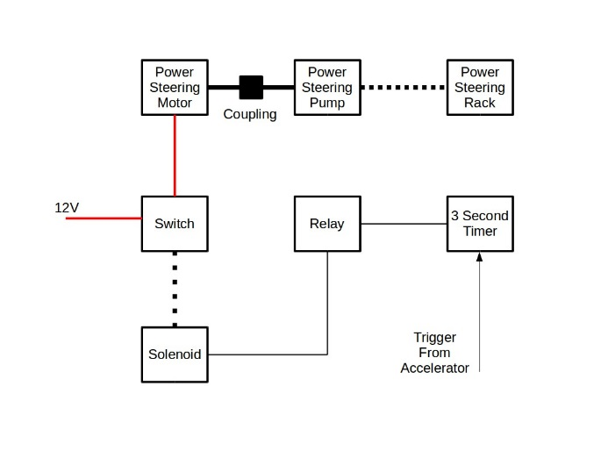
Starter
What is the correct name for each diagram?
Flow Chart
Block Diagram
Circuit Diagram
Circuit Diagram
Flow Chart
Block Diagram
What do they all have in common?
Notes:
Circuit- A circuit is a circular path (starts and stops at the same place) showing the path required to make electricity flow- shows every wire and electronic component.
Flow chart- This is a planning diagram- showing each process of how to make a product in the correct order, also including QC checks
Block diagram- similar to a flow chart- shows the function performed by each component – they are all linked together in order. (basically a flow chart but more technical for engineers)

Slide 3
What is a system?
A systems diagram is a representation of how a system will work.
What is a electronic system?
A collection of parts that is made up around three building blocks.
Input
Process
Output

Slide 4
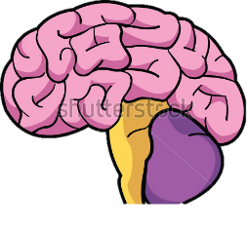
Open loop System
Input
The input starts the system
for example : switch or sensor.
Process
The mind of the system, which considers the inputs and decides what to do.
For example: Common process blocks include semi conductors, microprocessors (Chips)
Output
The system's response to being activated
For example: flashing light or a buzzer.
Notes:
Microprocessor- comes from combined word “Micro” “Processor” -performs the mathematical calculations required for products like computers to run programs
Semi conductor- conducts electricity depending on the environment (conduct or insulate – i.e. cold not conduct electricity - hot conduct electricity - so stop electricity flow or not) –controls electrical current.
Semiconductors are also used for other special properties. In fact, a solar cell is made of semiconductors which are sensitive to light energy. The amount of light energy that hits the semiconductors will determine the amount of electrical current generated by those semiconductors that make up the solar cells

Slide 5
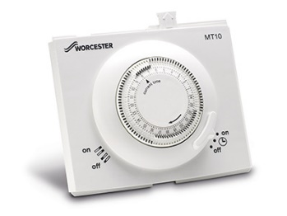
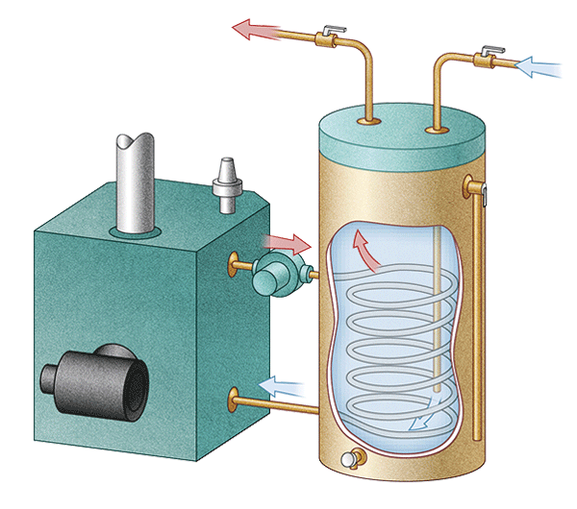
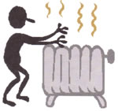
Example of an open loop system
Open-loop systems are set up to achieve desired results, but there's no way of checking if the results have been achieved. For example, an old-fashioned heating system might include:
Process
boiler (water heater and pump)
Input
an on-off switch
Output
radiator gets hot.
Notes:
An open loop control system does not include any feedback to the controller- i.e. it will keep performing a task-
Open-loop systems
Open-loop systems are set up to achieve desired results, but there's no way of checking if the results have been achieved. For example, an old-fashioned heating system might include:
input: an on-off switch
process: boiler (water heater) and pump
output: radiator
The aim of the system would be to heat a house. When turned on, the heating would stay on until it was turned off, regardless of whether the house remained cold or became too hot
Open ended-no attempt to alter conditions

Slide 6
Closed Loop Systems
Some systems are called Closed loop Systems
Closed loop systems are able to correct and change the process.
FEEDBACK
Input
Process
Output
Feedback in a system is a way of changing the process as a result of what happens at the output.
Notes:
Closed-loop systems are able to correct in order to meet target results. Normally a sensor is used to look at the output and adjust the process accordingly. This is called feedback.

Slide 7
Example of a closed loop system
Closed-loop systems are able to change the process as a result of what happens at the output.
Normally a sensor is used to look at the output and adjust the process accordingly. This is called feedback.
A thermostat is a device that automatically regulates temperature.
Notes:
For example, considering the heating system above, a thermostat could be added to measure the temperature of a room and compare it to a set target. If the room became too cold, the thermostat would turn the heating on and if the temperature became too hot the system would be turned off. The effectiveness of the system could be analysed by monitoring how good it is at keeping the room at the target temperature.
heating system has a thermoset (controller) This is a temperature sensitive devise that when the radiator has reached a certain temperature- it will stop it from getting any hotter.
Thermostat a device that automatically regulates temperature, or that activates a device when the temperature reaches a certain point.
Why feedback?
can be precisely controlled.
Feedback in a system is a way of changing the process as a result of what happens at the output.
If the home is too hot, the feedback loop will switch “OFF” the heating system to make it cooler. If the home is too cold, the feedback loop will switch “ON” the heating system to make it warmer.

Slide 8
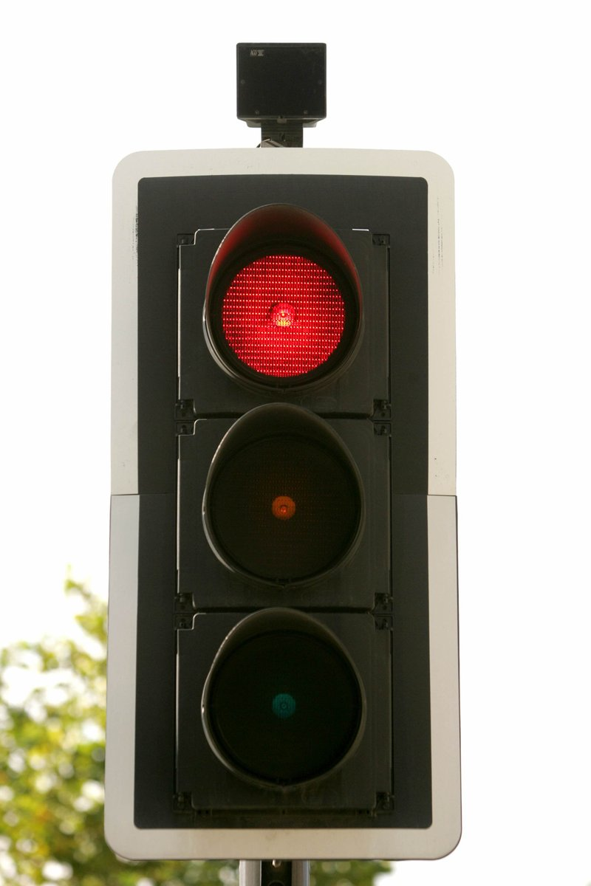
In pairs discuss and agree what you think is the
Input
Process
Output
For these traffic lights.
Notes:
Input- motion sensor at top of lights
Process- Microprocessor- sends a signal to control board
Output- Light

Slide 9
Using the diagram below explain how the closed
loop system would work for aeroplane on autopilot
FEEDBACK
Input
Process
Output
Notes:
Input- Data/speed/ height etc inputted
Process- computer calculating the data
Output- Speed/direction maintained to specifications
Feedback- new data- changes input and process- ie weather conditions change and it alters the direction/speed

Slide 10
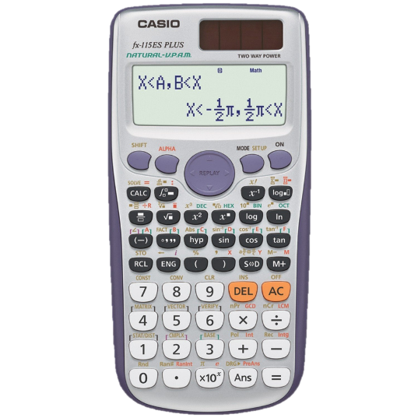
Task
Look at the images below and describe the input, process, output for each image.
Phone
Making a call
Digital Thermometer
Automatic
Night Light
Calculator
I – Keys being pressed
P – Microprocessor working
O – Sum displayed
(LED Screen)
I – Keys being pressed
P – Microprocessor working
O – Sound (microphone)
I – Heat via a sensor
P – Microprocessor working
O – Temperature
display (LED screen)
I – Sensor (LDR)
P – Switch being turned on
O – light via LED
Word Bank (some words can be used more than once)
Sensor (Heat or Light) Sound Display on a screen Keys being pressed Microprocessor working
Switch being turned on Light

Slide 11
Lesson Re – cap
1. What are the three building blocks of and electronic system
2. What is the difference between a open and closed loop system?
3. What does feedback have effect on?
4. Give an example of a closed loop system?

