Slide 1
Plant Pathogens Identification

Slide 2
Plants provide us with food, materials and breathable air.
We depend on plants for our survival.
But plants can catch diseases, just like we do.

Slide 3
When there’s an outbreak of plant disease
it’s important to find out which pathogen is causing it.
Identifying the pathogen helps us to stop it spreading.

Slide 4
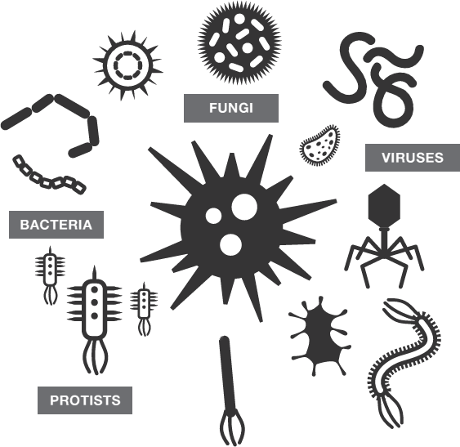
But thousands of different pathogens cause plant diseases, including bacteria, viruses, fungi and protists.
Narrowing it down could be tricky!

Slide 5
A plant pathologist uses standard diagnostic tests
in the lab and in the field to help identify
the pathogen causing a plant disease.

Slide 6
Recognising symptoms

Slide 7
The symptoms of disease in infected plants
can help us diagnose which pathogen is responsible.

Slide 8
PATHOGEN X
PATHOGEN Y
PATHOGEN Z
However, different pathogens can cause similar symptoms.
It’s usually necessary to do further diagnostic tests
to accurately identify the pathogen causing the disease.

Slide 9
Growth in culture

Slide 10
SAMPLE BOTTLE
Testing often starts by taking a sample from
plant tissue showing symptoms of infection.

Slide 11
PETRI DISH
WIRE LOOP
Cells from the sample are spread over a Petri dish
that contains a growth medium such as agar jelly.
The growth medium contains nutrients.

Slide 12
The Petri dish is kept in warm conditions in an incubator.
Bacteria and fungi from the sample grow to form cultures.

Slide 13
The appearance of a culture, such as its colour and furriness, can help a pathologist to identify the pathogen.

Slide 14
Different substances can be added to the growth medium to encourage or inhibit the growth of particular microorganisms.
This can help to identify the pathogens present in the sample.

Slide 15
Microscopy

Slide 16
Bacteria, fungi and protists (but not viruses)
can usually be observed using a light microscope.

Slide 17
Identification guide
Pathogen X
Pathogen Y
Pathogen Z
Different pathogens have different shapes.
Some pathogens grow in pairs or chains.
These characteristics can help us to identify them.

Slide 18
Identification guide
Gram-positive
Gram-negative
Different pathogens can be stained different colours using dyes.
One commonly used dye is Gram stain.
This is another piece of evidence that can help us to identify them.

Slide 19
Antibody tests

Slide 20
TEST STRIP
A sample from an infected plant can be put on
a test strip that is coated with monoclonal antibodies.

Slide 21
ANTIBODIES
TEST STRIP
A sample from an infected plant can be put on
a test strip that is coated with monoclonal antibodies.
The antibodies recognise an antigen from a specific pathogen.

Slide 22
CONTROL LINE
TEST LINE
SAMPLE
The test strip works like a home pregnancy test.
The test line on the strip will change colour when
the antigen from the pathogen is present.

Slide 23
Genome analysis

Slide 24
All organisms, including plant pathogens,
have unique genetic markers in their DNA.
Genetic markers can be used to identify a pathogen.

Slide 25
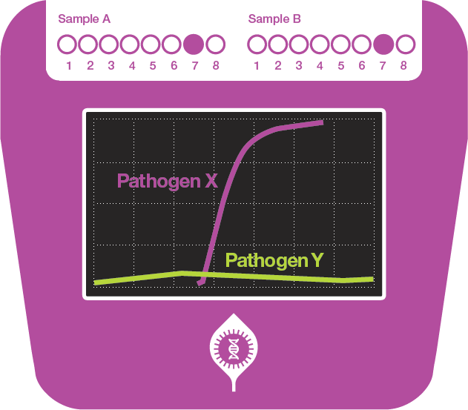
Pathologists use DNA probes that recognise
genetic markers from specific pathogens.

Slide 26
Small, portable machines enable plant pathologists to use DNA probes to quickly test samples from infected plants in the field.

Slide 27
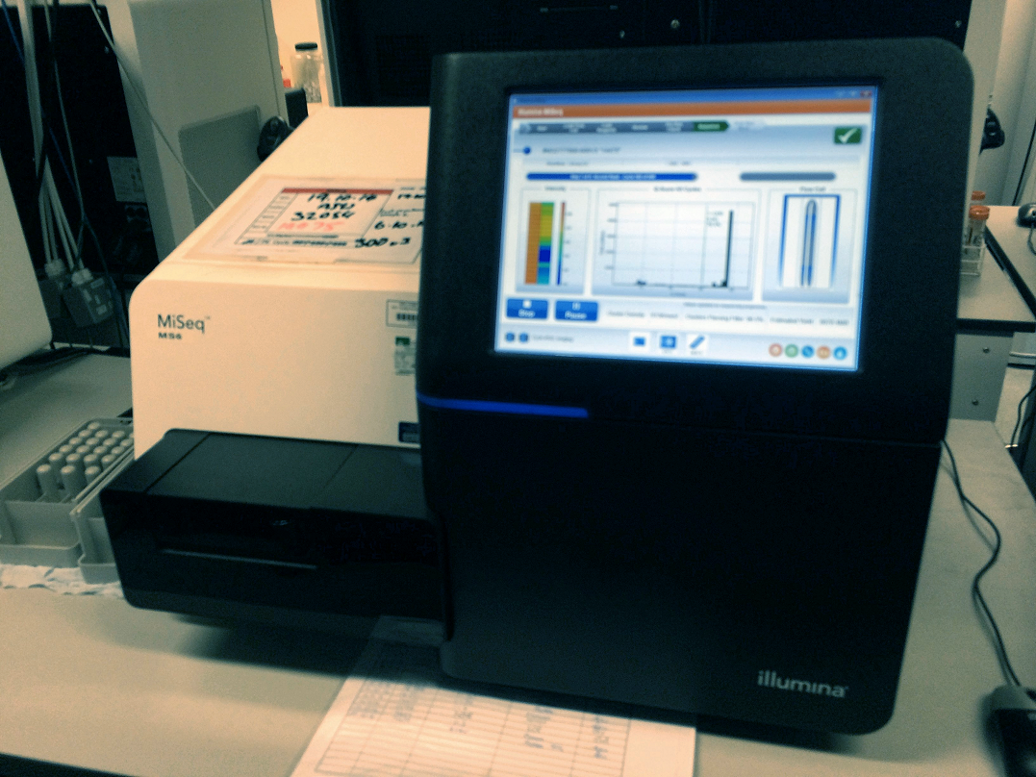
Back in the lab, it’s becoming quicker and cheaper to
sequence the whole genome of a pathogen.
This machine can sequence a bacterium’s genome in 8 hours.

Slide 28
ACUGUCCGAGGACAACUCCUUGGLICAAUGUCUAGCAGCGUCGUCUUUCGACACAGCOGUUGAAGAGUUUACGCUCGUGACCGCAGGCCCAAGGUGAACUUUUCAAAGUAAUA
AGCGAGGAGCAGACGCUUAUUGCUACCCGGGCGUAUCCAGAAUUCCAAAUUCAUUUUAUAACACGCAAUGCCGUGCAUUCGCUUGCAGGUGGUUGCGUCUUUAGAACUGGAUAU
CUGAUGAUGCAAUUCCCUCGGAUCAUUGACUUAUGACAUAGGCGGGAUUUUGCAUCGCAUCUGUUCAAGGGACGAGCAUAUGUACACUOCUGCAUGCCCAACCUGGACGUUCGAGAC
AUCAUGCGGCACGAAGGCCAGAAAGACAGUAUUGAACUAUACCUUUCUAGGCUAGAGAGAGGGOGGAAAACAGUCCCCAACUUCCAAAGGAAGCAUUUGACAGAUACGCAGAAUUCCU
GAAGACGCUGUCUGUCACAUACUUUCCAGACAAUGCOCAUCAOCCGAUGCAGCAUCAGGCAGAGUGUAUGCCAUUGCGCUACACAGCAUUAUGACAUACCAGCCGAUGAGUUCGOG
GCGGCACUCUUGAGGAAAAUGUCCAUACGUGCUAUGCCGCUUUCCACUUCUCUGAGAACCUOCUUCUUGAAGAUUCUACGUCAAUUUGGACGAAUCAACGCGUGUUUUUCGCGCGAU
GGAGACAAGUUGACCUUUUCUUUUGCAUCAGAGAGUACUCUUAAUUAUUGUCAUAGUUAUUCUAQUAUUCUUAGUAUGUGUGCAAACUUACUUCCCGOCCUCUAUAGAGAGGUUUAC
AUGAAGGAGUUUUUAGUCACCAGAGUUAUACCUGGUUUUGUAAGUUUUCUAGAAUGAUACUUUUCUUUUGUACAAAGGUGUGGCCCAUAAAAGUGUAGAUAGUGAGCAGUUUUAUACU
GCAUGGAAGACGCUGGCAUUACAAAAGACUCUUGCAAUGUGCAACAGCGAGAGAUCCUCCUUGAGGAUUCAUCAUCAGUCAUUCUGGUUUCCCAAAUGAGGGAUAUGGUCAUC
GUACCAUUAUUCGACUUUCUUUGGAGACUAGUAAGAGGACGCGCAAGGAAGUCUUAGUGUCCAAGGAUUUCGUGUUUACAGUGCUUAACCACAUUCGAACAUACCAGGCGAAAGCUCUU
ACAUACGCAAAUGUUUUGUCCUUUGUCGAAUCGAUUCGAUCGAGGGUAAUCAUUACGGUGUGACAGCGAGGUCCGAAUGGGAUGUGGACAAAUCUUUGUUACAAUCCUUGUCCAUGACG
UUUUACCUGCAUACUAAGCUUGCCGUUCUAAAGGAUGACUUACUGAUUAGCAAGUUUAGUCUCGGUUCGAAACGGUGUGCCAGCUGUGUGGGAUGAGUUUCGCUGGCGUUUGGGAAC
GCAUUUCCCUCCGUGAAAGAGAGGCUCUUGACAGGACUUAUCAGAGUGGCAGGCGACGCAUUAGAGAUCAGGOUGCCUGAUCUAUAUGUGACCUUCCACGACAGAUUAGUGACUGAG
UACAAGGCCUCUGUGGACAUGCCUOCGCUUGACAUUAGGAGAGAUGGAGAACGGAGUGAUGUCAAUGCACUUUCAGAGUUAUCOGUGUUAAGGGAGUCUGACAUUCGAUGUU
GUGUUUUUUCCCAGAUGUGCCAAUCUUUGGAAGUUGACCCAAUGACGGCAGCGAGGUUAUAGUCGCGGUCAUGAGCAAUGAGAGCGGUCUGACUCUCACAUUUGACGACCUCUGAG
GCGAAUGUUGCGCUAGCUUUACAGGAUCAAGAGAAGGCUUCAGAAGGUGCUUUGGUAGUUACCUCAAGAGAAGUUGAAGAACCGUCCAUGAAGGGUUCGAUGGCCAGAGGAGAGUUACAA
UUGCUGGUCUUGCUGGAGAUCAUCCGGAGUCGUCCUAUUCUAGACGAGGAGAUAGAGUCUUUGAGCAGUUUCAUAUGGCAACGGCAGAUUCGUUAUUCGUAGCAGAUGAGCUCG
AUUGUGUACACGGGUCCGAUUAGUUCAGCAAUGAAAACUUUUCGAUAGCCUGGUAGCAUCACUAUCUGCUGCGGUGUCGAAUCUCGUCAAGAUCCUCAAGAUCAGCUGCUAUU
GACCUUGAAACCCGUCAAAAGUUUGGAGUCUUGGAUGUUGCAUCUAGGAAGUGGUUAAUCAACCAACGGCCAAGAGUCAUGCUGGGGUGUUGUUGAAACCCACGCGAGGAGUAUCAU
GUGGCGCUUUUGGAAUAUGAUGAGCAGGGUGUGGUGACAUGCGAUGAUUGGAGAGAGUAGCUGUCAGCUCUGAGUCUGUUGUUUUUCCGACAUGGCGAAACUCAGAACUCUGCOCAGA
Sequencing the genome of a pathogen helps to identify it.
It can also show whether the pathogen has
antimicrobial resistance genes.

Slide 29
Isolation and reinfection

Slide 30
When a pathogen has been isolated from an infected plant
it can be used to reinfect a healthy plant.

Slide 31
If the same symptoms occur, we can be more confident that
the isolated pathogen is the cause of the plant disease.
This is called demonstrating Koch’s postulates.

Slide 32
Now you know about some of the diagnostic tests
that a plant pathologist uses in the lab and in the field
to help identify pathogens that cause plant diseases.

