Slide 1
Investigating Flower Structure and Function
Learning outcomes
You will:
Observe the structure of a Primula flower
Prepare a longitudinal section of a Primula flower
Produce an annotated scientific drawing of the longitudinal section of the flower
Understand how the structure of the Primula flower is adapted to its function.

Slide 2
Investigating Flower Structure and Function
Health and Safety
CLEAPSS Student Safety Sheet 74 provides information about assessing the risk posed by plant material.
Many plants contain toxins. To minimize any potential risk, inform your teacher if you are aware of allergies to a particular plant so that it can be avoided.
The pollen of some lilies stains clothing. Wear a lab coat to protect your clothes.
Take care when using sharp instruments such as single-edged (safety) razor blades, scalpels, scissors and mounted needles and follow the instructions for their safe use that have been given to you by your teacher.
When drawing it is important to take regular breaks to avoid eye strain and damage to the wrist and back. A short rest from drawing every half hour is a good idea.

Slide 3
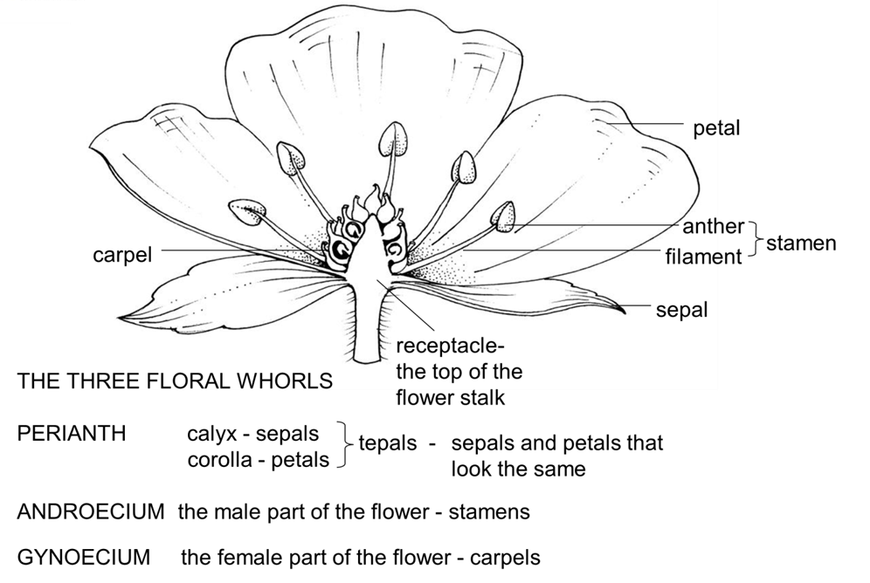
Generalised structure of a flower

Slide 4
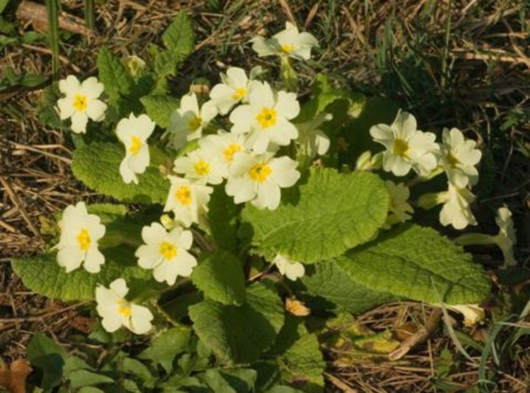
Investigating the Structure and Function of Primula Flowers.

Slide 5
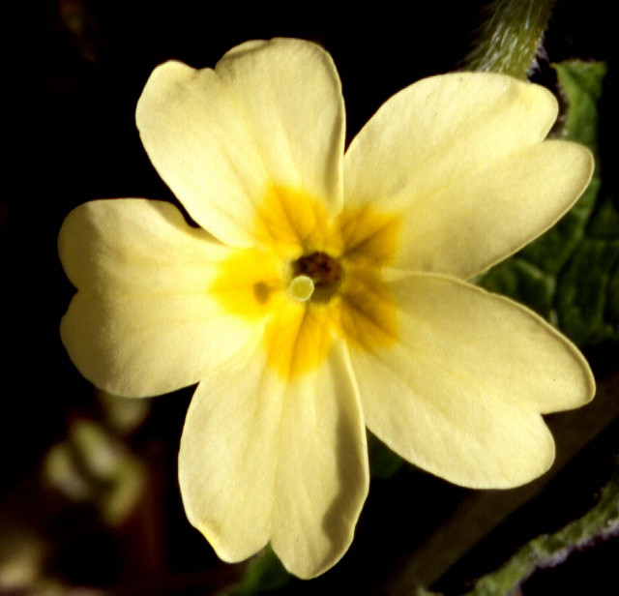
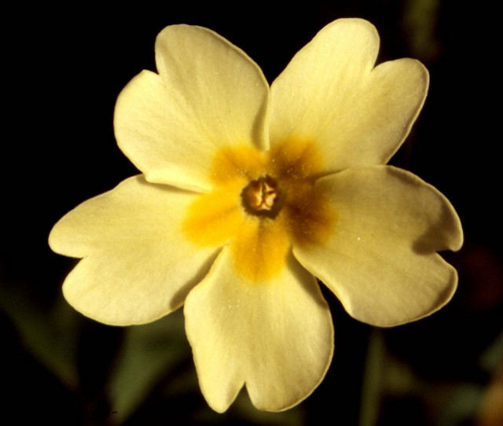
View down the corolla tube to show the external features of the two types of Primula flowers .
Lobes of corolla tube (Petals)
Stigma
Stamens
Pin
Thrum
Pin
Thrum

Slide 6
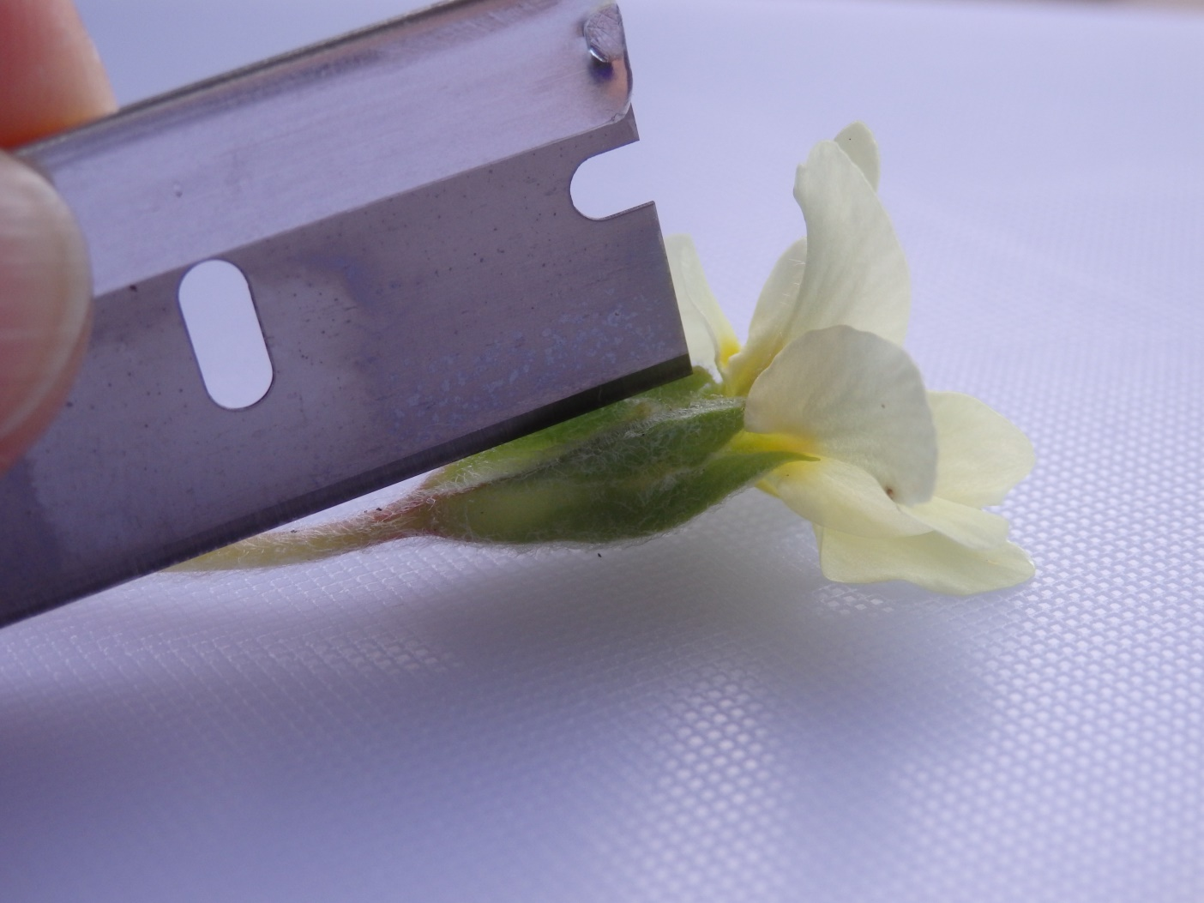
Cutting a longitudinal section through a Primula flower.

Slide 7
Cutting a longitudinal section through a Primula flower.

Slide 8
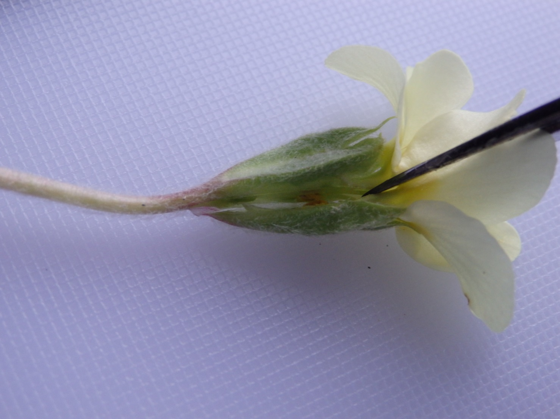
Cutting a longitudinal section through a Primula flower.

Slide 9
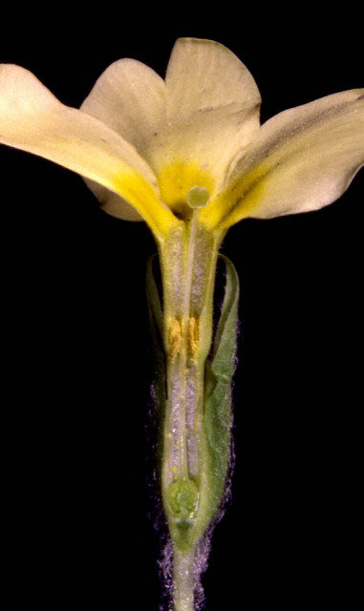
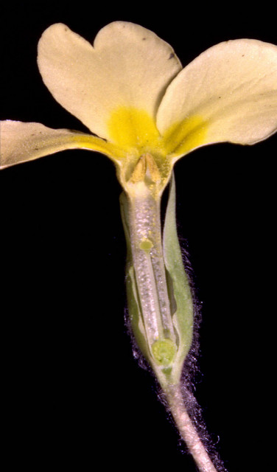
Longitudinal sections of the two types of Primula flowers.
Corolla lobe
Stigma
Style
Stamen
Ovary
Sepal
Pin
Thrum
Pin
Thrum

Slide 10
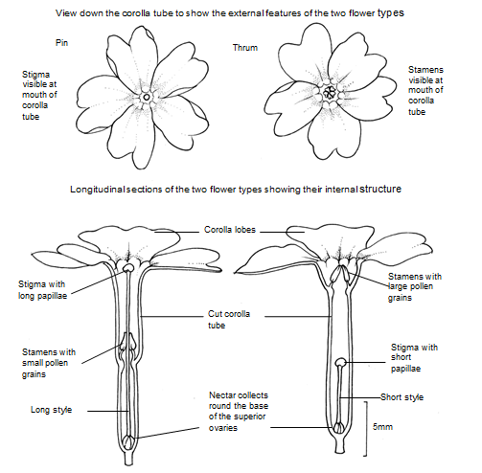
Fully annotated scientific drawing of the two types of Primula flowers

