Slide 2
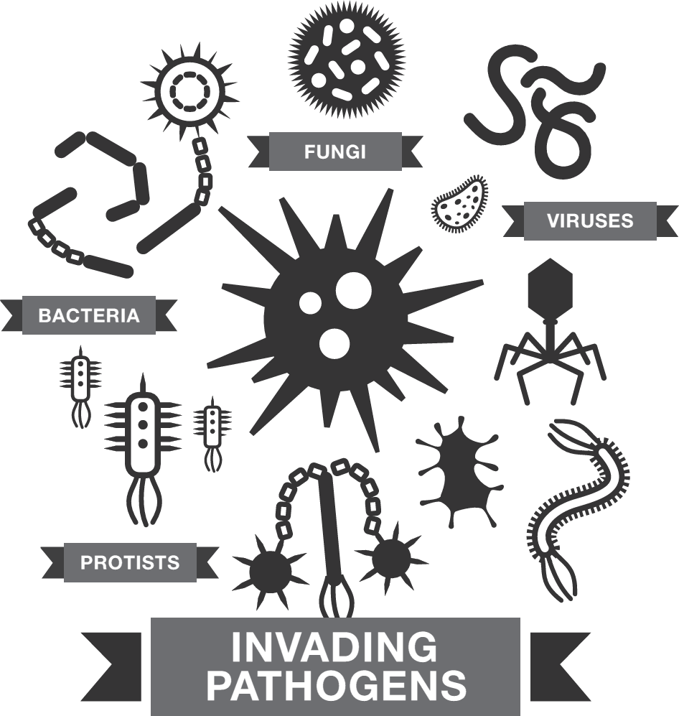
Some bacteria, viruses, fungi and protists are pathogens.
Pathogens can cause disease when they infect plants.

Slide 3
But a plant is like a fortress.
It has defences against pathogens.
It can even fight back!

Slide 4
In the battle for ‘fortress’ plant,
it’s plant defences versus invading pathogens!

Slide 6
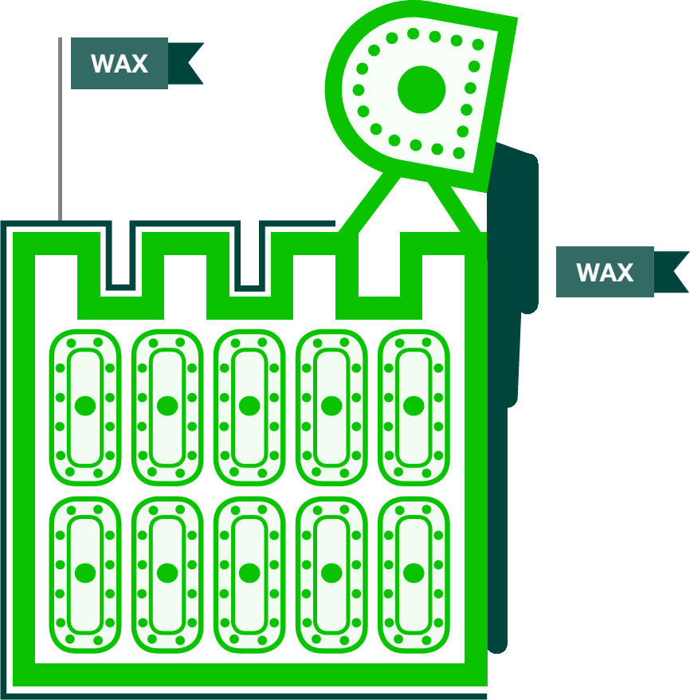
‘Fortress’ plant has physical defences against pathogens.
An important first line of physical defence is the cuticle.
The cuticle is a waxy coating on the plant’s outside surface.

Slide 7
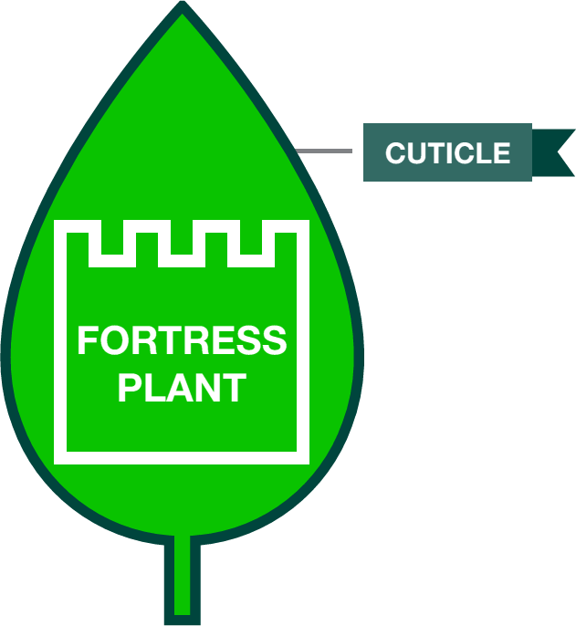
The waxy cuticle helps keep pathogens out.
It also provides a waterproof coat.

Slide 8
Inside the plant, each cell has a tough cell wall.
The cell wall is another type of physical defence.
A cell wall makes it harder for pathogens to get inside a cell.

Slide 10
Pathogens are carried to ‘fortress’ plant by
wind, water and infected animals.
They can also get there on infected plant material and tools.

Slide 11
Pathogens can invade through external openings
such as wounds and open stomata.
Some pathogens can puncture the plant tissue by growing through cell walls.
Some pathogens use enzymes to dissolve their way in.

Slide 13
Inside ‘fortress’ plant, pathogens steal food from plant cells.
Viruses use plant cells to copy their genetic material
so that the viruses can reproduce.

Slide 14
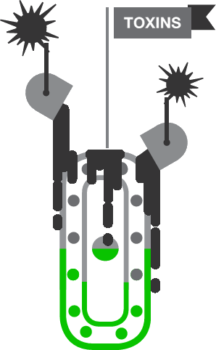
Pathogens also release toxins.
These toxic substances damage the plant cells.

Slide 16
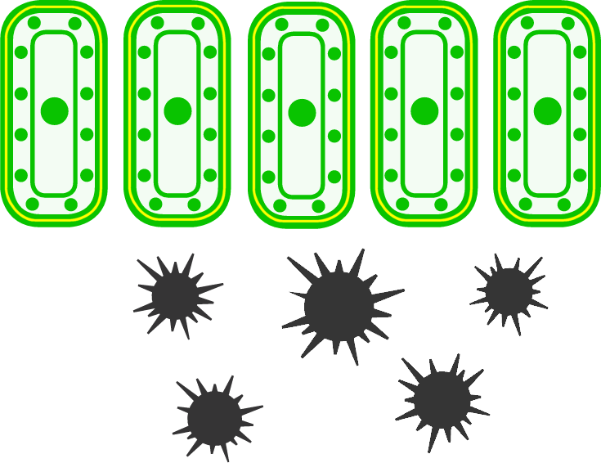
Cells in ‘fortress’ plant respond to the pathogen infection.
Cell walls are strengthened with extra protein and carbohydrate.
This makes it even harder for pathogens to get inside the cells.

Slide 17
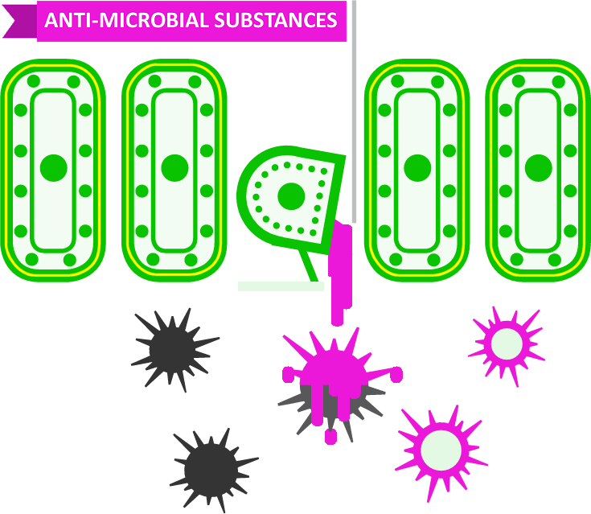
Plant cells use chemical defences against pathogens.
They make anti-microbial substances that destroy pathogens.

Slide 18
‘Fortress’ plant can even sacrifice parts of itself.
Healthy cells around the infection commit suicide.
Host cell death stops the infection spreading through the plant.

Slide 19
Now you know some ways in which plants
defend themselves against pathogens.
For plants, staying healthy is a
never-ending battle against pathogen attack.

