Slide 1
To learn about gears, pulleys and types of motion.
To understand how everyday mechanical devices work
Part of the theory that you will be examined on in your GCSE exam.
Use the techniques you have learnt in previous lessons

Slide 2
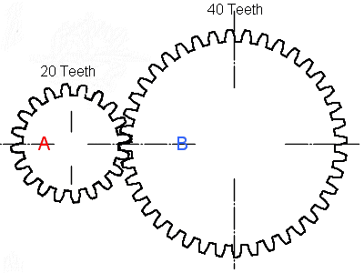
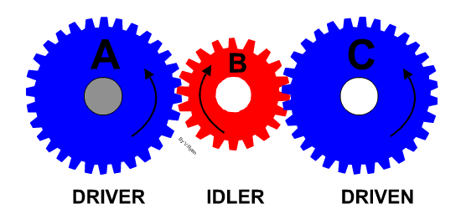
Gears
Gears are used to increase or decrease the speed or power of rotary motion.
Gears are wheels with teeth on the outer edge.
They are designed to fit into the teeth of other gears, so that they mesh or interlock together.
An idler gear is a gear wheel that is inserted between two or more other gear wheels
What do you notice about the direction each gear turns?
How has this idler gear affected the direction of gear C?
Notes:
Mating gears always rotate in opposite sense with respect to each other. There are certain applications where you will require the direction of rotation of input shaft to be same as output shaft. To achieve this, an idler gear is introduced which with change the direction of rotation.
Where very large speed reductions are required, several pairs of gears can be used in a compound gear train. A small gear drives a large gear. The large gear has a smaller gear on the same shaft. This smaller gear drives a large gear. With each transfer, the speed is significantly reduced.

Slide 3
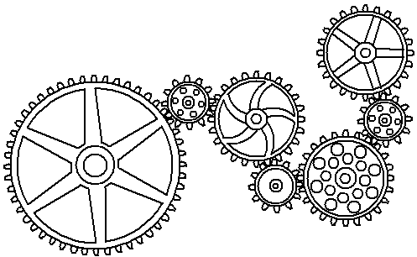
If A gear turns close wise, what direction will gear G turn?
G
A

Slide 4
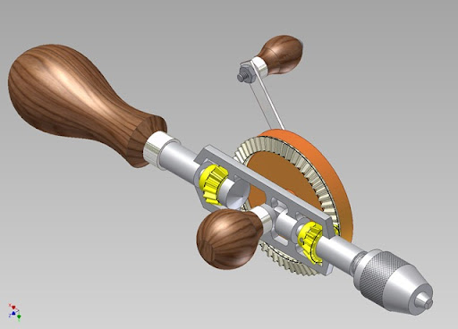
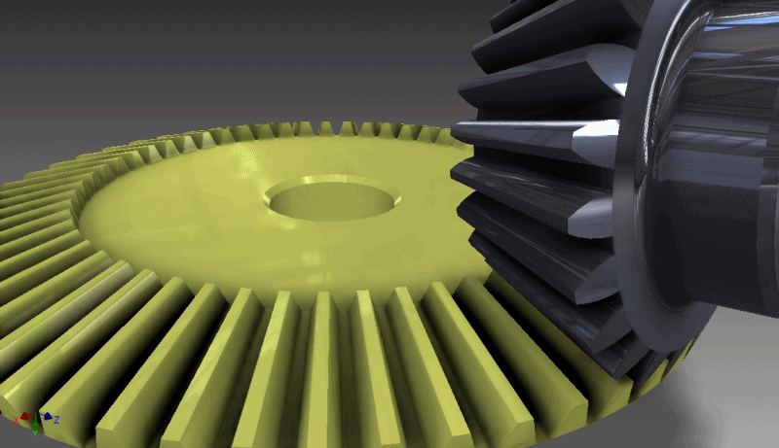
Bevel gears
Bevel gears, change the axis of rotation through 90°.
The teeth mesh at right-angles to each other.
For a hand whisk, the turning force of the handle is transferred to the whisk by gears.

Slide 5
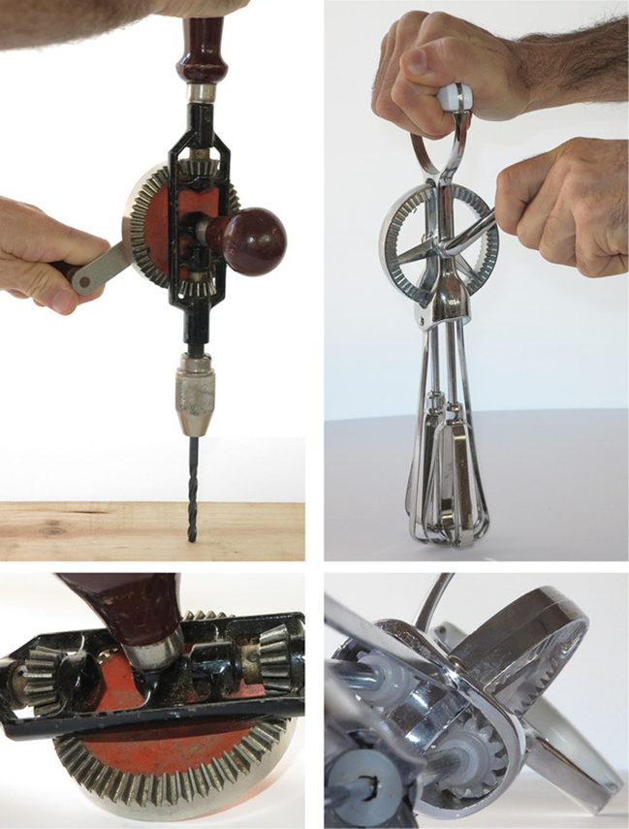
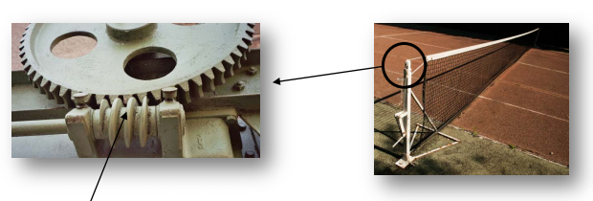
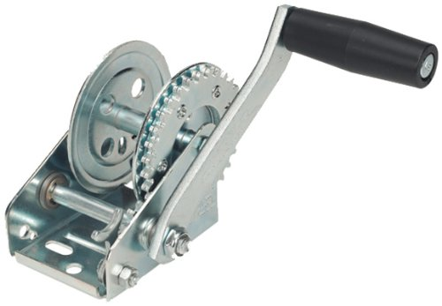
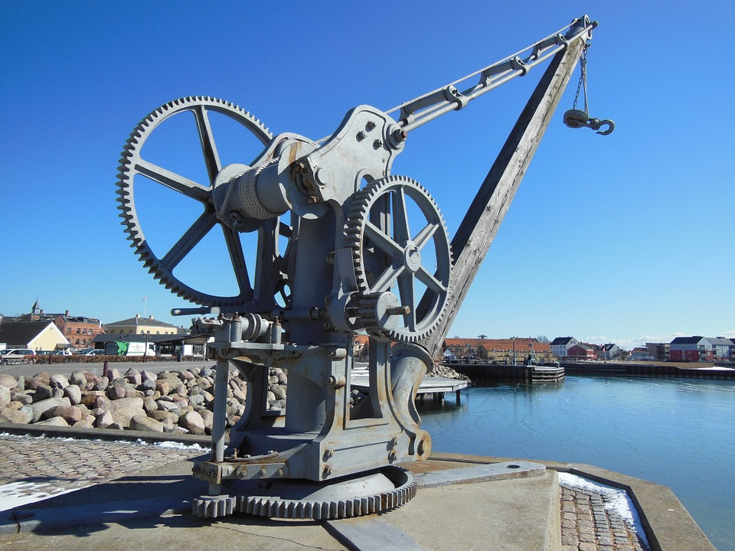
Gears - examples
Tennis net
Boat Winch
Hoist
Hand Whisk Hand Drill

Slide 6
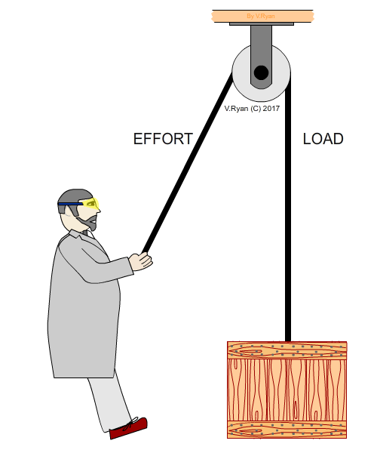
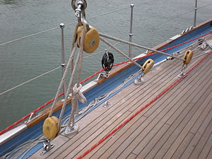
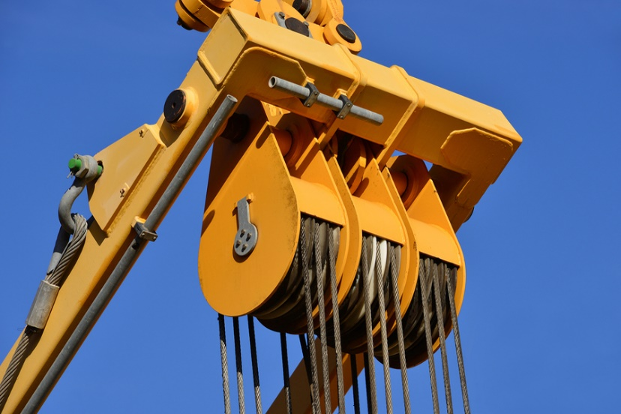
Pulleys are used to reduce the amount of force needed to lift a load or to change the speed or direction.
Pulleys
A pulley is a wheel with a belt or rope that goes around it.
The belt has a groove in it to prevent the belt or rope from slipping off.
https://www.youtube.com/watch?v=LiBcur1aqcg

Slide 7
Increased amount of pulley’s =
Increase mechanical advantage
Easier to lift same load
Decrease effort needed to lift load.

Slide 8
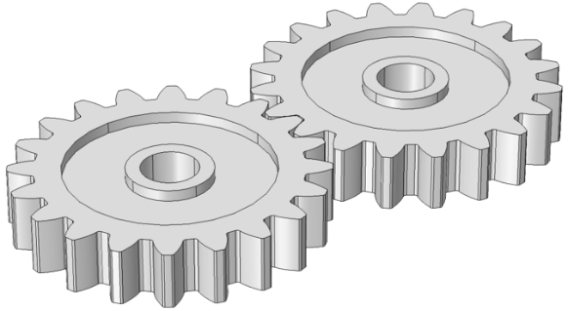
Advantages and disadvantages of pulley’s
and gears.
Pulleys |  | Gears
Simple to make & less expensive than gears. | Work by friction so can slip. | Less maintenance to use. | Have to touch each other in order to work.

Slide 9
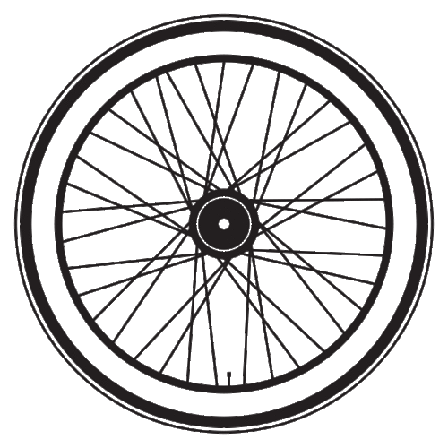
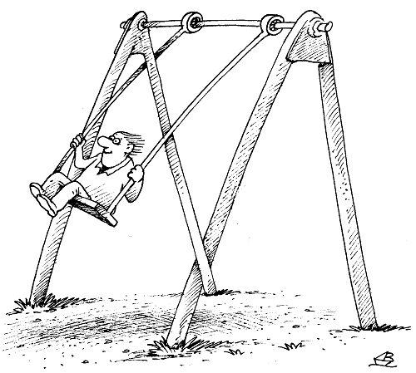
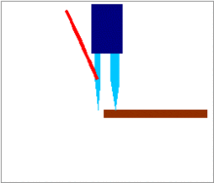
Motion involves movement of some kind. Four types of movement are listed below.
Reciprocating
Oscillating
Linear
Rotary
Link the picture with the correct symbol and then have a go at the correct name for the type of motion.
Notes:
-

Slide 10
1. Motion involves movement of some kind. Four types of movement are listed below. Label the diagrams that represent motion, with the correct name.
https://www.youtube.com/watch?v=8og1ThBA9sg
Linear
Rotary
Oscillating
Reciprocating
Notes:
-

Slide 11
Rotary Is turning round in a circle. | Linear Is moving in a straight line.
Oscillating Is swinging from side to side, in a curved arch. | Reciprocating Is moving backwards and forwards in a straight line.

Slide 12
The items shown below all involve movement. Name each picture with the correct type of motion.

Slide 13
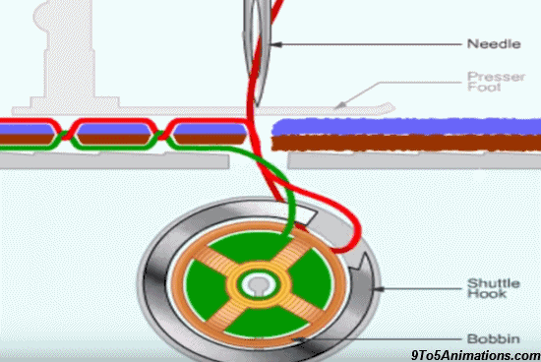
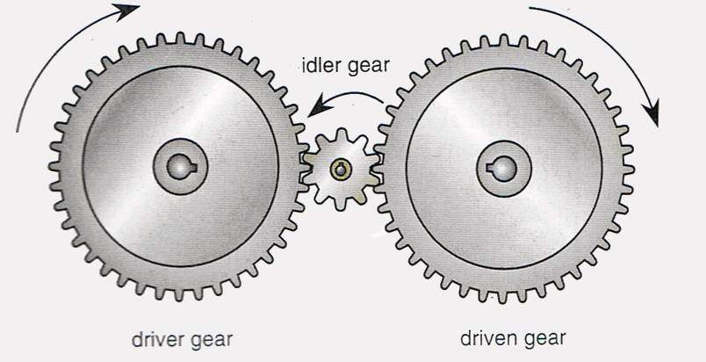
Is there more than one??
What effect does the idler gear have on the direction the driven gear turns?
What type of motion is the machine needle moving?
Describe this bevel gear.
What happens when the number of pulleys is increased to lift a heavy load?

