Slide 1
What are you doing?
Learn about the social and moral responsibility of the designer.
Where does it fit in?
You will be tested on this topic.
We have learnt a lot about how design and manufacture can effect the environment- note to yourself- this lesson is about effect on people.
Why are you learning this?
.
It is important for designers to consider the impact their products have on people and communities.
Believe Approach the task positively | Achieve Learn as many new things as you can! | Succeed Take quality notes and focus on the task. | Enjoy Have fun, but work Safely | Support Work independently and support each other

Slide 2
Personal Question
Listen out ☺

Slide 3
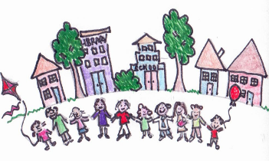
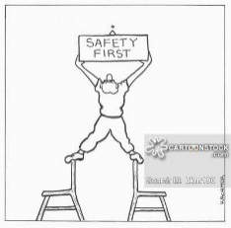
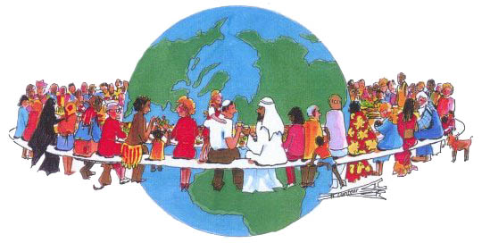
Understanding some key terms
These terms are very similar and cross over each other.
Term | Meaning | Picture
Social responsibility | Designers have a responsibility to create products that
Moral responsibility | Designers/manufacturers have a responsibility do what is right to an individual or group of people
Economic responsibility | Designers have a responsibility to ensure that poor workers and communities
Cultural responsibility | Designers have a responsibility to respect different cultures,
benefit societies (communities)
and keep them from harm.
benefit financially.
beliefs and customs.
benefit financially. | beliefs and customs. | benefit societies (communities) | and keep them from harm.
Notes:
If designers came from a wider range of racial, cultural, and socioeconomic backgrounds, we’d immediately see less broad, often-mistaken assumptions about our users.

Slide 4
Lets look at some examples of these.

Slide 5
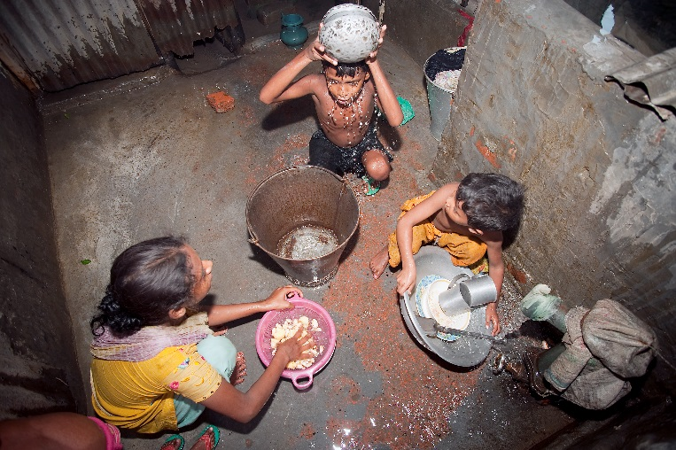
Social responsibility
Designers have a responsibility to create products that benefit societies (communities)
Designers have a responsibility to cause real positive change in the world through good design.
https://www.youtube.com/watch?v=oeb2fyHKirQ

Slide 6
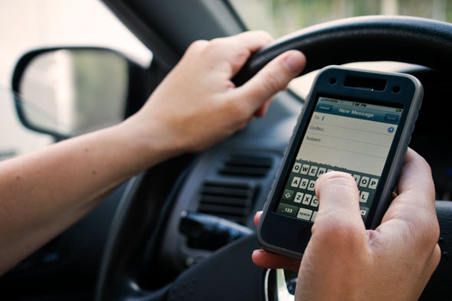
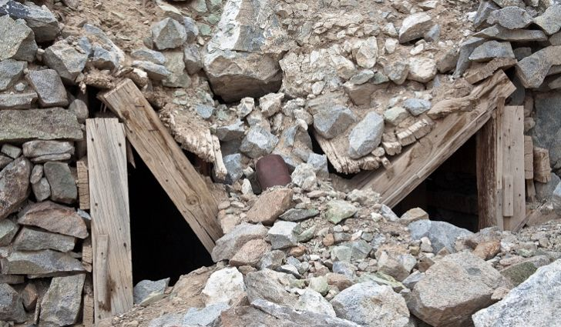
Moral responsibility
Designers/manufacturers have a responsibility do what is right to an individual or group of people and keep them from harm.
From collapsing mines to
lung disease from stone washing denim.
Fatal accidents caused by users
of mobile technology while driving, social media hate crime.
https://www.youtube.com/watch?v=zfVOP5LViac
Notes:
Dark web- Whose responsibility is it to protect people from abuse and cyber attacks?

Slide 7
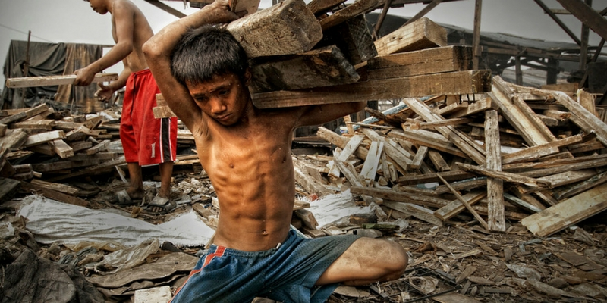
Economic responsibility
Designers have a responsibility to ensure that workers are paid a fair price and have decent working conditions.
There is estimated to be over 250 million child workers worldwide- starting at aged 5.
http://schools.fairtrade.org.uk/resource/make-bananas-fair-a-film-for-schools/
Notes:
Football one is quite long- about 7 mins- banana one is shorter. Show one of them depending on time.

Slide 8
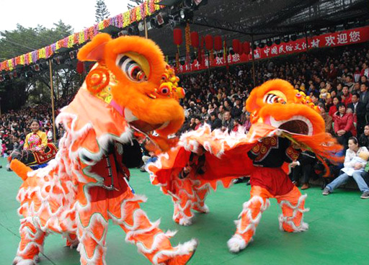
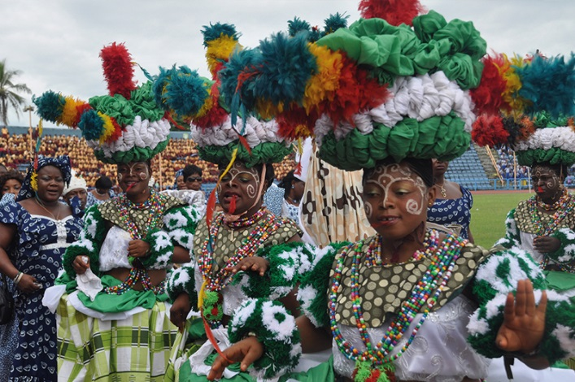
Cultural responsibility
Designers have a responsibility to respect different cultures beliefs and customs.
This means that the designer has to be very aware of what is acceptable and what is not acceptable to society.
https://www.youtube.com/watch?v=HxVN42BI0O4
Notes:
We live in a global market, thanks to easier transportation- products are sold all over the world- products need to be thoughtful to how other vultures will perceive them and use them.
This could also be how a product is advertised and promoted.

Slide 9
Personal Question
Fill in the sheet (meanings blank and add examples) from the answers that we hear.
Answer ☺

Slide 10
Cross word extension

Slide 11
Answers

