Slide 1
LESSON OBJECTIVE – TO UNDERSTAND ABOUT NATURAL TIMBERS
KEY WORDS
Timber
Hardwood
Softwood
Deciduous
Evergreen

Slide 2
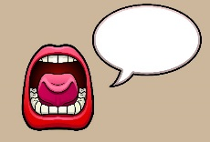
WHAT
UNDERSTANDING ALL ABOUT NATURAL TIMBERS
S&C Comment on how can this help you when you are choosing your own materials
WHY
THIS ALLOWS YOU TO CHOOSE AND USE APPROPRIATE MATERIALS TO MAKE PRODUCTS
WHERE
YOU WILL ALSO REQUIRE THIS KNOWLEDGE IN YOUR EXAMS
Believe Approach the task positively | Achieve Try to exceed my target! | Succeed Create some exciting designs | Enjoy Have fun, but work Safely | Support Work independently and support each other

Slide 3
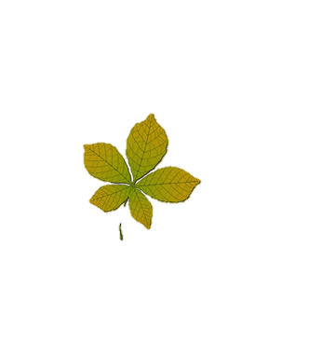
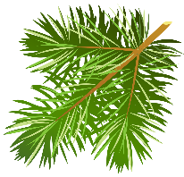
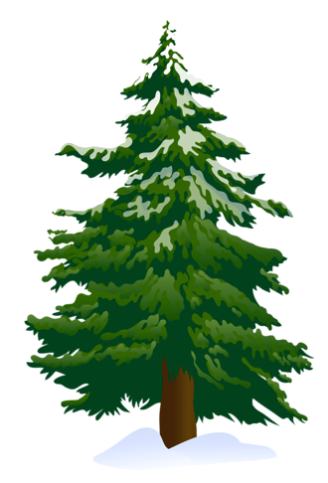
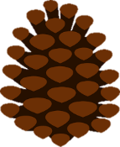
NATURAL TIMBER
There are two types of natural timber, called hardwood and softwood. These names do not refer to the properties of the wood: some softwoods can be hard and some hardwoods can be soft.
HARDWOODS
COME FROM DECIDUOUS TREES & GROW SLOWLY
ASH
BEECH
OAK
MAHOGANY
MORE EXPENSIVE
SOFTWOODS
COME FROM EVERGREEN TREES & GROW QUICKLY
CEDAR
SCOTS PINE
PARANA PINE
SPRUCE
Has pines & cones
Have broad leaves
DECIDUOUS TREES LOSE THEIR BROAD LEAVES IN THE AUTUMN
EVERGREEN TREES ARE GREEN ALL YEAR ROUND AND THEY HAVE PINES AND CONES
Notes:
1680s, from Latin deciduus "that which falls off,

Slide 4
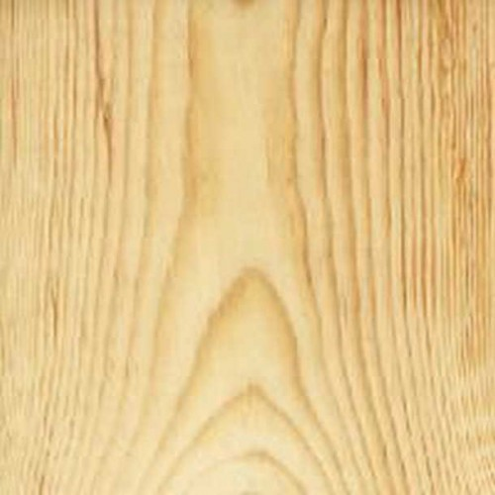
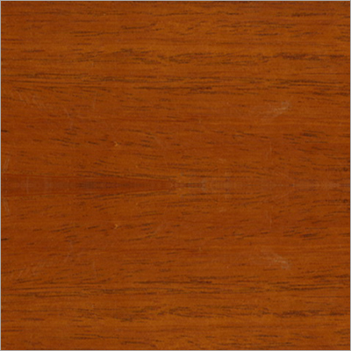
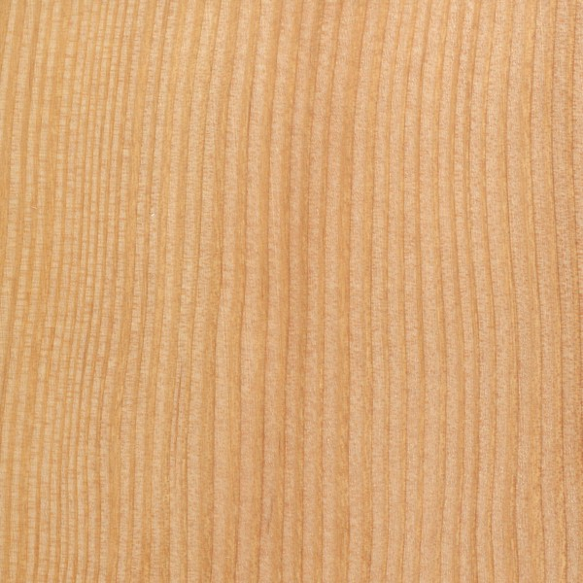
MATERIALS & THEIR PROPERTIES - SOFTWOOD
Softwoods are less expensive than hardwoods due to growing faster.
HARD
SOFT
Fir
Colour
A reddish brown wood and fairly knot free
Strength/durability
It is a strong and durable.
used for
In the production of plywood. Range of joinery work.
PINE
Colour
White or pale yellow
Strength/durability
Easy to work with/ lightweight prone to scratches/dents
Used for
Furniture, window frames, panelling, and roofing,
Cedar
Colour
Red/brown in colour
Strength/durability
quite strong and durable
used for
Musical instruments, furniture, decking, fence posts/ pencils
Notes:
Most hardwoods have a higher density than most softwoods.

Slide 5
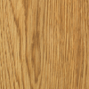
MATERIALS & THEIR PROPERTIES - HARDWOOD
Hardwoods are more expensive due to growing slowly and travelling further.
AFFORDABLE
EXPENSIVE
BEECH
Appearance
This wood has a very close straight grain which is White to pinkish-brown in colour
Strength
Very hard but is also very easy to work with. It does warp very easily.
Uses
It is often used for furniture, toys, tool handles.
ASH
Appearance
The timber has a Light, creamy-brown colour, it is open-grained
Strength
The wood is tough but flexible.
Uses
make
Sports equipment, wooden ladders, tool handles, cricket bats
MAHOGANY
Appearance
Has a reddish brown interlocking grain
Strength
It is fairly strong but easy to work
Uses
. This wood is very expensive. It is used for high quality indoor furniture
OAK
Appearance
Light brown in colour. It has an Open grain.
Strength
The timber is very strong and Hard to work with.
Uses
The wood corrodes steel screws and fittings therefore it is used mainly for Interior woodwork and good quality furniture

Slide 6
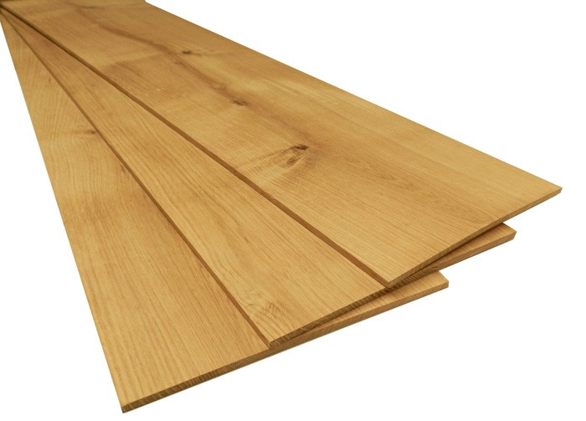
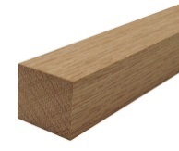
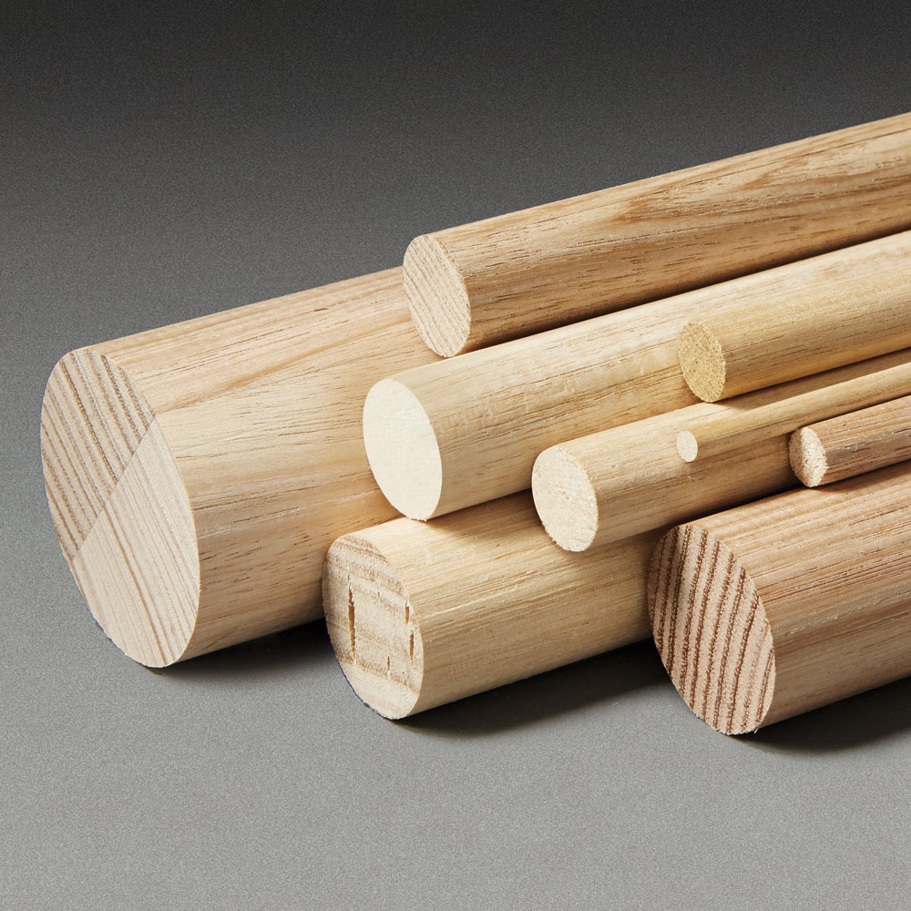
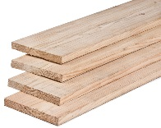
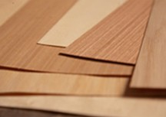
MATERIAL STOCK FORMS
AFFORDABLE
Material stock forms are the standardised sizes that different material can be bought in.
EXPENSIVE
Regulated/ all the same.
Timber planks
Timber boards
(not as thick as planks)
Strip
(thin slices of wood- 3mm)
Square timber
Dowel

Slide 7
Manufactured boards
Manufactured boards are timber sheets which are produced by gluing wood layers or wood fibres together. Manufactured boards often make use of waste wood materials.
Manufactured Board properties: • make use of waste wood materials (i.e. saw dust for MDF) • Are inexpensive so are often used instead of real woods. • However do not look as good as real woods look. • Often covered with a thin layer of real wood which is called veneer this improves their appearance.

Slide 8
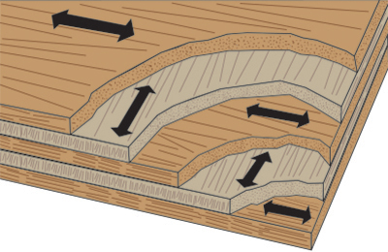
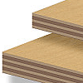
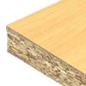
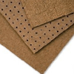
Manufactured boards
Manufactured boards are timber sheets which are produced by gluing wood layers or wood fibres together. Manufactured boards often made use of waste wood materials.
Manufactured timber | Description | Uses
MDF | Smooth, even surface. Easily machined and painted or stained. | Furniture and interior panelling . Often veneered or painted.
Plywood | A very strong board which is constructed of layers which are glued at 90 degrees to each other. | Strong board used in building construction. Furniture making.
Chipboard | Made from chips of wood glued together. Usually veneered or covered in plastic laminate. | Used for kitchen/bedroom furniture/Shelving/DIY work. usually veneered or covered with a plastic laminated.
Hardboard | A very cheap particle board which sometimes has a laminated plastic surface. | Used for furniture backs, covering curved structures, door panels.

Slide 9
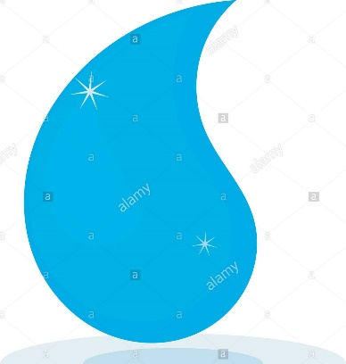
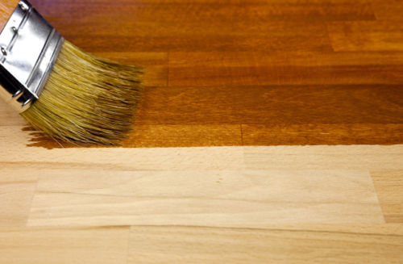
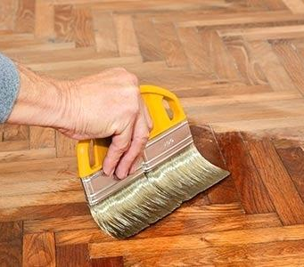
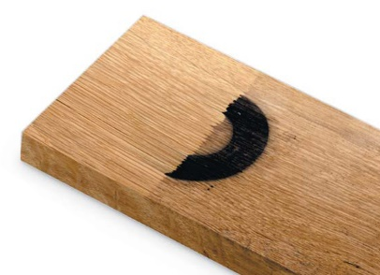
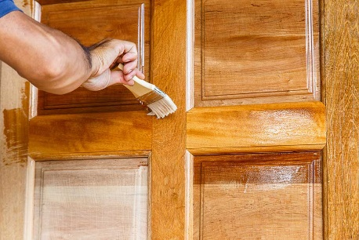
FINISHING & PROTECTING WOOD
Varnish
Wax
Stain
Bleaching
Seasoning
(remove moisture)
Oil
Various functions/ purposes.
Protect, resistance to moisture, enhance grain, easier to clean, seal pores to prevent bacteria, look more expensive, prevent insect attacks.

Slide 10
Questions
1) There are two types of timber- name them.
Hard wood and soft wood.
2) What's the difference between “deciduous” trees and “evergreen” trees.
Deciduous-Have broad leaves that they lose in winter/Evergreen have pines/cones and are green all year round.
3) Name a soft wood and give 2 properties or characterises .
Pine Cedar Fir .
4) Name a hard wood and give 2 properties or characterises .
Beach Ask oak mahogany
5) What's the difference between a “timber “plank” and a timber “board?” .
Planks are thicker than boards
6) What is a manufactured timber? .
“Man made” by gluing together wood layers or fibres.
7) Name a manufactured timber and describe it.
MDF, Plywood , chipboard, hardboard.
8) Name a finish that could be applied to wood and give a reason why it would be applied.
Varnish, wax, stain, bleaching, seasoning, oil.

