Slide 1
What are you doing?
Learn about modern materials
Where does it fit in?
You will be tested on this topic.
Why are you learning this?
Modern materials are changing the future possibilities of D&T.
Believe Approach the task positively | Achieve Learn as many new things as you can! | Succeed Take quality notes and focus on the task. | Enjoy Have fun, but work Safely | Support Work independently and support each other

Slide 2
Modern materials
They do not react to changes in environment like smart materials however they do have clever and often ground-breaking properties themselves.
Characteristics/features

Slide 3
Information sheets have been placed around the classroom on modern materials.
Read through the information, to answer the questions on the worksheet provided.

Slide 4
Kevlar
What is it? Kevlar® is a very strong artificial fibre. It is woven to make a material that is best known for being used for light and flexible body armour. | What does it look like? Its molecules can pack closely together
Properties Very strong and durable. 5x stronger than steel Can withstand high temperatures. Resist chemicals | What its used for Cables in civil engineering Cut resistant gloves. bullet proof vests.

Slide 5
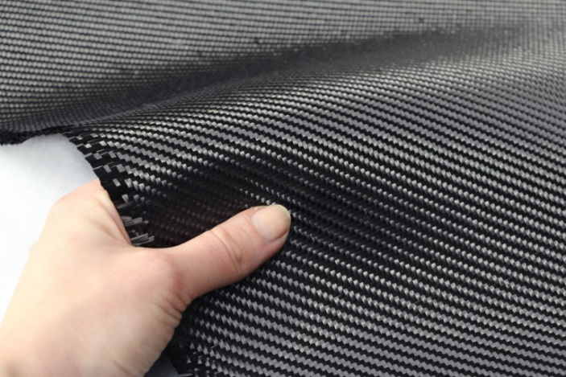
Carbon fibres
What is it? Carbon in the form of graphite is soft, slippery and easily broken. But very thin filaments of carbon are very stiff and are used as a strengthening material. | What does it look like?
Properties Its molecules can pack closely together to make it very strong. Its rigid. Lightweight Flame proof. 4x stronger than steel with ¼ weight. High cost. | What its used for Helmets Racing cars Aircraft frames High performance sport equipment. Carbon fibres are useful for reinforcing other materials to make them tougher.

Slide 6
GRP (Glass reinforced plastic)
What is it? | What does it look like?
Properties Resistant to water and corrosion Lightweight Very Strong Less stiff and brittle than carbon fibre | What its used for
Is a composite material made of plastic reinforced by fine fibres of glass.
Also known as “fibre glass”
Easily moulded into complex shapes. Can be woven into a flexible fabric. It can be any thickness.
Wind turbine blades
Boat hulls
Bath tubs
Swimming pools/water slides
Sport cars
Canoe
Surf boards
Aeroplanes
Notes:
Glass reinforced plastic
It is less stiff and far less brittle than carbon fibre.
GRP is composed of strands of glass. Each individual glass fibre is very fine with a small diameter, and they are woven to form a flexible fabric. The fabric is normally placed in a mould, for instance a mould for a canoe and polyester resin is added, The process is repeated so that there are many layers of fibre glass and resin and allowed to dry. The resulting material is strong and light. Glass Reinforced Plastic can be sanded for a smooth finish and painted.
Phase changing materials
Maintains a constant body temperature.
Phase changing materials are able to transform from solid to liquid and back whilst storing and releasing heat, large amounts of heat are absorbed and released.
6 Geotextiles Permeable –absorbent –liquids can pass through them

Slide 7
Phase changing materials
What is it? https://www.youtube.com/watch?v=YCrmzEwUrYY | What does it look like?
Properties When you are too warm- materials stores the excess heat. As the skin cools, the absorbed heat is released back to the body. | What its used for Bedding Wheel chair cushions Footwear Ski wear Outwear Sleeping bags
Originally developed by NASA, the material absorbs, stores and releases heat to maintain body
temperature.

Slide 8
Nomex
What is it? It is a registered trademark for flame-resistant material developed in 1960’s by DuPont. | What does it look like?
Properties Heat resistant Flame resistant Spark resistant Durable Synthetic fibre Light weight | What its used for Racing car drivers clothes Oven gloves Protective clothing Fire fighters, astronauts)

Slide 9
Geotextiles for landscaping
What is it? Is a term used for textile materials that are used in civil engineering . (industry term used for the construction of roads, bridges, canals, dams, and buildings) | What does it look like?
Properties Permeable /absorbent. Used in soil- can separate, filter, reinforce, protect and drain. | What its used for Can be used under plants or soil so no weeds can grow but water can get in and out. They can also be used to protect and strengthen river embankments from erosion.
Notes:
Permeable –absorbent –liquids can pass through them

Slide 10
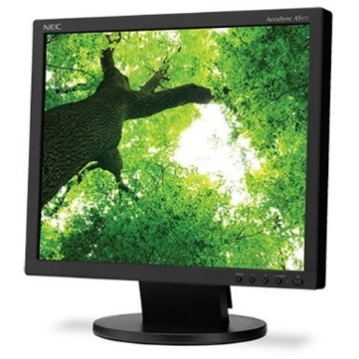
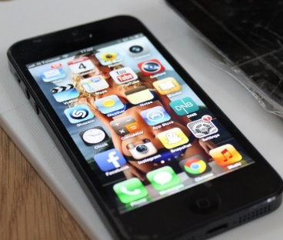
LCD (Liquid crystal display)
What is it? An electronic display that uses liquid crystals. | What does it look like?
Properties LCD’s can block or allow light to pass through, depending on the amount of electricity applied. LCDs allow displays to be much thinner and consume less power (better for portable appliances as battery life can be extended. ) Better display of imagery. | What its used for Displays information such as text, imagery and moving picture for computers, calculator , digital camera’s, laptops, TV’s and mobile phones.
Notes:
Permeable –absorbent –liquids can pass through them

Slide 11
Rhovyl as an antibacterial fibre.
What is it? Contains an antibacterial substance. The antibacterial substance is added in the heart of the fibre and prevents the development of bacteria that form during any bodily activity. | What does it look like?
Properties Long lasting antibacterial resilience Easy to care for. Continues to be antibacterial, even after washing material. | What its used for Bedding Underwear Socks Child care ( clothing)

Slide 12
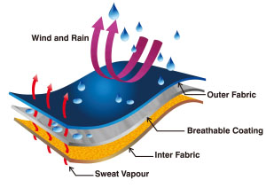
Breathable materials
What is it? Lets sweat (perspiration) out but not rain in, thus allowing the fabric to “breath” | What does it look like?
Properties Absorbs & releases sweat quickly Many can be made to repel water for outdoor clothing | What its used for Sports wear, outdoor clothing Gortex is a good example.

Slide 13
Breathable materials

Slide 14
UV protective clothing
What is it? Clothing that protects the skin from UV rays from the sun. | What does it look like?
Properties Pre-treated with UV-preventing ingredients during manufacture to enhance their effectiveness. (titanium dioxide) | What its used for Hats beach wear –especially for children UV beach tents

Slide 15
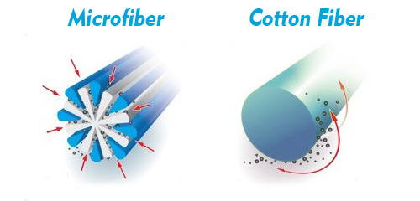
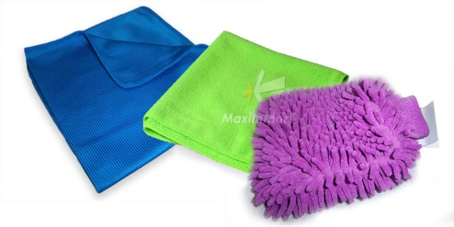
Microfibres
What is it? Polyester or nylon microfibres are 60-100 times finer than one human hair (technical definition is less than one denier thick) | What does it look like?
Properties Ultra fine Soft High strength Comfortable Breathable Quick drying Absorbent but dries very fast. | What its used for Active sportswear Underwear Cleaning products (the structure traps dirt and absorbs liquids) Towels (specialist)

Slide 16
Plenary
Around your tables, discuss and agree on the best modern material to use for the following products. You will be asked to justify why you have chosen the material.
Nomex
Geotextiles
Kevlar
Phase changing
GRP (Glass reinforced plastic
Rhovyl

