Slide 1
What are you doing?
Learn about the LCA of a product.
Where does it fit in?
You will be tested on this topic.
Why are you learning this?
.
It is important to be aware of the environmental impacts of products.
Believe Approach the task positively | Achieve Learn as many new things as you can! | Succeed Take quality notes and focus on the task. | Enjoy Have fun, but work Safely | Support Work independently and support each other

Slide 2
What % of mobile phone users recycle their phone?
What is the average time spent on social media in a persons life time (YouTube, face book, snap chat, twitter, Instagram)
3%
How many times per day, does the average user pick up their mobile phones?
85 times a DAY - twice as often as they realise.
What does “Nomophobia” mean?
It is the fear of being without your mobile phone or losing your signal.
How many different types of metals are used to make the average mobile?
62, including 16 of the 17 “rare earth metals”
How much time (per day) do people spend on their mobile phones in 2017?
More people in the world have mobile phones than what?
On average its over 4 hours a day.
Toilets

Slide 3
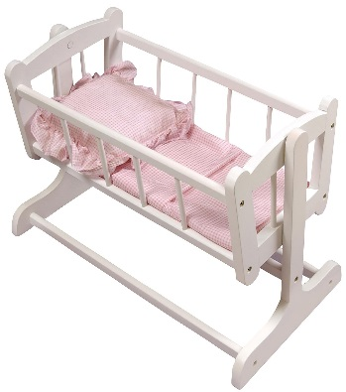
LCA (Life cycle analysis)
Working out the total impact a product has on the environment by looking at each stage of its “life”

Slide 4
In pairs, discuss what each of these
headings mean.

Slide 5
Just as living things are born, get older, and die, products also complete a life cycle. Each stage of product's life cycle can affect the environment in different ways.
https://www.youtube.com/watch?v=4lfhtIr2gmE

Slide 6
What was used to make the product? (e.g. plastics, metals, fabric
How and where was
it produced? (in the UK or overseas?) How do the processes effect the environment?
How can it be disposed
of? (charity shop, recycled, landfill)
How was it transported
at each stage of the lifecycle? (ship,
lorry, train) What packaging is used?
What was the product’s impact
during the use stage? (use of energy,
water)
Notes:
Packaging accounts for almost 10 % of the environmental impact of anything bought.

Slide 7
Read the information on the sheet provided.
Fill in the blanks from the information on the sheet given, into the correct stage.
In your own words, write a paragraph that explains what a LCA is.

Slide 8
Discuss and answer these questions around your tables.
What does LCA mean?
Explain the impact a mobile phone can have for one of the stages.
What does LCA stand for?
Name the 5 stages
of a LCA

