Slide 1
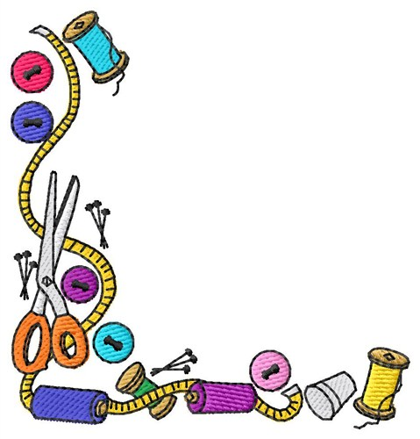
Natural, Synthetic, Blended and Mixed Fibres.
Learn about natural and manufactured fibres
This will enable you to understand the reasoning behind fabric choices.
Key theory that will be covered in your GCSE exam.
upport

Slide 2
This lesson you will look at:
Natural Fibres
Manufactured Fibres
Fibre Blends
Mixed Fibres

Slide 3
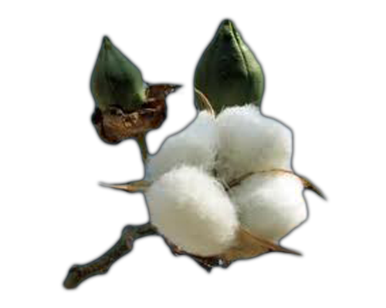
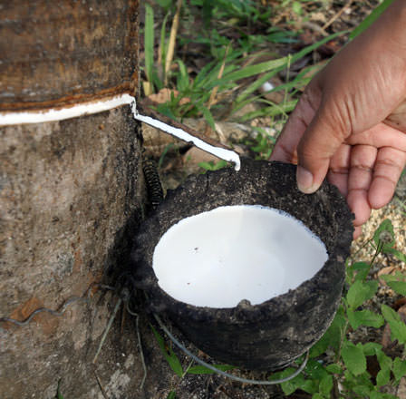
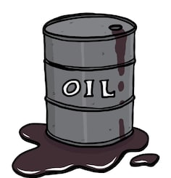
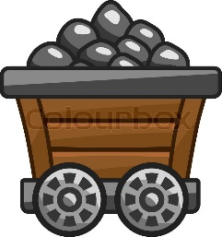
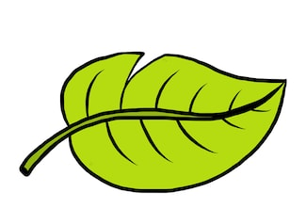
Fabrics are manufactured from various raw-materials which are available from nature or artificially generated or mix of both.
Natural Fibres
Manufactured Fibre
Manufactured are man-made fibres that are either completely made from non-organic (not living) materials or natural materials combined with chemicals.
Natural fibres are either from plants or animals that appear in nature.

Slide 4
Regenerated fibres from tree’s but changed through chemicals.
Synthetic fibres derived from coal or oil

Slide 5
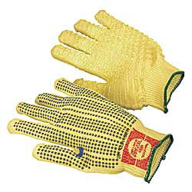
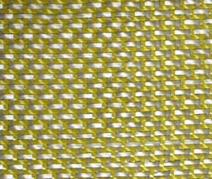
Usually manufactured by spinning in a chemical solution, know as wet spinning.
Aramid fibres
Aramid fibres are a class of heat-resistant and strong synthetic fibres. They are used in aerospace and military applications (Kevlar and Nomex are examples)
Properties
Strong
Heat resistant
Abrasion resistant.

Slide 6
Properties of Materials:
Key Words
Can you match the properties to their definition?
Strength |  | A material that soaks up liquid or moisture.
Elasticity |  | It is hydrophobic (a material that is completely resistant to water.
Absorbency |  | Strength of Materials: the behaviour of materials when forces are applied to them (pulled, tension, stress).
Durability |  | How long lasting and hard wearing a material is.
Insulation |  | A material that does not build-up of static electricity.
Flammability |  | The prevention or reduction of losing heat.
Water – repellence |  | How much a material can stretch and then return to its original position.
Anti-static |  | How well a material can stop or prevent reacting to something E.g.. Bleach, sunlight, chemical…..
Resistance to… |  | Materials ability to ignite and burns rapidly with a flame.

Slide 7
Properties of Materials:
Key Words
Can you match the properties to their definition?
Strength |  | A material that soaks up liquid or moisture.
Elasticity |  | It is hydrophobic (a material that is completely resistant to water.
Absorbency |  | Strength of Materials: the behaviour of materials when forces are applied to them (pulled, tension, stress).
Durability |  | How long lasting and hard wearing a material is.
Insulation |  | A material that does not build-up of static electricity.
Flammability |  | The prevention or reduction of losing heat.
Water – repellence |  | How much a material can stretch and then return to its original position.
Anti-static |  | How well a material can stop or prevent reacting to something E.g.. Bleach, sunlight, chemical…..
Resistance to… |  | Materials ability to ignite and burns rapidly with a flame.

Slide 8
Natural Fibres
Properties
Animal
Plant
These fibres come from renewable source.
They are also biodegradable (Something that will decay (break down) over time)
Generally absorbent
Poor resistance to chemical damage.
Durable – especially animal fibres
Notes:
Collect students together and has a class go through what students have found out.

Slide 9
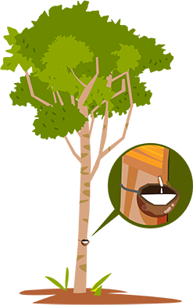
Manufactured Fibre
Less absorbent than natural fibres.
Wrinkle less than plant fibres
Easier to care for than natural fibres (ie wash/clean)
Resistant to moths/insects
Durable

Slide 10
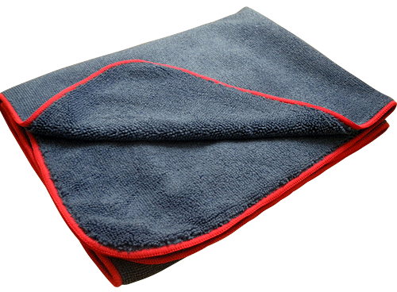
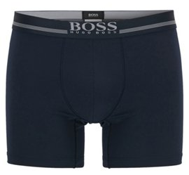
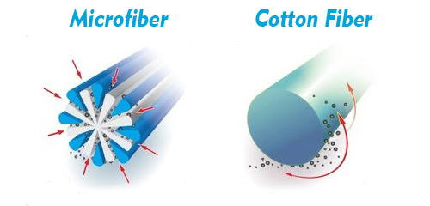
Microfibre
Microfibre:
These are really thin fibres.
They are less than 1 denier thick (60x finer than one human hair)
Denier :
The unit of weight for determining the fineness or thickness of the fabric. The lower the value the more fragile and sheer the fabric.
Microfibres have a smooth round shape. This creates less friction and tension and leads to soft fabrics. (Tactel & tencel are examples)

Slide 11
What do we mean by these terms?
Blends
Mixed
The combining of 2 or more different fibres together to make a yarn.
Usually combining a natural fibre with a synthetic fibre.
This is when a fabric is made from two or more different types of yarn.
The two different yarns can be knitted or woven together to make a fabric.
Notes:
Use these definitions to fill in the gaps on the worksheet.

Slide 12
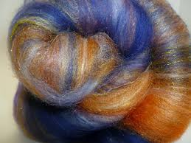
why they are blended
Improve appearance
Improve Performance
Improve
comfort
Reduce cost
Common fibres blends
.
Polyester/cotton blend: shirts are more easy-care and crease-resistant than shirts made from 100 percent cotton.
Cotton/lycra blend: jeans are more comfortable, stretchy and fit better than cotton jeans.
Acrylic/wool blend: trousers are less expensive than 100 percent wool trousers.

Slide 13
You have been given a fibre card, with a list of what the fibre is commonly used for and some properties of that fibre.
Read through your card and write why you think that particular fibre is suitable for one of the products stated.
I
Example ………..
Wool is suitable for a winter hat as it is insulating and will prevent heat from escaping from the wearers head. It is also soft so will feel nice and be comfortable for the wearer.

